Slide 1
Semi-supervised Learning for Nucleic Acid Cross-linking Mass Spectrometry
Bachelor Thesis Bioinformatics
By Emil Paulitz

Slide 2
Outline
Background
Nucleic Acid Protein Interactions
Cross-linking Mass Spectrometry
Score Post-processing using Semi-supervised Learning
Challenges of Cross-link Identification
Implementation
Pycolator – Percolator Reimplementation in Python
Performance Metric: Pseudo ROC
Experiments
Reranking of Multiple Candidates during Learning
Impact of Small Number of PSMs on Algorithm Performance
Data Imputation
Class Balancing
Conclusion and Outlook

Slide 3
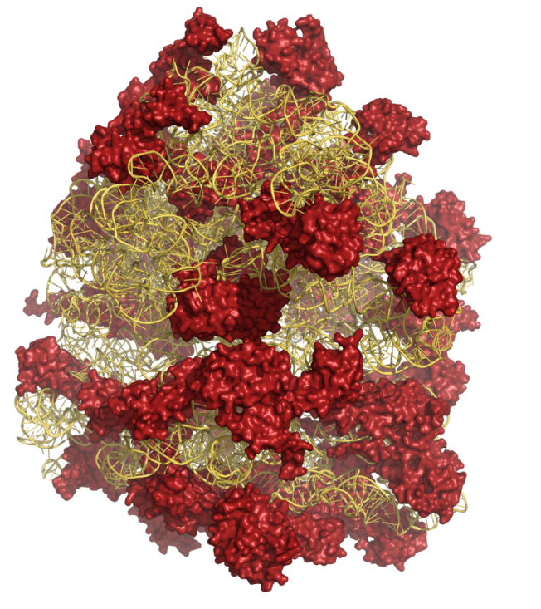
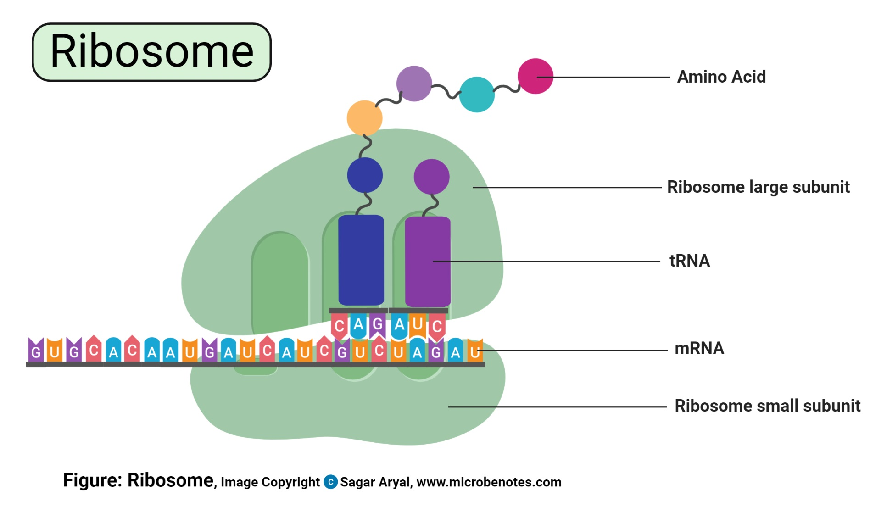
Background – Nucleic Acid Protein Interactions
From: Timo Sachsenberg. Computational methods for mass spectrometry-based study of protein-RNA or protein-DNA complexes and quantitative metaproteomics. 2017.
Notes:
Also happens in for example pre-translational regulation
Interaction studied using UV-light cross-linking

Slide 4
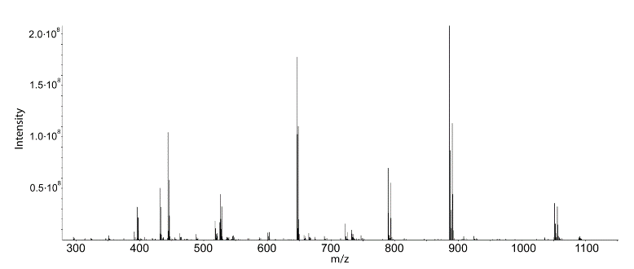
Background: Cross-linking Mass Spectrometry
Cross-linking introduces stable bonds between protein and RNA
Peptides are measured using mass spectrometry
Mass spectra are compared with theoretical
spectra from possible peptides
Peptide with highest similarity is annotated
(= Peptide-Spectrum-Match (PSM))
Adding decoy peptides to the search allows
to estimate distribution of false matches
From: Timo Sachsenberg. Computational methods for mass spectrometry-based study of protein-RNA or protein-DNA complexes and quantitative metaproteomics. 2017.

Slide 5
Background: Score Post-processing using Semi-supervised Learning
Goal: Separate false hits from true hits
Idea: Use decoys as false hits and best targets as true hits to learn a discriminative function
Not one score but multiple
(our data: 52)
Can improve the identification rate
Re-score hits and repeat with new
positive examples
Decoys (only F)
frequency
Targets (T+F aka noisy labels)
score
Notes:
This can improve the identification rate compared to using some score that makes mathematically or chemically sense and is often times a combination of certain sub scores.
q-value

Slide 6
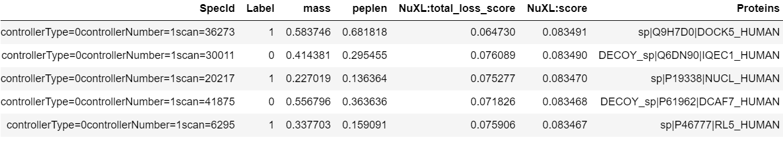
Background: Annotated PSMs
Target or Decoy
Features
Notes:
Berechnung FDR und q-value
Paar Worte zum benutzten data set

Slide 7
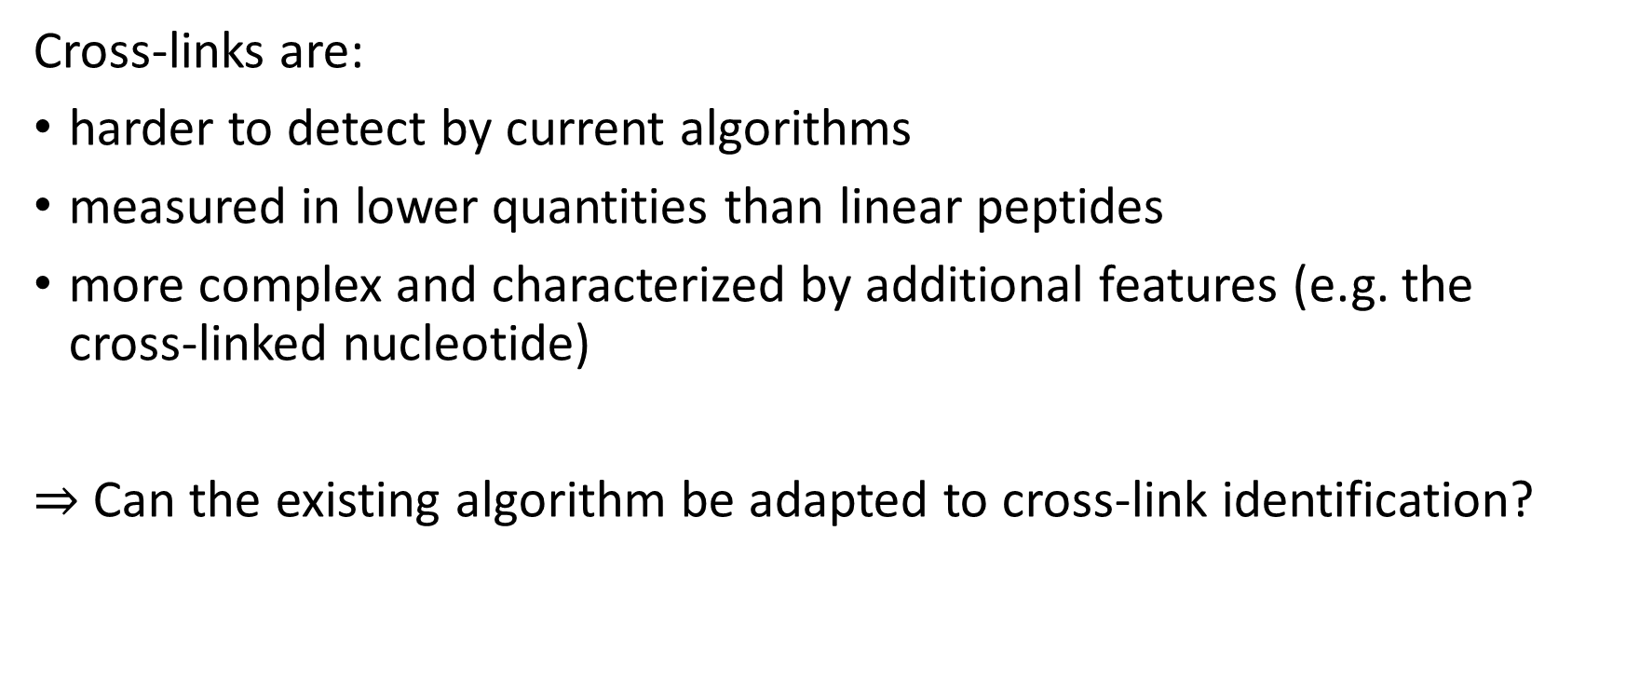
Background: Challenges of Cross-link Identification
Cross-links are:
harder to detect by current algorithms
measured in lower quantities than linear peptides
more complex and characterized by additional features (e.g. the cross-linked nucleotide)
$⇒$ Can the existing algorithm be adapted to cross-link identification?

Slide 8

Pycolator – Percolator Reimplementation in Python
Training
Validation
Training
Validation
C⁺ | 0.1 | 1 | 10
C⁻ | 0.1 | 1 | 10
 | 0.3 | 3 | 30
 | 1 | 10 | 100
Repeat
10 x
Training of the C-SVM
Scoring
Score Normalization
3x
$$→$$
Decoys
5% q-value
Notes:
C-SVM refers to the C parameter (roughly explain C parameter)

Slide 9
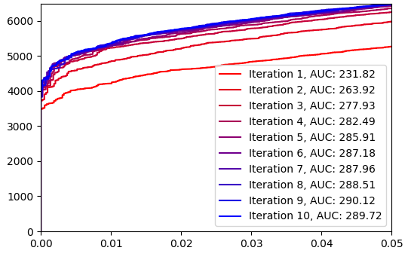
Performance Metric: Pseudo ROC
Number of Identified Cross-linked PSMs
q-value
Notes:
X-axis, y-axis
One Curve per iteration (colorcoded)
Allows observation of improvement
Calculate area under the curve (AUC)
Called pseudo ROC

Slide 10



Experiment: Reranking of Multiple Candidates during Learning
Motivation: Correct identification is sometimes not the best scoring one
Including 2nd or n-th best candidate in learning with reranking might push correct PSM to the top.
Rank
1
2
3
4
Linear
Cross-linked
Linear
Cross-linked
Cross-linked
Linear
$$→$$
Cross-linked
Cross-linked
Cross-linked
Re-Ranking
Linear
Cross-linked
Cross-linked
Linear
Linear
Cross-linked
Linear
Linear
Cross-linked
Cross-linked
Linear
Linear
Cross-linked
Linear
Linear
After reranking complete:
$$→$$
Cropping
Correct Scoring
$$→$$
Cross-linked
Cross-linked
Linear
Cross-linked
Cross-linked
Linear
Notes:
Motivation: … this is especially true for cross-links, which are harder to detect than linear peptides. Thus, sometimes a spectrum gets identified as linear when it actually came from a cross-linked peptide.

Slide 11
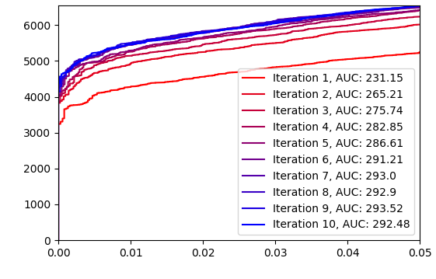
Experiment: Reranking of Multiple Candidates during Learning
AUC increase of 1% compared to showing top hit only (previous best)
Number of Identified Cross-linked PSMs
Removal of low ranks
q-value
Notes:
At 1%: 8 cross-linked PSMs more (0.14%)
At 5%: 90 cross-linked PSMs more (1.4%)

Slide 12
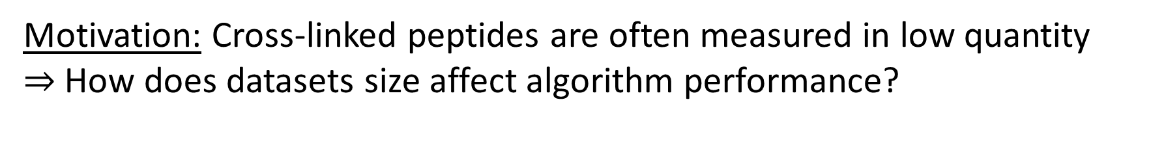
Experiment: Impact of Small Number of PSMs on Algorithm Performance
Motivation: Cross-linked peptides are often measured in low quantity
$⇒$How does datasets size affect algorithm performance?
Random sampling of cross-linked PSMs with q-value < 10%
Calculating pseudo ROCs, AUC, number of PSMs with q-value < 1% from unchanged NuXL-score
Applying Pycolator and using the resulting score
Repeat 10 times to compensate for uneven sampling
Notes:
Metrics are calculated w.r.t. dataset size because this changes when applying Pycolator

Slide 13
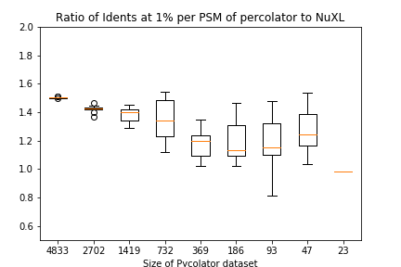
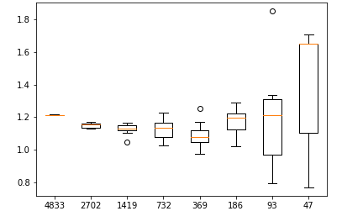
Experiment: Impact of Small Number of PSMs on Algorithm Performance
Proportion of AUC using
Pycolator score vs unchanged score
Proportion of Identified PSMs at 1% q-value using
Pycolator score vs unchanged score
Size of Pycolator dataset
Size of Pycolator dataset
Notes:
AUC decreases until very small size (problems with calculation of area under the curve, variance gets too big)
Identifications also show a decrease of performance with smaller dataset size
The algorithm gradually ﬁnds less high-conﬁdence PSMs when the dataset size gets smaller.

Slide 14
Experiment: Data Imputation
Motivation: The used SVM function cannot handle missing values
Potentially information lost during learning or bias introduced due to bad substitution
The iterative imputer (scikit-learn package) tries to find numerical values minimizing the influence on the SVM-score
Performance did not improve on the dataset
Notes:
Non-cross-linked PSMs have fewer features than cross-linked PSMs
Numerical values lie on the decision limit
Imputation could prevent fitting onto only linear PSMs (for example when true cross-linked PSMs are rarer, cross-linked PSMs are false more often)

Slide 15
Experiment: Class Balancing
Motivation: Ratios of targets to decoys and cross-linked to linear peptides differ
This can lead to different ratios in different splits and biases during learning
Whole Dataset
Implementation of class balancing
Training
Validation
Training
Validation

Slide 16
Experiment: Class Balancing
AUC of pseudo ROC |  | Best Run | Worst Run | Median | Best - Worst
balancing | Cross-linked | 293.91 | 293.12 | 293.58 | 0.79
 | Linear | 53.85 | 53.76 | 53.58 | 0.09
 | All PSMs | 348.65 | 347.48 | 348.19 | 1.17
No balancing | Cross-linked | 294.42 | 291.51 | 292.86 | 2.91
 | Linear | 53.63 | 54.34 | 53.78 | -0.71
 | All PSMs | 349.14 | 347.04 | 347.69 | 2.1
Notes:
Variance reduced to under a third
Median slightly improved

Slide 17
Conclusion:
Implementation of the Percolator algorithm in python (Pycolator)
Number of cross-links in dataset greatly influences performance
Improved performance by including multiple candidates per spectrum
Improved robustness by class balancing
Outlook:
Additional experiments on data imputation
Testing on other data sets
Other machine learning methods
Notes:
Other, more like common data sets (few cross-links, many linear PSMs)
More flexible models or combining weak models (AdaBoost)

Slide 18
Any questions left?

