Slide 1
Semi-supervised Learning for Nucleic Acid Cross-linking Mass Spectrometry
Bachelor Thesis Bioinformatics
By Emil Paulitz

Slide 2
Outline
Background
Data Generation and Preprocessing
Original Percolator
Pseudo ROCs
Characteristics of Cross-linked PSMs
Experiments
optimalRanking
Small Datasets
Imputation
Proportions of Different Classes
Outlook

Slide 3
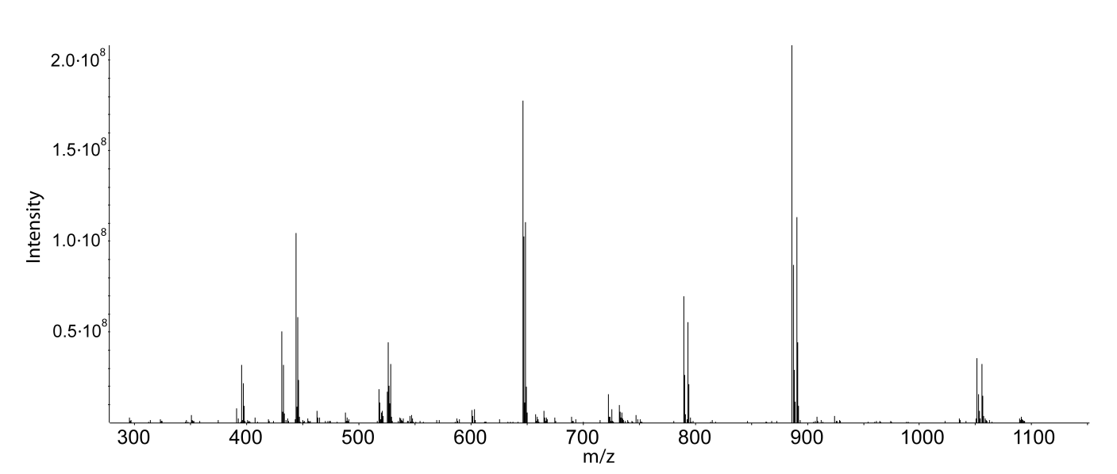
Data Generation and Preprocessing
Peptides in tandem mass spectrometry produce spectra
From: Timo Sachsenberg [1]

Slide 4
Data Generation and Preprocessing
Peptides in tandem mass spectrometry produce spectra
Compared with theoretical spectra from possible peptides
For example known peptides from the cell type analyzed

Slide 5
Data Generation and Preprocessing
Peptides in tandem mass spectrometry produce spectra
Compared with theoretical spectra from possible peptides
For example known peptides from the cell type analyzed
Peptide with highest similarity is considered peptide-spectrum-match (PSM)

Slide 6
Data Generation and Preprocessing
Peptides in tandem mass spectrometry produce spectra
Compared with theoretical spectra from possible peptides
For example known peptides from the cell type analyzed
Peptide with highest similarity is considered peptide-spectrum-match (PSM)
Mixing reversed or shuffled peptides (decoys) estimates distribution of false matches

Slide 7
Data Generation and Preprocessing
F
Decoys (only F)
frequency
frequency
T
Targets (T+F aka noisy labels)
score
score

Slide 8
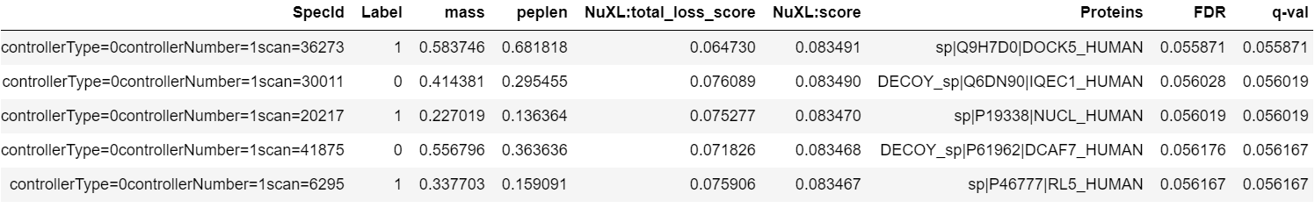
Data Generation and Preprocessing
Target or Decoy
Different features
Notes:
Berechnung FDR und q-value
Paar Worte zum benutzten data set

Slide 9
Original Percolator
Training
Validation
Training
Validation
C⁺ | 0.1 | 1 | 10
C⁻ | 0.1 | 1 | 10
 | 0.3 | 3 | 30
 | 1 | 10 | 100

Slide 10
Original Percolator
Training
Validation
Training
Validation
C⁺ | 0.1 | 1 | 10
C⁻ | 0.1 | 1 | 10
 | 0.3 | 3 | 30
 | 1 | 10 | 100
Training
Decoys
5% q-value

Slide 11
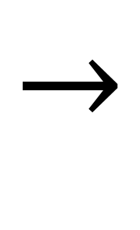
Original Percolator
Training
Validation
Training
Validation
C⁺ | 0.1 | 1 | 10
C⁻ | 0.1 | 1 | 10
 | 0.3 | 3 | 30
 | 1 | 10 | 100
Training
Scoring
Score Normalization
3x
$$→$$
Decoys
5% q-value

Slide 12
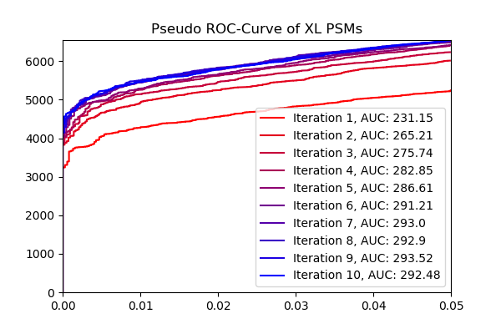
Pseudo ROCs
Notes:
Calculation of AUC

Slide 13
Characteristics of Cross-linked PSMs
Harder to detect by current algorithms
Measured in lower quantity than linear peptides
Possess more features (e.g. the cross-linked nucleotide)
Generally different from linear PSMs
Notes:
optimalRanking
small datasets
imputation
proportion

Slide 14
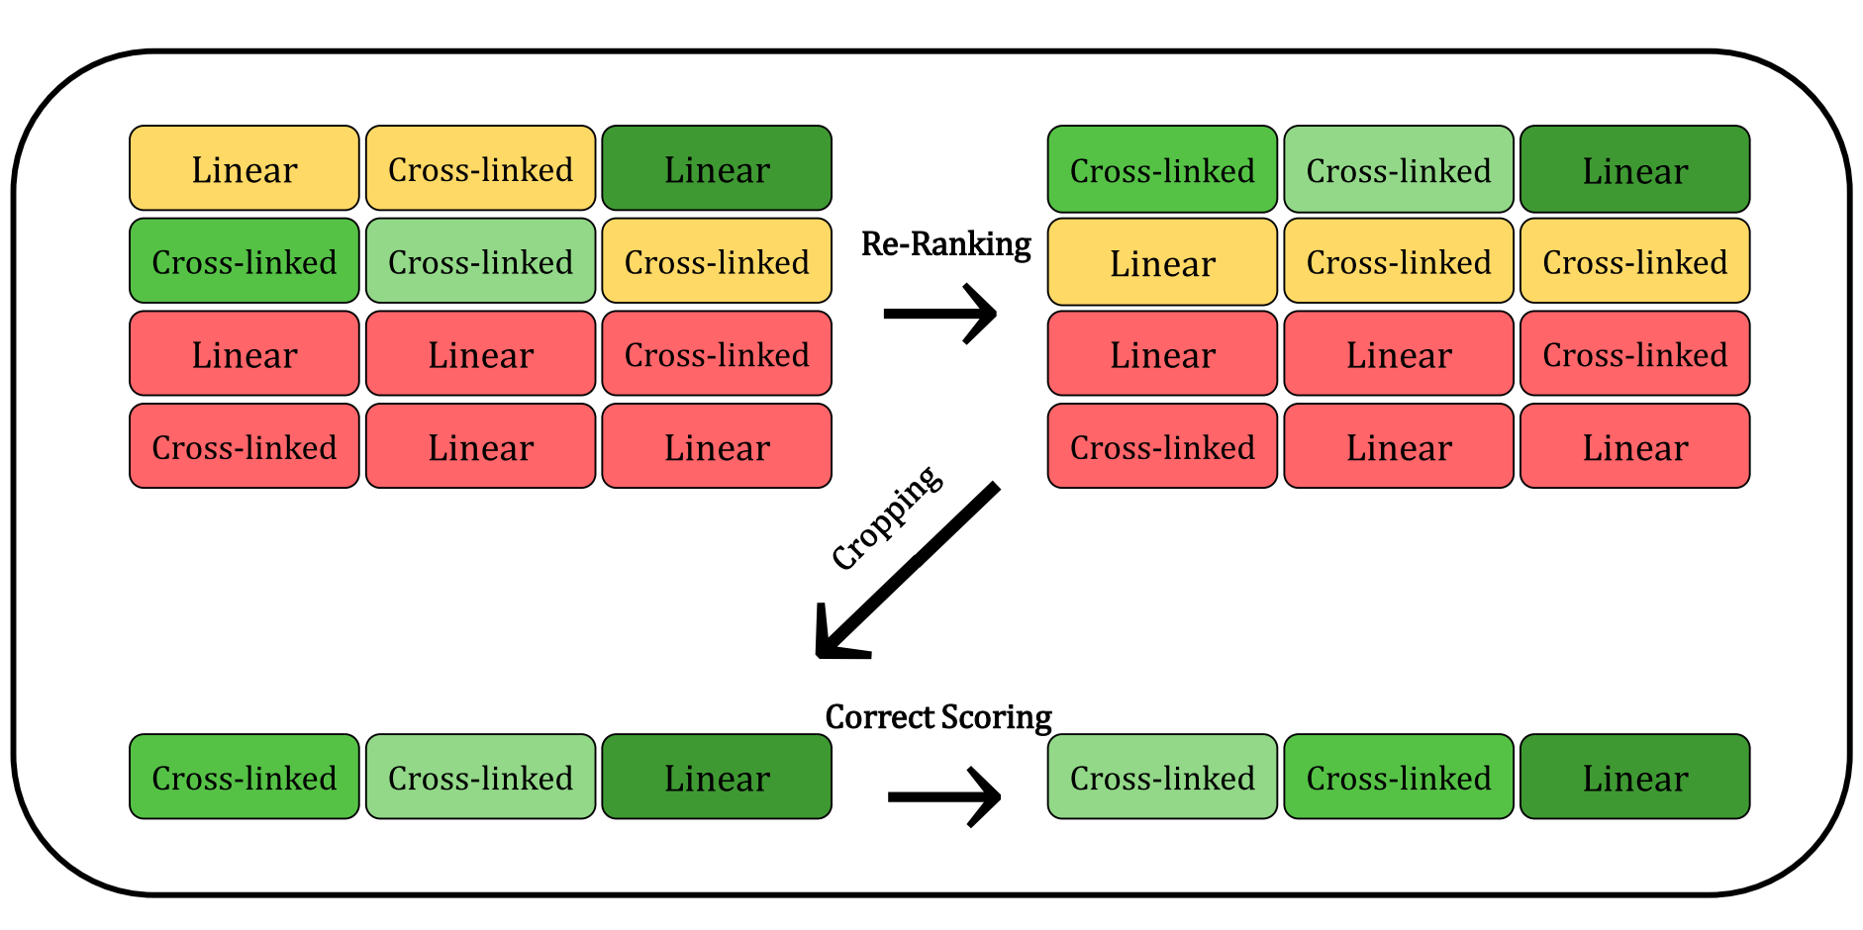
optimalRanking - Methods

Slide 15
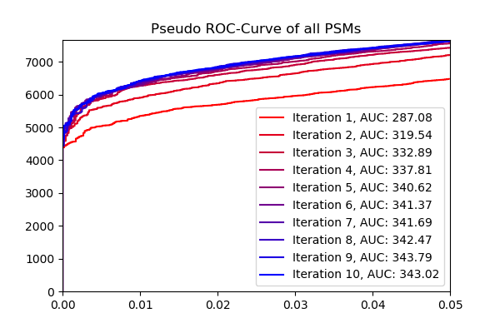
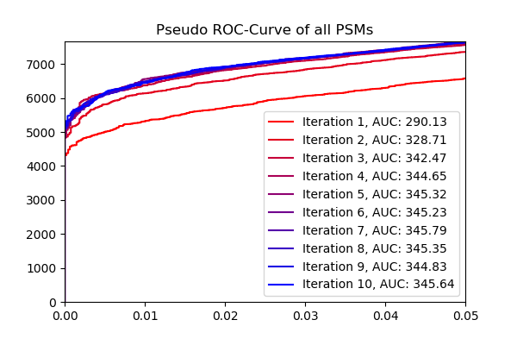
optimalRanking – Results & Discussion
Pseudo ROCs of all PSMs
Pseudo ROCs of only rank 1 PSMs
Notes:
Lower ranking PSMs contain misleading information and let the SVM learn wrong patterns
Higher quality of data lets the SVM learn the correct patterns after fewer iterations.

Slide 16
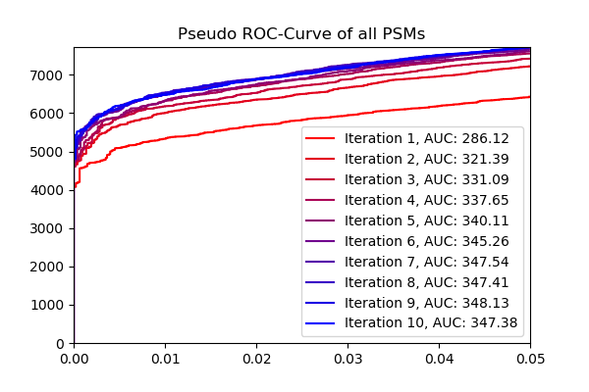
optimalRanking - Results & Discussion

Slide 17
optimalRanking - Results & Discussion
Cropping after iteration 5

Slide 18
optimalRanking - Results & Discussion
Cropping after iteration 5
Best result of the three

Slide 19
optimalRanking - Results & Discussion
Cropping after iteration 5
Best result of the three
Re-Ranking took place
Pseudo ROCs of only rank 1 PSMs:

Slide 20
Small Datasets - Methods
Random sampling of cross-linked PSMs with q-value < 10%
Calculating pseudo ROCs, AUC, number of PSMs with q-value < 1% from unchanged NuXL-score
Applying Pycolator and using the resulting score
Notes:
Metrics are calculated w.r.t. dataset size because this changes when applying sPycolator

Slide 21
Small Datasets - Methods
Random sampling of cross-linked PSMs with q-value < 10%
Calculating pseudo ROCs, AUC, number of PSMs with q-value < 1% from unchanged NuXL-score
Applying Pycolator and using the resulting score
Repeat 10 times to compensate for uneven sampling
Notes:
Metrics are calculated w.r.t. dataset size because this changes when applying sPycolator

Slide 22
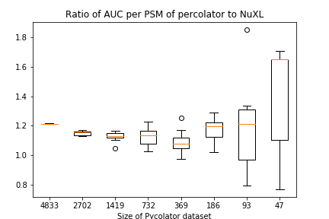
Small Datasets – Results & Discussion
AUC using Pycolator score to unchanged score
Notes:
AUC decreases until very small size -> next slide

Slide 23
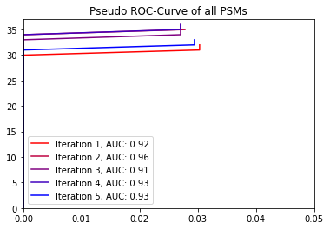
Small Datasets – Results & Discussion
AUC using Pycolator score to unchanged score
Notes:
Pycolator finds a few more targets
Allows 1 more decoy
Extends range, over which the AUC can be calculated

Slide 24
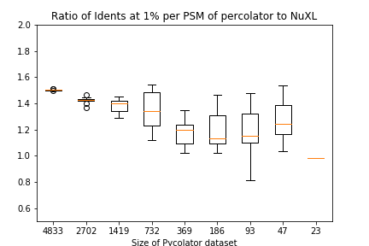
Small Datasets – Results & Discussion
Identified PSMs at 1% q-value using
Pycolator score to unchanged score
AUC using Pycolator score to unchanged score
Notes:
AUC not able to be calculated for small datasets -> new metric

Slide 25
Imputation
The used SVM function cannot handle missing values
The imputer tries to find numerical values minimizing the influence on the score
Notes:
Non-cross-linked PSMs have fewer features than cross-linked PSMs
Numerical values lie on the decision limit / hyperplane
Imputation could prevent fitting onto only linear PSMs (for example when true cross-linked PSMs are rarer, cross-linked PSMs tend to be decoys)
Switched off by default

Slide 26
Imputation
The used SVM function cannot handle missing values
The imputer tries to find numerical values minimizing the influence on the score
No influence on the used dataset
Notes:
Non-cross-linked PSMs have fewer features than cross-linked PSMs
Numerical values lie on the decision limit / hyperplane
Imputation could prevent fitting onto only linear PSMs (for example when true cross-linked PSMs are rarer, cross-linked PSMs tend to be decoys)
Switched off by default

Slide 27
Imputation
The used SVM function cannot handle missing values
The imputer tries to find numerical values minimizing the influence on the score
No influence on the used dataset
Could be useful for datasets with more linear PSMs
Notes:
Non-cross-linked PSMs have fewer features than cross-linked PSMs
Numerical values lie on the decision limit / hyperplane
Imputation could prevent fitting onto only linear PSMs (for example when true cross-linked PSMs are rarer, cross-linked PSMs tend to be decoys)
Switched off by default

Slide 28
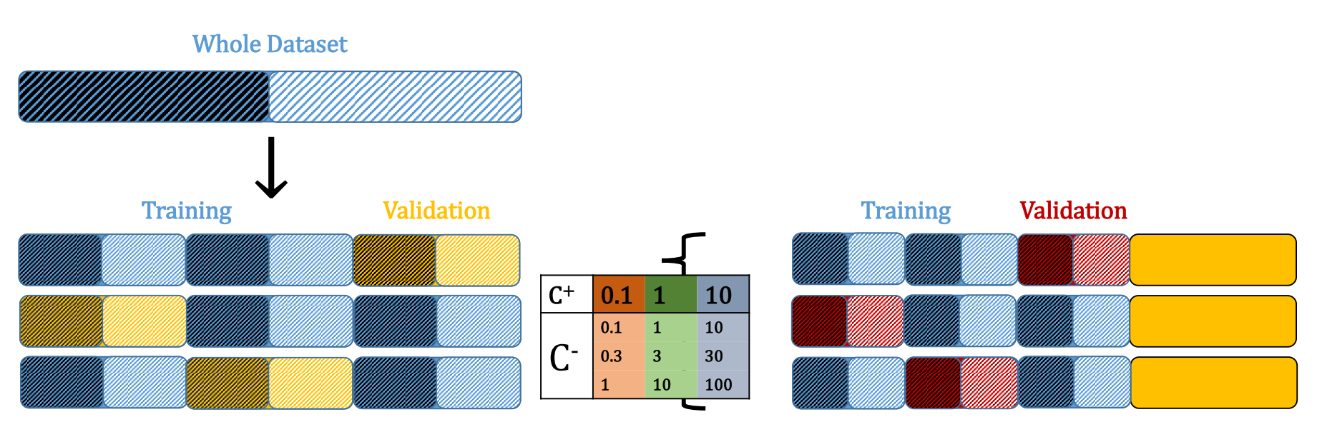
Proportions of Different Classes - Methods
Notes:
Black and white parts represent target and decoy or any arbitrary class, in our example cross-linked and linear PSMs

Slide 29
Proportions of Different Classes - Results
Ratio of target to decoy PSMs is 1.18865 in the whole dataset
Originally: 1.17 to 1.2 in the different splits
Now: 1.18862 to 1.18870

Slide 30
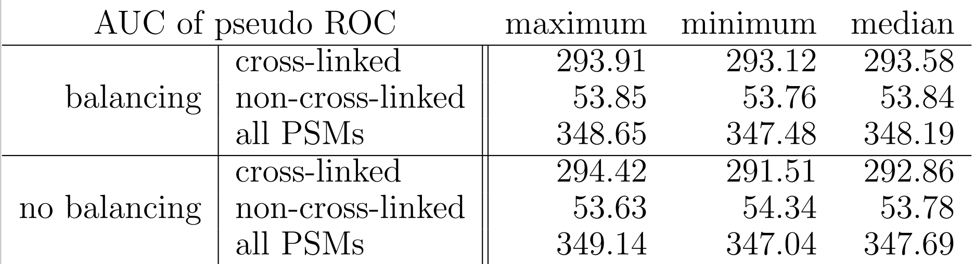
Proportions of Different Classes - Results
Notes:
Slightly reduced variance

Slide 31
Outlook
Testing on other data sets
Machine learning methods to increase flexibility
Does FDR estimation still work?
Feature Selection to reduce effect of correlated features
Notes:
Other, more realistic data sets (few cross-links, many linear PSMs)
More flexible models or combining weak models (AdaBoost)
Redundant features often worsen linear models, common in proteomics (related scores)

Slide 32
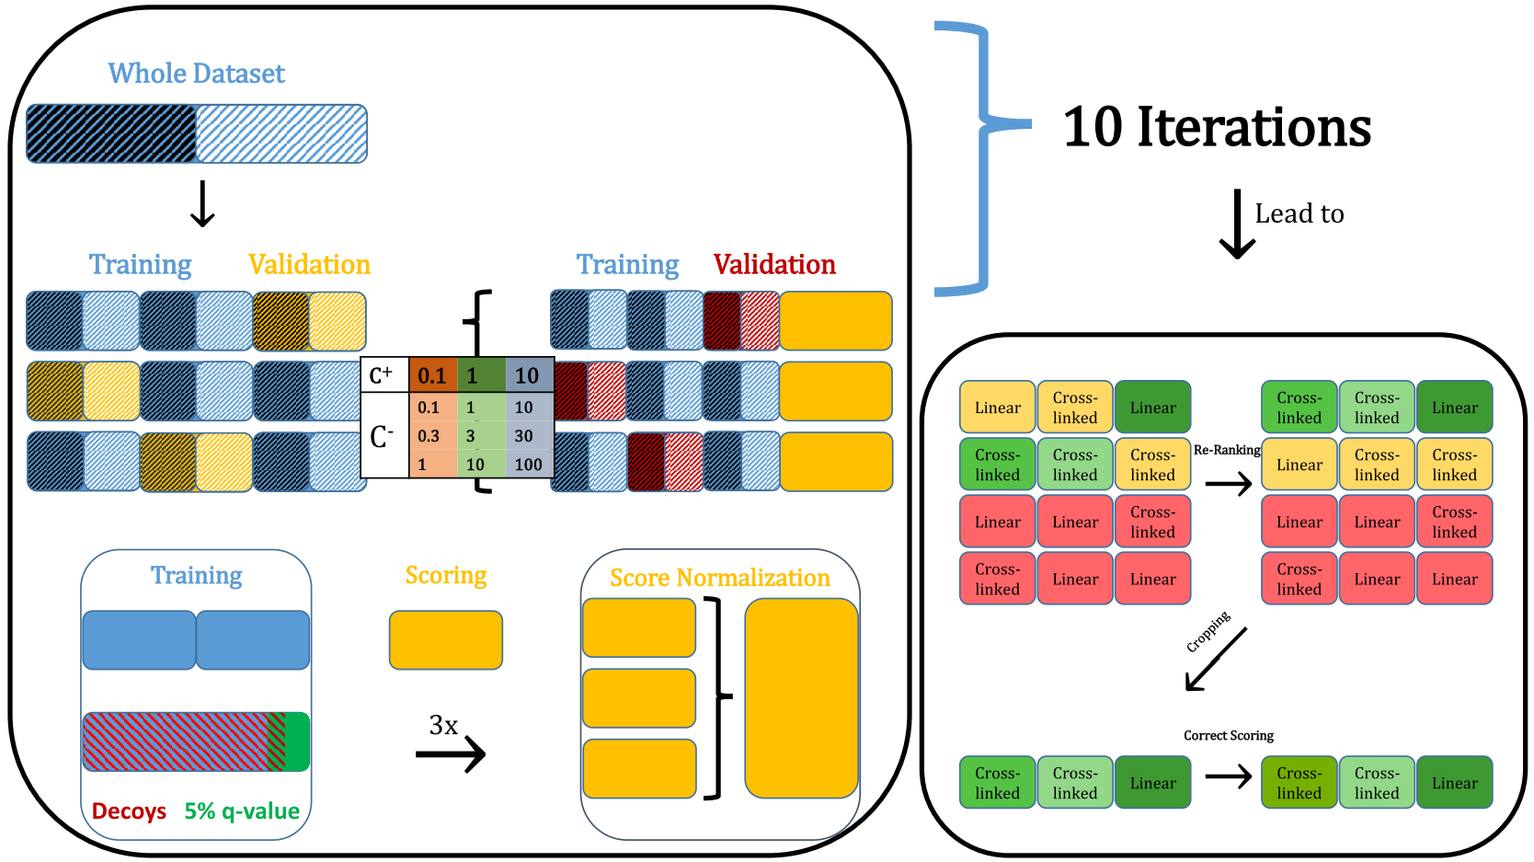

Slide 33
References
[1] Timo Sachsenberg. Computational methods for mass spectrometry-based study of protein-RNA or protein-DNA complexes and quantitative metaproteomics. 2017.

