Slide 1
Semi-supervised Learning for Nucleic Acid Cross-linking Mass Spectrometry
Bachelor Thesis Bioinformatics
By Emil Paulitz

Slide 2
Outline
Background
Nucleic-Acid protein interactions
Cross-linking mass spectrometry
Score post-processing using semi-supervised learning
Challenges of Cross-link identification
Implementation
Pycolator – Percolator reimplementation in Python
Performance metric: pseudo ROC curves
Experiments
Reranking of multiple candidates during learning
Impact of small number of IDs on performance
Data Imputation
Class balancing
Conclusion and Outlook
Notes:
Motivation: Can existing algorithm (Percolator) be adapted to cross-link ID?

Slide 3
Background - Nucleic-Acid protein interactions

Slide 4
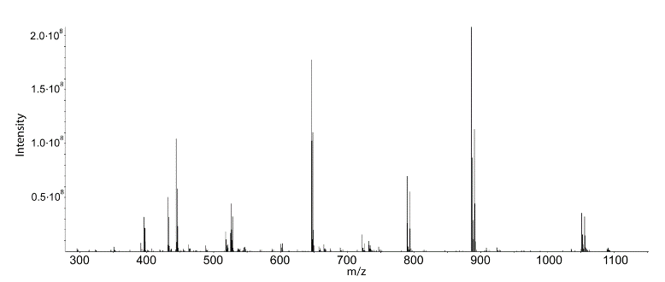
Background: Cross-linking mass spectrometry
Cross-linking introduces stable bonds between protein and RNA
Peptides are measured using mass spectrometry
Mass spectra are compared with theoretical
spectra from possible peptides
Peptide with highest similarity is annotated
(= Peptide-Spectrum-Match (PSM))
Adding decoy peptides to the search allows
to estimate distribution of false matches
From: Timo Sachsenberg [1]
Notes:
id = data

Slide 5
Background: Score post-processing using semi-supervised learning (Percolator)
Goal: Separate false hits from true hits
Idea: Use decoys as false hits and best targets as true hits to learn a discriminative function
Re-score hits and repeat with new
positive examples
Not one score but multiple
(our data: 52)
Can improve the identification rate
Decoys (only F)
frequency
Targets (T+F aka noisy labels)
score
Notes:
This can improve the identification rate compared to using some score that makes mathematically or chemically sense and is often times a combination of certain sub scores.

Slide 6
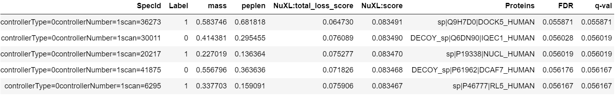
Background: Annotated PSMs
Target or Decoy
Features
Notes:
Berechnung FDR und q-value
Paar Worte zum benutzten data set

Slide 7
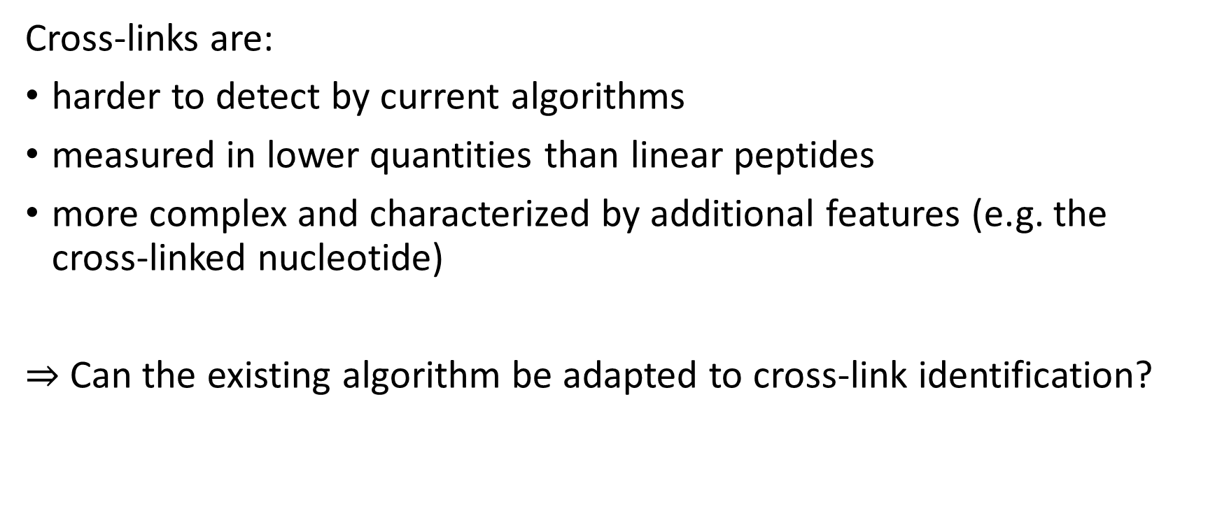
Background: Challenges of Cross-link identification
Cross-links are:
harder to detect by current algorithms
measured in lower quantities than linear peptides
more complex and characterized by additional features (e.g. the cross-linked nucleotide)
$⇒$ Can the existing algorithm be adapted to cross-link identification?
Notes:
optimalRanking
small datasets
imputation
proportion

Slide 8

Pycolator – Percolator reimplementation in Python
Training
Validation
Training
Validation
C⁺ | 0.1 | 1 | 10
C⁻ | 0.1 | 1 | 10
 | 0.3 | 3 | 30
 | 1 | 10 | 100
Repeat
10 x
Training of the C-SVM
Scoring
Score Normalization
3x
$$→$$
Decoys
5% q-value
Notes:
C-SVM refers to the C parameter (roughly explain C parameter)

Slide 9
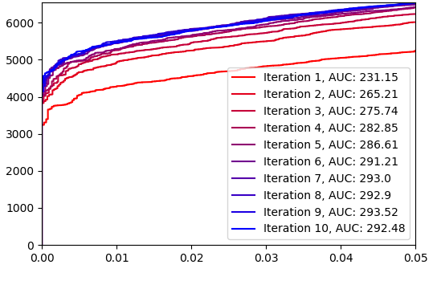
Performance metric: pseudo ROC curves
Identified Cross-linked PSMs
q-value
Notes:
X-axis, y-axis, ROC curves, etc.
One Curve per iteration (colorcoded)
Allows observation of improvement
Calculate area under the curve (AUC)

Slide 10
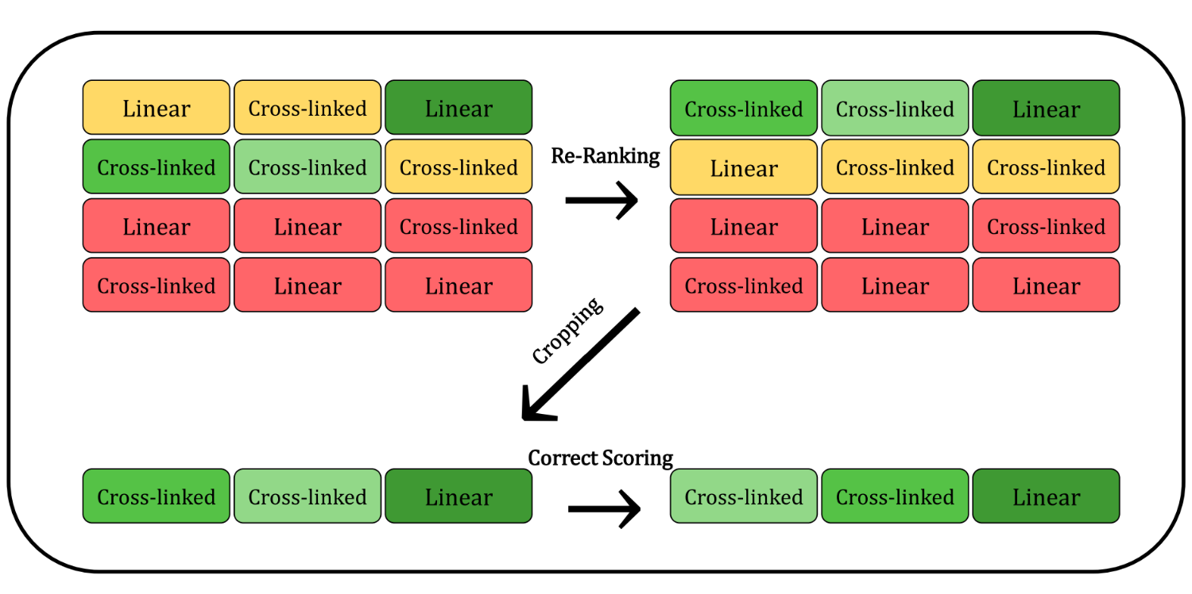
optimalRanking - Methods
Motivation: Correct ID is sometimes not the best scoring one.
Including 2nd or n-th best candidate in learning with reranking might push correct ID to the top.
Rank
1
2
3
4
after 5 iterations

Slide 11
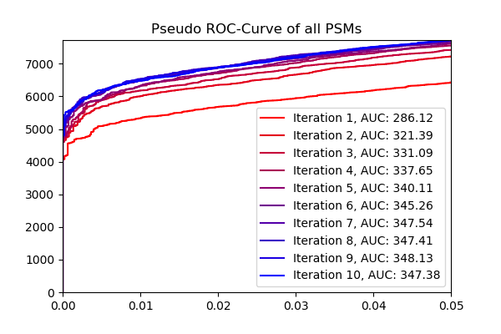
AUC increase of 1% compared to top hit only.

Slide 12
Small Datasets - Methods
MOTIVATION!
Random sampling of cross-linked PSMs with q-value < 10%
Calculating pseudo ROCs, AUC, number of PSMs with q-value < 1% from unchanged NuXL-score
Applying Pycolator and using the resulting score
Repeat 10 times to compensate for uneven sampling
Notes:
Metrics are calculated w.r.t. dataset size because this changes when applying sPycolator

Slide 13
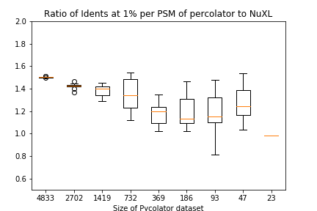
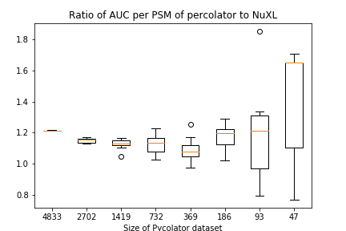
Small Datasets – Results & Discussion
Identified PSMs at 1% q-value using
Pycolator score to unchanged score
AUC using Pycolator score to unchanged score
Notes:
AUC decreases until very small size -> next slide

Slide 14
Imputation
Motivation: The used SVM function cannot handle missing values -> potentially information lost during learning
The imputer tries to find numerical values minimizing the influence on the score
Performance did not improve on the dataset
Notes:
Non-cross-linked PSMs have fewer features than cross-linked PSMs
Numerical values lie on the decision limit / hyperplane
Imputation could prevent fitting onto only linear PSMs (for example when true cross-linked PSMs are rarer, cross-linked PSMs tend to be decoys)
Switched off by default

Slide 15
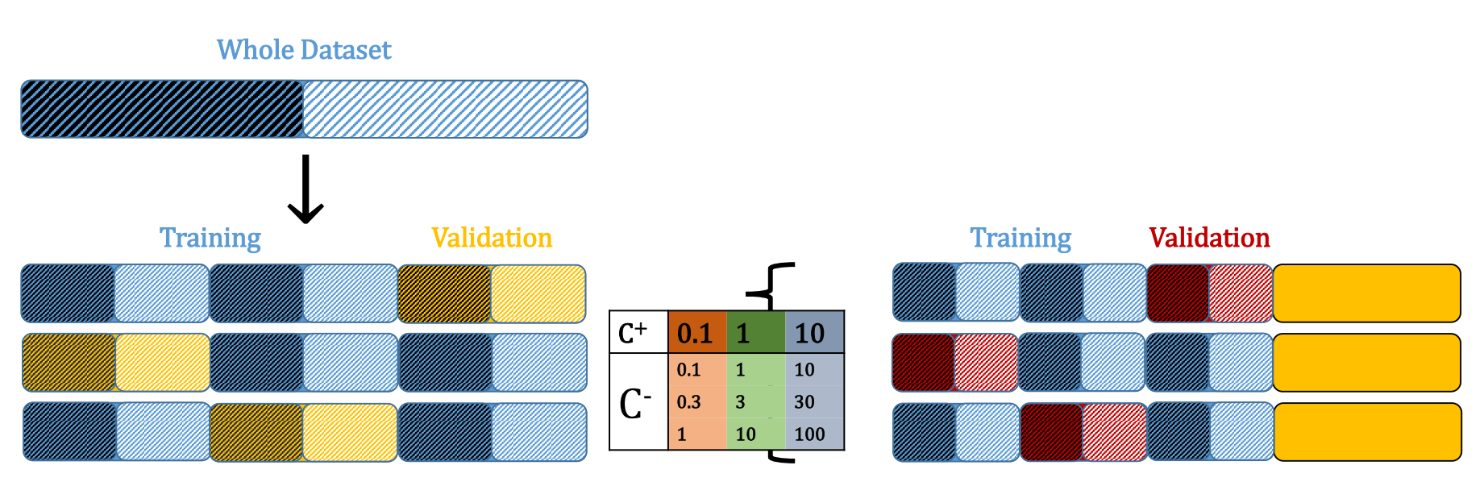
Proportions of Different Classes - Results
Ratio of targets/decoy differ as well as ratio of XLs to linear peptides
This can lead to different ratios in splits and biases during learning
Implementation of class balancing

Slide 16
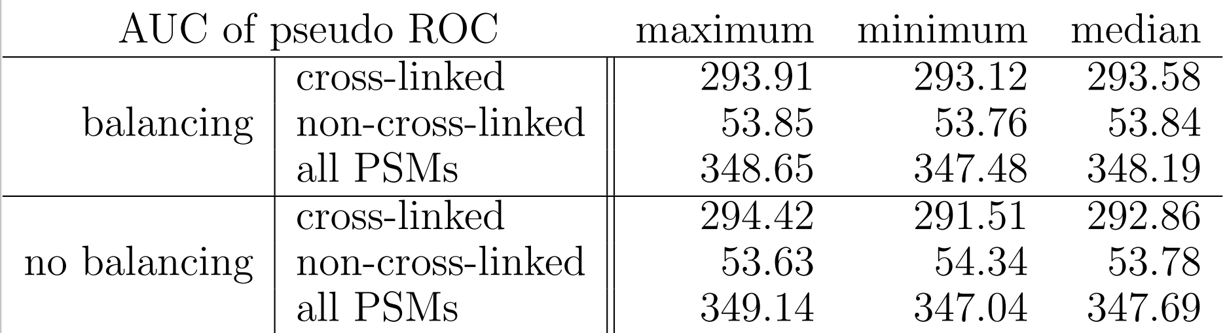
Proportions of Different Classes - Results
Notes:
Slightly reduced variance

Slide 17
Conclusion:
Implementation of the percolator algorithm in python (Pycolator)
Number of cross-links in dataset greatly influences performance
Improved performance by including multiple candidates per spectrum
Improved robustness by class balancing
Outlook:
Additional experiments on data imputation
Testing on other data sets
Other machine learning methods
Notes:
Other, more realistic data sets (few cross-links, many linear PSMs)
More flexible models or combining weak models (AdaBoost)
Redundant features often worsen linear models, common in proteomics (related scores)

Slide 18
References
[1] Timo Sachsenberg. Computational methods for mass spectrometry-based study of protein-RNA or protein-DNA complexes and quantitative metaproteomics. 2017.

