Slide 1


Whole Dataset
$$↓$$
Training
Validation
Training
Validation
C⁺ | 0.1 | 1 | 10
C⁻ | 0.1 | 1 | 10
 | 0.3 | 3 | 30
 | 1 | 10 | 100
Training
Scoring
Score Normalization
$$→$$
3x
Decoys
5% q-value

Slide 2



Linear
Cross-linked
Linear
Cross-linked
Cross-linked
Linear
$$→$$
Cross-linked
Cross-linked
Cross-linked
Re-Ranking
Linear
Cross-linked
Cross-linked
Linear
Linear
Cross-linked
Linear
Linear
Cross-linked
Cross-linked
Linear
Linear
Cross-linked
Linear
Linear
Cropping
$$→$$
Correct Scoring
$$→$$
Cross-linked
Cross-linked
Linear
Cross-linked
Cross-linked
Linear

Slide 3



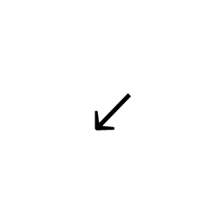


Whole Dataset
10 Iterations
$$↓$$
$$↓$$
Lead to
Training
Validation
Training
Validation
C⁺ | 0.1 | 1 | 10
C⁻ | 0.1 | 1 | 10
 | 0.3 | 3 | 30
 | 1 | 10 | 100
Linear
Cross-linked
Linear
Cross-linked
Cross-linked
Linear
Cross-linked
Cross-linked
Cross-linked
Re-Ranking
Linear
Cross-linked
Cross-linked
$$→$$
Linear
Linear
Cross-linked
Linear
Linear
Cross-linked
Training
Scoring
Score Normalization
Cross-linked
Linear
Linear
Cross-linked
Linear
Linear
$$→$$
Cropping
$$→$$
3x
Correct Scoring
$$→$$
Cross-linked
Cross-linked
Linear
Cross-linked
Cross-linked
Linear
Decoys
5% q-value

