Slide 1
VCFtable & VCFline

Slide 2
Filterdialog
Main
VCF Table
Mainwindow
VCF Line
Annotation Service
Annotation
Data base
Frequencies
Transcriptcons

Slide 3
Mainwindow
------
AnnotationService: annotationService
VCF Table: tableObj
Filterdialog: filter
QProcess: pipeline
--------
parseVCF(QString filename): void
on_actionVCF_file_triggered(): void
on_actionpull_all_annotations_triggered(): void
update_row(int index): void
Notes:
GUI Carmen: auf VCF file öffnen klicken

Slide 4
VCF Table
-------
QList<VCFline> listOfLines
--------
parse(std::string filename): void

Slide 5
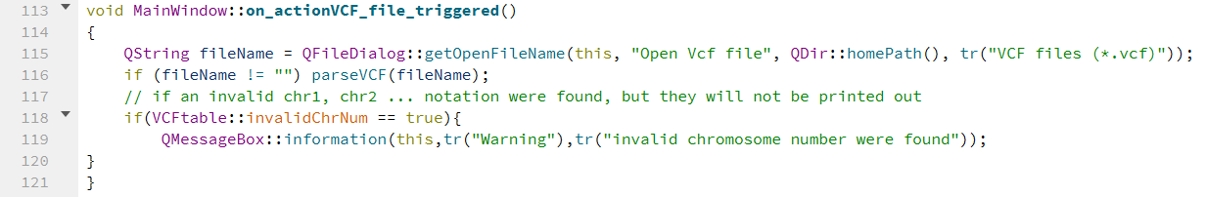
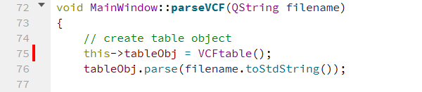
Notes:
GUI Carmen: VCF file auswählen und open klicken

Slide 6
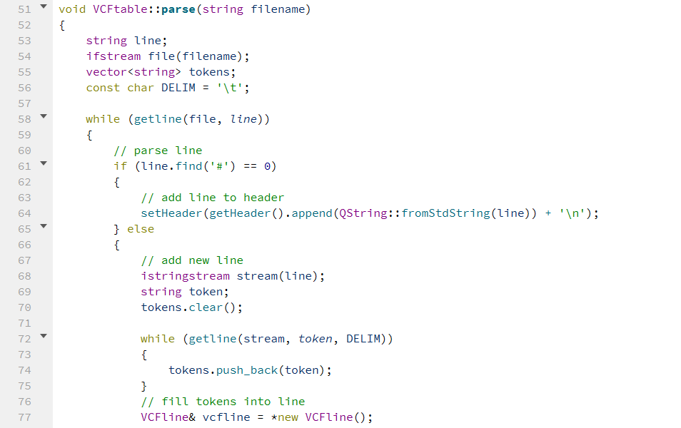

Slide 7
VCF Line
------
QString header, chr, pos, id, ref, alt, qual, filter, info, format, sample
Annotation anno
------------
Getter/Setter
getHgvsNotation(): QString

Slide 8
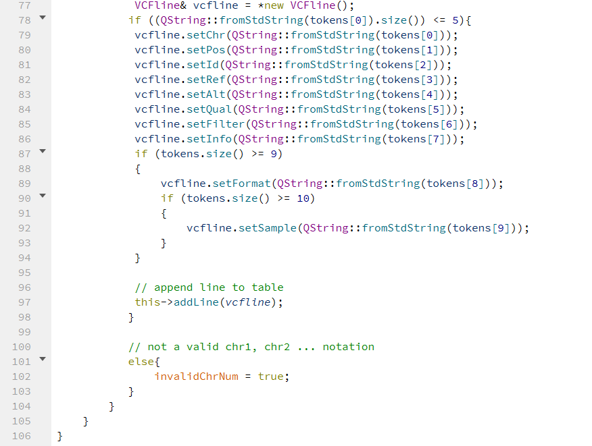

Slide 9
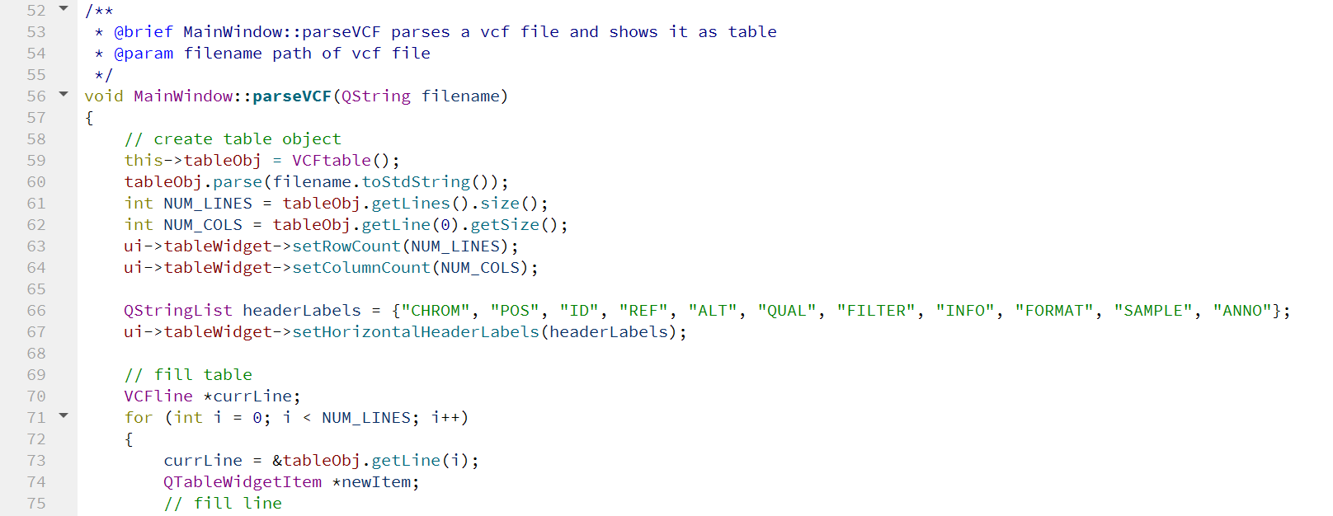
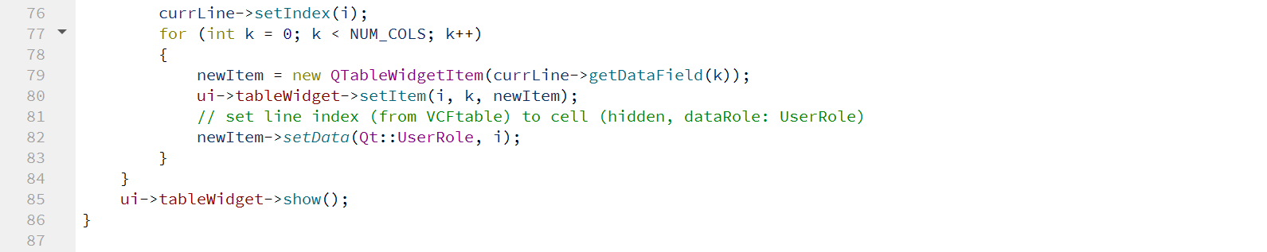
Notes:
GUI: VCF Tabelle ist zu sehen

Slide 10
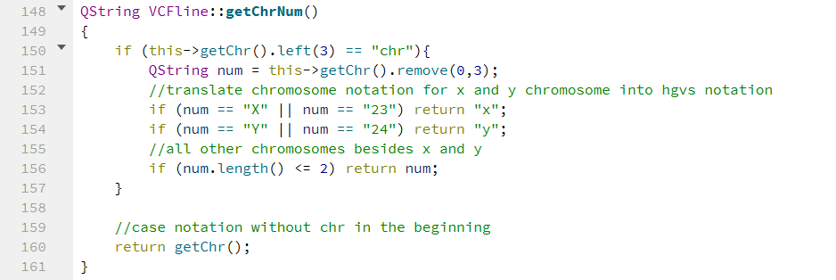

Slide 11
