Slide 1
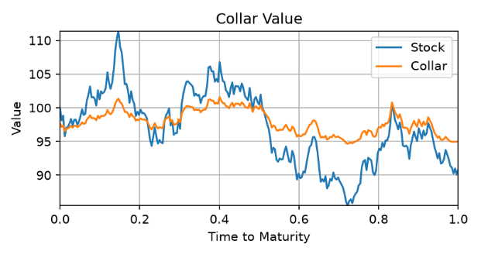
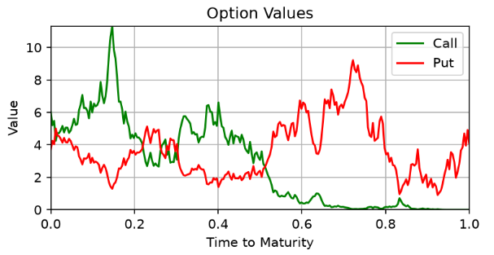
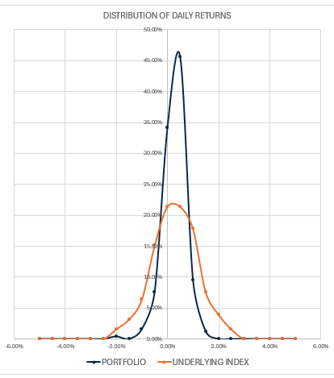
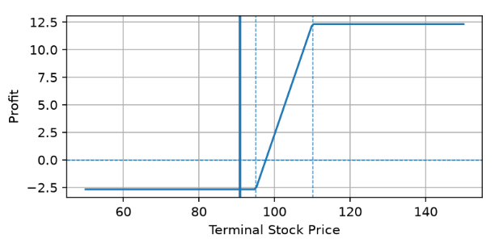
STRUCTURED EQUITY DERIVATIVES – EQUITY COLLAR
1. Generate underlying asset price path as a Geometric Brownian Motion process.
2. Then the daily returns to both the Put and Call option positions, and their combined running profit.
3. Then compare holding just the underlying to holding underlying + collar.
4. Simulated many times, I then examine the distribution of daily returns of both strategies and the payoff at maturity.

Slide 2
STRUCTURED EQUITY DERIVATIVES – EQUITY COLLAR
Key takeaways:
PRO’s:
Materially reduces drawdowns vs unhedged underlying
Reduces volatility (as seen by the narrower daily return distribution)
Eliminates left-tail risk
CON’s:
Upside is capped.
Path dependency: I looked at simulations which all ended at near 100. While payoff at maturity was similar, their interim profits varied widely.
Can still make losses if fall is large enough.
FUTURE WORK:
Test a cross-hedge: Sell expensive Calls on one asset to buy cheaper Puts on another asset, but the assets are highly correlated anyway (especially downside correlation).
Optimal strategy for roll-overs: Wait for maturity or close and re-open options before maturity?

