Slide 1
Who is CS7295
Emily Dutile

Slide 2
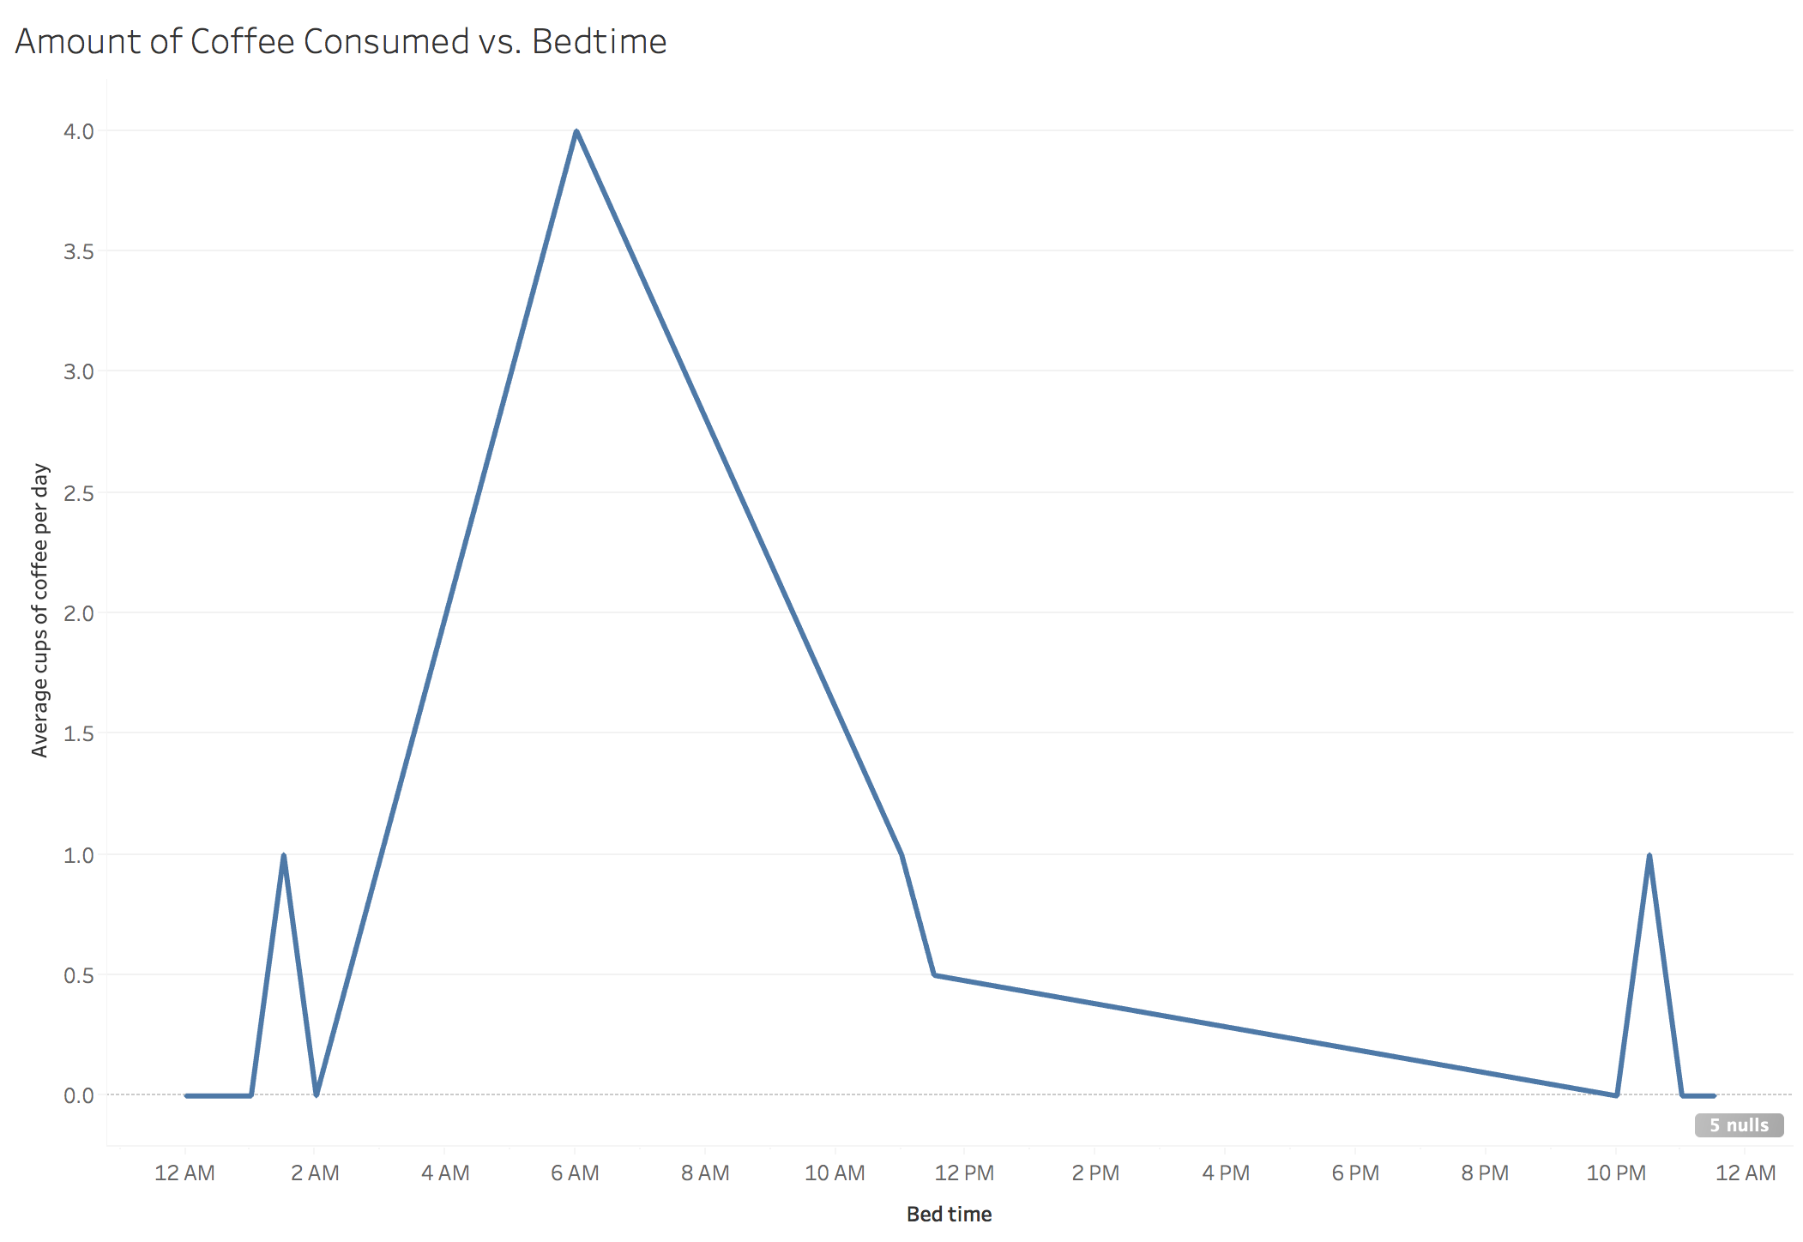
Is there a correlation between bedtime and coffee consumption?
It looks like students who stay up later (or very early in the morning) tend to drink more coffee

Slide 3
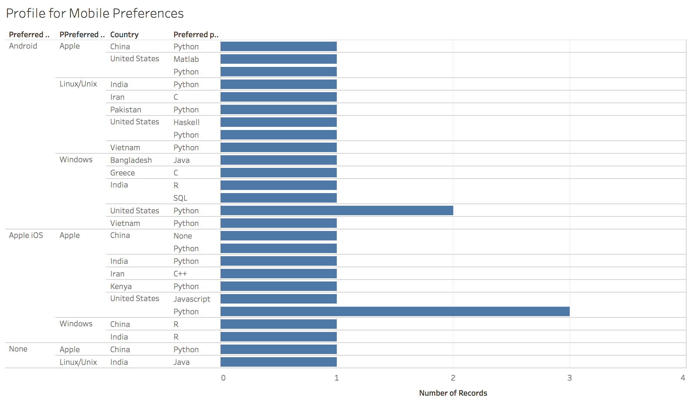
Is there a typical “profile” for someone who prefers to use a mobile phone with an Android versus Apple OS?
Students who prefer Andriod probably prefer Windows (or possibly Linux/Unix)
If the student prefers Apple iOS for their mobile device, they probably prefer Apple OS.
Python seems to be popular in both profiles.

Slide 4
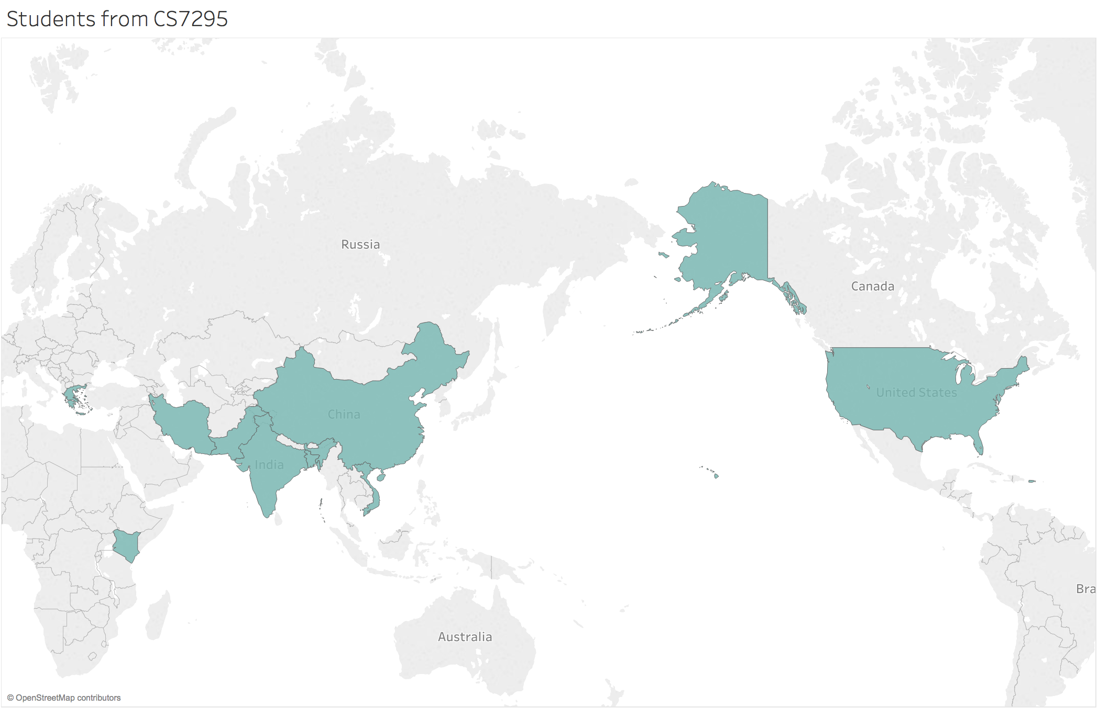
Where are students from CS7295 from?
Students at Northeastern in CCIS are from all over the world.

Slide 5
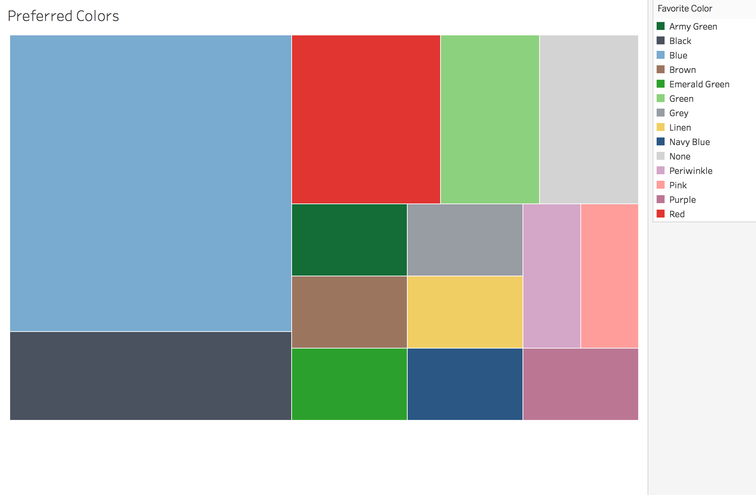
What are students favorite color?
Blue looks to be the most popular among students
Red and black are fairly popular as well, so NEU colors must be appealing to students

Slide 6
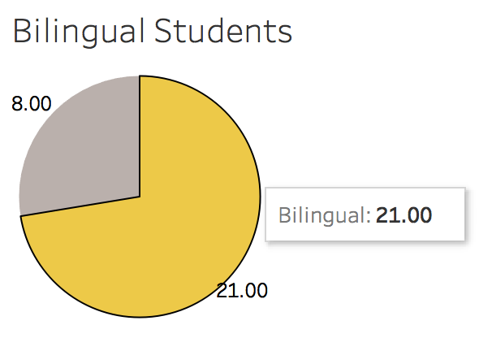
How many students are bilingual?
The majority of the class is bilingual

