Slide 1
Classifying High-Resolution Brain Scans using Apache Spark
Emily Dutile
Asha Chen-Phang
Nate Otenti
Tristan Sweeney
Notes:
NATE

Slide 2
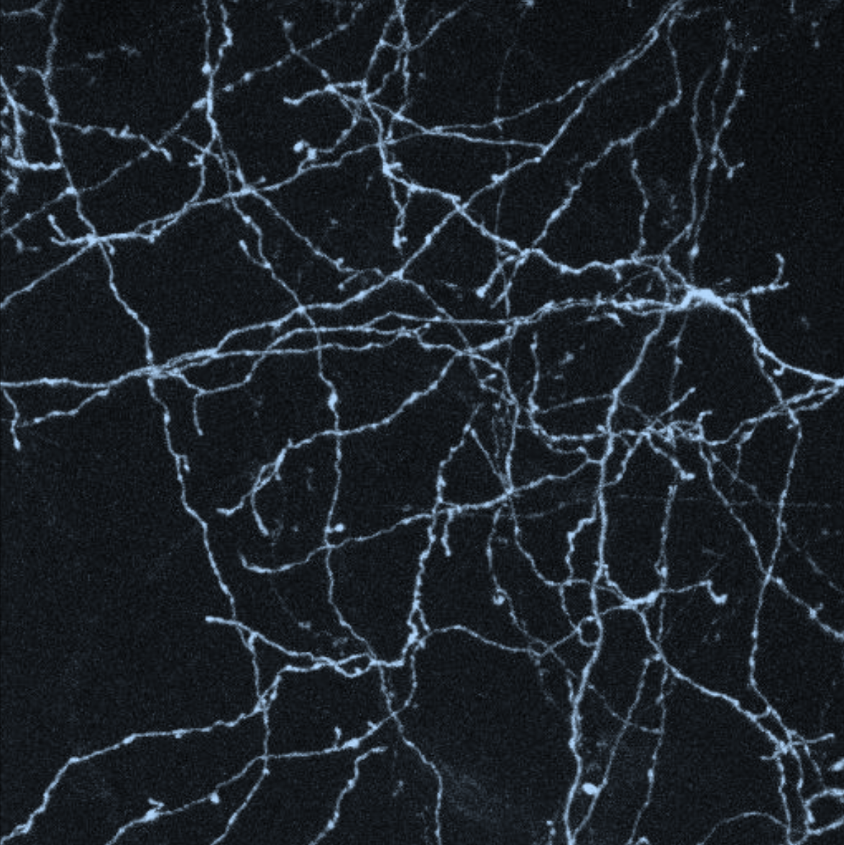
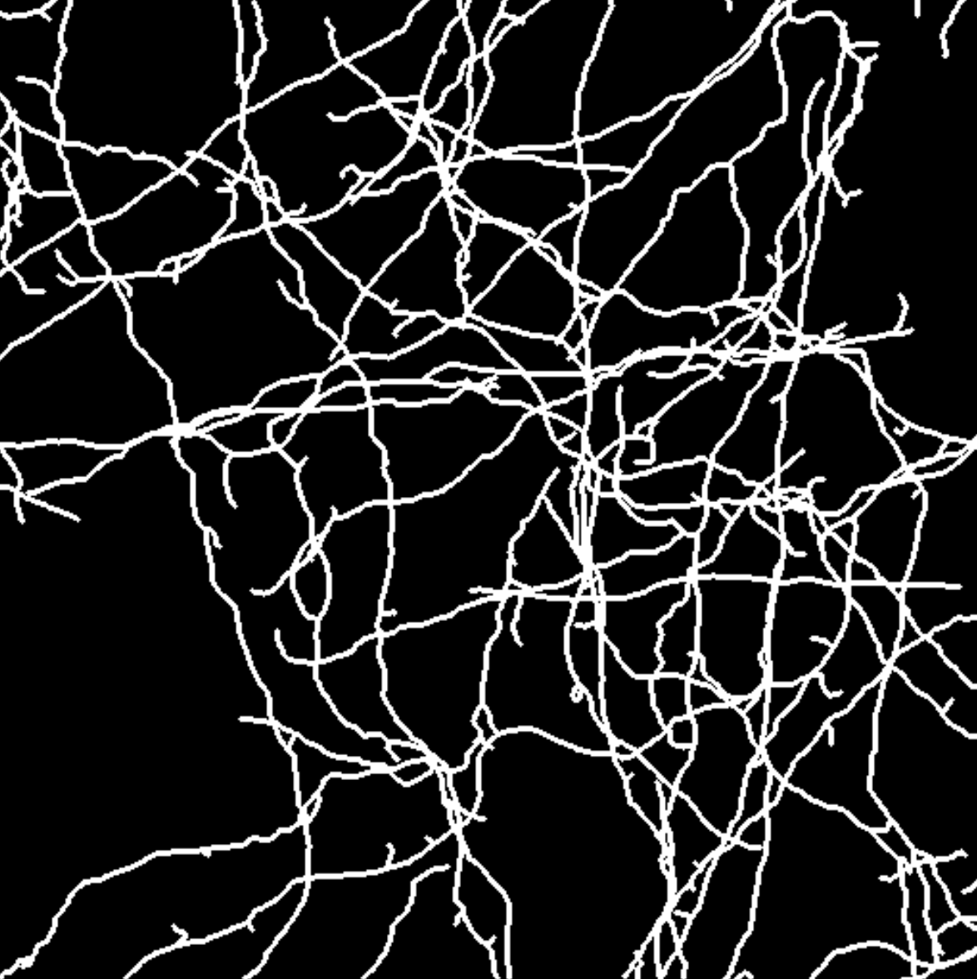
The Data
6 csv files, roughly 6.5GB (image 5 is for prediction)
Rows: input vector of 21x21x7 brightness values (intensity) from a 3D image
Label: Center pixel’s foreground (1) vs background (0)
Each line there are 21*21*7+1 values
Final evaluation set: 0.0057% foreground, 99.99% background
Notes:
NATE
We worked with a dataset with the interest of turning high-resolution brain scans, as seen in the left figure, into a graph representing nerve connections indicated by the bright lines. The original image is 3-dimensional. For better intuition the 2-dimensional projection on the X-Y plane is shown. As you can see, the image is noisy but the axons, which are the lines going across the image, are clearly visible. To improve the quality of algorithms that automatically trace these axons in an image, we classified each pixel as foreground (belongs to an axon) or background (does not belong to an axon). The traced data looks like the figure on the right, where white indicates foreground and black indicates background.
The dataset is composed of several labeled csv files, each consisting of rows that contain an input vector of 21x21x7 brightness values (intensity) from a 3D image, together with the center pixel's foreground-vs-background label. The last value is the label for the whole image. On each line there are 21*21*7+1 values. Each image, which is a csv file, is roughly 6.5 GB. The labeled data from images 1, 2, 3, 4, and 6 are used to train the most accurate model for predicting the labels in image 5 of the datasets. In the final evaluation set, there are nearly 0.0057\% foreground and 99.99\% background pixel. For classification accuracy, a high value does not necessarily mean the model is performing well. In our case, the "dumb" model that always predicts label 0 for every input will have 99\% accuracy, so any model achieving less than 99\% would not be beating the dumb model. \\

Slide 3
Apache Spark & Machine Learning
Distributed framework for data science
Resilient datasets
No work lost when machines fail
MLLib runs on Spark
Packaged ML algorithms
Limited to easy to parallelize algorithms
Ensembles are trivially parallel!
Notes:
TRISTAN

Slide 4
Analysis & Feature Extraction

Slide 5
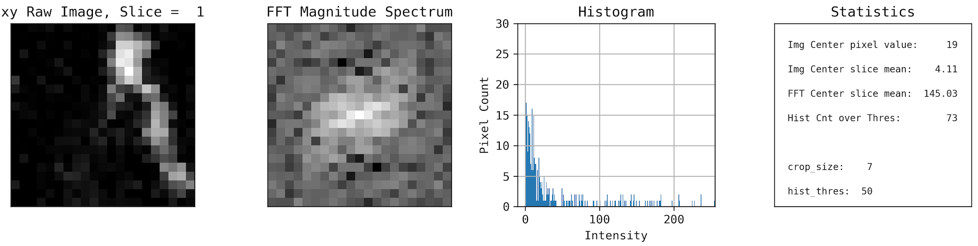
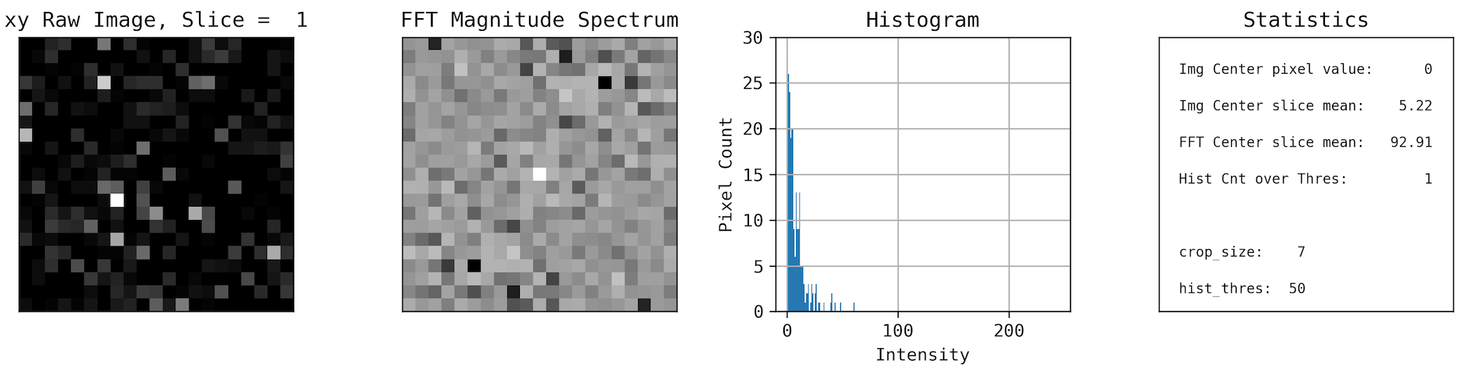
Visualizing the Data
Foreground on xy plane (1 of 7 slices)
Background on xy plane (1 of 7 slices)
Notes:
EMILY
Have foreground and background image
We can see the foreground image have a higher density of points with values higher than a particular threshold (50)
Foreground and background have diff characterizes – foreground has more clustering of white images on the center (in the raw image and FFT transformation)
We extracted more features based on clusters of pixels with higher values
Decided to do window around the center – analyze raw image and foreground transformation which is a representation of image.
Features selected (small feature vector): center pixel, overall # of pixels > threshold, FFT

Slide 6
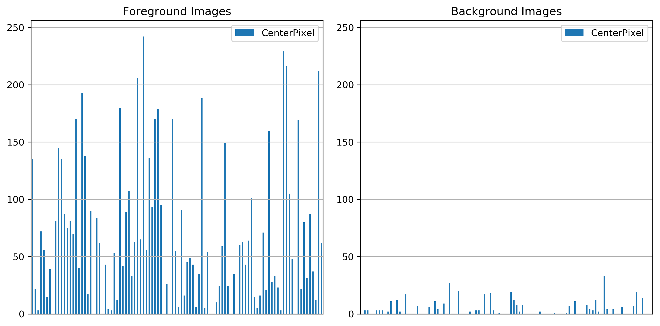
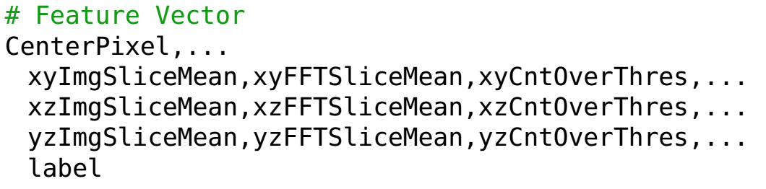
Feature Extraction
Feature Vector of Preprocessed Data:
Notes:
CENTER VALUE FOR FOREGROUND WAS MUCH LARGER
Decision tree and RF splits the samples on the features
Foreground image has a higher value than background

Slide 7
Model & Results

Slide 8
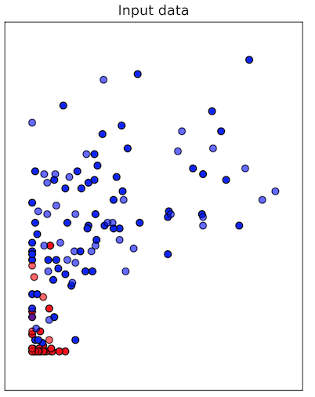
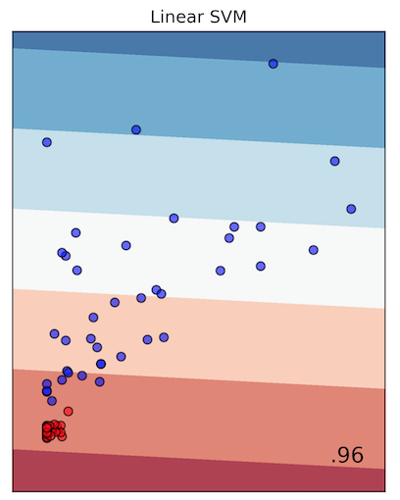
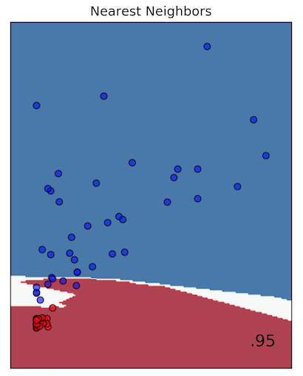
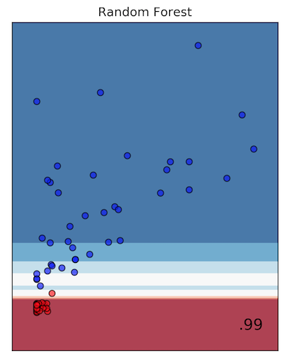
Random Forest
Decision trees are efficient
Intuitive/rule based (unlike NNs)
Decision trees can be biased by noise
Make suboptimal rules, lead to errors
Ensemble of DTs voting minimizes error
Each DT gets a subset of the data
Biases tend to average out to nil
Classification Comparison Test:
Notes:
TRISTAN
Ran a subset of samples, Using cross validation, we can create multiple training and test sets and average the scores to give us a less biased metric.
Decision trees, RF, AdaBoost ensembles doing best
RF scaled the best with framework
Image shows subset of samples as background or foreground
Red = background, blue = foreground

Slide 9
Parameter Tuning
ParamGridBuilder() – constructs a grid of parameters to search over
*numTrees – increasing lead to better accuracy and less compute time
*maxDepth - higher values lead to overfitting and increased run time of the model
maxBins - maximum number of bins used for splitting features
*impurity – criterion (gini)
Notes:
ASHA
Use following parameters – got from paramgridbuilder
Gini used since it doesn't require to compute logarithmic functions (which is calculated in entropy), which are computationally intensive.

Slide 10
Splitting the Dataset
Training & Test data (image 1,2,3,4,6)
Validation data (image 5)
Notes:
ASHA
No form of randomization
Didn’t use cross validation from scala spark, we implemented ourselves
Use 1,2,3,4 and 6 bc we didn’t want data from test inside train (used 4 image for train, 1 for test). This way NO test sample was used during training.
Split dataset into train and test sets
Train the model
Predict with both training and testing
Measure error in the predictions (in both sets)
Compare the error of the two data sets
Trained on diff images and tested

Slide 11
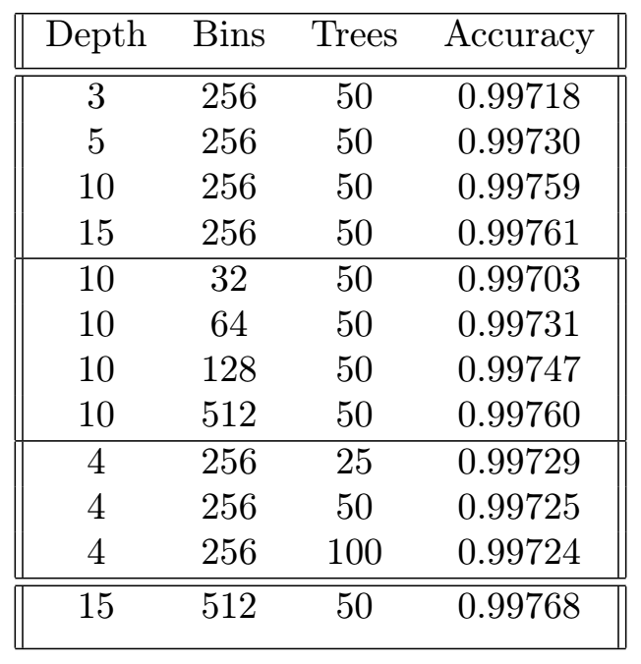
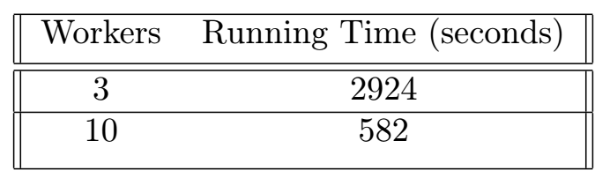
Parallel Processing Results
Exploring Parameters:
Varying Depth
Scaling of Training Phase:
Bins
*Increasing trees past 50 did not increase accuracy significantly
Trees
the best model!
Notes:
EMILY
Highlight best model
* Right table shows scaling of training
What was scaling of processing – parallel
Classification – not that parallel (small feature vectors, fit into 65MB for 1 image, then make splits on this thing). If we split beyond 4 parts, the time it takes to fire up other machines it is expensive.
After 4 workers, which is 16 splits, no real scaling
IMAGE 2 = validation, train on the rest of the data.
Base accuracy = total number of samples / negatives
Best = TN + TP / total
Don’t have as good sensitivity for foreground. Getting a better sensitivity for foreground we lose on background.
Similar to classifying patients with cancer, by selecting accuracy metric – true negatives is important. Have the smallest false positive rate.

Slide 12
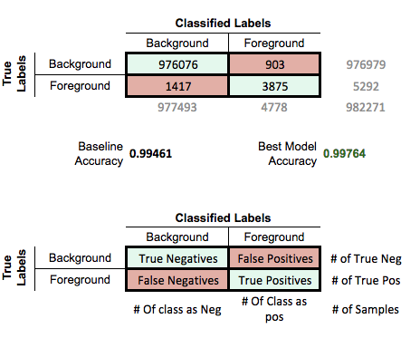
Parallel Results – Cont.

Slide 13
Single Machine Results
Loading entire dataset kills the jupyter kernel
Preprocessed dataset: training RF takes ~9.22 mins
Gini classifier: slower – processed data
Entropy: faster (thousand % more accurate) – preprocessed data
Notes:
NATE

Slide 14
Spark Application Pipeline
Image 5
Split data in several Partitions
(1 job per image, map only job)
6 GB/image.csv
*Each image took ~25 minutes to process, dual core machine 1 worker
PRE-PROCESS
VALIDATION
PRE-PROCESSING
~65 MB / image
Persist data during training
TRAIN RANDOM FOREST
*New Partition
Model
Persist model during classification
CLASSIFY
on multiple machines
Results
Notes:
EMILY
First, preprocessing was 1 job per image. It is a map only job.
Pre-processing transformations 6GB image on 65MB image
The training image are fed to the random forest model to train
We persist the image, which is a job that shuffles the data depending on the the parameters (shuffling correlated with params – it depends more on the depth & number of trees)
Classification job that has a persisted model and it receives only the image that we want to classify
because our feature vector is small we didn’t see much scaling on this one (firing up more than 4 workers isn’t necessary)

Slide 15
The End :)
Thanks!
Questions?

Slide 16
Conclusion
99.57% - Spark
99.56% - Single Machine RF
Notes:
TRISTAN

