Slide 1
Classifying High-Resolution
Brain Scans using Apache Spark
Emily Dutile
Asha Chen-Phang
Nate Otenti
Tristan Sweeney
Classifying High-Resolution Brain Scans
April 26, 2018

Slide 2
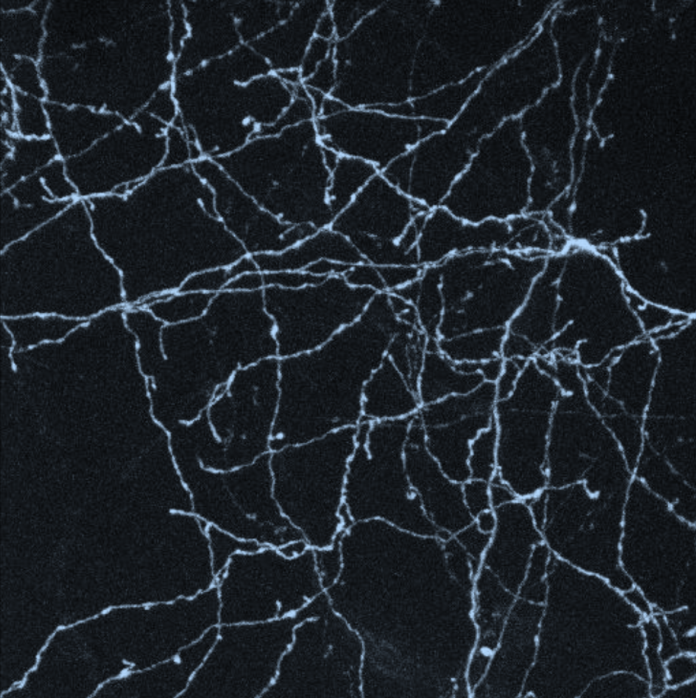
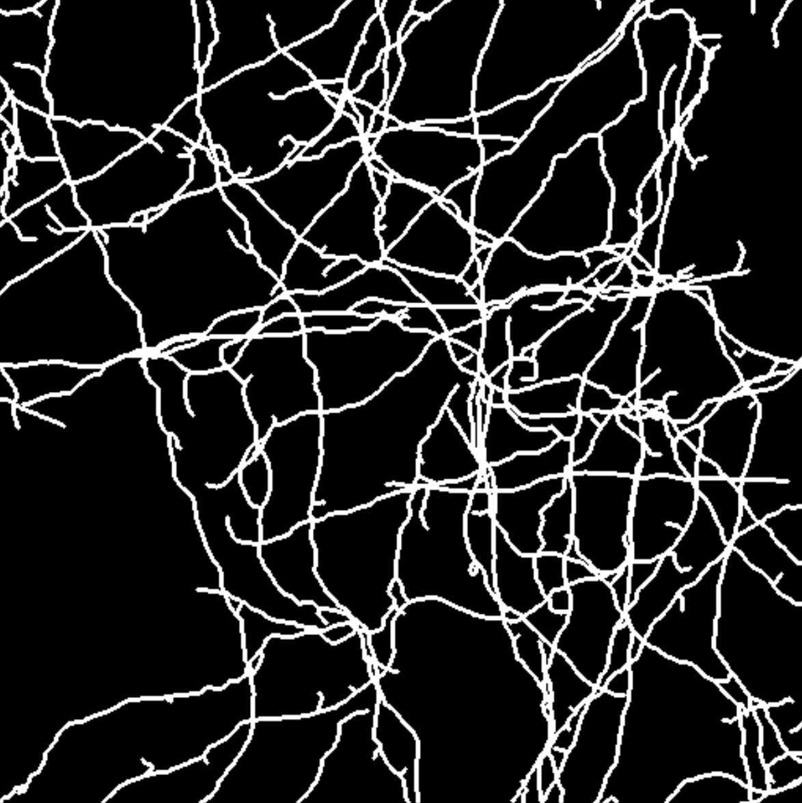
The Data
6 csv files, roughly 6.5GB (image 5 is for prediction)
Rows: input vector of 21x21x7 brightness values (intensity) from a 3D image
Label: Center pixel’s foreground (1) vs background (0)
Each line there are 21*21*7+1 values (~3080 features)
Final evaluation set: 0.0057% foreground, 99.99% background
Classifying High-Resolution Brain Scans
April 26, 2018

Slide 3
Apache Spark & Machine Learning
Distributed framework for data science
Resilient datasets
    No work lost when machines fail
MLLib runs on Spark
  Packaged ML algorithms
  Limited to easy to parallelize algorithms
    Ensembles are trivially parallel!
Classifying High-Resolution Brain Scans
April 26, 2018

Slide 4
Analysis & Feature Extraction
Classifying High-Resolution Brain Scans
April 26, 2018

Slide 5
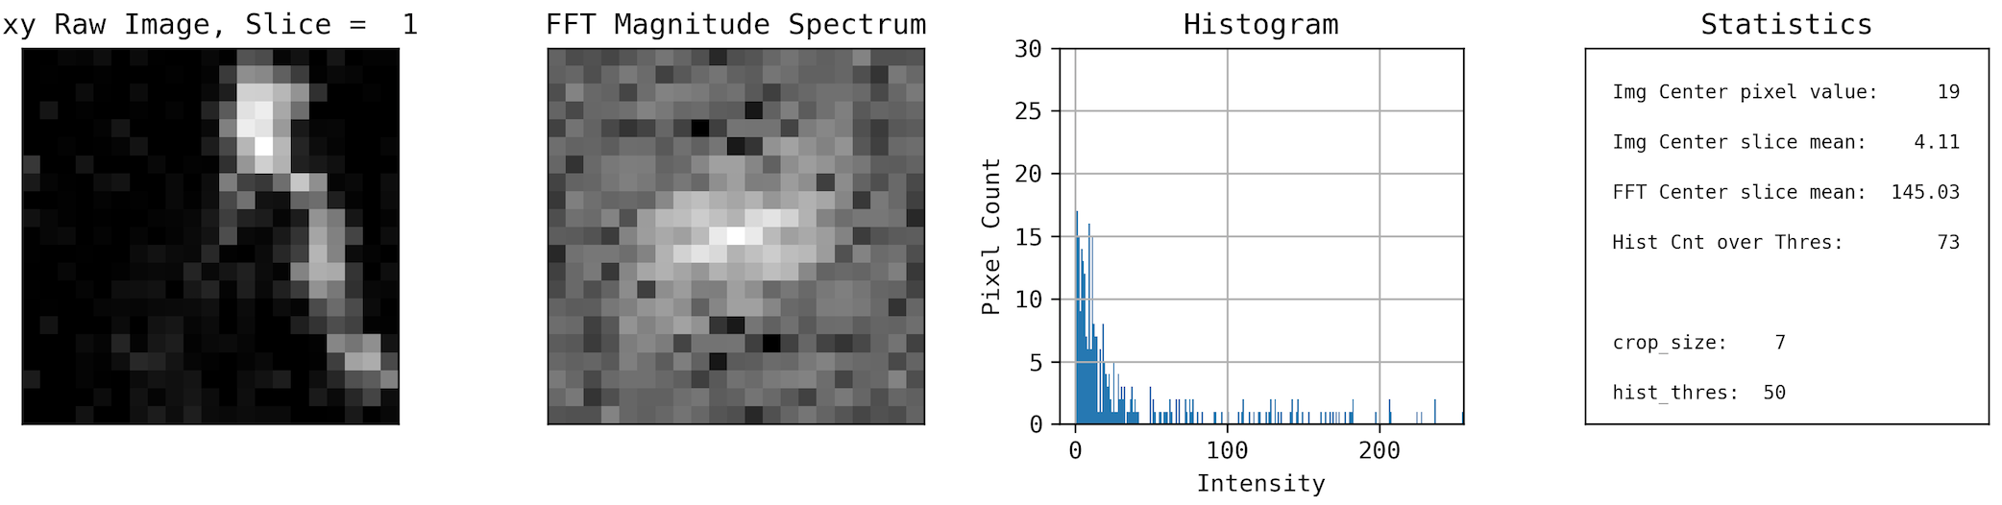
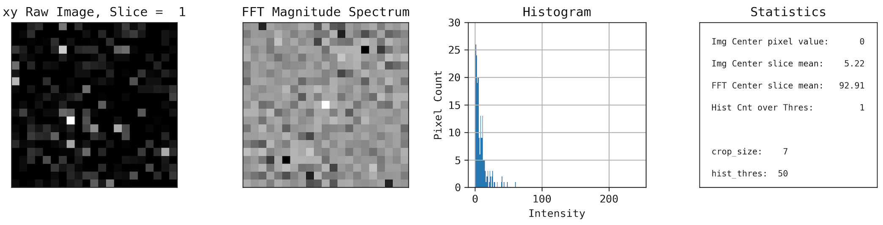
Visualizing the Data
Foreground on xy plane (1 of 7 slices)
Background on xy plane (1 of 7 slices)
Classifying High-Resolution Brain Scans
April 26, 2018

Slide 6
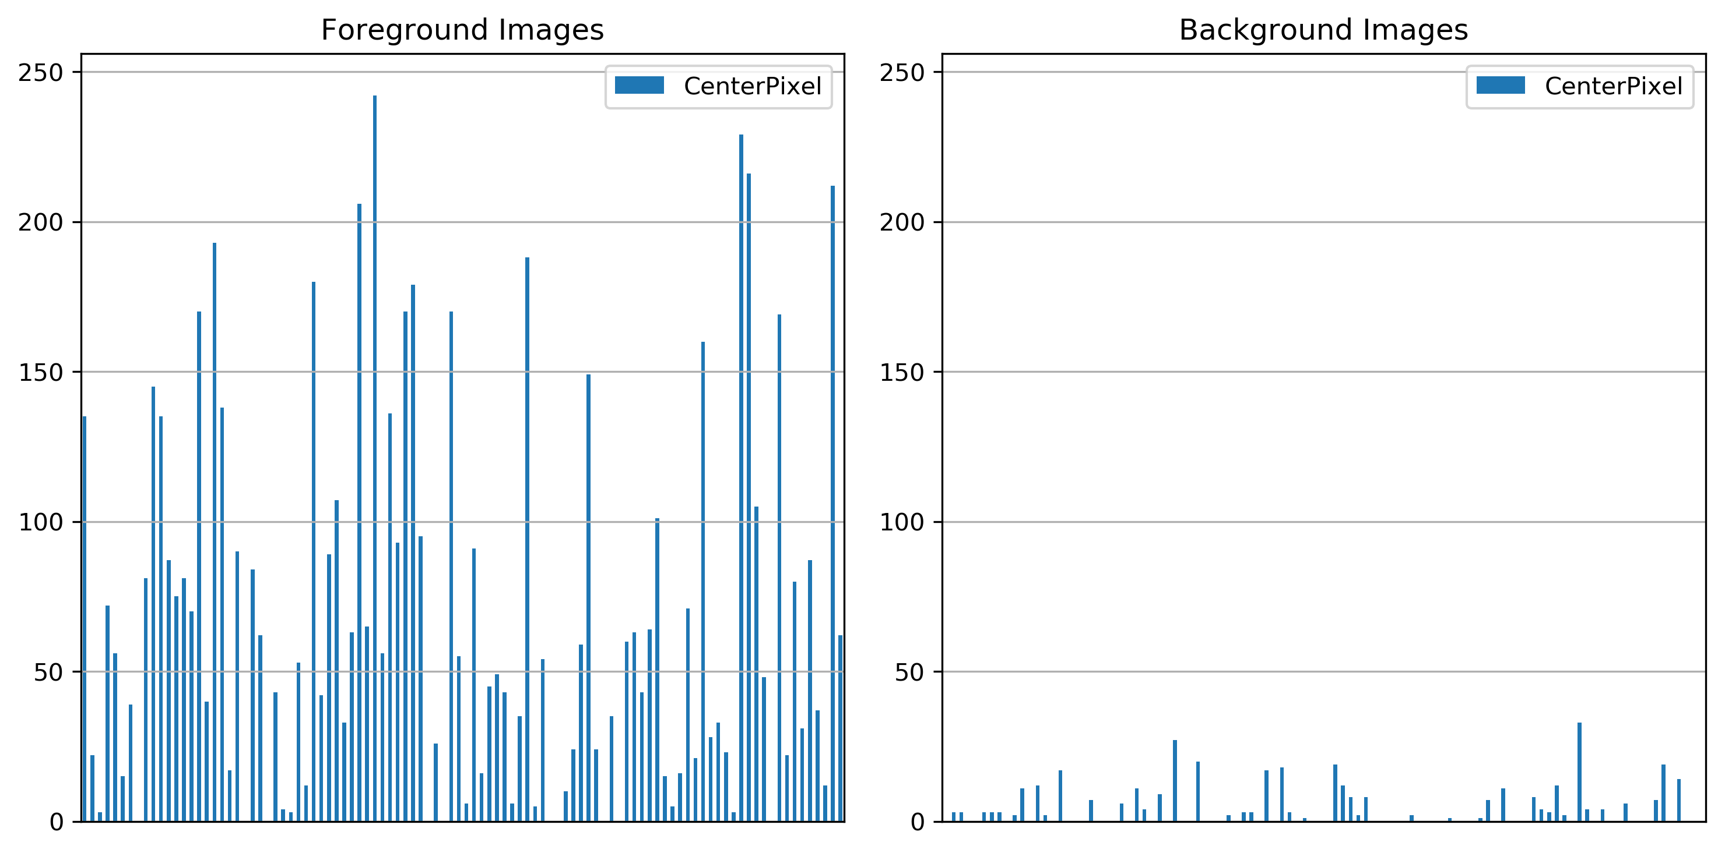
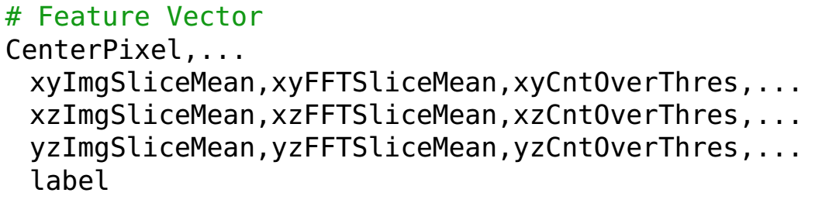
Feature Extraction
Feature Vector of Preprocessed Data:
Classifying High-Resolution Brain Scans
April 26, 2018

Slide 7
Model & Results
Classifying High-Resolution Brain Scans
April 26, 2018

Slide 8
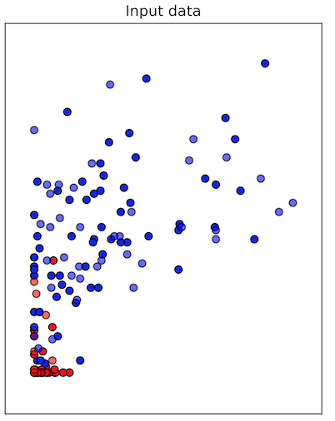
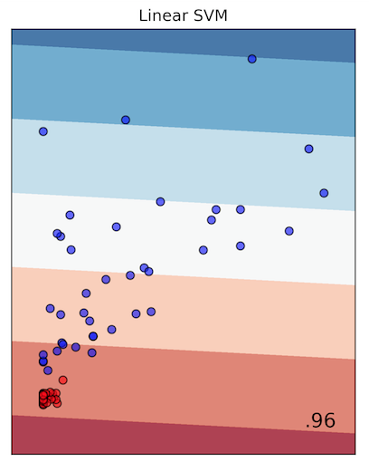
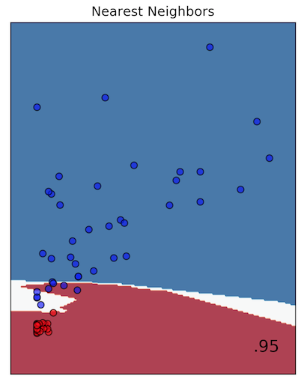
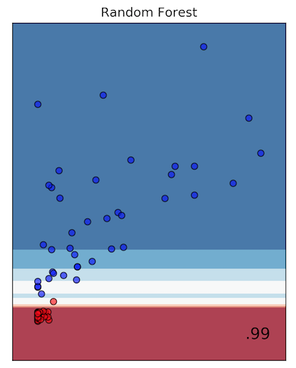
Random Forest
Decision trees are efficient
  Intuitive/rule based (unlike NNs)
Decision trees can be biased by noise
  Make suboptimal rules, lead to errors
Ensemble of DTs voting minimizes error
  Each DT gets a subset of the data
  Biases tend to average out to nil
Classification Comparison Test:
Classifying High-Resolution Brain Scans
April 26, 2018

Slide 9
Parameter Tuning
ParamGridBuilder() – constructs a grid of parameters to search over
*numTrees – increasing lead to better accuracy and less compute time
*maxDepth - higher values lead to overfitting and increased run time of the model
maxBins - maximum number of bins used for splitting features
*impurity – criterion (gini)
Classifying High-Resolution Brain Scans
April 26, 2018

Slide 10
Splitting the Dataset
Training & Test data (image 1,2,3,4,6)
Validation data (image 5)
Classifying High-Resolution Brain Scans
April 26, 2018

Slide 11
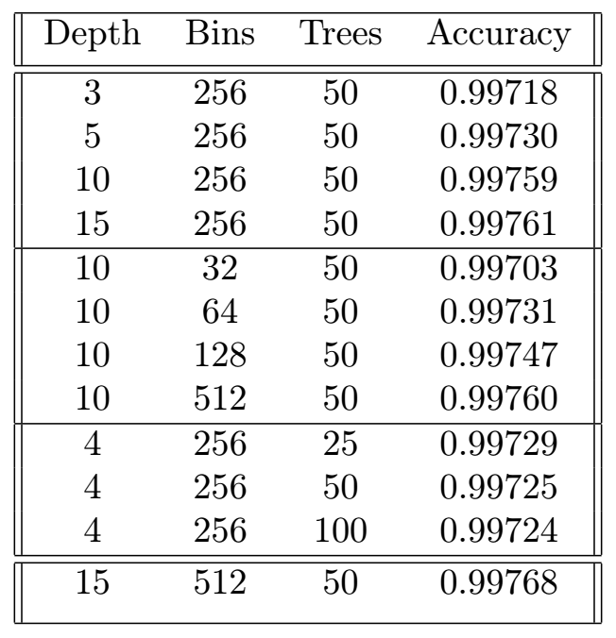
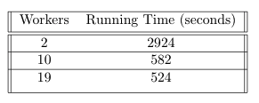
Parallel Processing Results
Exploring Parameters:
Scaling of Training Phase:
Varying Depth
Bins
*Increasing trees past 50 did not increase accuracy significantly
Trees
winner!
Classifying High-Resolution Brain Scans
April 26, 2018

Slide 12
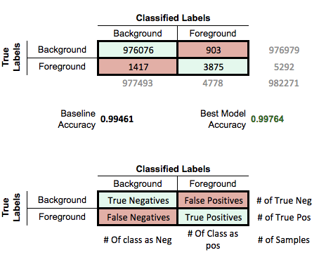
Parallel Results – Cont.
Classifying High-Resolution Brain Scans
April 26, 2018

Slide 13
Single Machine Results
Loading entire dataset kills the Jupyter kernel
Training Random Forest takes ~9.22 mins (on preprocessed data set)
Gini classifier: slower on the processed data
Entropy: faster and a bit more accurate
Classifying High-Resolution Brain Scans
April 26, 2018

Slide 14
Spark Application Pipeline
Image 5
Split data in several Partitions
(1 job per image, map only job)
6 GB/image.csv
*Each image took ~25 minutes to process, dual core machine 1 worker
PRE-PROCESS
VALIDATION
PRE-PROCESSING
~65 MB / image
Persist data during training
TRAIN RANDOM FOREST
*New Partition
Model
Persist model during classification
CLASSIFY
on multiple machines
Results
Classifying High-Resolution Brain Scans
April 26, 2018

Slide 15
The End :)
Thanks!
Questions?
Classifying High-Resolution Brain Scans
April 26, 2018

