Slide 1
Classifying High-Resolution Brain Scans using Apache Spark
Emily Dutile
Asha Phang
Nate Otenti
Tristin Sweeney

Slide 2
Analysis & Feature Extraction

Slide 3
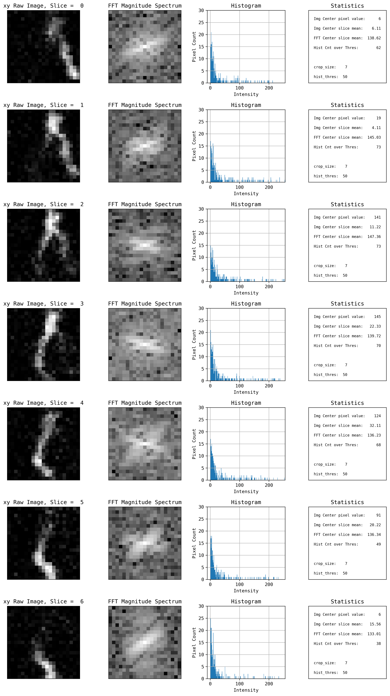
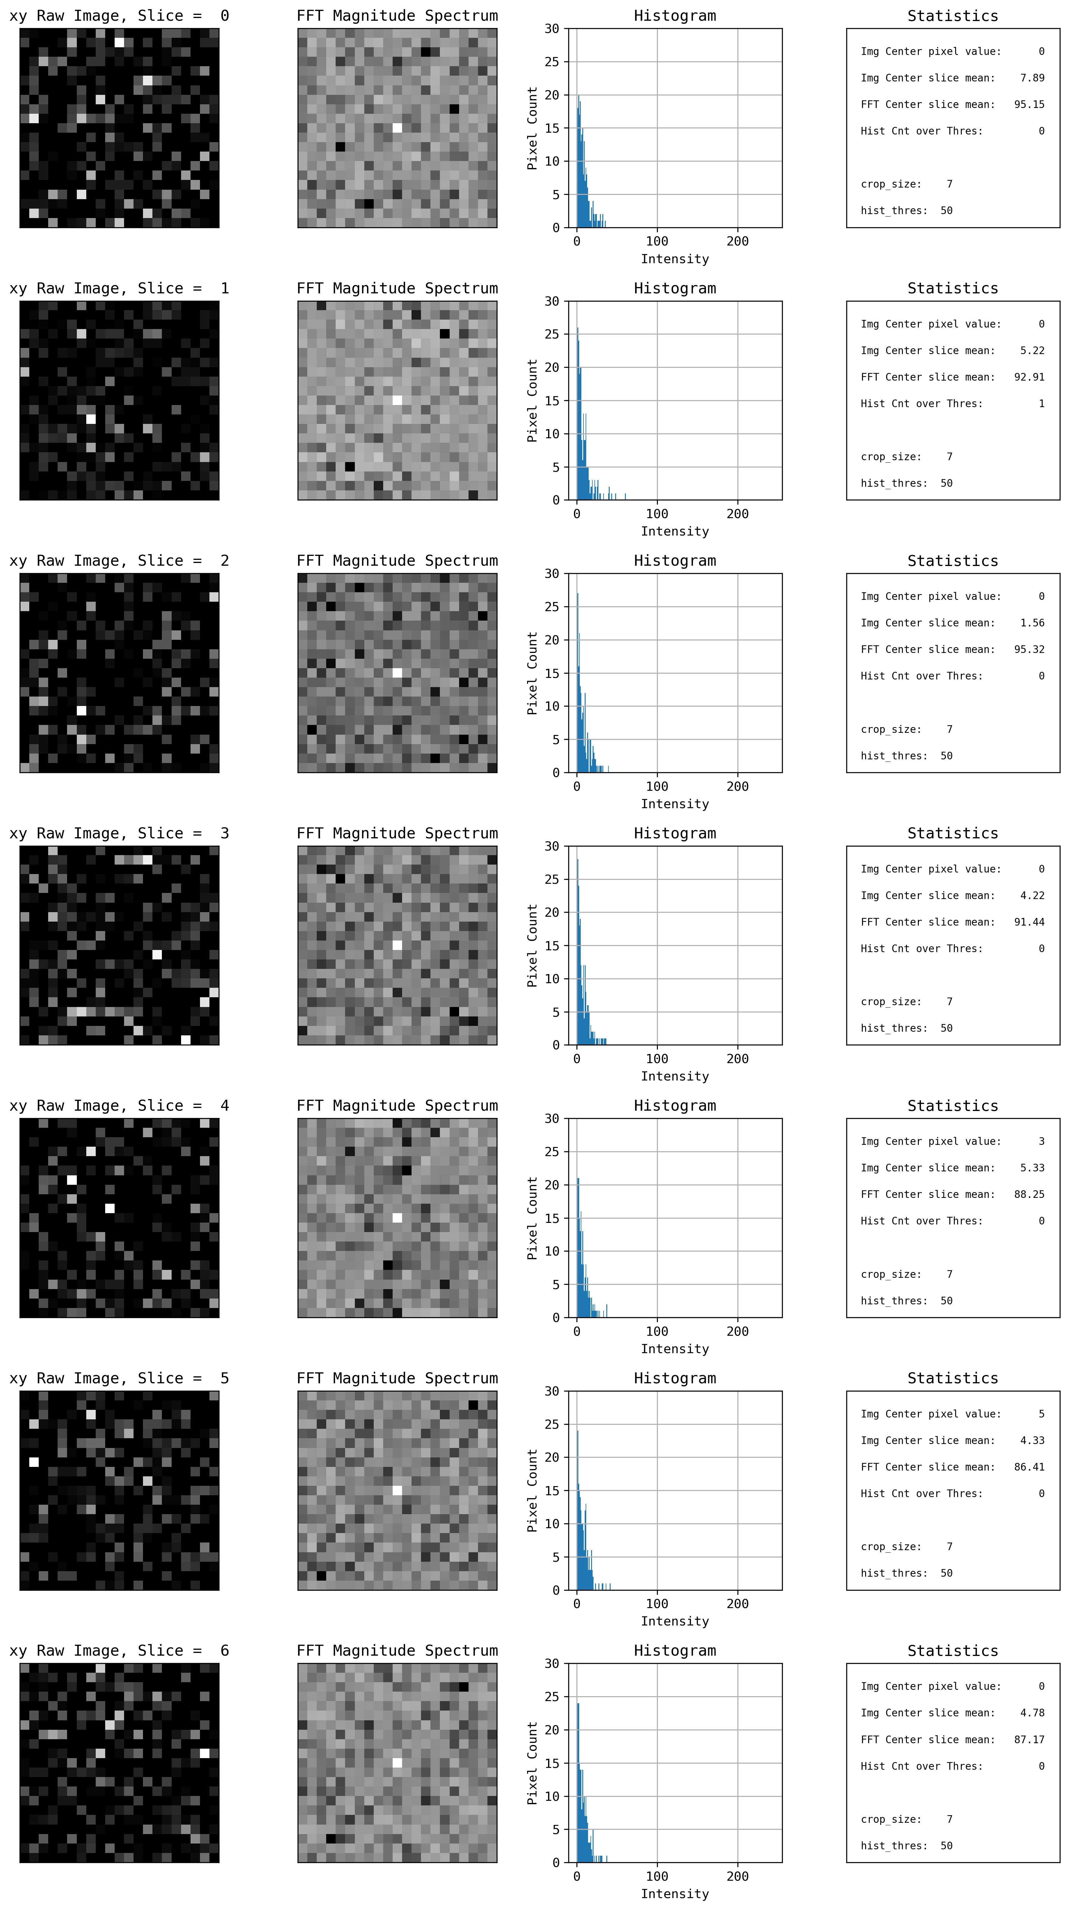
Visualizing the Data
Foreground on xy plane
Background on xy plane
Notes:
We looked at the distribution of the data to identify class imbalance - a term used to describe when a target class within a data set is outnumbered by another target class (or classes). This can create misleading accuracy metrics, known as an accuracy paradox.

Slide 4
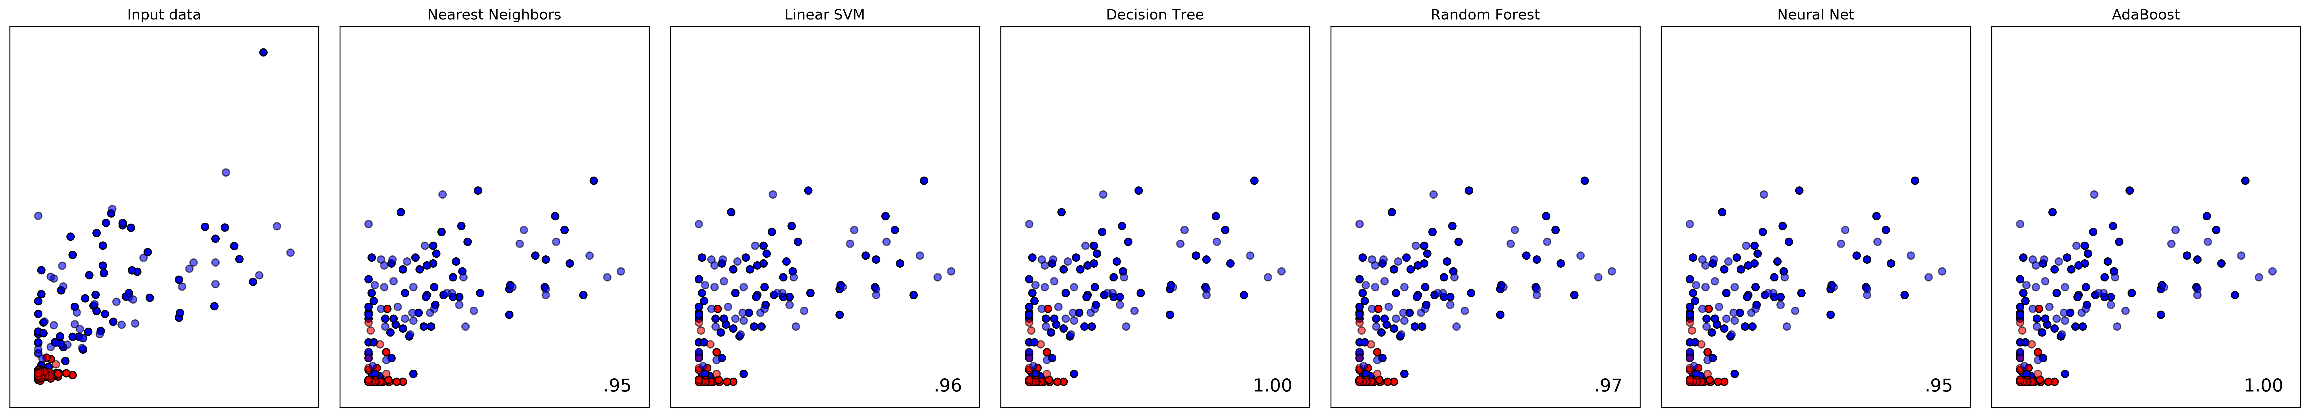
Classification Comparison Test
Why Random Forest?
Notes:
Using cross validation, we can create multiple training and test sets and average the scores to give us a less biased metric.

Slide 5
Model & Results

Slide 6
Parameter Tuning
ParamGridBuilder() – constructs a grid of parameters to search over
TrainValidationSplit() – tries all combinations of values and determines the best model
numTrees – increasing lead to better accuracy and less compute time
maxDepth - higher values lead to overfitting and increased run time of the model
maxBins - maximum number of bins used for splitting features
impurity – criterion (gini)
Notes:
Gini used since it doesn't require to compute logarithmic functions (which is calculated in entropy), which are computationally intensive.

Slide 7
Splitting the Dataset
Cross-Validation: how well a model “generalizes” (ability to accurately predict using previously-unseen data)
Training data RDD (80%)
Validation data RDD (20%)
Notes:
Split dataset into train and test sets
Train the model
Predict with both training and testing
Measure error in the predictions (in both sets)
Compare the error of the two data sets

Slide 8
Application Pipeline
Image 5
Diff. Partitions
GGB/image.csv
PRE-PROCESS
VALIDATION
PRE-PROCESSING
~65 MB image
Persist during training
TRAIN RANDOM FOREST
*New Partition
Model
CLASSIFY
on multiple machines
Results

Slide 9
Results

Slide 10
Confusion Matrix

Slide 11
The End :)
Thanks!
Questions?

