Slide 1
Classifying High-Resolution Brain Scans using Apache Spark
Emily Dutile
Asha Chen-Phang
Nate Otenti
Tristan Sweeney

Slide 2
Analysis & Feature Extraction

Slide 3
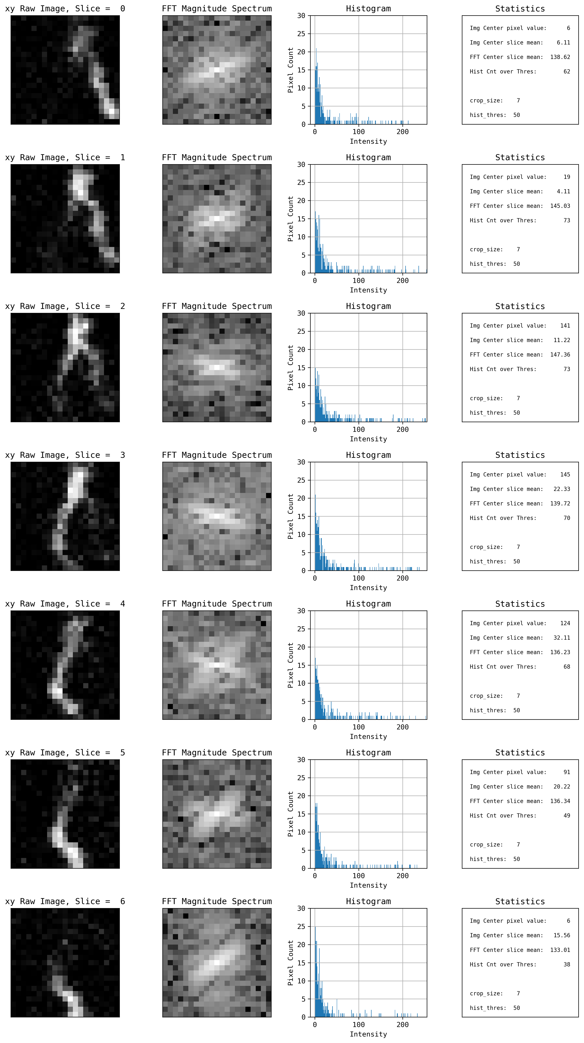
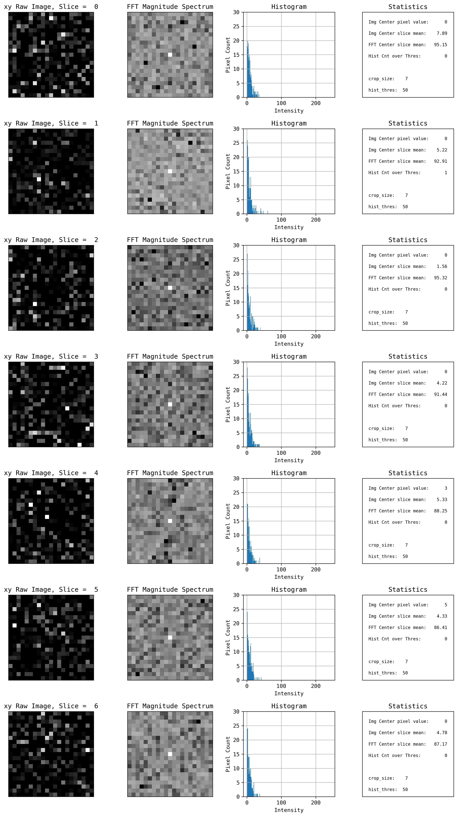
Visualizing the Data
Foreground on xy plane
1st image column
= raw
2nd image column
= 2D FFT
3rd image column = histogram
4th image column
= statistics
Background on xy plane
Notes:
Have foreground and background image
We can see the foreground image have a higher density of points with values higher than a particular threshold (50)
Foreground and background have diff characterizes – foreground has more clustering of white images on the center (in the raw image and FFT transformation)
We extracted more features based on clusters of pixels with higher values
Decided to do window around the center – analyze raw image and foreground transformation which is a representation of image.
Features selected (small feature vector): center pixel, overall # of pixels > threshold, FFT
We looked at the distribution of the data to identify class imbalance - a term used to describe when a target class within a data set is outnumbered by another target class (or classes). This can create misleading accuracy metrics, known as an accuracy paradox

Slide 4
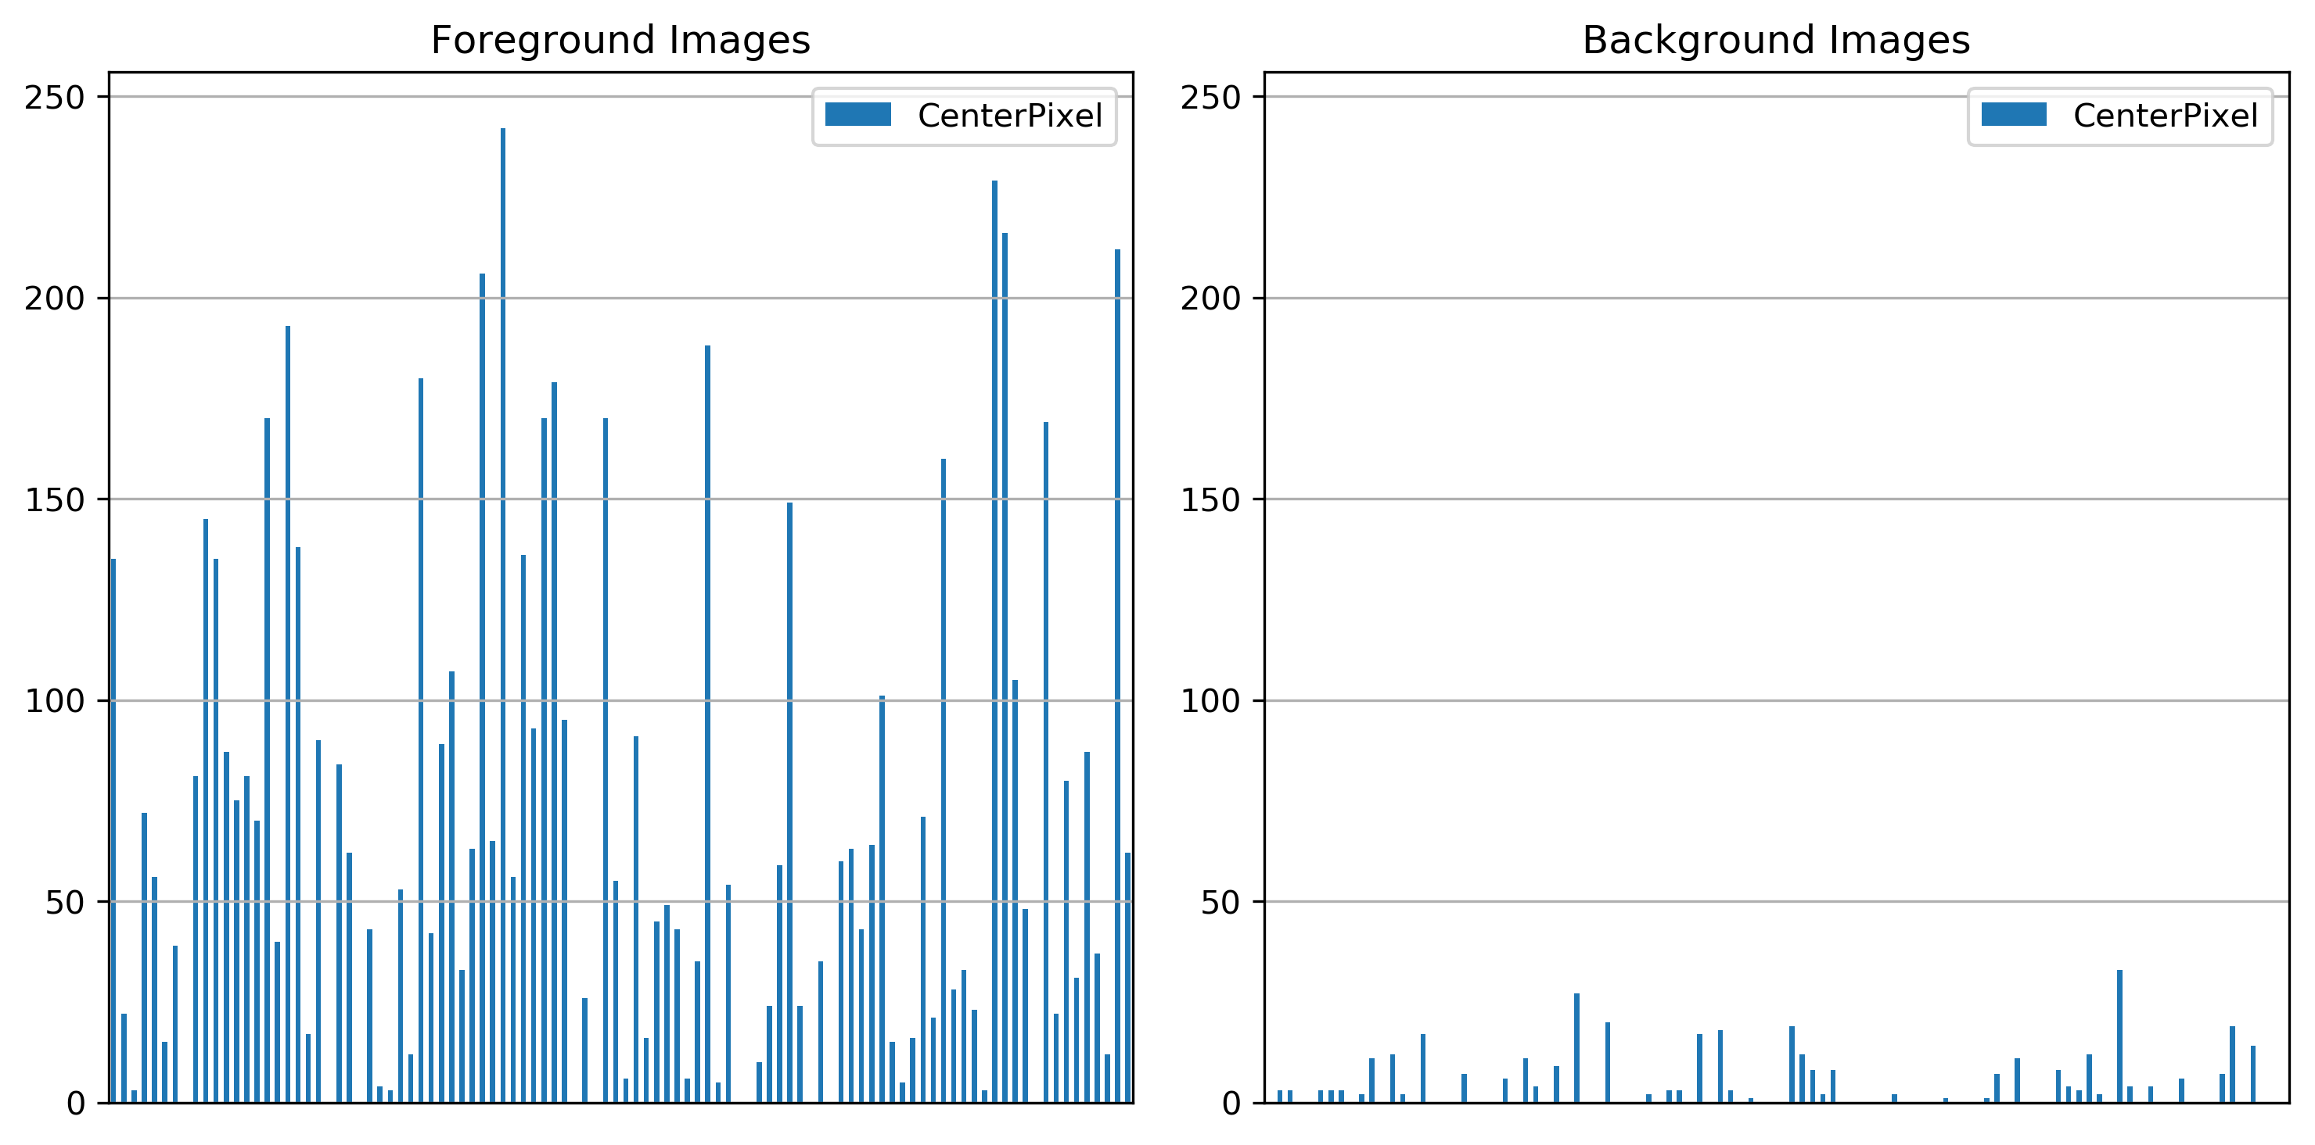
Visualizing the Data
Notes:
Decision tree and RF splits the samples on the features
Foreground image has a higher value than background

Slide 5
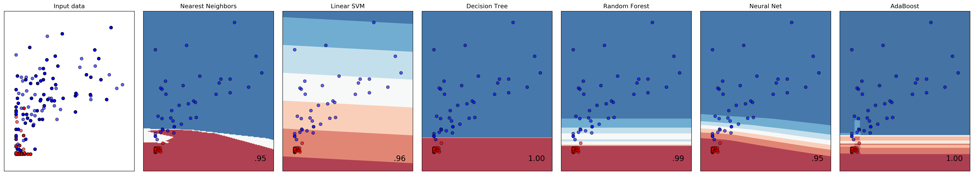
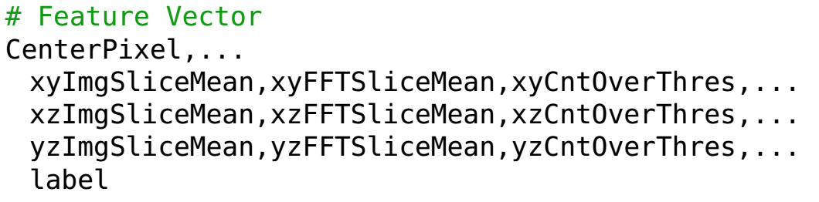
Why Random Forest?
Classification Comparison Test:
Feature Vector of Preprocess Data:
Notes:
Ran a subset of samples, Using cross validation, we can create multiple training and test sets and average the scores to give us a less biased metric.
Decision trees, RF, AdaBoost ensembles doing best
RF scaled the best with framework
Image shows subset of samples as background or foreground
Red = background, blue = foreground
Bottom image = feature vector image with preprocessed data

Slide 6
Model & Results

Slide 7
Parameter Tuning
ParamGridBuilder() – constructs a grid of parameters to search over
numTrees – increasing lead to better accuracy and less compute time
maxDepth - higher values lead to overfitting and increased run time of the model
maxBins - maximum number of bins used for splitting features
impurity – criterion (gini)
Notes:
Use following parameters – got from paramgridbuilder
Gini used since it doesn't require to compute logarithmic functions (which is calculated in entropy), which are computationally intensive.

Slide 8
Splitting the Dataset
Cross-Validation: how well a model “generalizes” (ability to accurately predict using previously-unseen data)
Training data RDD (80%)
Validation data RDD (20%)
Notes:
No form of randomization
Didn’t use cross validation from scala spark, we implemented ourselves
Use 1,2,3,4 and 6 bc we didn’t want data from test inside train (used 4 image for train, 1 for test). This way NO test sample was used during training.
Split dataset into train and test sets
Train the model
Predict with both training and testing
Measure error in the predictions (in both sets)
Compare the error of the two data sets
Trained on diff images and tested

Slide 9
Application Pipeline
Image 5
*Each image took ~25 minutes to process, dual core machine 1 worker
Split data in several Partitions
(1 job per image, map only job)
6 GB/image.csv
PRE-PROCESS
VALIDATION
PRE-PROCESSING
~65 MB / image
Persist data during training
TRAIN RANDOM FOREST
*New Partition
Model
Persist model during classification
CLASSIFY
on multiple machines
Results
Notes:
First, preprocessing was 1 job per image. It is a map only job.
Pre-processing transformations 6GB image on 65MB image
The training image are fed to the random forest model to train
We persist the image, which is a job that shuffles the data depending on the the parameters (shuffling correlated with params – it depends more on the depth & number of trees)
Classification job that has a persisted model and it receives only the image that we want to classify
because our feature vector is small we didn’t see much scaling on this one (firing up more than 4 workers isn’t necessary)

Slide 10
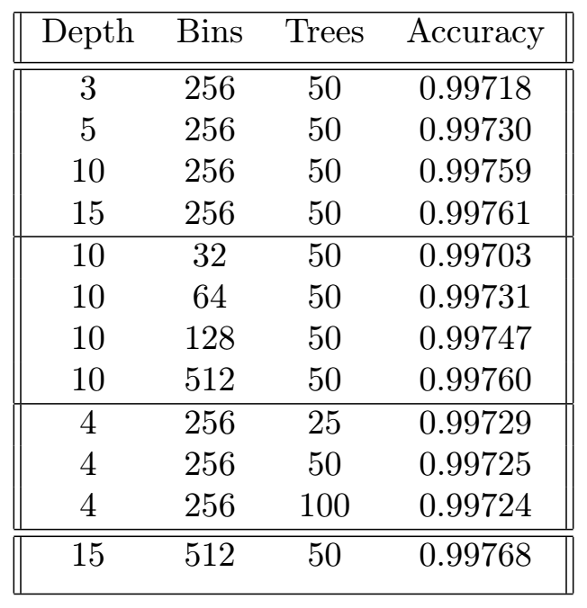
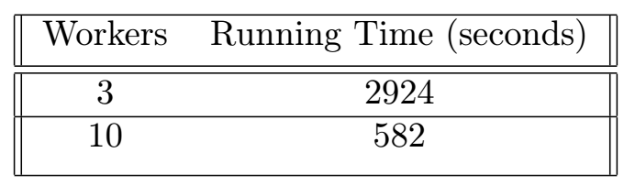
Parallel Processing Results
Varying Trees
Depth
*Increasing trees past 50 did not increase accuracy significantly
Bins
Notes:
Highlight best model
* Right table shows scaling of training
What was scaling of processing – parallel
Classification – not that parallel (small feature vectors, fit into 65MB for 1 image, then make splits on this thing). If we split beyond 4 parts, the time it takes to fire up other machines it is expensive.
* After 4 workers, which is 16 splits, no real scaling

Slide 11
Single Processor Results

Slide 12
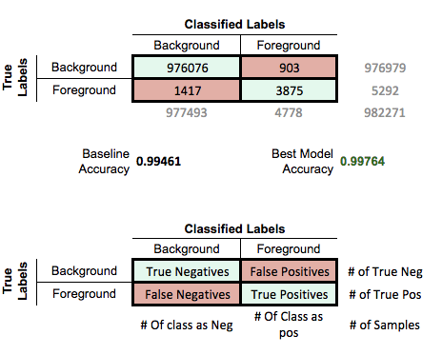
Confusion Matrix – Image 2
Notes:
IMAGE 2 = validation, train on the rest of the data.
Base accuracy = total number of samples / negatives
Best = TN + TP / total
Don’t have as good sensitivity for foreground. Getting a better sensitivity for foreground we lose on background.
Similar to classifying patients with cancer, by selecting accuracy metric – true negatives is important. Have the smallest false positive rate.

Slide 13
The End :)
Thanks!
Questions?

