Slide 1
Yelp Data Mining
Emily Dutile, Tony Tian, Xiwen Song, Vyshaal Narayanam

Slide 2
Meet the Data Miners

Slide 3
Topics of Focus
What topics are discovered frequently in reviews? Do they correlate positively or negatively to a review?
What neighborhoods in a city have the best cuisine selection?
Are some areas more upscale or divey?
Can we recommend a particular dish at a top restaurant?

Slide 4
Yelp Dataset
The dataset is given in the SQL file
4.7 million reviews
156,000 business
12 metropolitan areas
Focused on the restaurants reviews
Pittsburgh, PA (2089 restaurants, 53 neighborhoods, 43 different cuisines)
Github: https://github.com/emily-jean/yelp-data-mining

Slide 5
Methods
Preprocessing
Tokenization
Filtering
Lemmatization
Stemming
Clustering
Recommendation System
Topic Modeling

Slide 6
Clustering
K-Means
GMM
DBSCAN

Slide 7
Results
Method | Silhouette Score
K-Means (k=4) | 0.29
GMM (n_components=15) | 0.31

Slide 8
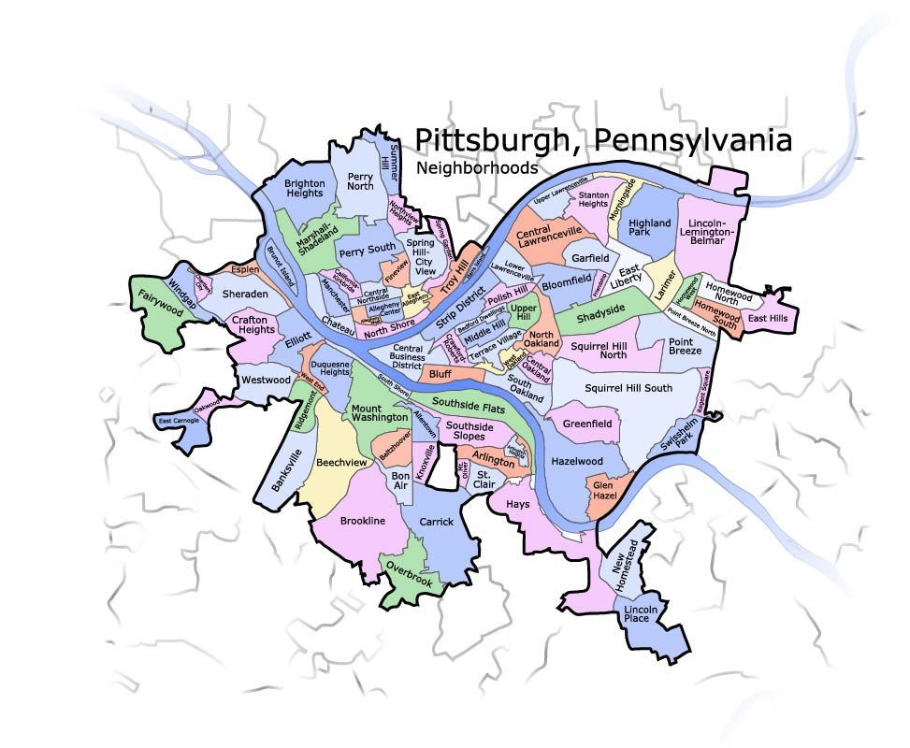

Slide 9
Recommendation System

Slide 10
Topic Model

Slide 11
Title Only!

Slide 12
Two Columns!?
Left
Two
Three
Right
Two
Three

Slide 13
Comparison!
One One Hand
But Then Again
One
Two
Three
A
B
C

Slide 14
The End :)
Questions?

