Slide 1

COGS 9 Week 1 DI
Emily Le
OH Friday CSB 114: 9:50 a.m. - 10:50 a.m. & 4 p.m. - 5 p.m.
e9le@ucsd.edu

Slide 2
Review

Slide 3
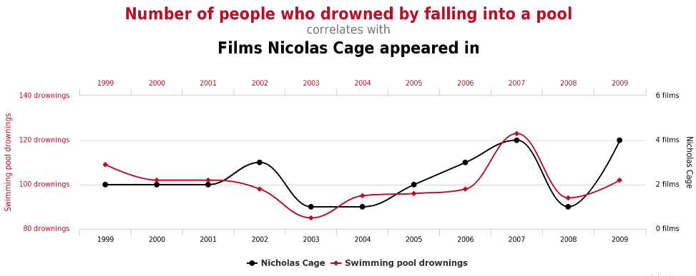
Data is Everywhere
Explore and Analyze
Question results
It’s a process!
Intuit about Data - the bigger picture
Trends are not causation
Example: Influenza and Slime molds

Slide 4
What can be Data?
Information that is not yet interpreted.
Anything we can see, hear, smell, touch, taste is “data”.
Data can be transmitted from one place to another and stored

Slide 5
Kinds of Data
Experimental:
Data collected as part of a hypothesis-driven experiment
Examples: clinical interventions, brain imaging, IQ testing, LHC, chemical sampling, etc.•
Observational (or retrospective or secondary):
Data just “sitting around”
Examples: Human genome, web data, types of species, etc.
Notes:
Experimental and Observational

Slide 6
Information
Data placed into a context that can be understood.
Information allows us to make decisions

Slide 7
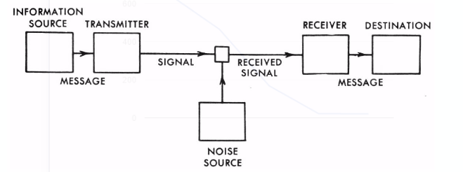

Slide 8
Information Theory
How can perfect communication be achieved over an imperfect, noisy communication channel?
Use more reliable components
Stabilize the environment
Reduce noise sources
These are all costly and/or outside our ability

Slide 9
Information Theory
Shannon information:
Uncertainty
The number of possible messages.
Surprise
Likelihood of a message.
Difficulty
How do you transmit the message

Slide 10
Python Basics
Emily Le

Slide 11
What we will be covering
What is it
How to use Python in Data Analysis
Variables
Methods
How to load in molecules
Importing libraries
Documentation
For loops
If/else statements
List & dictionary

Slide 12
What is Python
Created to be easy to learn
Tools useful for data analysis
https://www.codecademy.com/learn/python
Recommended you go through lessons 1 - 8 if you are a beginner

Slide 13
Documentation
https://docs.python.org/3/library/statistics.html

Slide 14
Variables
They are similar to math variables, you set them equal to something

Slide 15
Types of Variables
Numbers
String
List
Tuple
Dictionary
For sure covering first three

Slide 16
Variable: Number
variable1 = 7
7
variable1

Slide 17
Variable: String
b = “hello”
hello
b

Slide 18
Variable: Numbers
a = 10
c = a + 1
a = c

Slide 19
Variable: Numbers
a = 10
c = a + 1
a = c
10
a

Slide 20
Variable: Numbers
a = 10
c = a + 1
a = c
10
11
a
b

Slide 21
Variable: Numbers
a = 10
c = a + 1
a = c
11
11
a
b

Slide 22
Variables
a = 7 # commenting code
b = "hello"
c = a + 1 # this prints...
a = c # this prints...

Slide 23
Using Print with variables
Demo!

Slide 24
Truth Tables!
or
0 | 0 | False
0 | 1 | True
1 | 0 | True
1 | 1 | True

Slide 25
Truth Tables!
and
0 | 0 | False
0 | 1 | False
1 | 0 | False
1 | 1 | True

Slide 26
Boolean Expressions
Equality test | ==
or | or
and | and
not | not
Less than | <
Greater than | >
Less than or equal to | <= Math operator then =
Greater than | >=

Slide 27
Math
Parentesis | ( )
Addition | +
Subtraction | -
Multiplication | *
Division | /
Modulus | %
Exponent | **

Slide 28
Order of Precedence
https://docs.python.org/3/reference/expressions.html

Slide 29
First how to write conditional statements
Basic Format:
if expression1: statement(s) elif expression2: statement(s) else: statement(s) ***Notice indentation matters***

Slide 30
Understanding code
number = 100
if (number != 99):
print ("This number is not 100")
else:
print("The value of number is 100!")

Slide 31
Understanding code
variable1 = 33
variable2 = 34
if variable2 < variable1: print(“Blue”) elif (variable1 + variable2) < variable1: print(“Green”) else: print(“Yellow”)

Slide 32
Understanding code
ageOne = 5
ageTwo = 15
if variable2 == variable1:
print("They are the same age!")
else:
print("One person is: " + str(ageOne))
print("Another person is age: " + str(ageTwo))

Slide 33
If / else
varA = 2
varB = 0
if varA > 6:
varA = varA + 1
print (varA)
elif varA <= 6 and varB < 5: # what would it happen if it was “or”
varB = varB + 1
varA = 7
print (varA)
print (varB)
else:
print("Last statement")

Slide 34
Variables
Always define the variable you are using
Meaningful variable names!
Comment your code, so when you go back to it, it will be easy to understand
useCamelCase instead of _ or a space
Do NOT start variable names with a number (okay if you spell it out)
Do NOT use keywords (i.e. or, and, etc)

Slide 35
So far we have been declaring variables before the if statements
What happens if we define the variables inside the conditional statements (if, elif, else)?

Slide 36
Will this code work?
mesa = "8"
if (mesa == 8):
miramar = mesa
print(miramar)

Slide 37
How about now?
mesa = "8"
if (mesa == 8):
miramar = mesa
print(miramar)
print(miramar)

Slide 38
This was variable scope!
Within each “block” of code the variables have a limit on where they can be seen by the rest of the code

Slide 39
Python Lists
https://docs.python.org/3/tutorial/datastructures.html

Slide 40
List
iceCream= ['chocolate', 'strawberry', “vanilla”]
listOfNumbers= ['1', '2', “3”]

Slide 41
Loop
myList = ['hey', 5, 'd']
for x in myList: # x can be named anything
print(x) # call it when printing

Slide 42
for x in range(0, 5):
print(x)
print ('Final x = %d' % (x))
Hint: Range is inclusive of first number and exclusive of second number

Slide 43
Demo

Slide 44
Challenge: If / else and loops
Use your print statements!
Now let’s a write a program that determines even and odd numbers by looping through the numbers 1 - 100

Slide 45
I’ll put the powerpoint and notebook on my public repo
github.com/emily-le/Python_Workshop/

