Slide 1
Tic tac toe but make it super complicated
Emily Sear

Slide 2
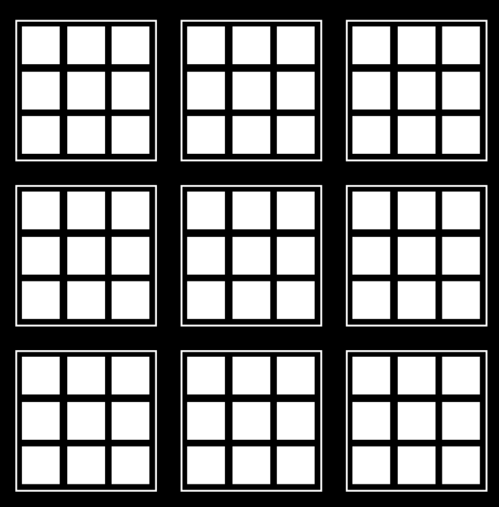
An Extreme Version of Tic Tac Toe…
Rules:
Boxes are randomly chosen
Have to win a small box for it to count in the game

Slide 3
Plan
Create GUI
Make a working 2 human player tic tac toe game
Make the tic tac toe game extreme
Make a working human vs. computer extreme game
Add reinforcement learning to the computer side
Hook the now extreme human vs. computer up to the GUI

Slide 4
Reinforcement Learning
Trains with 2 computer players
Takes a board hash to store procedures
Aka the board in a string format
The reward is at the end of the game
High reward if won (+1)
Negative reward if lost (-1)
Small reward if tied (+0.2)

Slide 5
Reinforcement Learning (continued…)
Set each game to different level of learning
The number of iterations would equal box square num * 10,000
1 → 10,000 iterations
2 → 20,000 iterations…..
9 → 90,000 iterations
1
2
3
4
5
6
7
8
9

Slide 6
Conclusions
Need at least 20,000 iterations to have a good opponent
Over 40,000 iterations they are all kind of the same
Reinforcement learning doesn’t do well with randomness

Slide 7
Questions?

