Slide 1
Exploring Player Archetypes in League of Legends
Emily Yu
New York University
Notes:
Hi everyone, today we’ll be exploring player archetypes in e-sports, particularly the popular game, League of Legends.
…
As for the problem that we’ll be taking a look at, it stems from the fact that in games like these, there is often a “metagaming strategy” that is formed as players become familiar with the game. By this, it means that players will often selectively choose their characters in game based on this general knowledge of the optimal selections. By doing so, they theoretically maximize their chance of winning, which is the ultimate goal of each game.
For some background, League of Legends is a game where 5 players from two different teams face off, leveling up and controlling champions from ground up within the League atmosphere to destroy the other team’s base.
In ranked games, games that give you a rating within the game, Riot has established a team selection that establishes five different roles - one player in the top of the map, one in the middle of the map, two at the bottom of the map, and one who will roam freely around the map.
From this, the problem that we’ll be talking about within the League of Legends meta is whether players really tend to fall into the specific roles defined by the game creators in their actual games.
…
From the domain knowledge that I posses as a long-time player, and with the general knowledge that comes of the game, we should expect that player roles will be fairly standard across the board, between professional and non-professional players, as these roles have been defined by the game creators.
A consideration made, though, was that perhaps the performance of non-professional players will vary more than those who are professionals, due to the difference in skill levels.
…
Moving on to the data that was used in this study, there is currently no comprehensive dataset available freely for League of Legends match and player data. This is likely because, with the immense amount of constant change, there is no one right way to represent data, and Riot provides a comprehensive, flexible, and easily available API that users can access information. Therefore, it is likely not necessary for players to create datasets for their own purposes.
However, this ended up to be an issue in this case. As the problem that I intend to address was to analyzing data on a large scale, for 150 million players across League’s 13 different servers, we require much more data upfront to get started. Therefore, the datasets that I used were primarily to select which players to analyze, of which I chose to analyze the Korean server simply due to Korea’s dominance in the gaming sector at this moment. As for professional data, I used another dataset to pull the names of the players who participated in the 2019 Spring Tournaments across multiple regions, to ensure that I had a comprehensive list of the professional field. However, as the pro scene is constantly changing, it is necessary to note that this may not be accurate for the following seasons, as the only professional data analyzed was for that season.
…
The primary technique that I used in this case was the k-means clustering algorithm. Although the original intent was to provide a recommender system, for the scope of this study there was no need to insert new players, thus ruling out the interest of using a kNN instead.
Within k-means, I used PCA to more easily allow us to cluster data, as well as computing scores tailored for this study, to allow us to analyze the data numerically.
…
From this, we came to see a couple of major points.
First of all, in terms of pro-player performance, the clusters were much less defined. As exhibited by the non-professional players performance, the division between clusters and the variation among players was much greater than those of the professionals. This variation can both be attributed to the raw greater amount of non-professionals sampled, but also due to the variation in skill of the players sampled.
The professional clusters tended to all converge towards a tightly compacted sector, in which does not exist in the non-professional clusters. For a highly skilled non-professional, the reason that separates them from being a professional is likely due to a gap in their skill. The strong association between professional clusters likely demonstrates the extent to which professionals have reached a skill bar that leaves little room for error, unlike those of their non-professional counterparts.
The role error for each professional player cluster was much lower than that of non-professional player performance, likely due to less ambiguity between players in terms of their roles, as well as each having a distinct playstyle during tournament games as opposed to standard ranked games.
…
With the above results, it is clear that there are a set of archetypes that exist for the general League population, but players are more similar and less archetypes for higher skill levels. This is exhibited in the difference in cluster strength, as well as the accuracy of classifying players into certain roles within clusters.
Further research could explore the possibility of classifying different play styles within the clusters themselves, and using those playstyles to emulate professional players. That being said, the playstyle of non-professionals will be much less coherent than those of professionals, who are trained to work well together.
Implementing a system such as this could allow for a better matchmaking system, which could apply to players looking to construct teams that emulate a certain game experience. By matching players whose playstyles are more naturally compatible, this approach could help lower the amount of toxicity between players in-game, resulting in an overall more positive experience playing the game for all players.
…
That being said, thank you for your time. Please feel free to email me at the email listed on the screen if there are any questions, and I hope that some insight was learned upon this game.

Slide 2
Overview
Problem
"Over the years, players (the crowd) have formed a metagaming strategy, which is widely adopted" (1).
Are there player roles that deviate more often from the "playstyle" that other players tend to box themselves into?
playstyle; analyze performance in game,
objective control
lane dominance
etc.
roles refer to the five League of Legends standard draft picks;
TOP
AD CARRY
SUPPORT
JG
MID
Notes:
1 https://dl.acm.org/doi/abs/10.1145/3102071.3102081

Slide 3
Overview
Hypothesis
player roles will be fairly standard across the board, as non-professional players tend to follow the example set by professional players
non-professional players will vary in terms of gameplay more so than professional players, as they are less skilled
Notes:
1 https://dl.acm.org/doi/abs/10.1145/3102071.3102081

Slide 4
Data Used
*data is used to sample the most recent comprehensive games and act as a representation of pro-gameplay
Where from?
Data was collected from the Riot Games API, the most comprehensive source of game information.
10,000 games of Korean-server data
2019 Spring professional game data*
Games chosen for analysis chosen from lists of game information in Kaggle datasets
How was it used?
Game reference ID's off of Kaggle were sent to Riot's API to acquire a comprehensive result of each game and player
numerical and categorical data processed separately
columns without enough information dropped

Slide 5
Modeling Techniques Used
Goal: confirm assumptions that the five archetypes defined by Riot Games exist
K Means++
classification of items all at once
no need to insert new items, so no kNN
Principal Component Analysis - PCA
used within k-means
scale data into 2d space

Slide 6
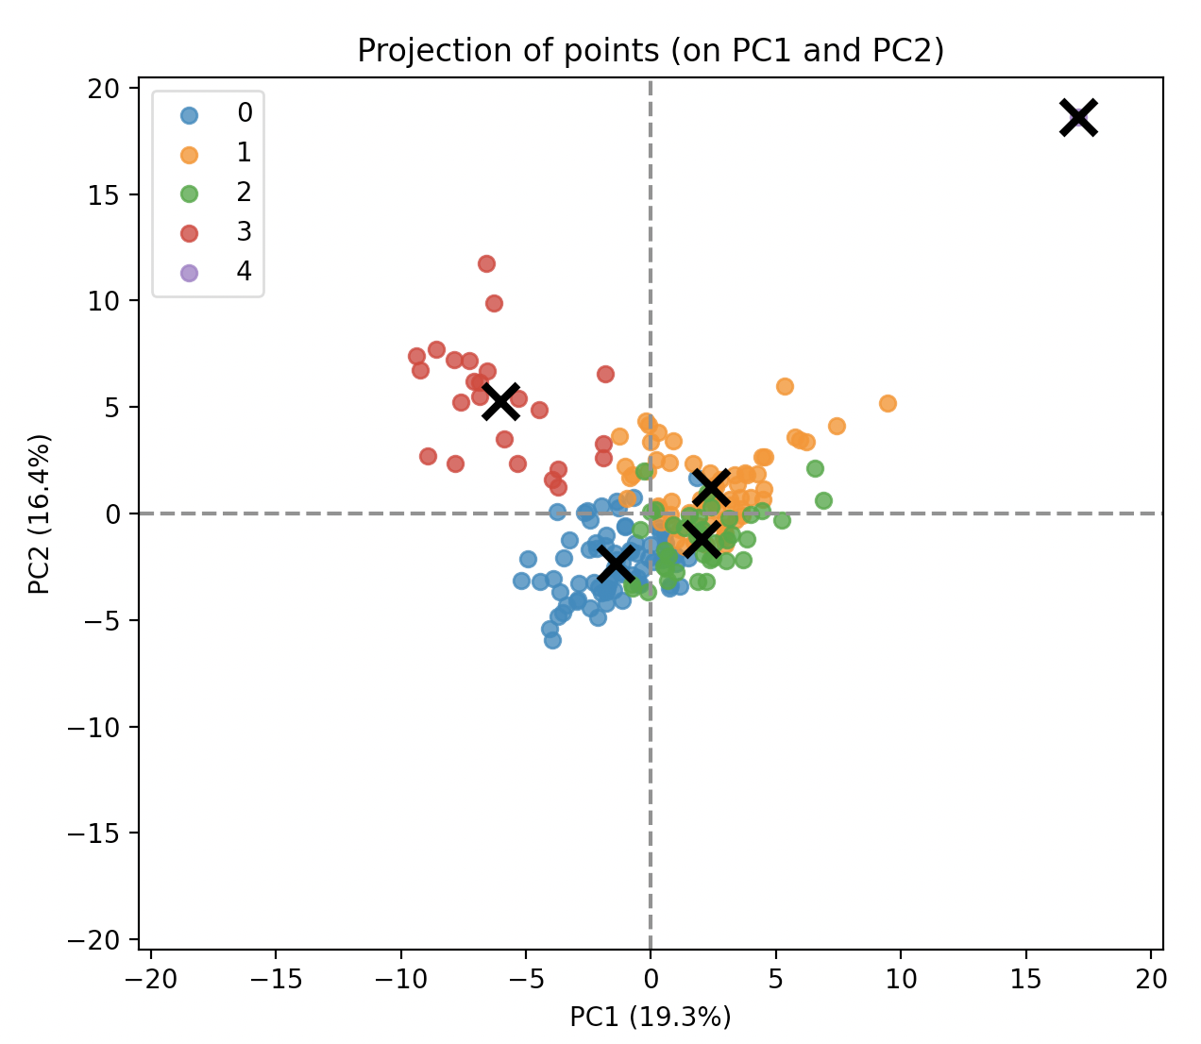
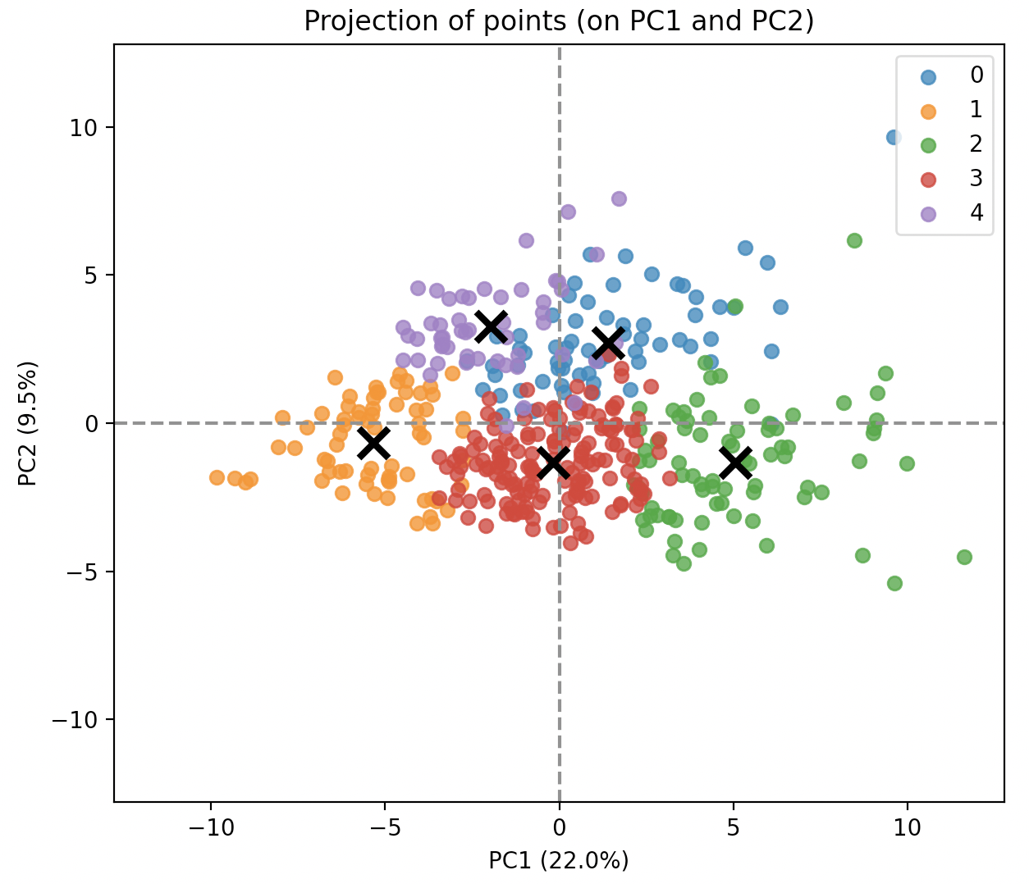
Conclusions
professional play
clusters less defined
cluster roles defined clearly
non-professional play
clusters varied
clusters clearly separated by role
cluster statistics based on roles varied
methods of playing role varies

Slide 7
Applications
different playstyles within clusters for each role
recommendation of players within clusters
emulate team composition
reduce toxicity in game

