Slide 1
ISA Extension
Emily Johnson
CS 4200 Computer Architecture

Slide 2
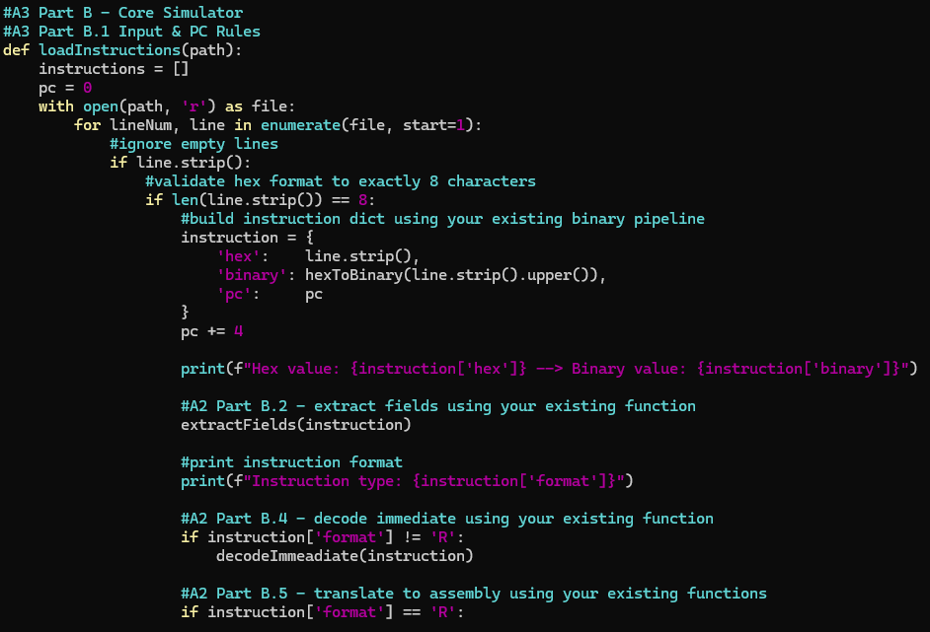
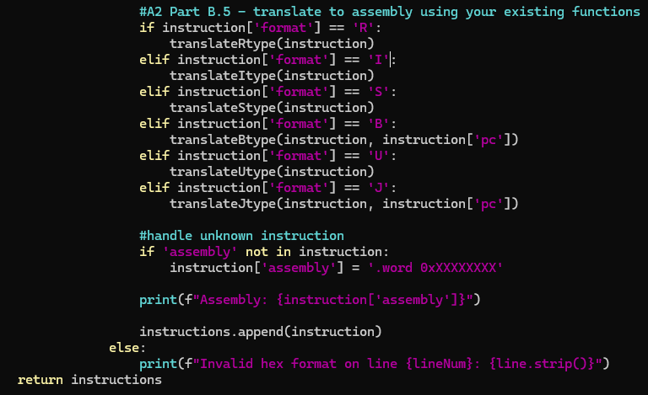
Decode

Slide 3
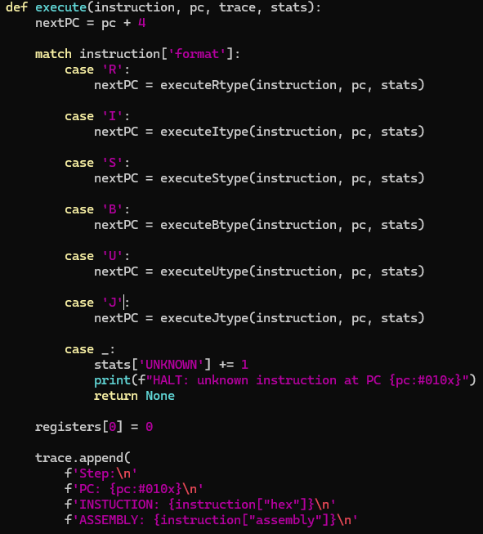
Execute

Slide 4
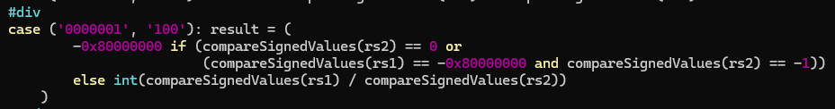
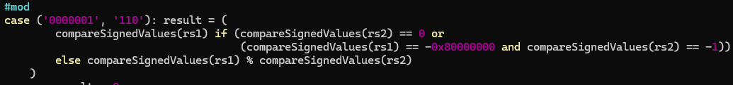
Added Instructions
Mul
Div
Mod

Slide 5
Demo
hex_inst.txt
00500093 → addi x1, x0, 5 0 + 5 = 5
00300113 → addi x2, x0, 3 0+3 = 3
022081B3 → mul x3, x1, x2 5 * 3 = 15
0220C1B3 → div x3, x1, x2 5/3 = 1
0220E1B3 → mod x3, x1, x2 5 % 3 = 2

