Slide 1
InVEST 3.16 (new settings bar)

Slide 2
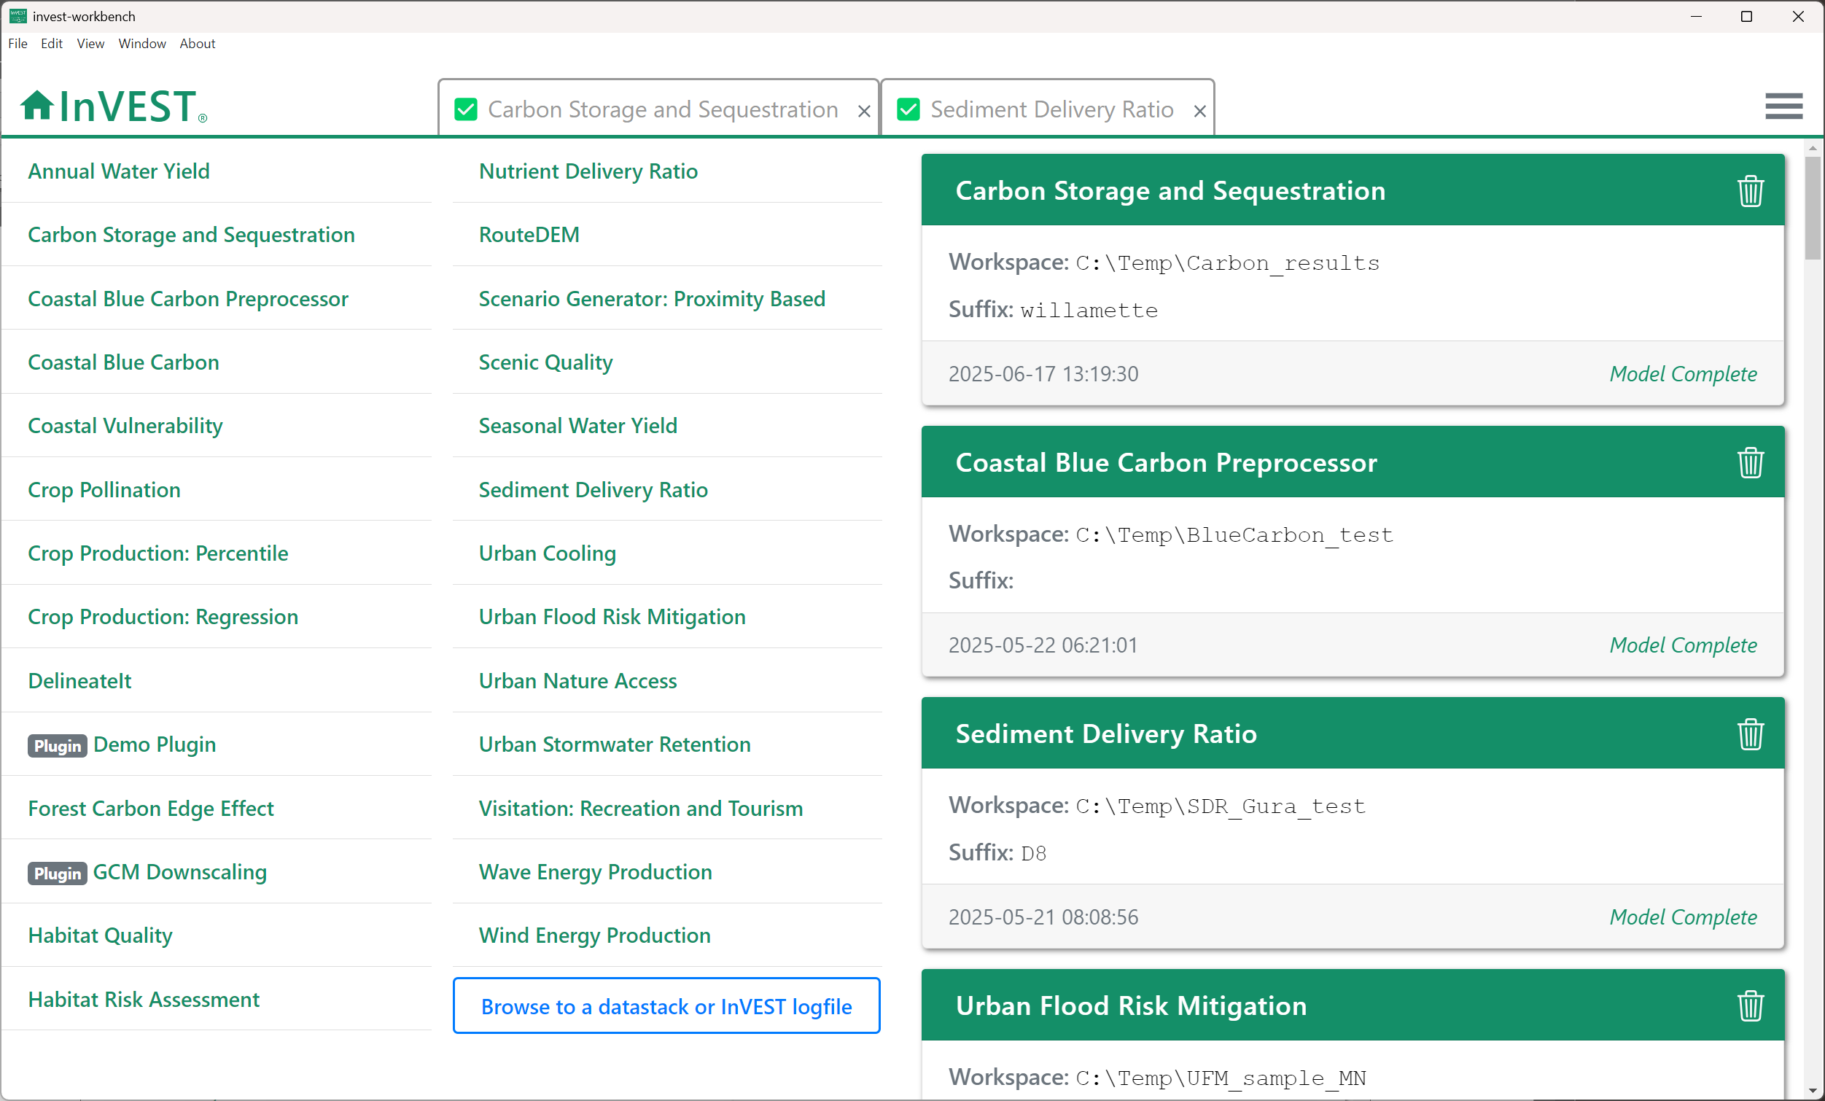
Home
screen
Previous
model runs
Settings/Plugins
Sample data
InVEST models

Slide 3
Settings/Plugins
Sample data

Slide 4
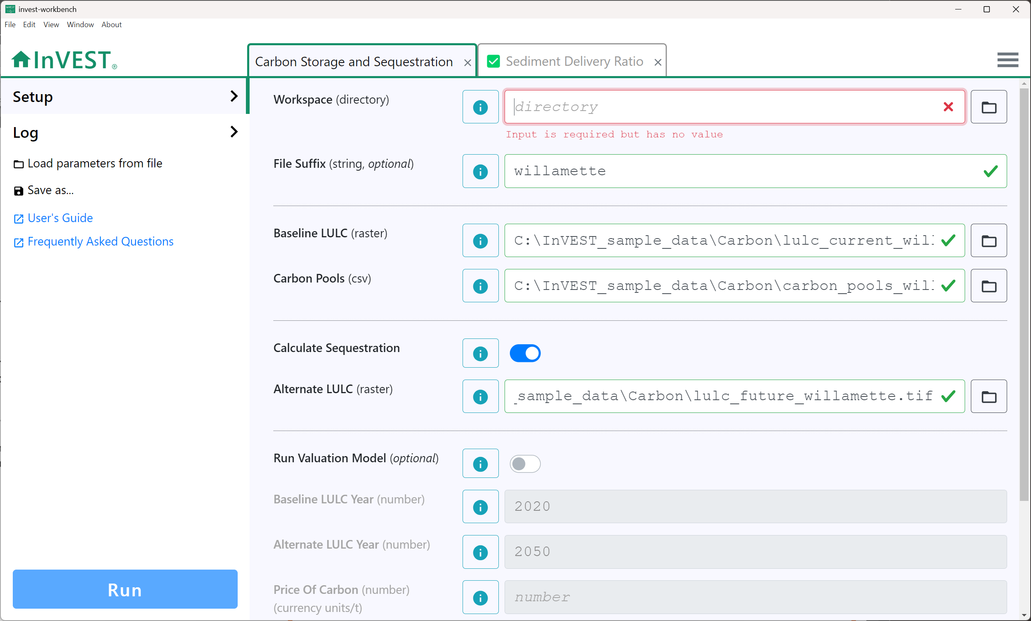
Tabs for multiple
model runs
Model
inputs
Load parameters and optionally data from a saved file
Save parameters and optionally data to a file
Link to User Guide
chapter for this model
Link to Community Forum posts related to this model
Click to run
the model

Slide 5
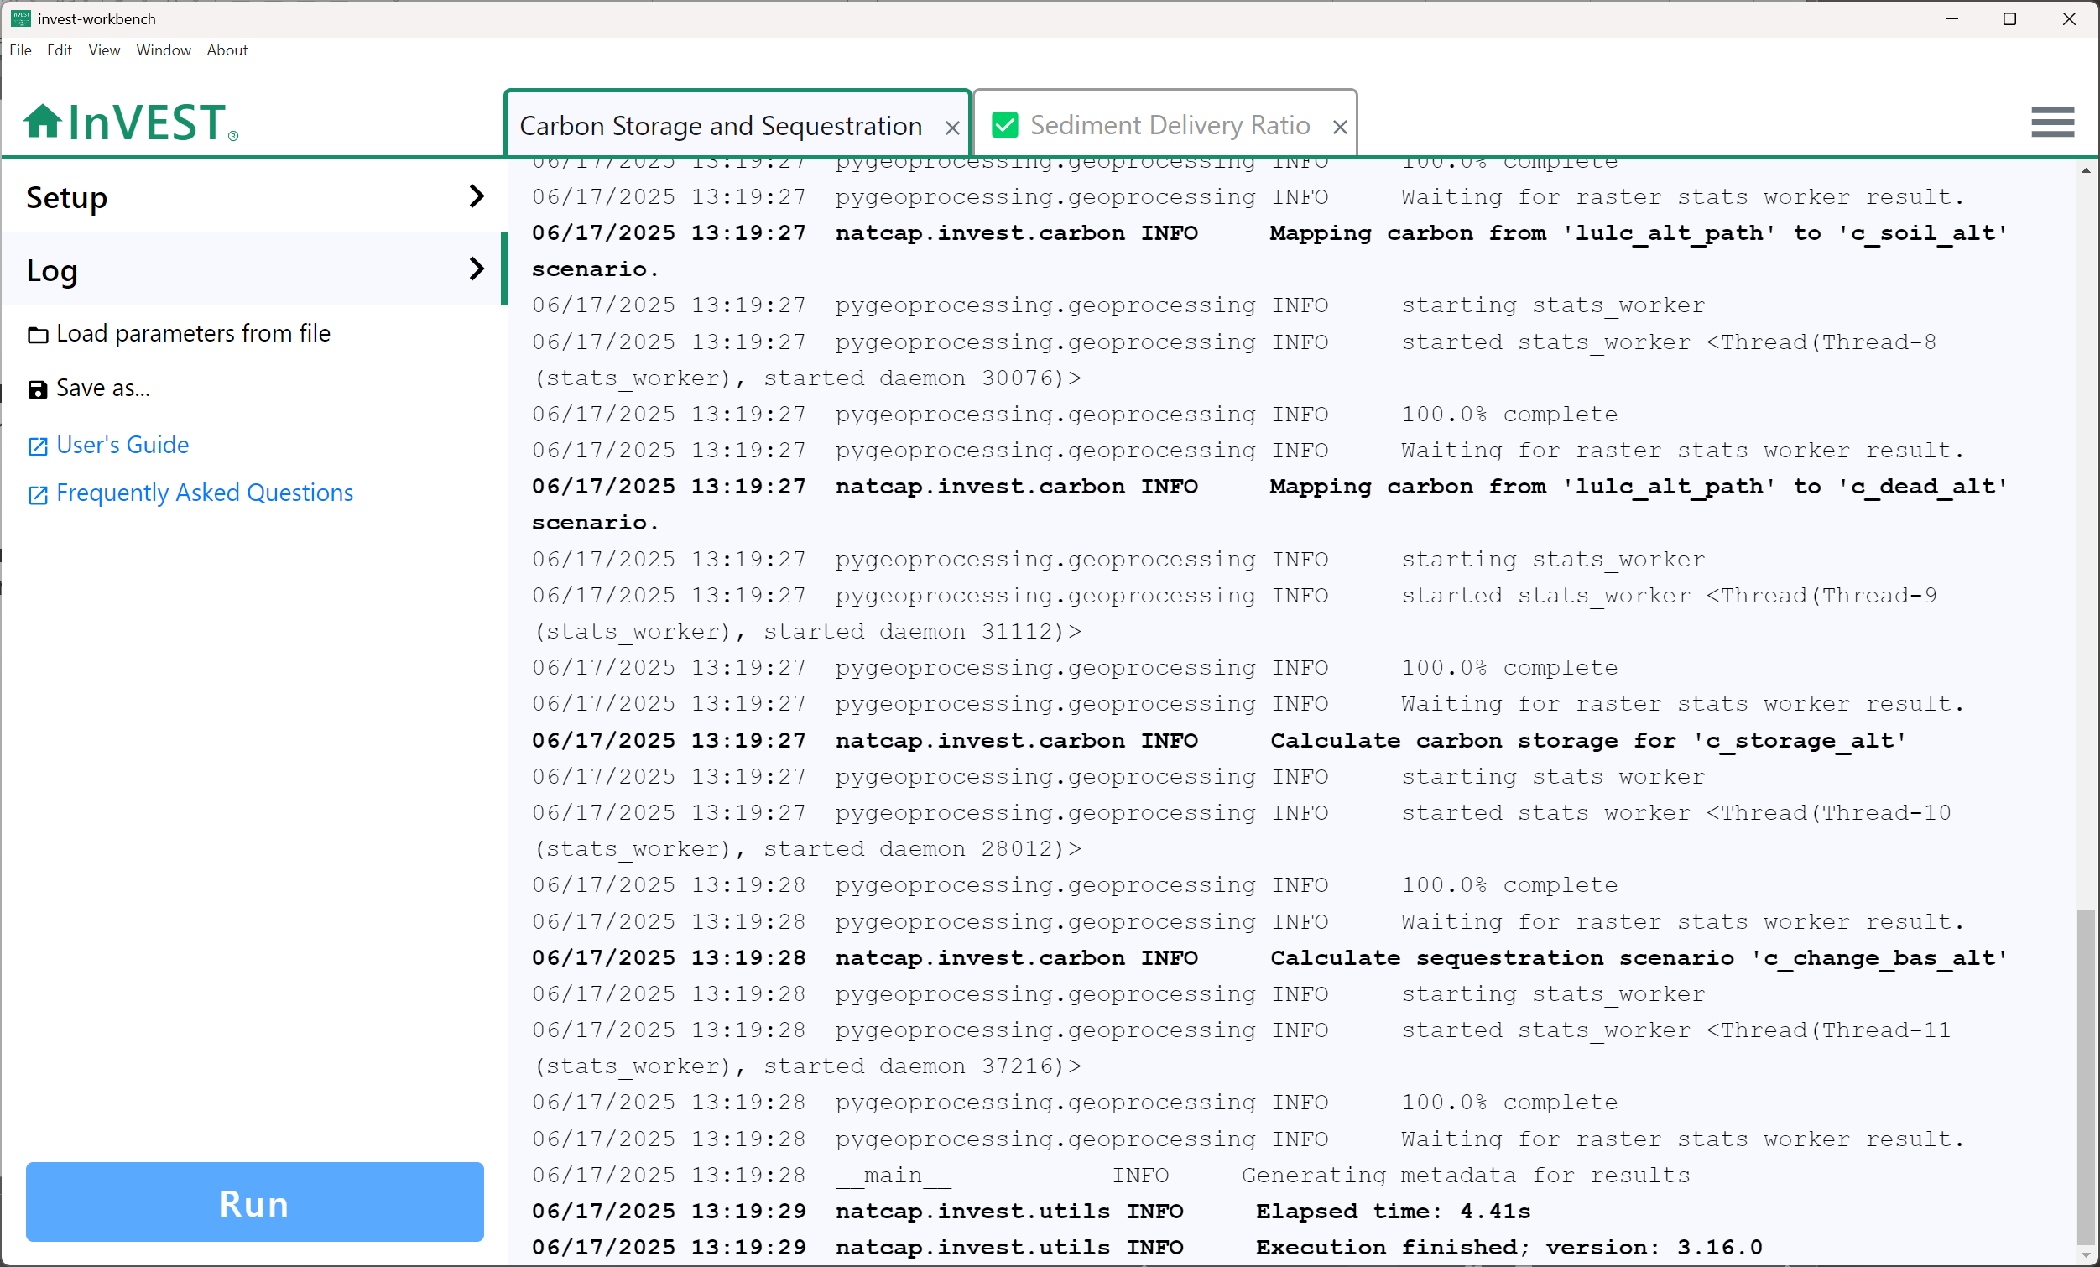
Logging
messages
Return to the model input screen
View logging messages for this model run
View
results

Slide 6
InVEST pre-3.16

Slide 7
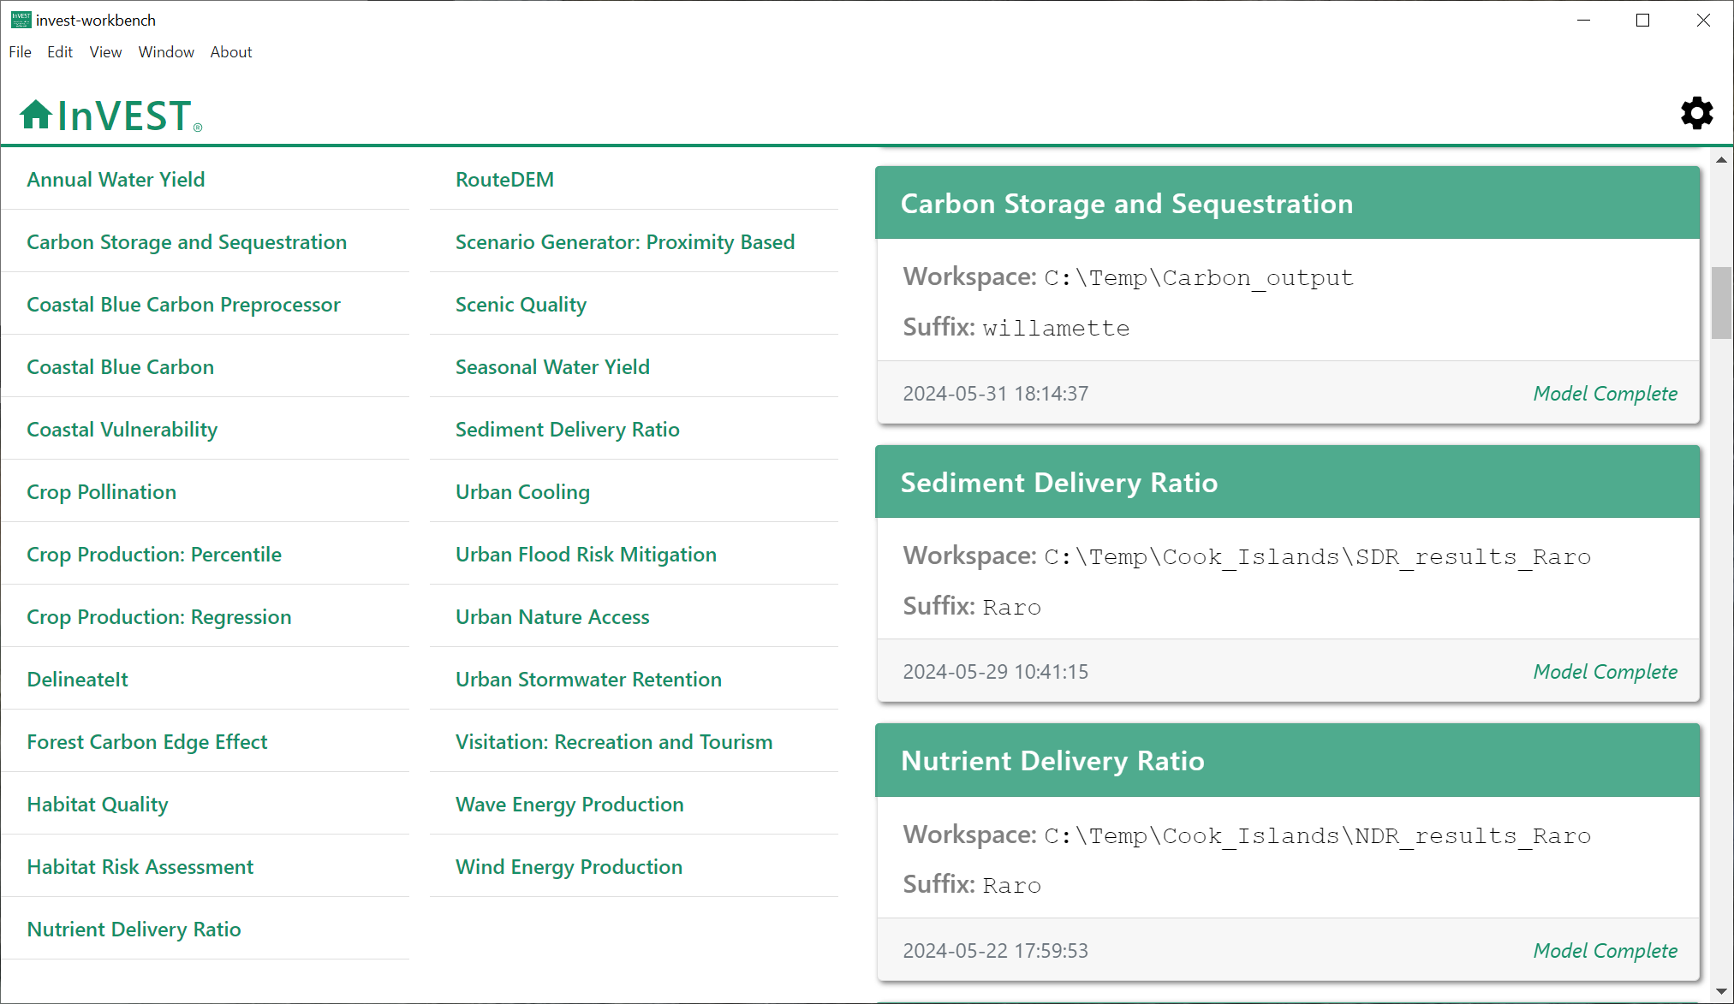
Home
screen
Previous
model runs
Settings/
Sample data
InVEST models

Slide 8
Settings/
Sample data

Slide 9
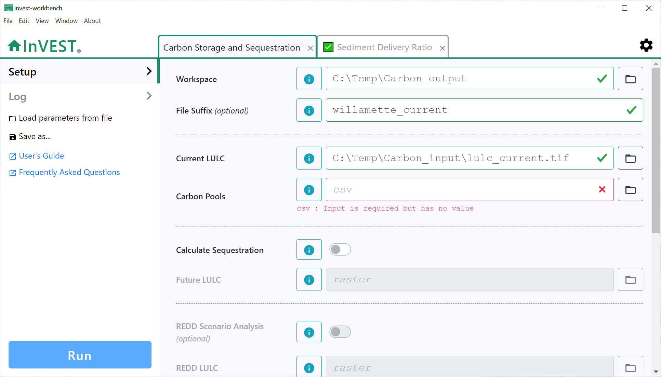
Tabs for multiple
model runs
Model
inputs
Load parameters and optionally data from a saved file
Save parameters and optionally data to a file
Link to User Guide
chapter for this model
Link to Community Forum posts related to this model
Click to run
the model

Slide 10
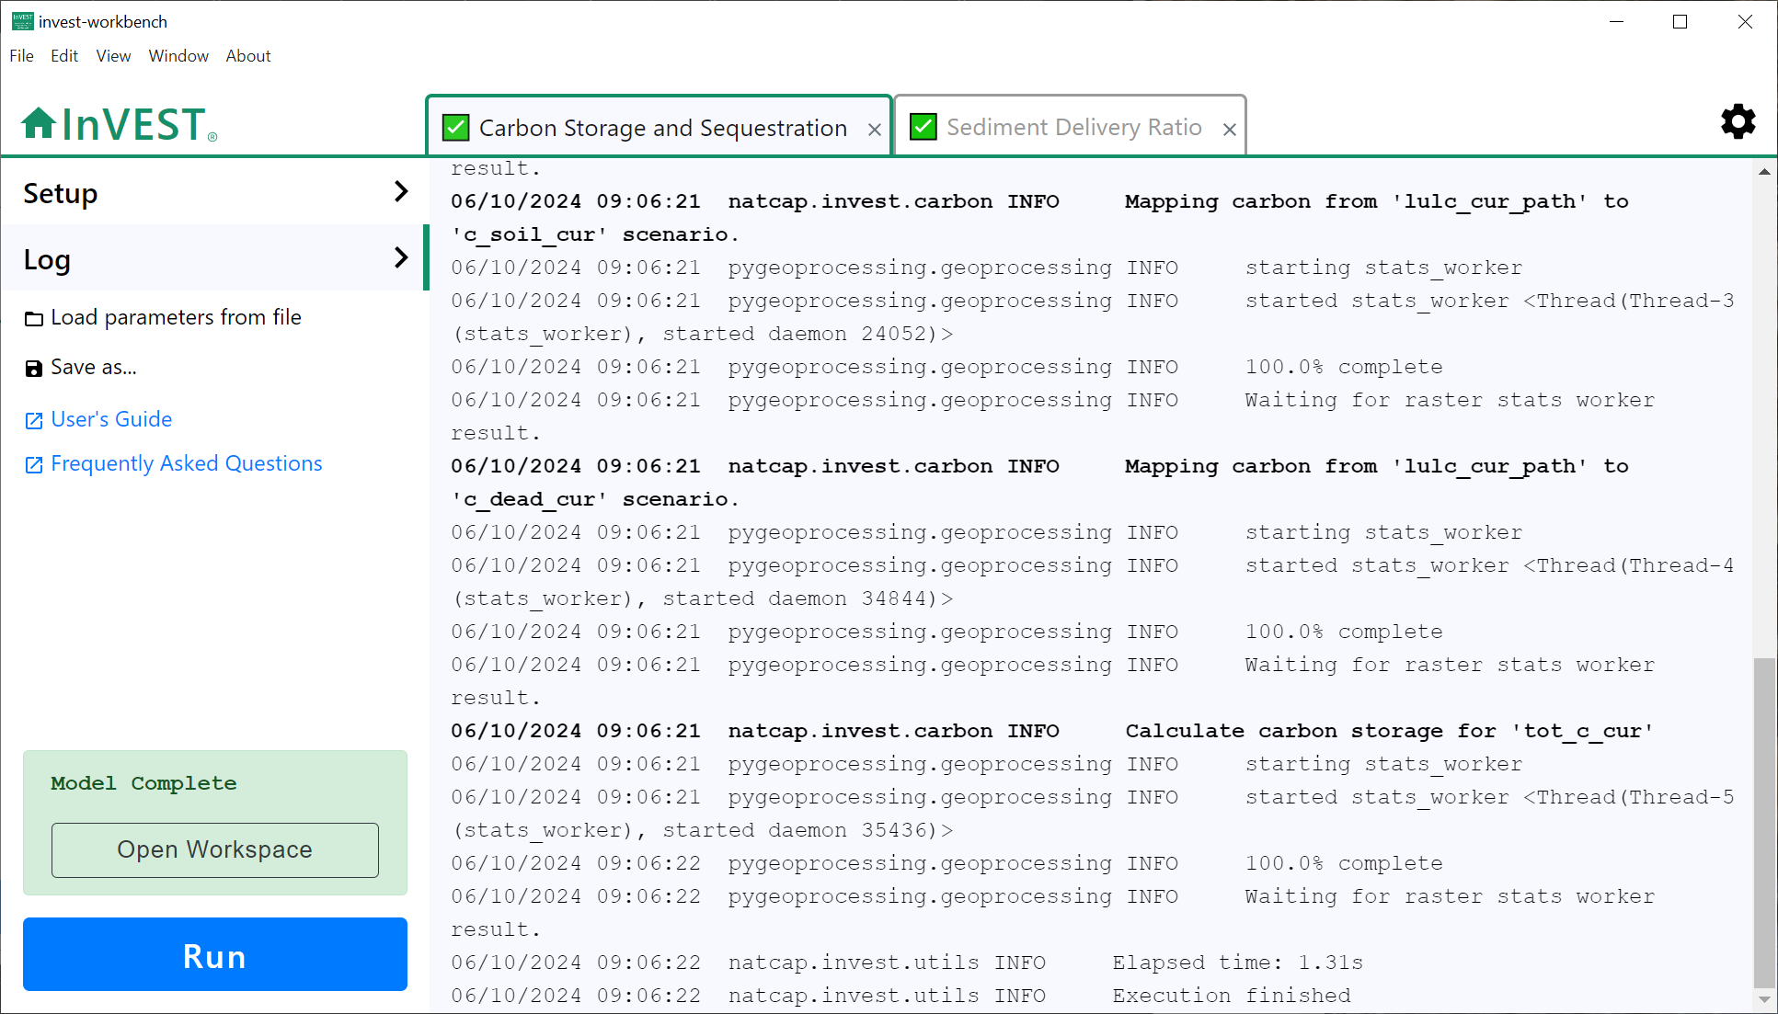
Logging
messages
Click to return to
the model input screen
Click to view logging messages for this model run
Click to view
results

