Slide 1
EV Charging Demand & Forecast Dashboard
Goal:
Build an end-to-end EV Charging analytics and forecasting demand dashboard using SQL, Python, and Tableau
Key Components:
Data ingestion + cleaning
Feature engineering and forecasting model (SARIMAX)
BigQuery SQL pipelines
Interactive Tableau dashboard

Slide 2
Technical Stack
Languages & Tools
Python (Pandas, Statsmodels)
BigQuery SQL
Tableau
JupyterLab / VS Code
Skills Demonstrated
Time-series forecasting
Data visualization
SQL data modeling
KPI development
Dashboard design

Slide 3
High Level Data Metrics
From the full dataset (five cities):
Total Sessions: 1,320
Total Energy Delivered: 53,474 kWh
Total Revenue: $29,767.78
Dynamic Filters: KPIs update instantly based on city + date selection
These KPIs form the primary operational view of overall EV charging activity.

Slide 4
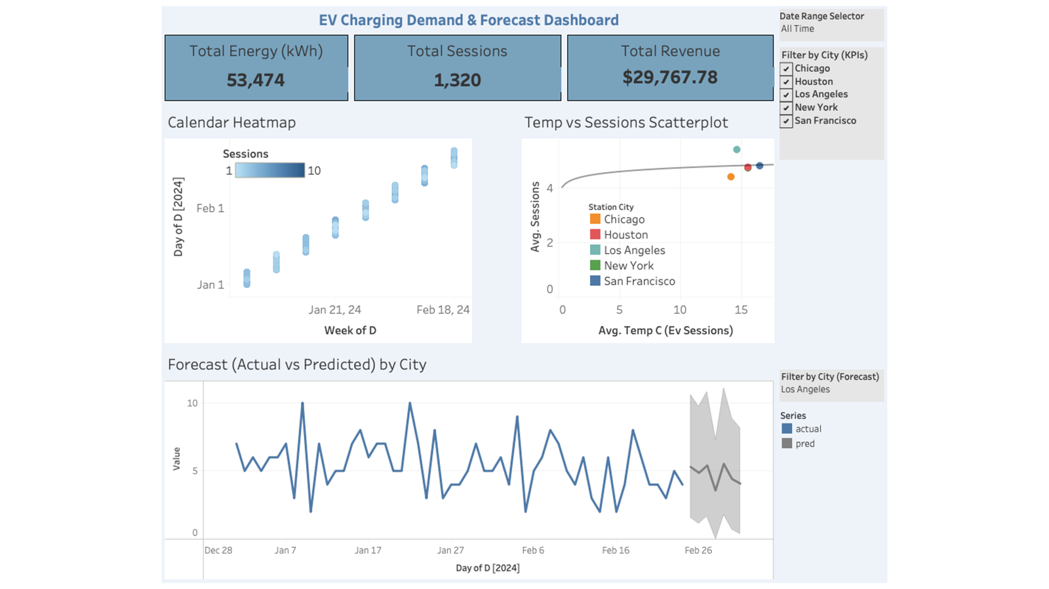
Dashboard Screenshot

Slide 5
Key Findings
Daily charging demand varies significantly across cities, with mid‑week usage peaks
Higher temperatures show a slight positive relationship with charging sessions
Forecast model captures short-term demand trends, with increasing uncertainty further out
Los Angeles and San Francisco show stable activity, while Chicago and New York exhibit strong weather sensitivity

Slide 6
Future Enhancements
Expand Forecasting Models
Explore Prophet, Gradient Boosted Trees, or LSTM models for longer-range predictions and improved seasonality capture
User Behavior Segmentation
Cluster charging patterns by user type (commuter, long-distance traveler) to identify behavioral profiles and tailored recommendations
Deeper Environmental Modeling
Incorporate humidity, precipitation, or seasonal variables to improve forecasting accuracy under different weather conditions

