Slide 1

RU FORMAL

Slide 2

WHAT IS RU FORMAL
Our company is a global formal-wear rental service for university students and young professionals. Across campuses worldwide, career fairs, networking events, and industry panels require professional attire. Instead of purchasing expensive outfits for one-time occasions, customers can rent high-quality suits, dresses, and accessories from us at affordable rates.

Slide 3

CUSTOMER VALUE PROPOSITION
Our company ensures high‑quality formal wear in excellent condition, with collections that keep up with modern styles fitting regional trends.
After each rental, items go through a standardized inspection and care process ensure they are always in good condition
In addition to clothing rentals, we offer formal accessories along side clothing rental—to meet a wide range of needs.
We provide fit guidance and basic tailoring services where available, making our service accessible and responsive.
Customers can place orders online, choose campus pickup or local delivery in supported cities, and access prompt assistance through localized customer support.
We make professional dressing simple, affordable, and reliable for students around the world.

Slide 4

VISION STATEMENT, MISSION STATEMENT, CORE VALUES
Vision statement：Brightness to the brightest
Mission statement：Provide cost-effective, stylish formal clothing to university students worldwide through a student-oriented rental service.
Core values：
We keep prices fair so dressing professionally is accessible to all students.
We offer a wide selection of high‑quality formal clothing to meet diverse needs and occasions, delivered cost‑effectively through our rental service.
By prioritizing rentals and garment care, we help reduce material waste and promote more sustainable consumption.
We provide meaningful internship and employment opportunities for students and recent graduates, supporting skill development and early career growth across our global locations.

Slide 5

FINANCIAL AND STRATEGIC OBJECTIVES
Financial Object：
Target annual revenue of $300,000–$600,000 in FY2027 as a growing, student-run business operating across multiple international campuses.
Achieve ROIC of 12%–15% by the end of Year 3 through disciplined inventory turns, regional cleaning partners, and lean logistics.
Reach annual net income of $60,000–$100,000 (10%–14% net margin) by the end of Year 3 while keeping pricing student-friendly.
Strategic objectives：
Achieve 300–500 weekly active viewers across our global social channels within the first month, focusing on 3–5 priority campuses.
Reach 10%–15% market share in each target campus/city by the end of Year 3, with localized pricing and partnerships.
Acquire 80–120 new customers per month during the first year of expansion, driven by campus ambassadors, referral programs, and event pop-ups.

Slide 6

CORPORATE SOCIAL RESPONSIBILITY KEY INITIATIVES AND RATIONALE
Implement sustainable sourcing (organic cotton, recycled fabrics)
  Rationale: Reduces waste and carbon footprint, strengthens trust with community stakeholders, and differentiates brand with credible sustainability practices.
LGBTQ+ friendly selection of clothing
  Rationale: Expands reach to a large, diverse customer base; signals inclusion; aligns with global campus values and advocacy groups.
Hire university students (including work-study where available) in each market
  Rationale: Creates equitable access to paid experience, builds pride and advocacy among students/alumni, and improves service through a mission-aligned workforce.
Gender equality in hiring, pay, and leadership pathways
  Rationale: Ensures fair representation and equal pay for equal work, widens talent pipeline, and enhances decision quality and brand perception across global campuses.
Environmental protection through circular operations
  Rationale: Extend product life via repair/refurbishment, offer garment take-back and recycling, and set targets to cut water/energy use in cleaning—lowering costs and emissions while meeting global sustainability expectations.

Slide 7

NEW PRODUCT/SERVICE
Offer optional delivery and pickup for rentals across all operating regions for an added fee, providing consistent, convenient service to customers globally while accommodating local logistics and pricing.

Slide 8
NATIONAL EXPANSION DECISION, APPROACH, AND RATIONALE
Raise Capital
Emphasize diversified, region-aware funding: combine founder capital with small seed rounds from alumni/angel networks across regions, plus grants for sustainability and student entrepreneurship.
  Maintain strategic control: use non-dilutive funds (grants, revenue-based financing) and capped SAFE notes to preserve decision-making while scaling internationally.
  Unlock economies of scale: aggregate cross-region purchasing, centralized tech/operations, and multi-market supplier contracts to reduce unit costs.
  Capture full earnings uplift: retain majority ownership to consolidate profits from all regions, reinvesting in market launches, localization, and compliance.
National expansion offers strong, staged growth if executed carefully. Brand-driven categories reward early, consistent presence across regions; scaling internationally helps establish credibility before competitors localize similar models. To align with our expansion approach, we will:
  Rebrand once for a unified identity with localized adaptations ( sizing, cultural cues).
  Centralize tech, supply, and data while partnering locally for last-mile ops, student hiring, and community engagement.
  Budget for higher operating costs and compliance, funded via diversified, region-aware capital, while preserving strategic control.
  Leverage economies of scale (multi-market suppliers, shared playbooks) to offset costs and protect margins.

Slide 9
GLOBAL EXPANSION EXAMPLE: CANADA
Opportunity
Easy entry into the market
Culturally similar to the U.S.
Stable political and economic environment
Strong IP protection, low corruption, and low crime rates
High urban concentration for efficient launch
Strong university network for campus-focused growth
Challenges
Well-established market with strong incumbents
May need to adjust products to Canada’s style or preferences
Higher logistics costs across large geography
Seasonal demand shifts impacting inventory mix
Rationale
Canada offers the best balance of opportunity and safety; its stable democracy, cultural similarity to the U.S., and strong legal protections make it the most attractive option for RU Formal’s first international step, with dense urban hubs and campus channels enabling efficient, low-risk scaling.

Slide 10
EXPANSION STRATEGY
Customization
For RU Formal, tailoring the rental clothing line for the Canadian market is the most suitable approach. Canadian students participate in similar professional events as U.S. students, but may prefer different fits, colors, and styles that reflect local preferences and cultural norms. By customizing, RU Formal can strengthen its brand positioning in a respectful, inclusive, and globally consistent way. This approach is more appealing to new customers, helps capture attention quickly during market entry, and supports a stable, scalable presence across regions through localized assortments, sizing, and messaging aligned with our global standards.
Do-it-Yourself (DIY)
Rationale
Strategic control: Retain full control of the business, set direction, and choose strategies that best reflect our goals, values, and global standards.
Agility: Pivot quickly without external approvals, enabling faster response to market feedback across regions.
Profit retention: Keep a greater share of earnings versus joint ventures or partnerships, allowing reinvestment in product, technology, and international expansion.
Financing flexibility: Greater optionality to pursue non-dilutive funding and region-aware capital while preserving governance control.
Cost discipline: Maintain low operational costs through centralized systems and phased market rollouts, aligning with a scalable global operating model.
The DIY strategy provides the highest degree of control, agility, and profit retention, supporting disciplined global expansion while safeguarding brand consistency and financial sustainability.

Slide 11

KEY POSITION:
SALE ASSOCIATES
Role focus: Daily customer service, merchandising, and inventory per global SOPs
Responsibilities: Assist customers; after-sales support; maintain store; receive/restock; collaborate; uphold brand, ethics, and data privacy
Qualifications: Flexible schedule; strong communication; 1+ year team/customer service; digital literacy; stand/move stock safely
Compensation: $25K base; 2% commission; health/dental (per local policy); performance rewards; employee discount; L&D access
Recruiting: Handshake, LinkedIn, careers page, in-store QR sign, local boards; inclusive description and EEO
Selection: Resume screen; “Why hire you?”; multi-round interviews; final role-play; references; structured rubric; manager decision
Global alignment: Standardized tools, local law compliance, inclusive workplace, consistent onboarding and CX

Slide 12
EMPLOYEE MOTIVATION INITIATIVES
Top Sales Associate: Monthly revenue contest; $1,000 bonus; ethical, team-aligned.
Growth & Development: Job enlargement/enrichment/rotation; clear promotions; on/off-campus training; mentor coaching.
Regular Feedback: 15-min biweekly check-ins on strengths, improvements, goals, and well-being.
Culture & Recognition: Team lunches, milestone/degree celebrations; recognition to boost morale and trust.
Mind Breaks: One 30‑min mindfulness break per shift (in addition to lunch) to reset and refocus.
Global Notes: Apply per local laws/culture; ensure fairness, inclusion, and data privacy.

Slide 13
ANNOUNCEMENT FOR INFORMING EMPLOYEES OF DEPARTURE OF
TWO KEY EMPLOYEES
Team,
As you may have already heard, 2 of our valued employees have decided to part ways with our company and resigned. It was clear to us that one of the main reasons for this was dissatisfaction with our management practices. In an effort to address this issue, we have decided to implement more programs and initiatives that will benefit you, our highly-valued employees. Starting next month, we plan to start a monthly “Top Sales Associate” competition where the sales associate with the most revenue made from sales each month will be rewarded with a $1,000 bonus in the form of a check. Next, we plan to establish more job enlargement, job enrichment, job rotation, and promotional opportunities. There would also be In/off-campus training with other companies. Here, the managers and associated professors would provide personal development and mentorship opportunities. We also plan on implementing daily “Mind Breaks”. This would be a daily, 30 minute break, in addition to your 30 minute lunch break. You could use this time to give your mind a break and come back replenished for the rest of your shift. You could enjoy a nice walk around our building or help yourself to the various snacks that will be supplied in our communal kitchen. Starting as-soon-as-possible we also intend to spend more one-on-one time with you, our employees. Furthermore, we plan to implement feedback sessions. They would be 15 min, every 2 weeks, where a manager will give you a performance analysis on what can be done better and what is being done well. Here, we will also check up on your mental space. Lastly, we want to make sure that you, our employees, feel appreciated. We plan to have more small get-togethers to celebrate individual work anniversaries and academic achievements, as every one of our employees is like family to us, and we want to make sure they feel the same way. As saddened as I am about the departure of our 2 fellow employees, I look forward to implementing these initiatives and fostering a more productive, motivating work environment. Our goal is to create an environment where everyone feels empowered, supported, and excited to be part of our journey. If you have any questions or suggestions, please do not hesitate to reach out to me directly or share your thoughts during our next team meeting.
Thank you for your continued dedication and hard work. Together, we will continue to grow and thrive as a team.
Best regards,
RU Formal Management Team

Slide 14

KEY DRIVERS AND ACTIONS SELECTED TO ACHIEVE HIGH LEVELS OF
EMPLOYEE ENGAGEMENT
Leadership & Management
  Leaders invest in growth, link employee/org success, build trust.
  Managers design meaningful jobs; provide autonomy, resources, training; recognize great work.
Culture
  Trust and respect; open communication; collaboration; flexibility; pleasant conditions; strong reputation.
HR Practices
  Fair reviews; competitive comp/benefits; work–life balance; DEI; safe workplace; employee support.
Development & Well‑Being
  Professional development (training, mentorship, certifications).
  Wellness programs (physical, mental/emotional).
  Recognition with ongoing feedback and rewards.

Slide 15

SIPOC FOR KEY PROCESS
Suppliers: Low-cost formalwear wholesalers; student second-hand; dry cleaners/univ. laundry; tailors; logistics; university networks.
Inputs: Formalwear inventory; storage; cleaning supplies/services; booking platform (web/app/manual); marketing materials.
Process:
  Source inventory
  Launch booking platform
  Promote to students
  Take requests
  Process payment/confirm
  Deliver or pick-up
  Return, inspect, clean, prep
Outputs: Rented attire; enhanced student experience/after-sales; revenue; positive social impact (CSP).
Customers: Students; student orgs; university staff; general public.

Slide 16
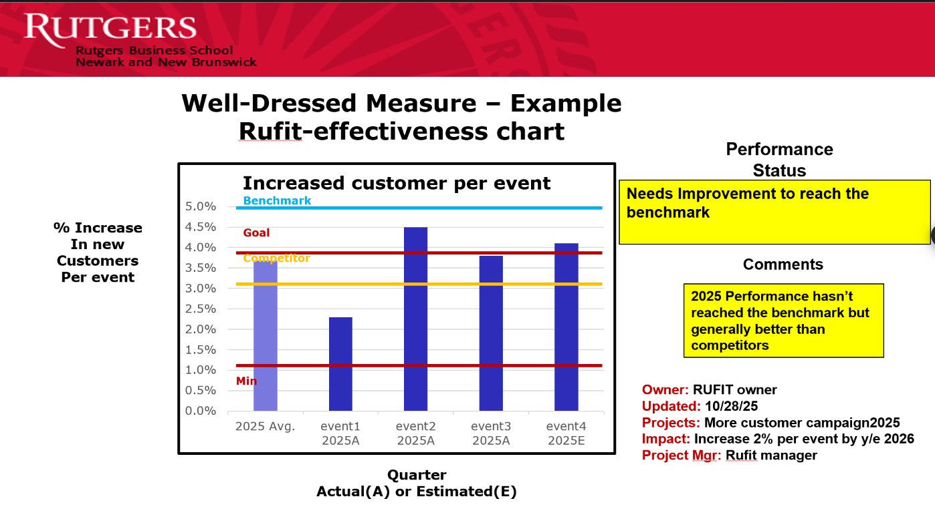
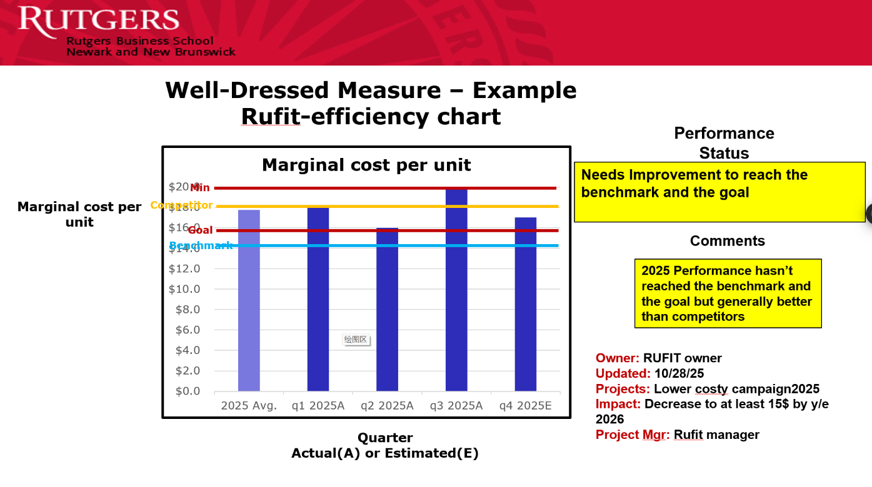
EFFECTIVENESS MEASUREMENT CHART AND EFFICIENCY
MEASUREMENT CHART

Slide 17

DESCRIPTION OF KEY INITIATIVE TO IMPROVE THE PROCESS
Focus: Effectiveness
Current: 2025 below benchmark, but ahead of competitors
Target: +2% per event by end of 2026 to reach benchmark
Actions:
  Marketing: Boost social, pre/post‑event campaigns; partner more with student orgs to expand reach.
  Feedback: Digital kiosks and QR/receipt surveys for real-time satisfaction insights and rapid fixes

Slide 18
TEAM DECISION ON WHETHER TO SELL THE BUSINESS OR NOT AND RATIONALE
Decision: Proceed with the sale.
Rationale:
  Strong offer with a significant premium that maximizes shareholder value.
  Structured transition via 3-year consulting ensures continuity and knowledge transfer.
  Access to greater capital and scale supports global growth potential.
  Reduces risk amid uncertain global economic conditions.
  Limited long-term impact on workforce; most roles are short-term student positions.
  Enables reinvestment into new ventures that can create jobs and broader global impact.
Commitments:
  Follow a fair, transparent process for all stakeholders worldwide.
  Provide equitable severance and job placement support.
  Honor existing international agreements and uphold CSR standards.

Slide 19
TEAM DECISION ON WHETHER TO SELL THE BUSINESS OR NOT AND RATIONALE
Decision: Proceed with the sale.
Rationale:
  Strong offer with a significant premium that maximizes shareholder value.
  Structured transition via 3-year consulting ensures continuity and knowledge transfer.
  Access to greater capital and scale supports global growth potential.
  Reduces risk amid uncertain global economic conditions.
  Limited long-term impact on workforce; most roles are short-term student positions.
  Enables reinvestment into new ventures that can create jobs and broader global impact.
Commitments:
  Follow a fair, transparent process for all stakeholders worldwide.
  Provide equitable severance and job placement support.
  Honor existing international agreements and uphold CSR standards.

Slide 20
WHY OUR BUSINESS HAS BEEN SUCCESSFUL
Clear Value Proposition
  Affordable, convenient formalwear rentals; bundles (attire + tailoring + cleaning + delivery)
  Positive social impact via access and reuse (CSR/CSP)
Strong Operations
  Diversified suppliers; partner cleaning/tailoring; reliable logistics and campus networks
  Simple cycle: source → book → fulfill → return/clean → redeploy (high utilization)
Customer Focus
  Core segments: students, orgs, staff; event-driven demand (career fairs, formals)
  University partnerships amplify reach
Improvement Discipline
  Target: +2% per event by end-2026 to meet benchmark
  Levers: social + pre/post-event offers; ambassadors; streamlined booking; bundles
  Feedback loop: QR/kiosks; 48-hour response
Governance & Impact
  Transparent, stakeholder-aligned decisions; honor agreements; fair employee support
Strategic Optionality
  Proven premium buyer interest validates model
  Transition/consulting preserves know-how; capital enables reinvestment and job creation

Slide 21


THANK YOU

