Slide 1


Slide 2
Agents

Slide 3


LangChain
Agents are one of the newest (and most experimental) parts of LangChain, but they offer huge potential for LLM based applications.
By combining what we already learned about Model IO, Data Connections, and Chains, we’ve already approached applications that are similar to agents that allow us to create more robust applications, Agents takes this one step further with the ReACT framework.

Slide 4
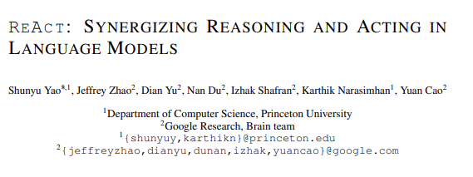
LangChain
At their core, agents allow LLMs to connect to tools (e.g. Wikipedia, Calculator, Google Search, etc…) and conduct a structured approach to complete a task based on ReAct: Reasoning and Acting.

Slide 5
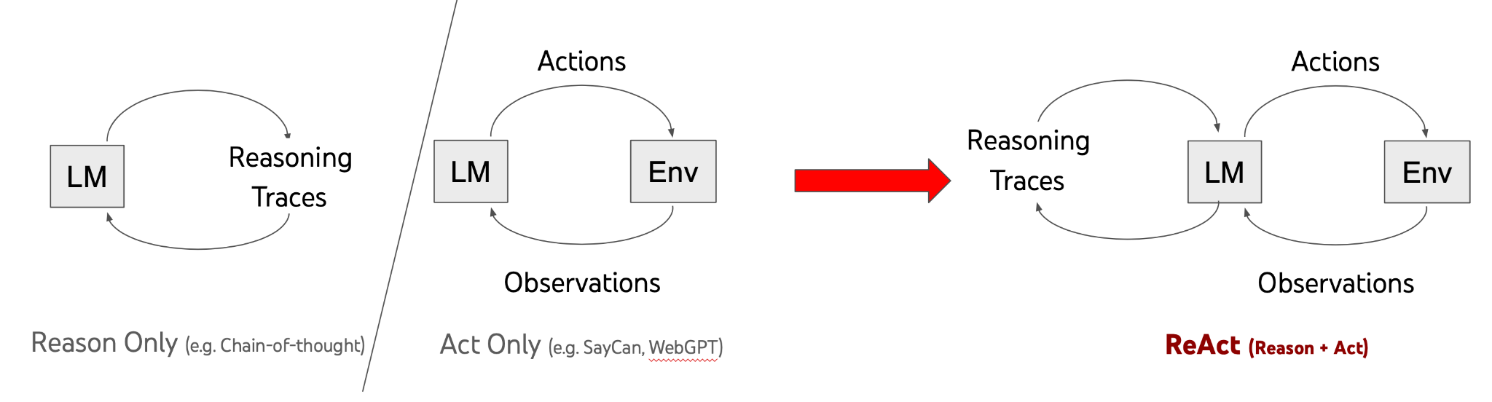
LangChain
ReAct prompting can help an LLM reason about a task and perform correct actions based on observations:

Slide 6
LangChain
In LangChain’s implementation, this takes the form of an Agent that has access to a list of tools.
The Agent is given a task and can reason which tools are appropriate to use and can then utilize those results to continue on via an internal chain until it solves the task.
Internally LangChain labels the thinking in terms of Observation, Thought, and Action.

Slide 7
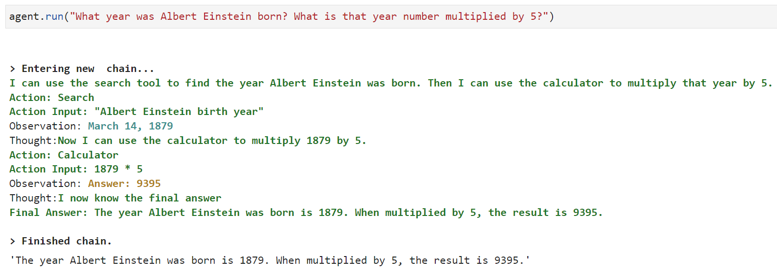
LangChain
Here is an example of a complex question that an Agent can answer:

Slide 8
LangChain
Agents can be extremely powerful, especially we combined with your own custom tools.
Imagine an Agent with access to internal corporate documents and the ability to conduct outside relevant searches, suddenly you have a very powerful corporate assistant with perfect recall and memory to answer questions!
Keep in mind that agents aren’t perfect and you may experience “funny” behaviour as you experiment with them.

Slide 9
LangChain
Agent Section
Agents are actually quite simple to use and set-up, so this section focuses on bringing you up to speed as quickly as possible, given that you’ve already done the hard work of learning the building blocks of Agents: Model IO, Data Connections, and Chains!

Slide 10
LangChain
Agent Section
Agent Basics
Agent Tools
Custom Tools
Conversation Agents

Slide 11
Let’s get started!

Slide 12
Agent Basics

Slide 13
Agent Tools

Slide 14
Custom Tools

Slide 15
Conversation Agents

