Slide 1
Engineering Essentials Hackathon:
Mapping COVID-19 Data to Market Volatility
Lucas Souza
Emily Ringel
Eirene Oyakhilome
Anjolaoluwa Tope - Babalola

Slide 2
VIX

Slide 3
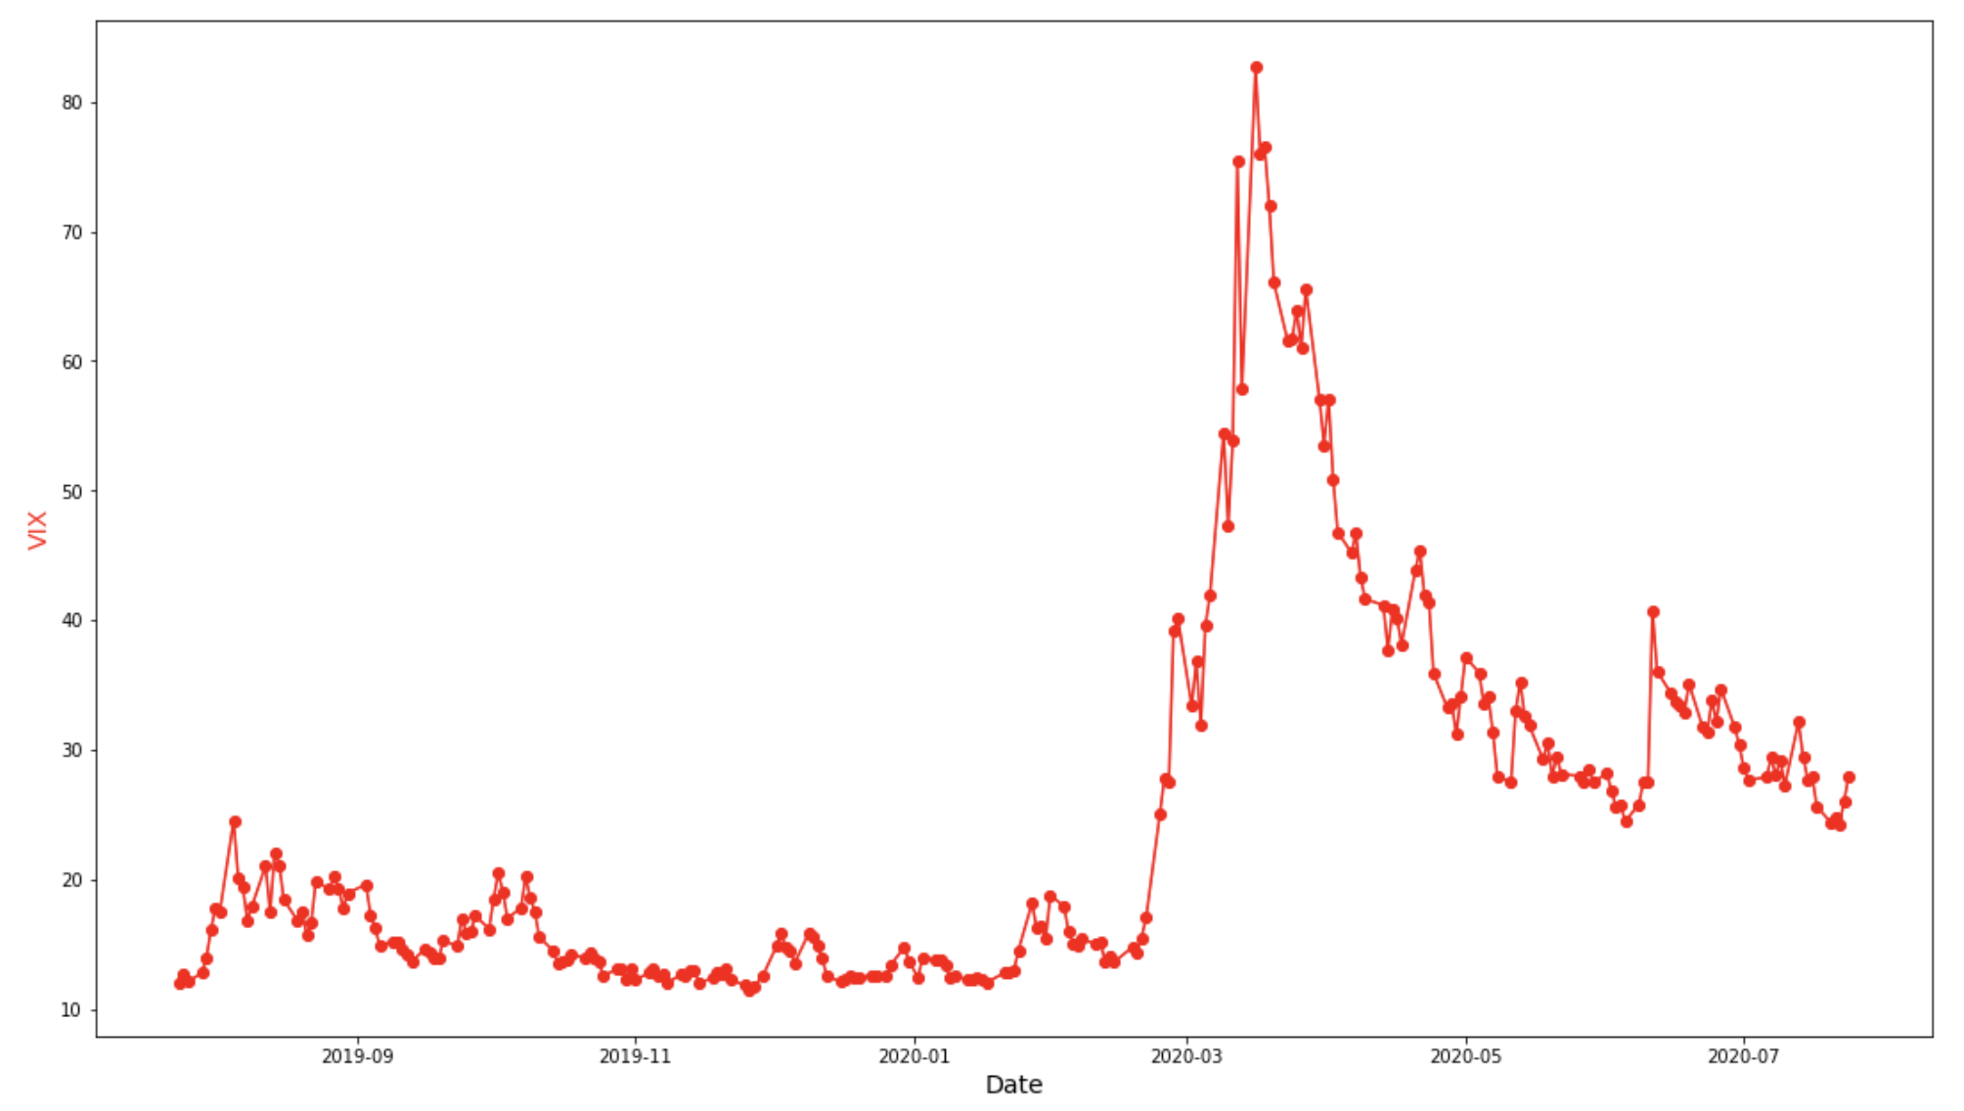
What is VIX?
Tracks Expected Volatility of the S&P 500 over the next 30 days
AKA the “Fear Index”
Tradable through various instruments
Change in VIX over the past year

Slide 4
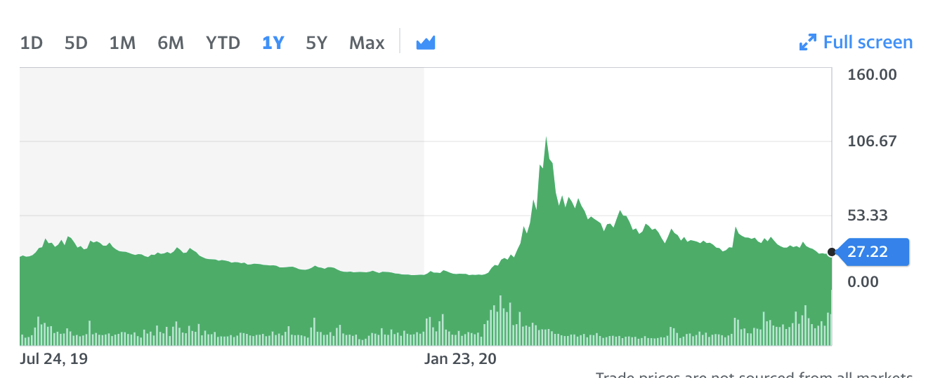
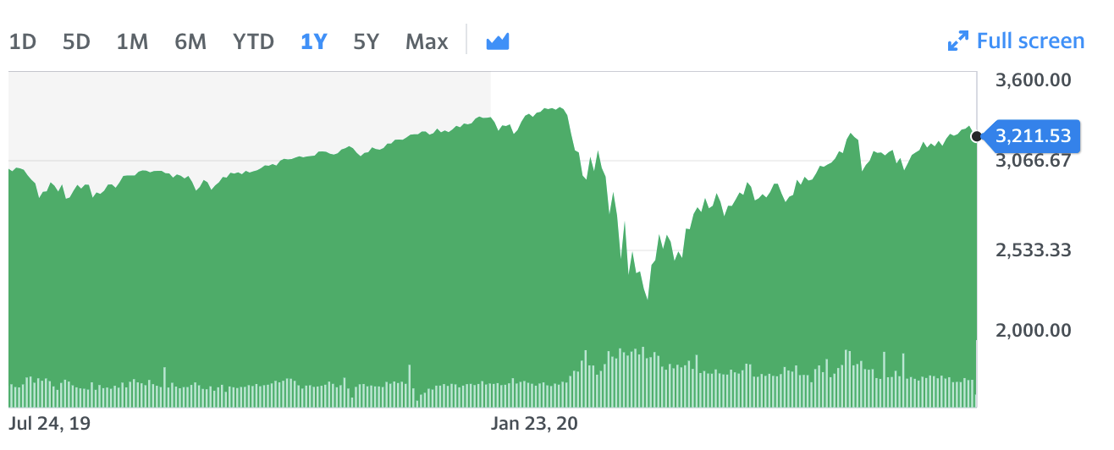
VIX has an Inverse Relationship with the Market
VIX over the past year
S&P 500 over the past year
Source: Yahoo Finance

Slide 5
US Data

Slide 6
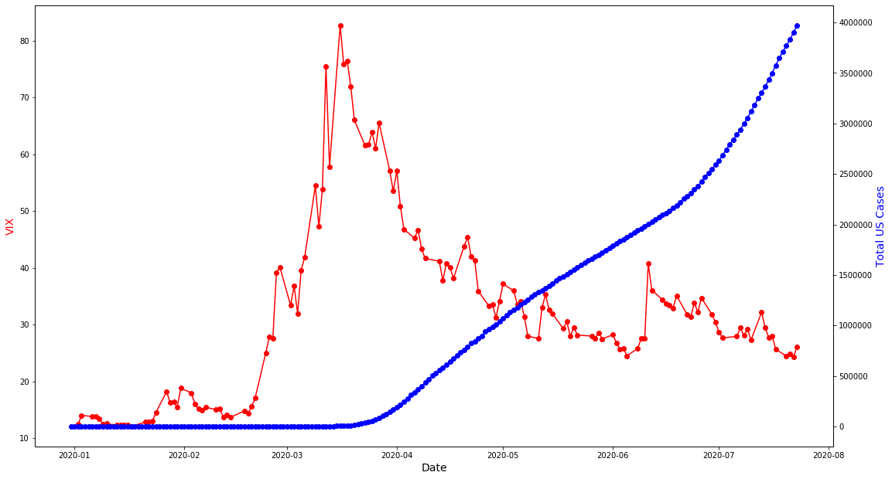
VIX vs US Total Cases

Slide 7
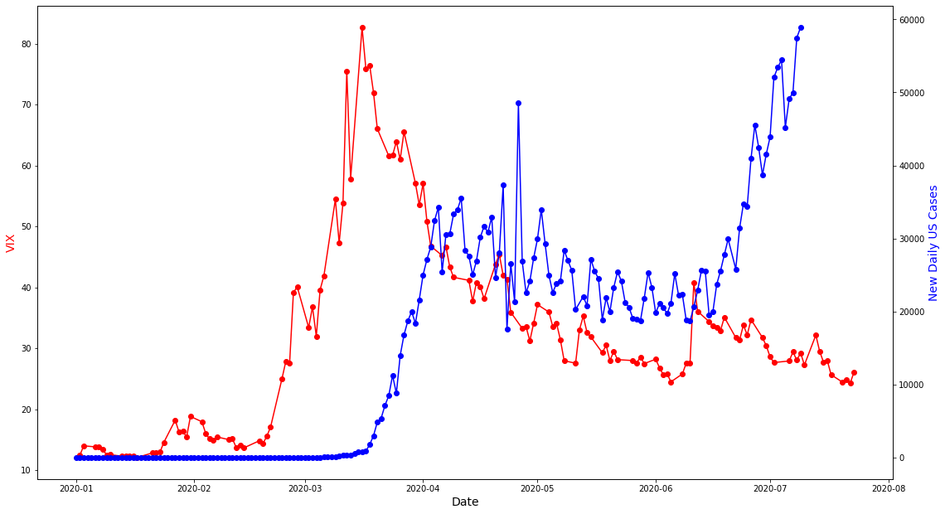
VIX vs US New Daily Cases

Slide 8
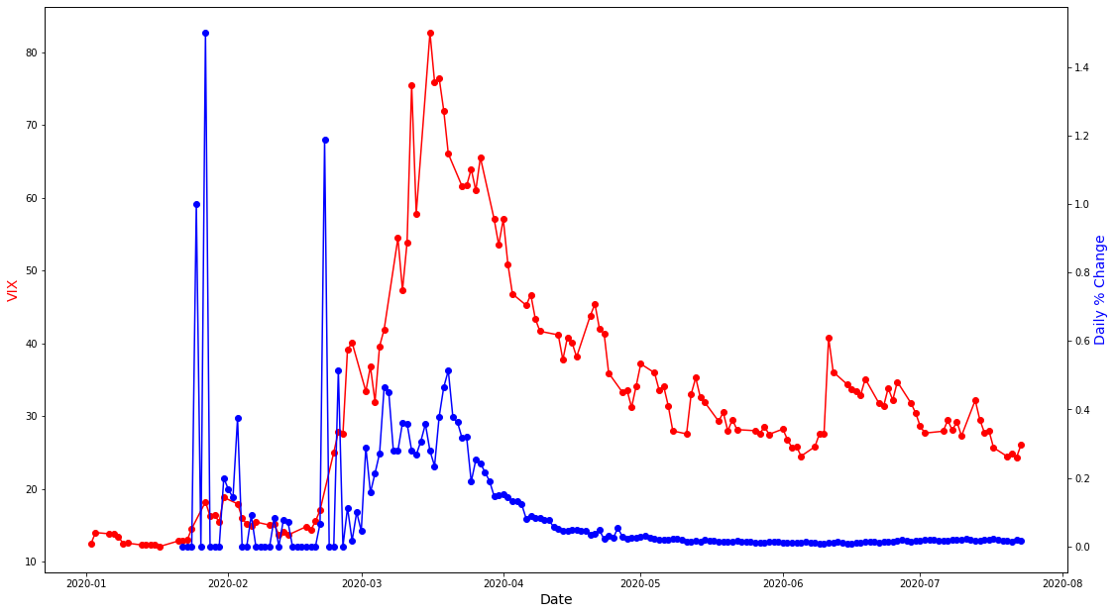
VIX vs US % Change in Daily Cases
We noticed spikes in the US Daily % Change in cases closely coincided with VIX surges

Slide 9
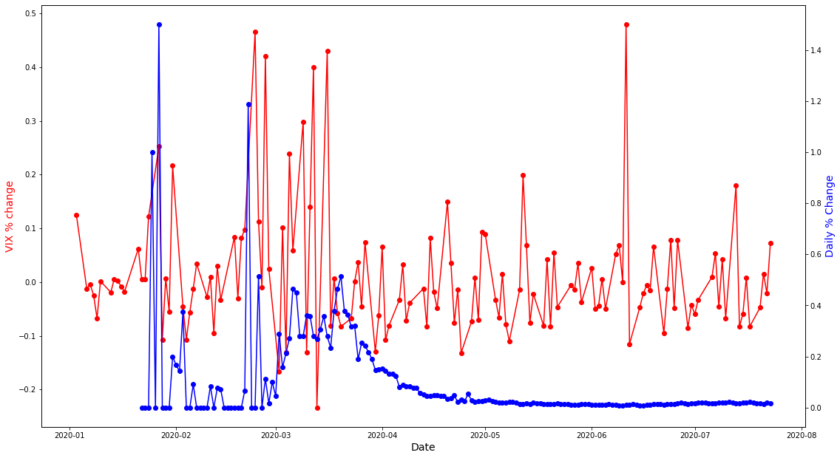
% Change VIX vs US % Change in Daily Cases

Slide 10
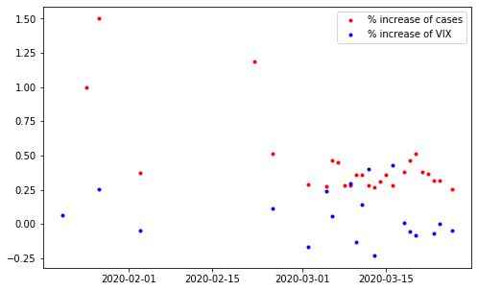
Rudimentary Trading Strategy
We want to capitalize on the “spike anomaly”
Strat:
Long VIX when there was a 25%+ spike in cases from one day to another
Results:
27 Trades in total
Hit rate of 70% with Avg. Return of 6.14% per trade

Slide 11
Global Data

Slide 12
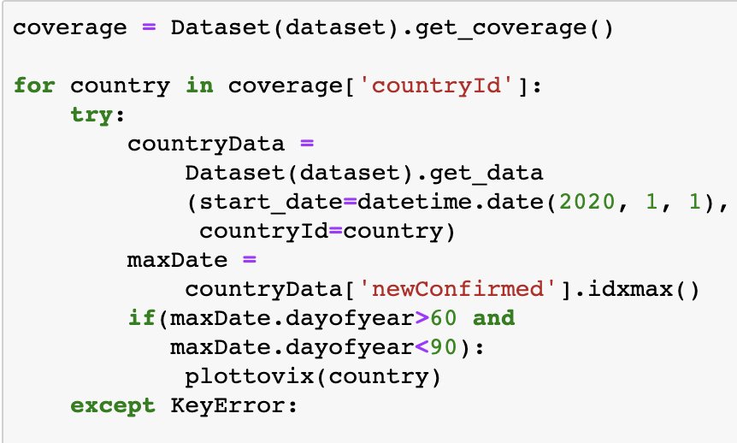
Method
Create plottovix, a method that takes a country and prints its new confirmed cases with the VIX data
For all the countries in the dataset, find if that country maps reasonably close to VIX (ie. that the maximum happened near the VIX maximum)
Print all countries for which this is true
Find which of these countries map the rest of VIX most accurately

Slide 13
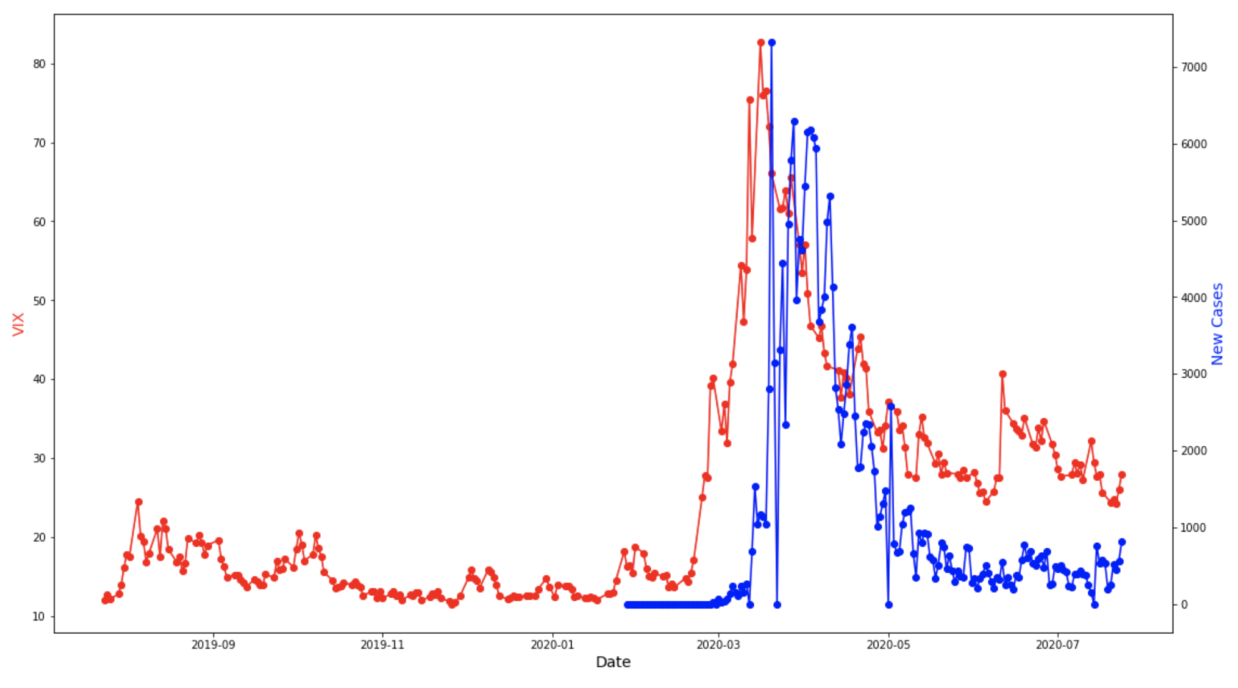
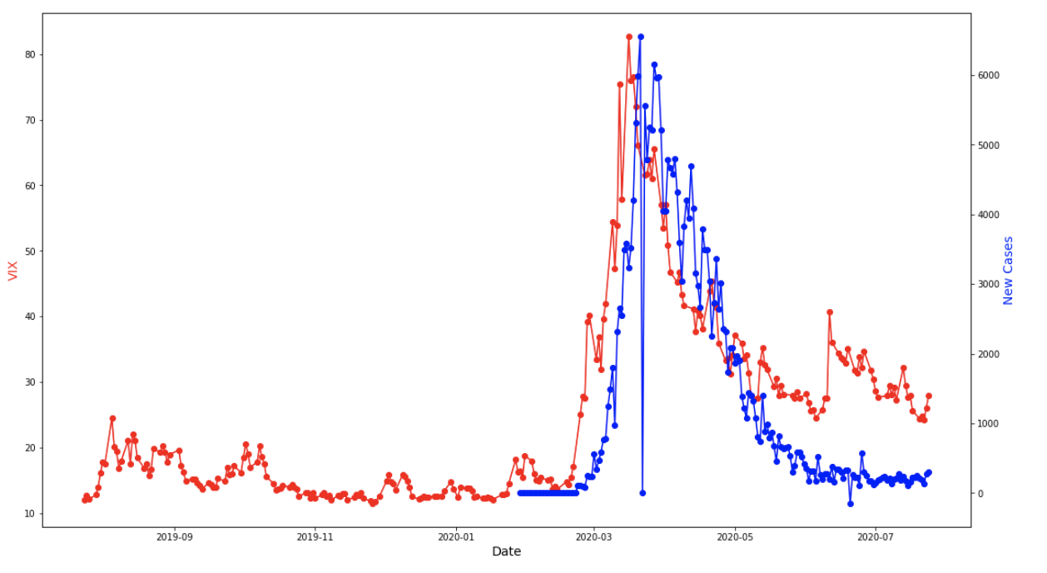
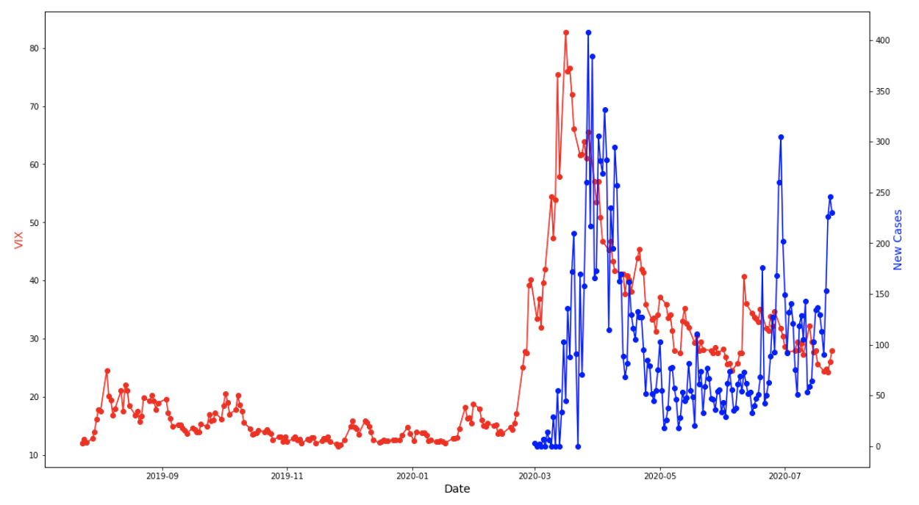
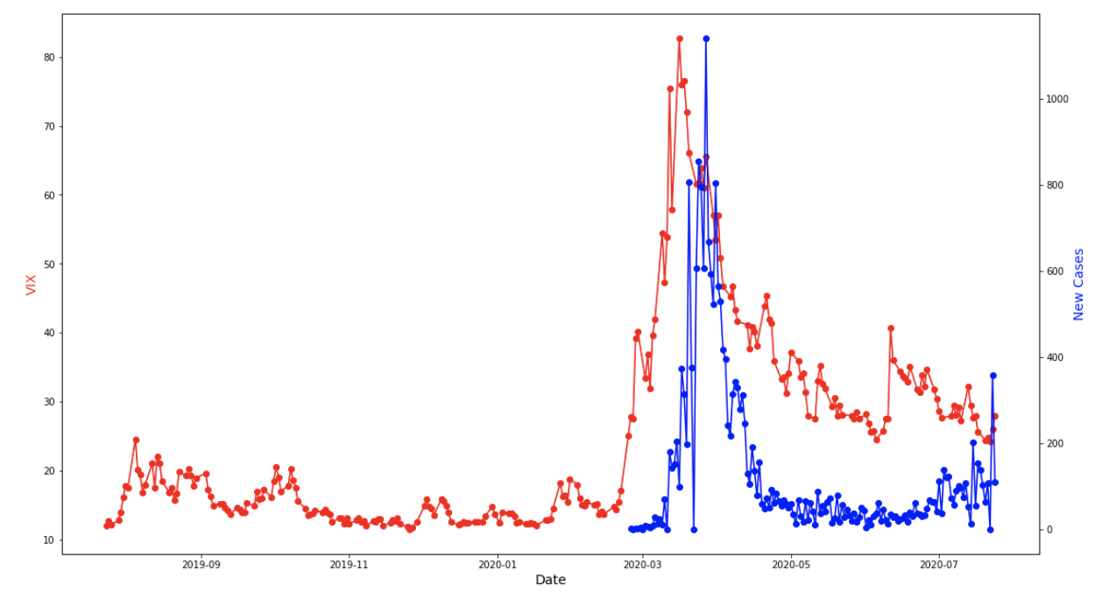
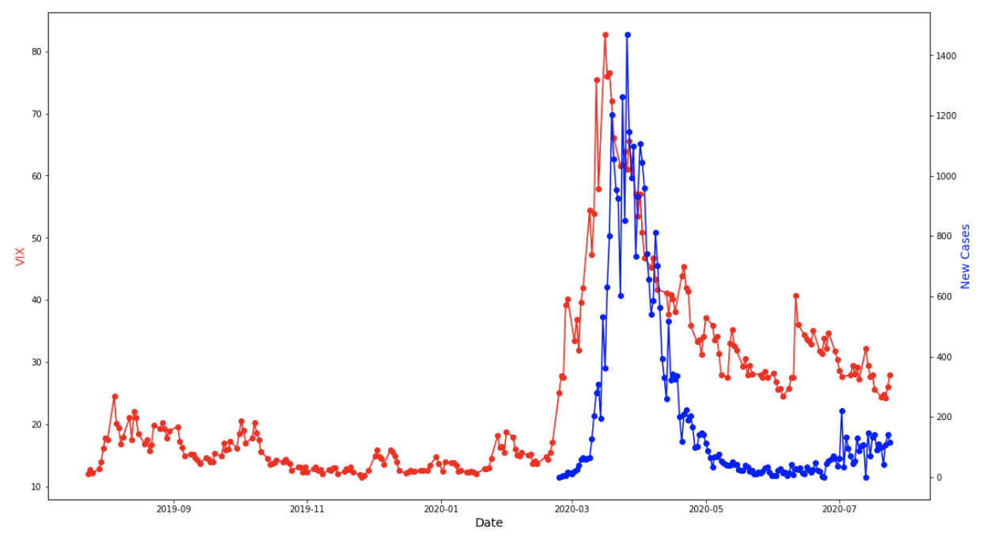
Best Fits to VIX curve
Germany
Italy
Czech Republic
Austria
Switzerland

Slide 14
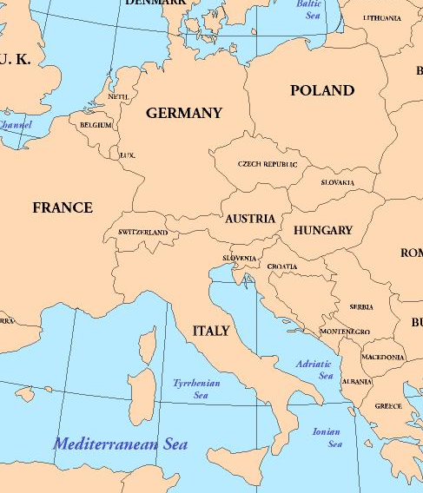
Interesting Parts of this Data
All of the closest curves are countries geographically close to each other
These countries are not the ones with the most impact on the global economy
All of these curves peak after VIX

Slide 15
Forecasting

Slide 16
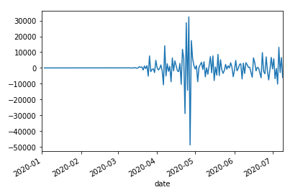
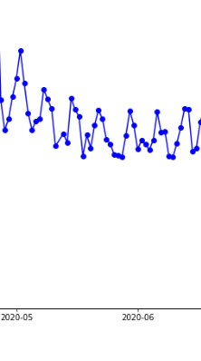
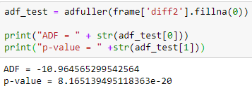
Possible paths:
New Daily Cases
~Traditional AR/MA Models
Stationarity requirement for time series.
2-time differentiated time series for new cases
Passed Dickey-Fuller test for stationarity, making it a candidate

Slide 17
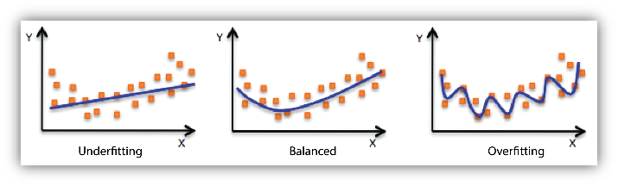
Possible paths:
~ML approach
Certain problems:
No sufficient data, could lead to overfitting, lack of generalization
A standard linear regression approach glances over inflection points or behavioral changes of data
Possibilities:
RNNs

