Slide 1
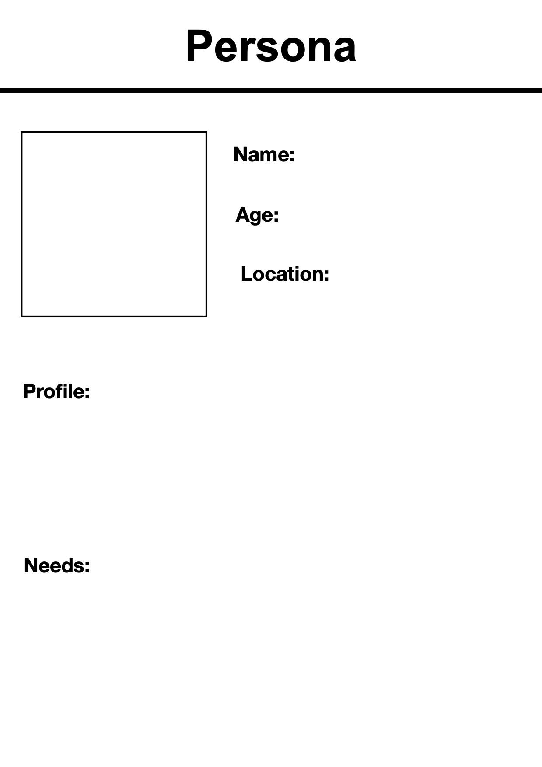
PLEASE DONT MOVE OUR STUFF!!!

Slide 2

Jamie
26
Ontario
University graduate living in Oshawa, ON looking for employment.
Jamie graduated with a Masters degree in AI from University of Toronto. She moved from downtown Toronto to Oshawa after completion of the degree with her friends. Jamie is managing her living expenses with a part-time. She has a student debt that kicks off in 6 more months and she is actively looking for full-time employment to cover it.
Jamie needs a decent paying job and student debt relief plan. Without financial freedom she is overwhelmed. She feels that AI is taking away the jobs of fresh graduates and junior positions.

Slide 3
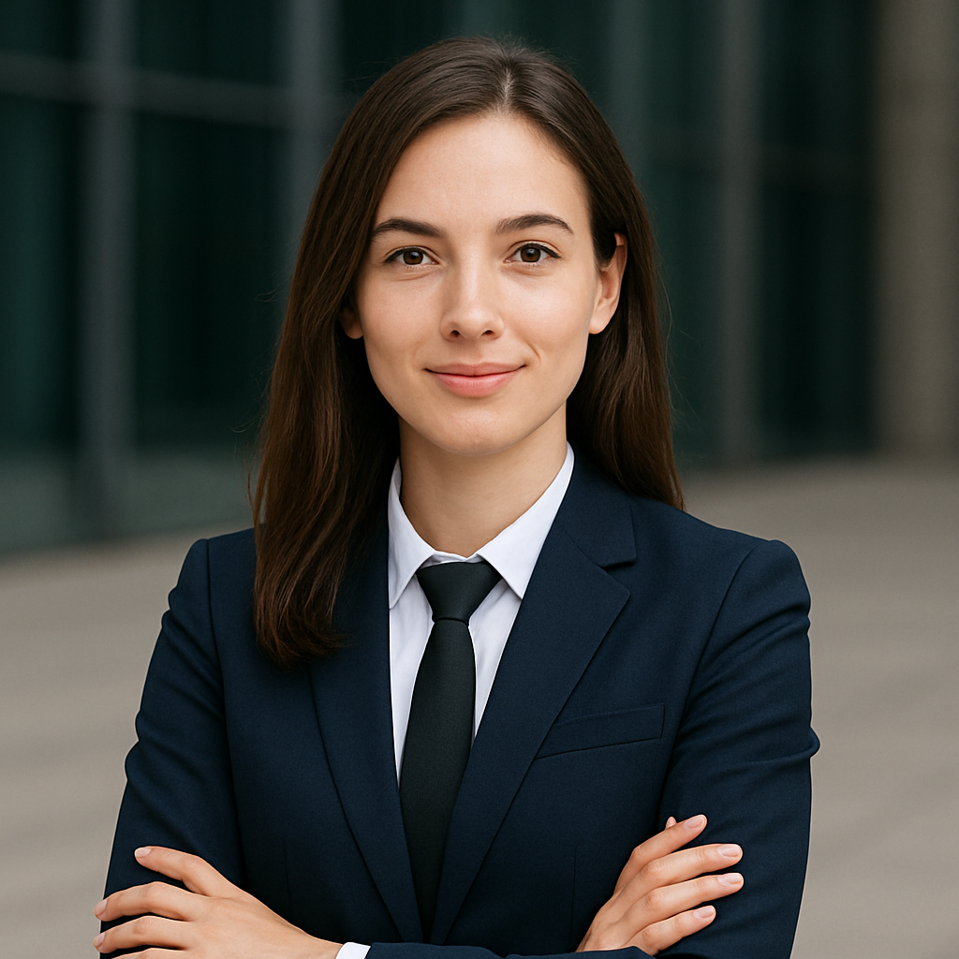
Catherine
28
Ontario
Masters graduate who secured a job in J.P.Morgan in Toronto
Catherine pursued her Masters in Business Analytics & AI in Oshawa and secured a full-time position as a Data Analyst in J.P.Morgan, Toronto. She took advantage of AI and strengthened her profile by learning AI tools and agents, which helped her stand-out.
She is unable to pay all her debt with her present package and so wants to level up and get a promotion as a Sr.Analyst so she can give her parents some rest.
Catherine uses AI tools to improve her skills in her profession.

