Slide 1


Agile Development
Chada Tech: SNHU Travel
Emily Nagorski

Slide 2
Agile Roles
Product Owner
Defines stories, prioritizes the backlog, main communication channel for the client
Scrum Master
Often called the 'servant leader', leads and organizes scrum events, ensures agile principals are being followed
Development Team and Testers
In charge of story completion, as well as making sure tests parameters are clear, participate in daily scrum events to ensure their team knows what they are working on

Slide 3
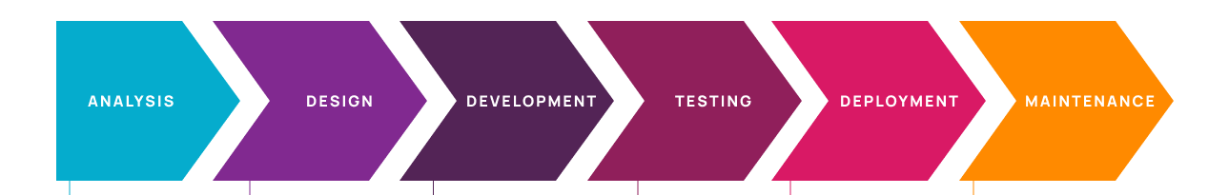
Software Development Lifecycle
Analysis: collaboration with clients and obtaining requirements
.
Design: outlining desired functionality, limitations, time restraints and budget for the project
.
Development: development and story work for the product begins
.
Testing: this occurs simultaneously with development, and identifies potential issues before deployment
.
Deployment: product is released for client use
.
Maintenance: stories are still in the production environment, and new features are being added simultaneous to bug fixes and other general maintenance

Slide 4
Agile vs. Waterfall
No time to market constraint
Flexible requirements
Customer focused
Promotes efficient communication
Ability to reprioritize as you go
Do not have to preplan all requirements before starting the project
Defined scope of work
Typically easier cost planning
No flexibility for uncertainty
Rigid structure, does not keep the customer as priority
Testing is only done as the late phases of project completion

Slide 5
Recommendation: Agile
Agile allows for reprioritization keeping the product customer focused
Testing as we go ensures there are no failed dependencies as you may run into at the end with waterfall
Frequent and quick meetings allow the team to feel comfortable communicating with one another
Visual aids such as Kanban boards can also aid in creating a united team, that is aware of the daily progress, and able to help fellow team members
Agile allows for every team to pick and chose aspects of the practice that work best for them, every team and every person needs something a little different and agile accounts for that

Slide 6
References:
Glamazdina, Y. (2021, September 15). A guide to the agile software development life cycle (SDLC). Brocoders blog about software development. Retrieved April 15, 2022, from https://brocoders.com/blog/agile-software-development-life-cycle/
Santos, J. M. D. (2022, April 14). Agile vs. Waterfall: Software Development Methodologies. Project. Retrieved April 15, 2022, from https://project-management.com/agile-vs-waterfall/
Martin, R. C. (2020). Clean agile: Back to basics. Pearson.

