Slide 1
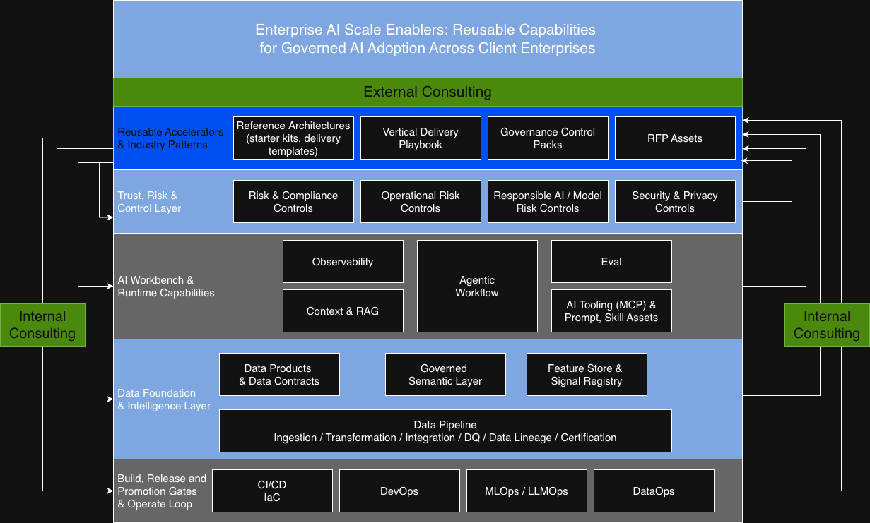
From AI Accelerator to Repeatable Practice IP
CTO interview one-page narrative
Executive Thesis
Enterprise AI Scale Enablers - reusable capabilities for governed AI adoption
Problem: AI pilots stay bespoke and hard to scale.
Shift: Convert delivery know-how into reusable practice IP.
Result: Faster solutioning, safer delivery and lower cost-to-serve.
Conversion logic
AI Accelerator
↓
Architecture Pattern
↓
Delivery Playbook
↓
Vertical Blueprint
↓
Repeatable Practice IP
What this gives Tech Mahindra
GTM leverage
Delivery leverage
Control leverage
Commercial leverage
Sharper RFP narratives, reusable solution stories and stronger client confidence.
Faster mobilisation, less reinvention and consistent engineering patterns.
Governance, security, risk and auditability embedded from the start.
Lower cost-to-deliver and scalable cross-vertical practice IP.
Positioning line: I help convert AI delivery capability into repeatable, governed, enterprise-grade practice IP.

