Slide 1
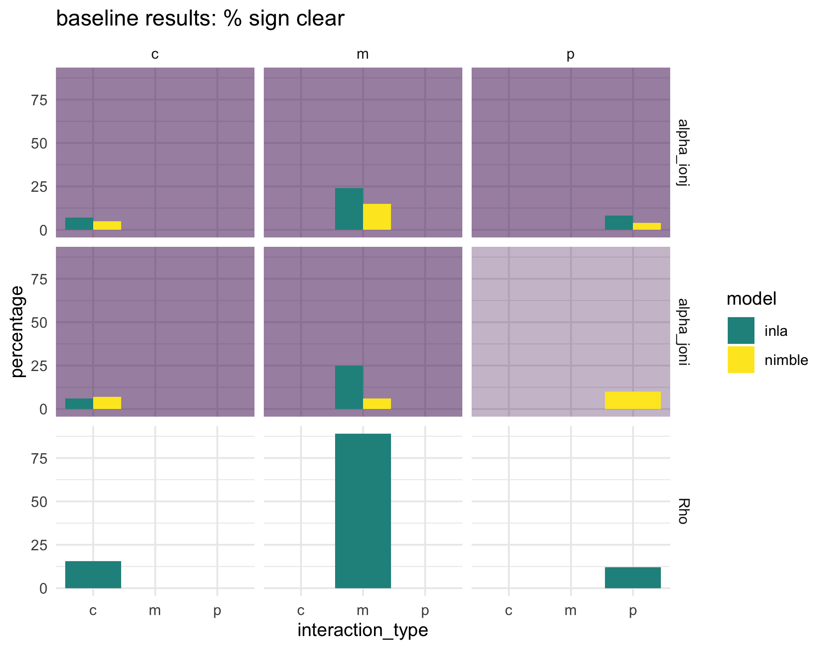
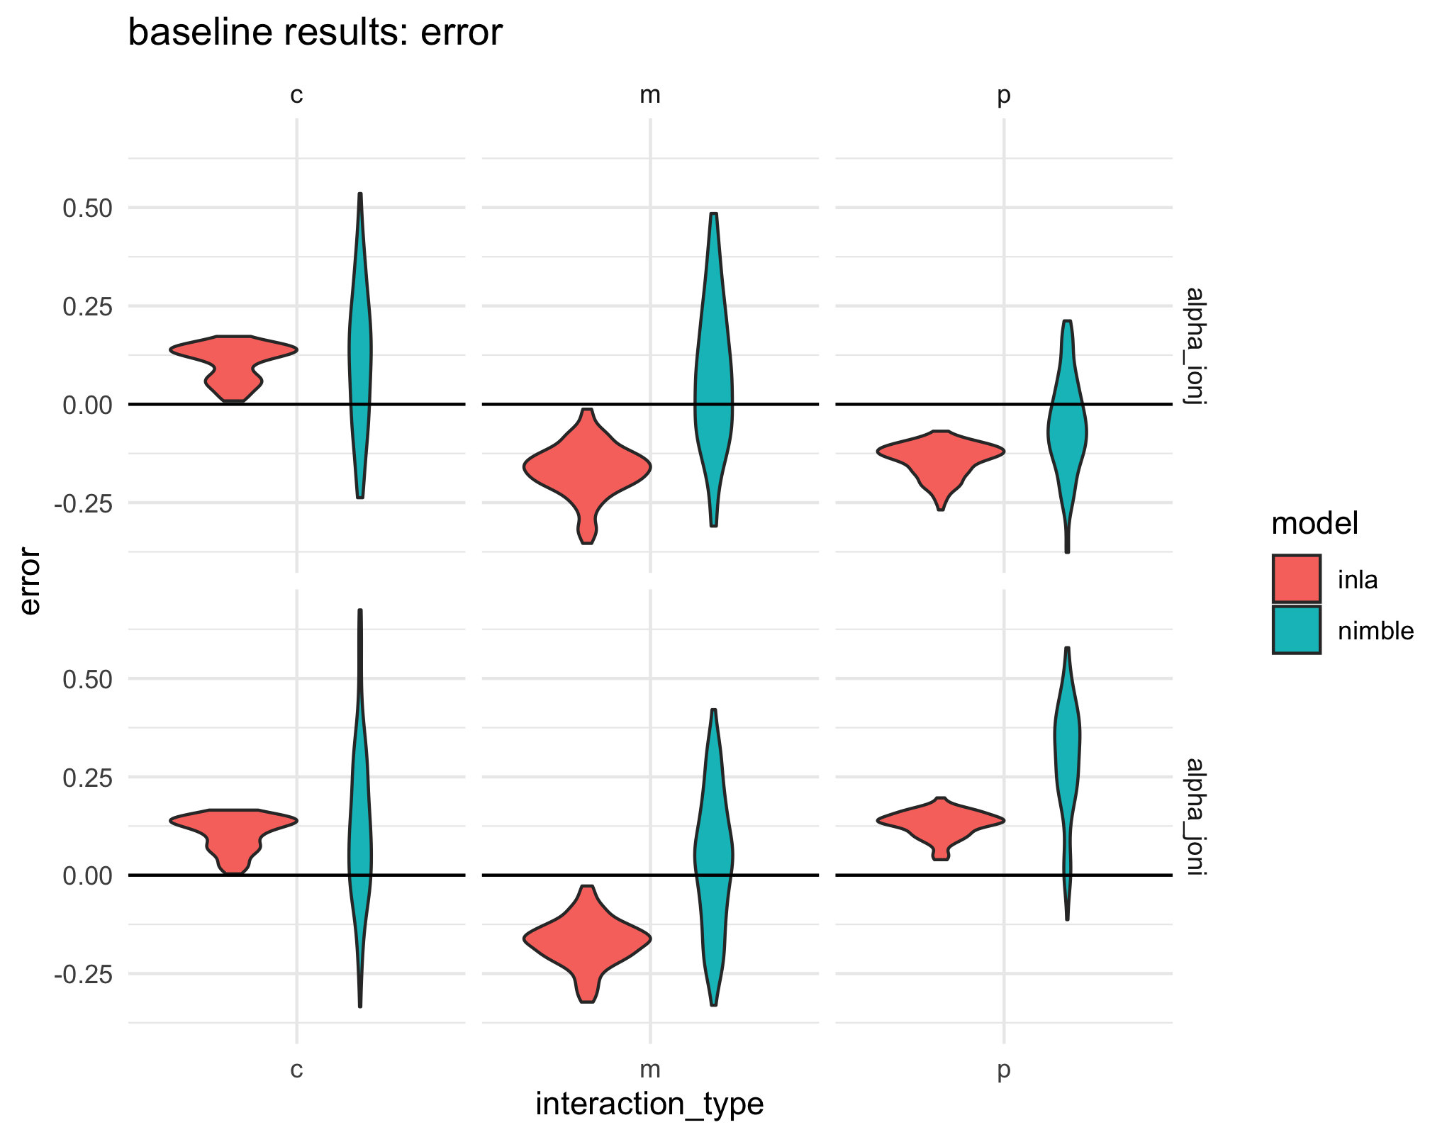
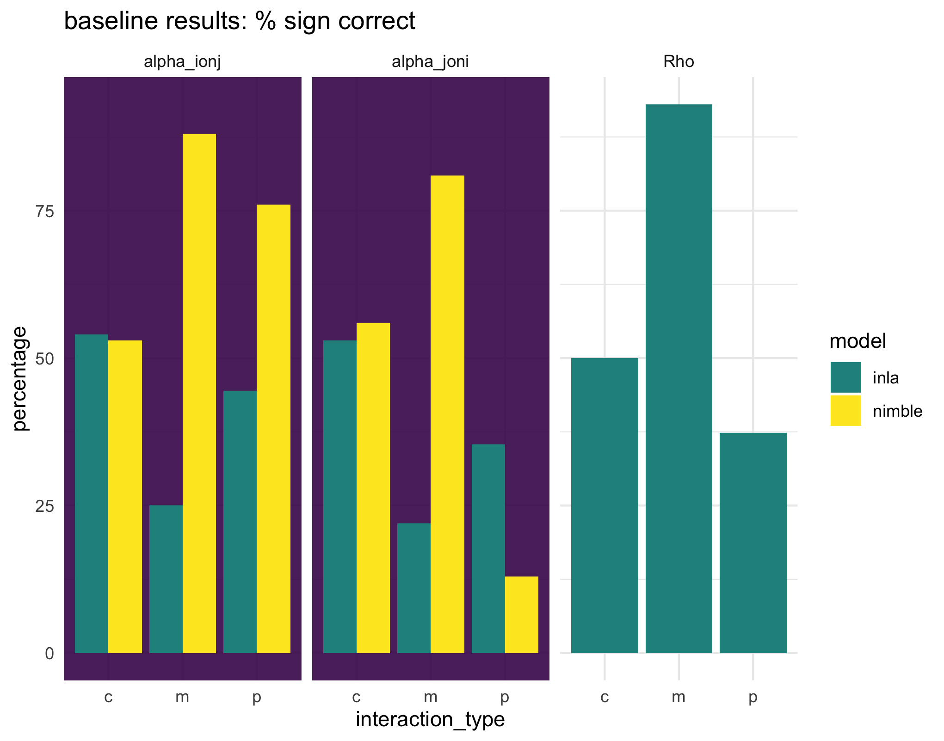
Results from baseline scenario
Key points:
The direction of the interaction was NEVER returned clearly.
For competition, 50:50 whether it works. pp is worse that 50:50 for species j on i.
Nimble is good at mutualism but INLA is poor.
INLA error is strange shape, Nimble is as would be expected.

Slide 2
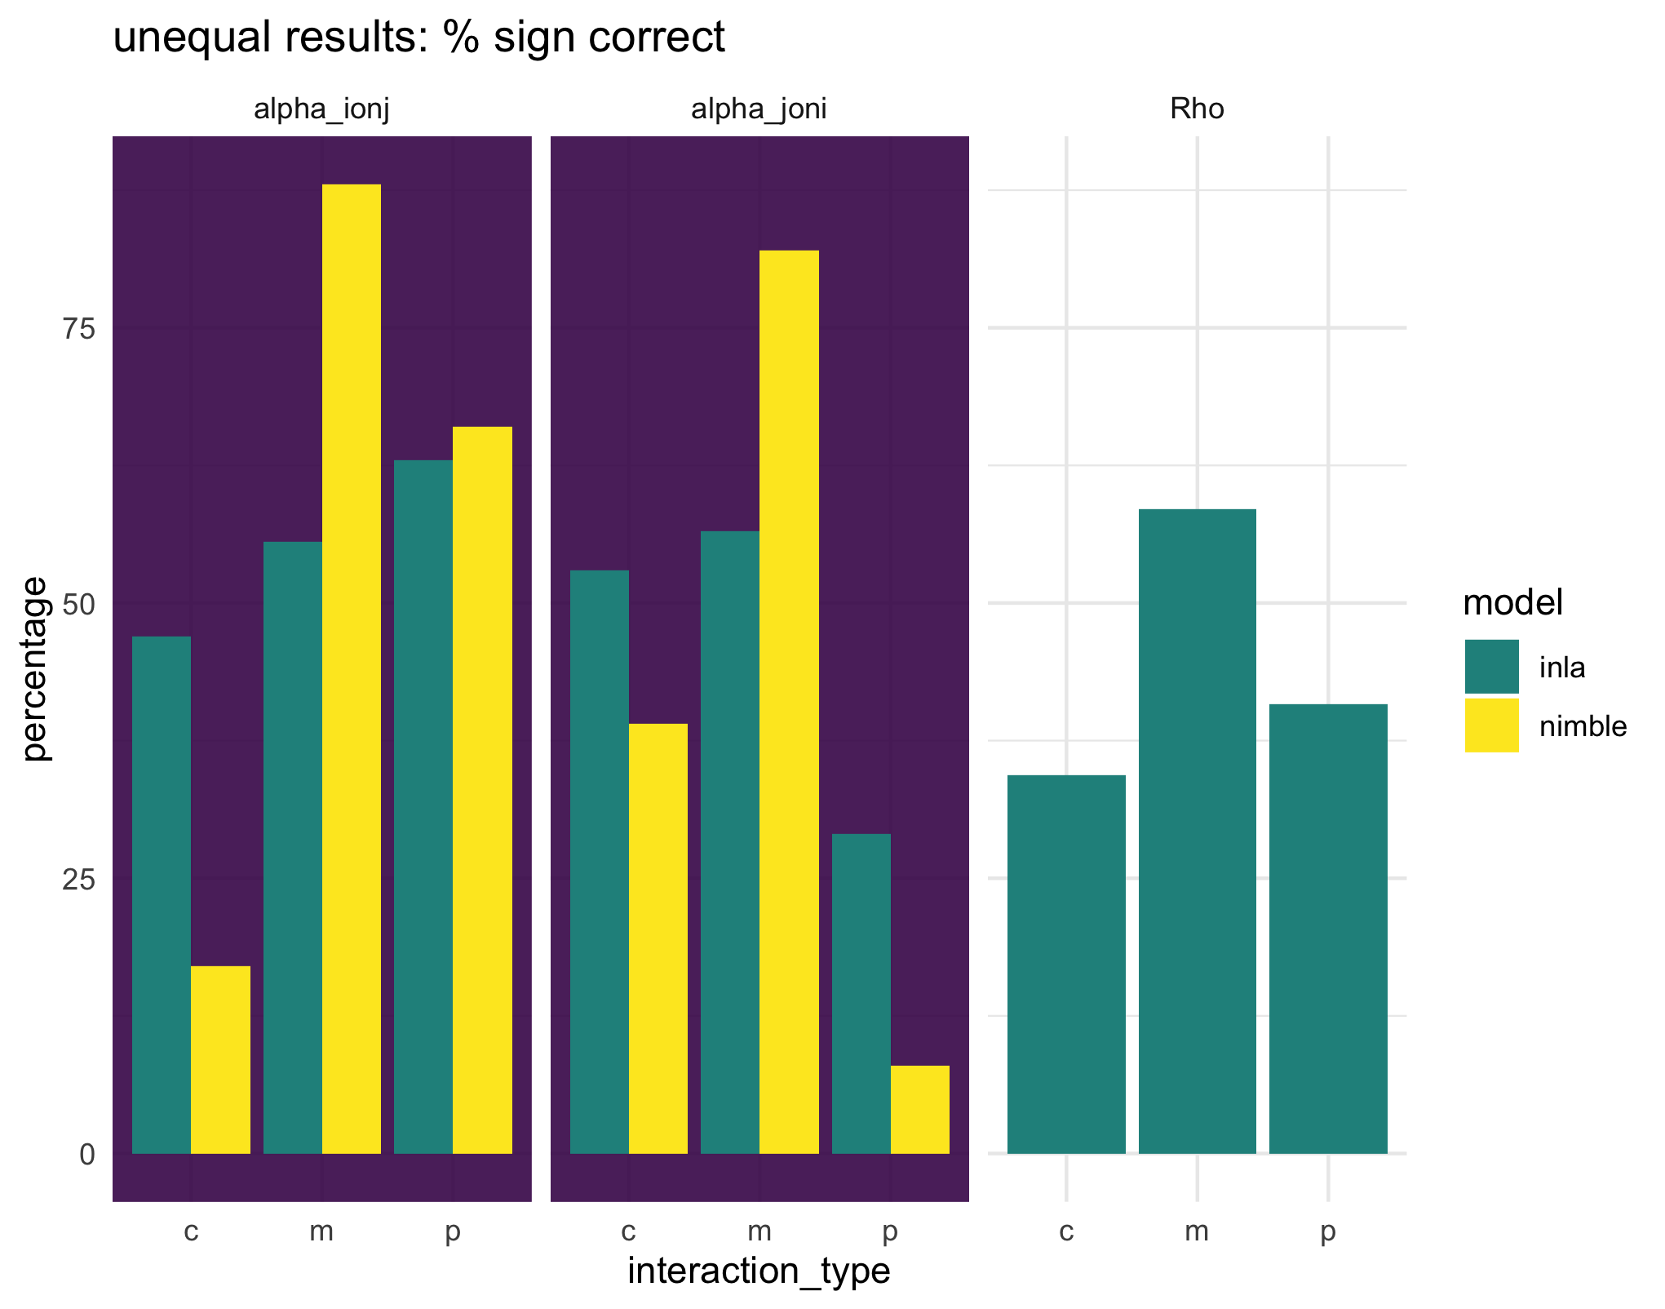
Unequal interaction strengths vs baseline
Key points:
Error and % times the sign was clear are largely the same.
When interaction strengths are unequal, Nimble does same for mutualism but less well for cc and pp. INLA does better for mm and pp and about same for cc.

Slide 3
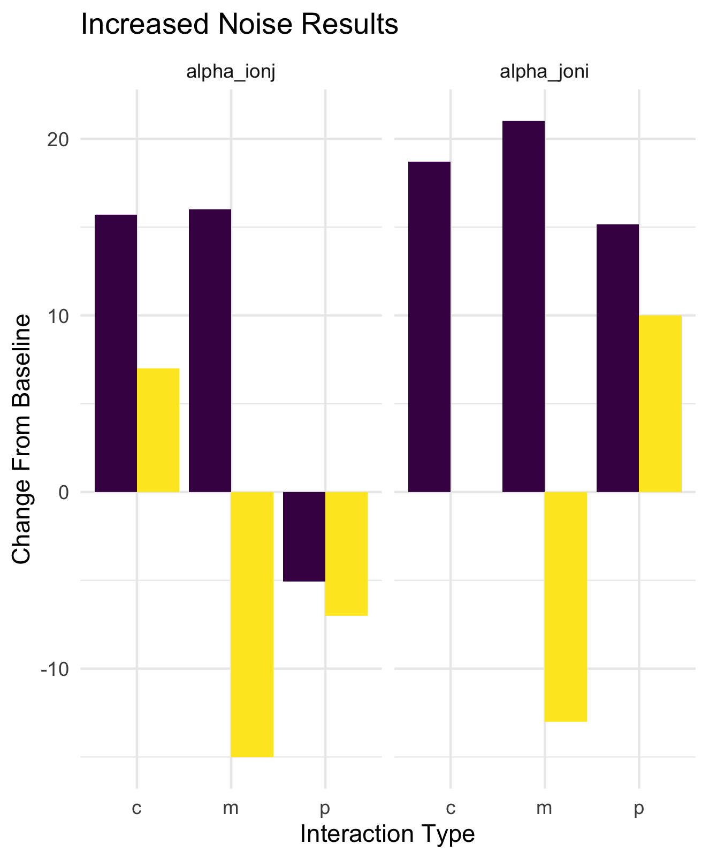
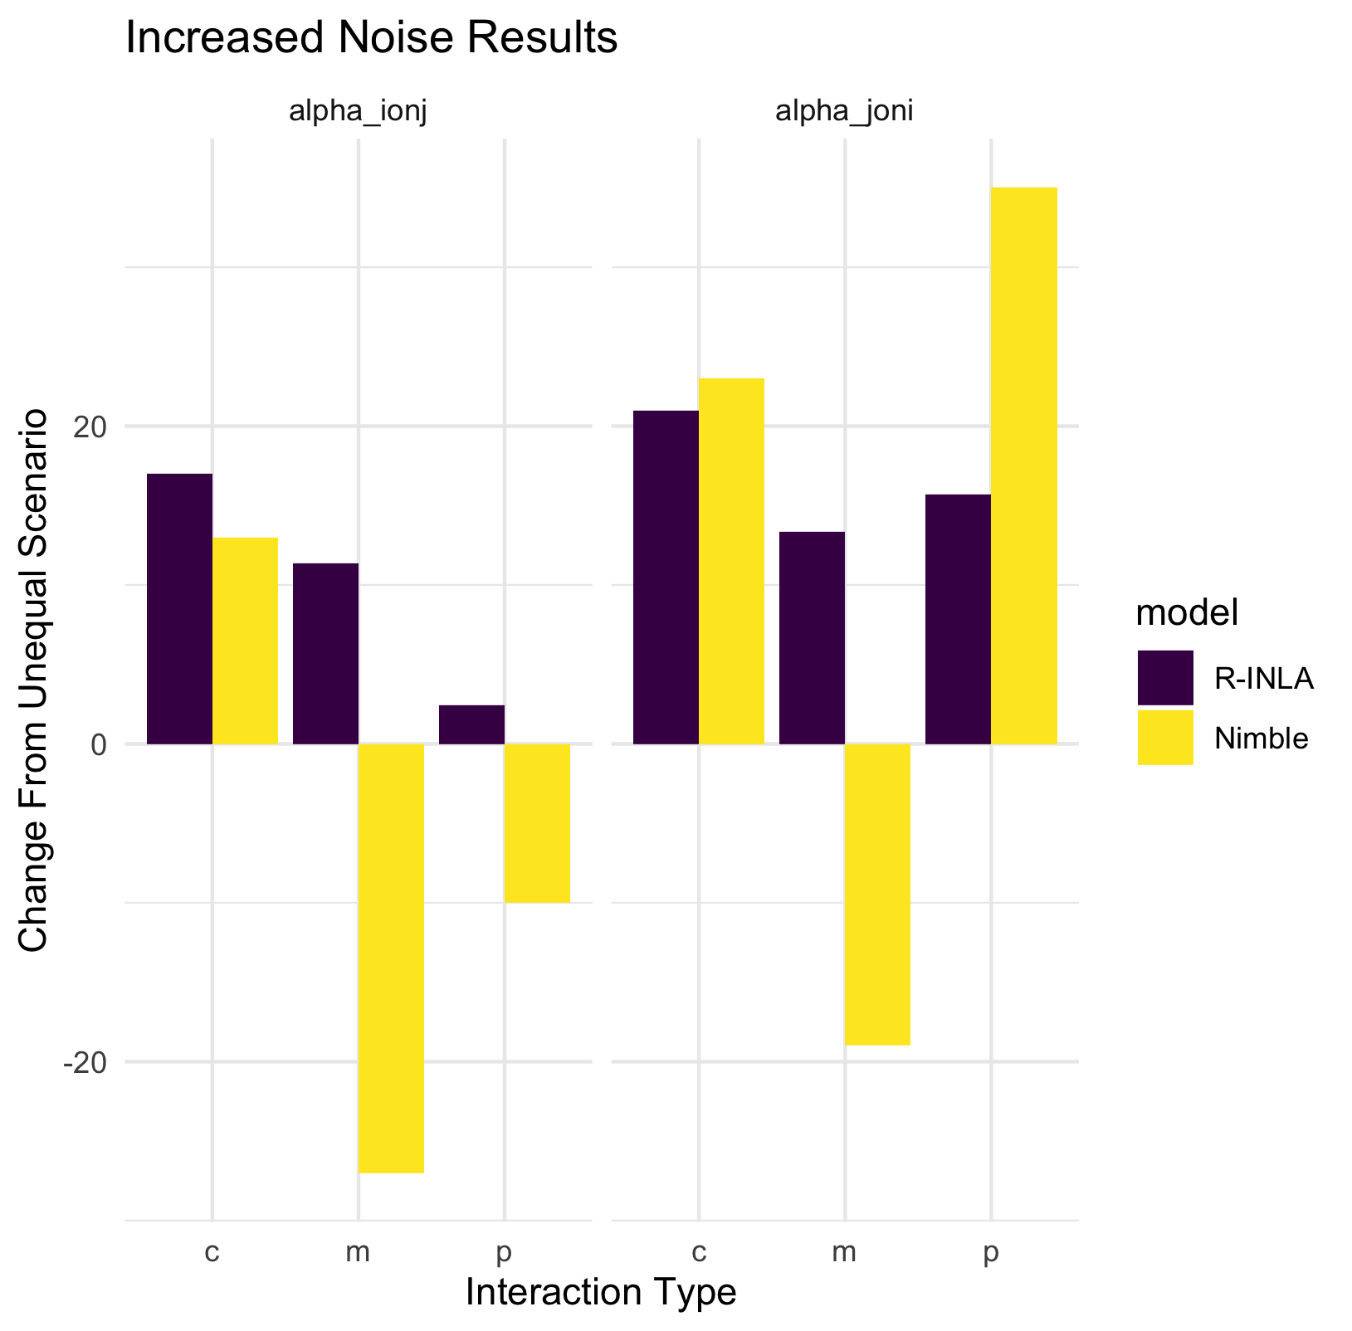

Slide 4
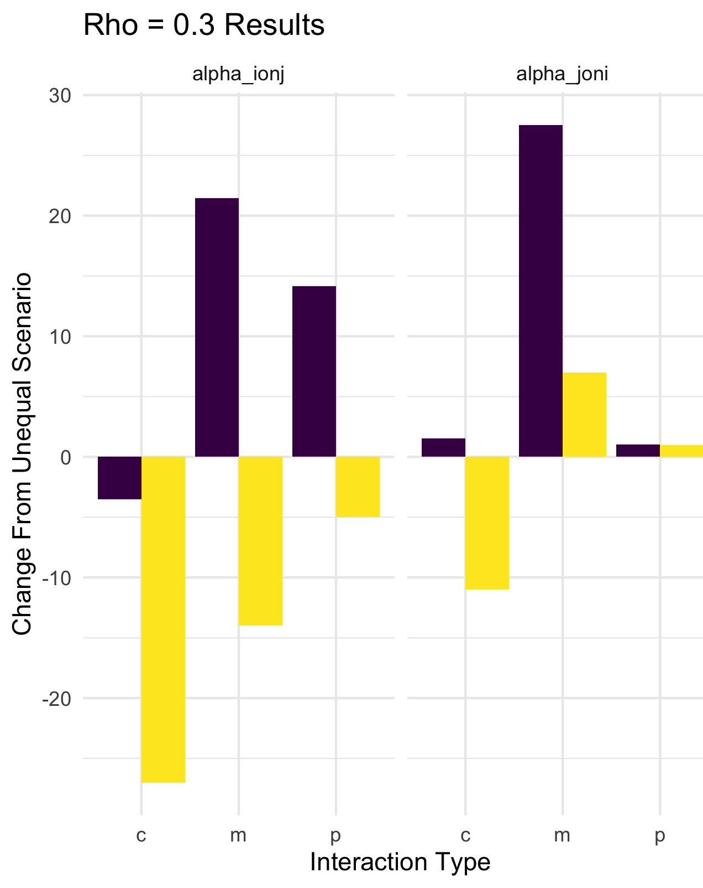
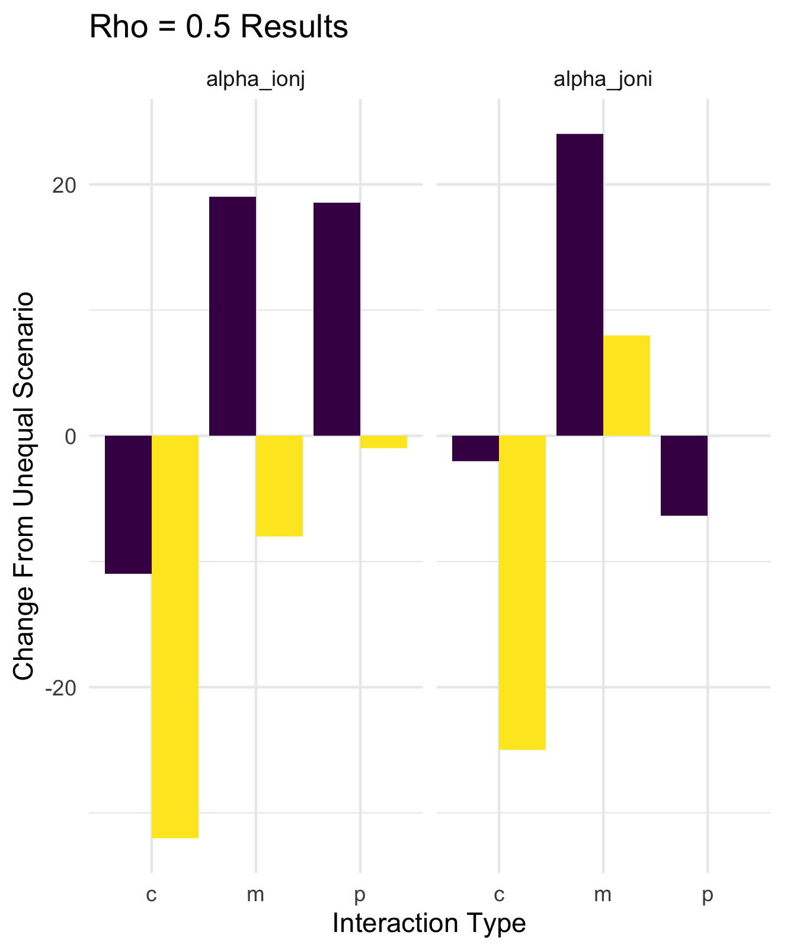
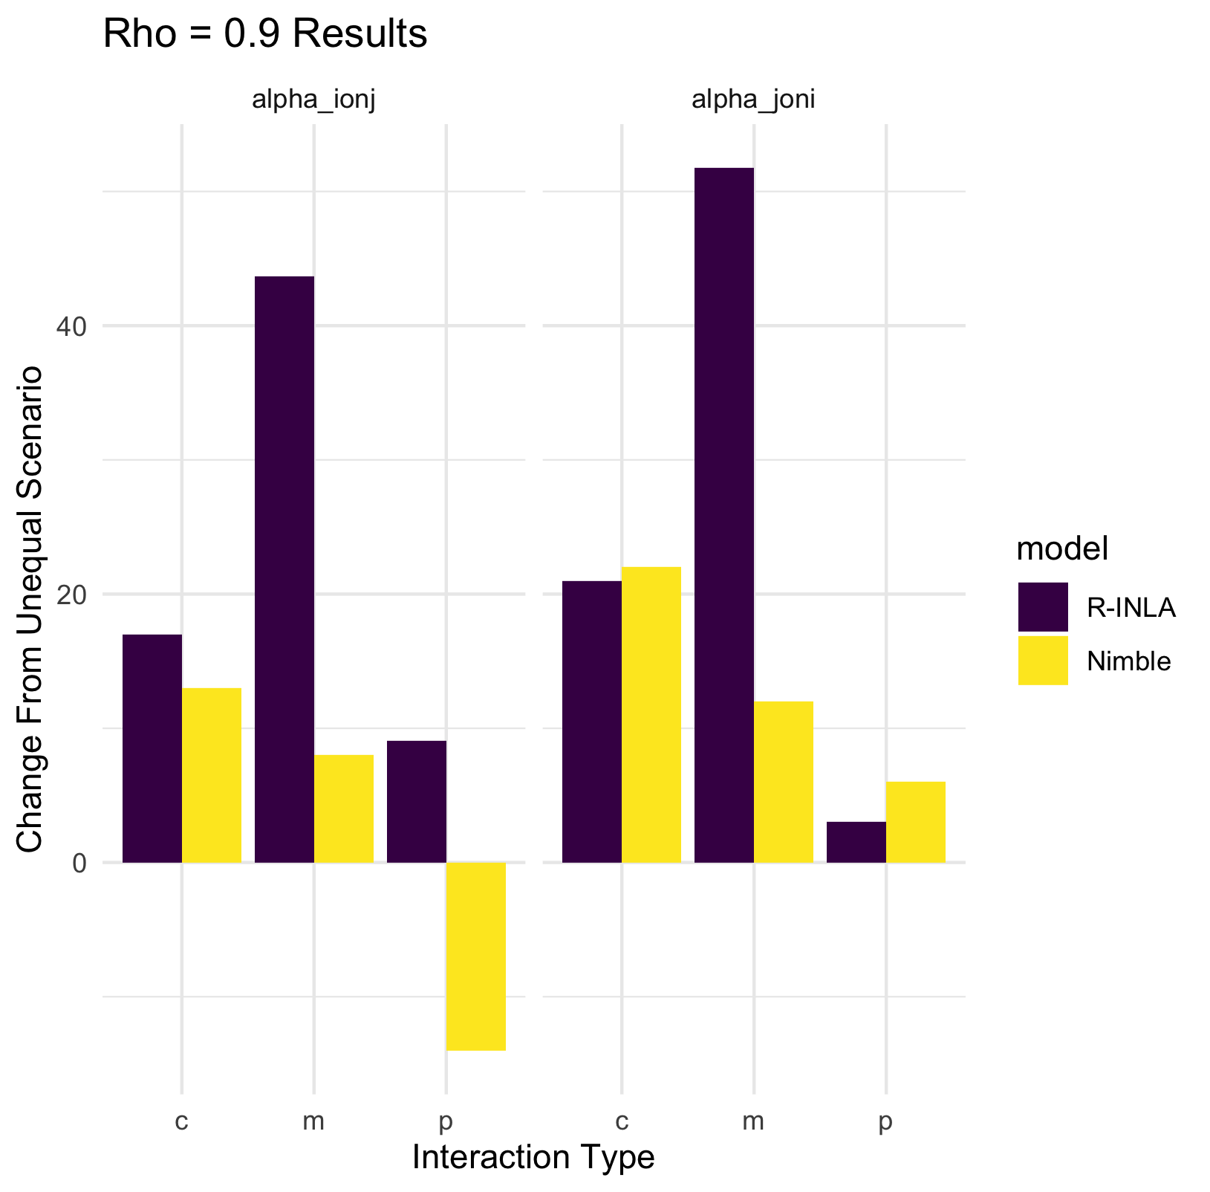

Slide 5
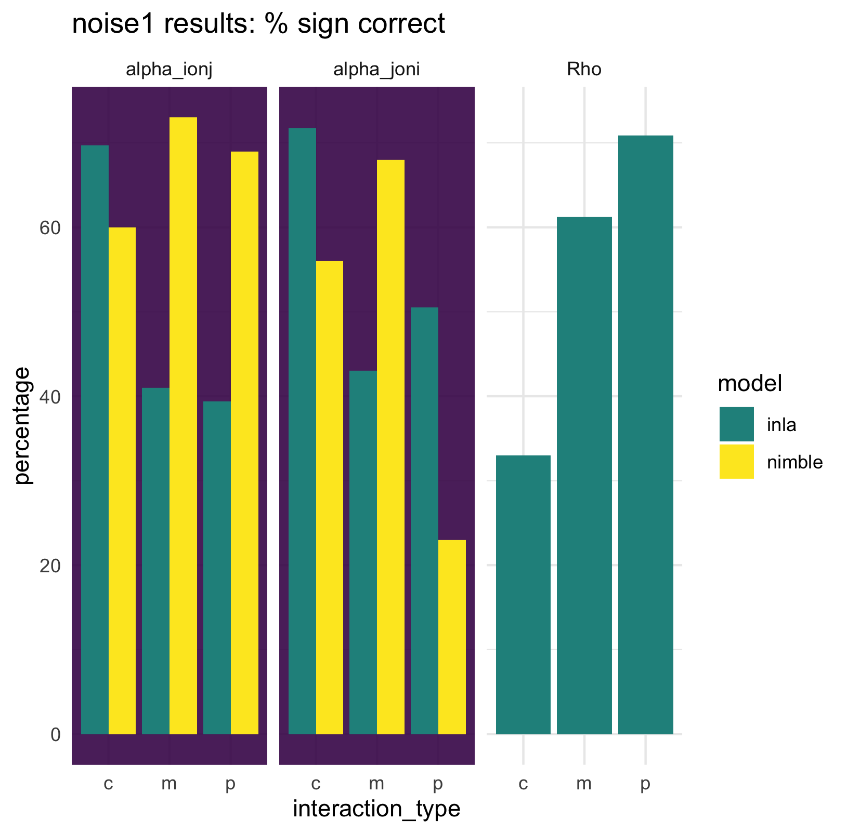
Increased noise vs baseline (equal interaction strength)
Key points:
INLA successfully retrieves competition > 50% of the time when noise is increased and strength is equal.
Nimble also improves when noise is higher for cc and pp. Mutualism = same.

Slide 6
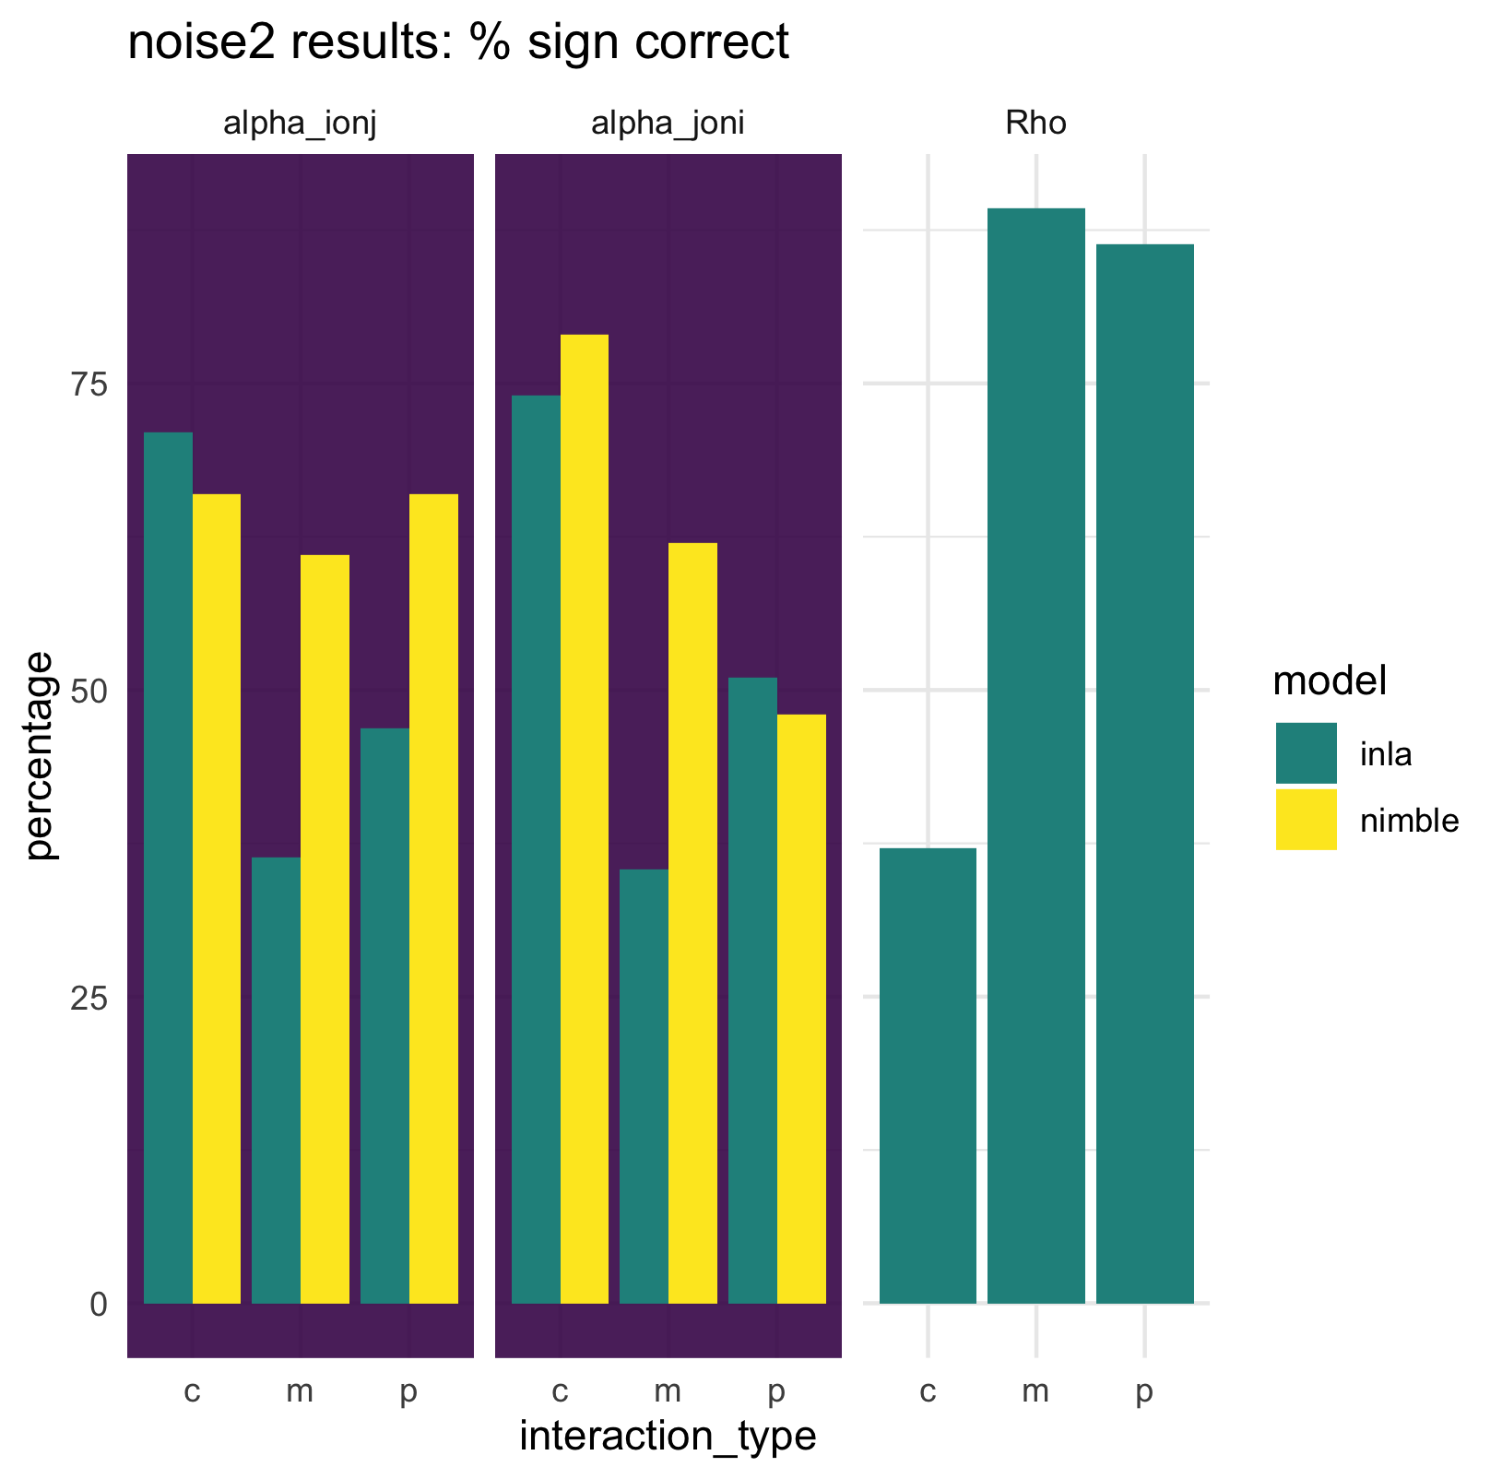
Increased noise vs unequal (unequal interaction strength)
Key points:
Error and % times the sign was clear are largely the same.
Competition improves again to > 50% correct for both models.
mutualism less good for both. Predator prey improved most for Nimble but also for INLA

Slide 7
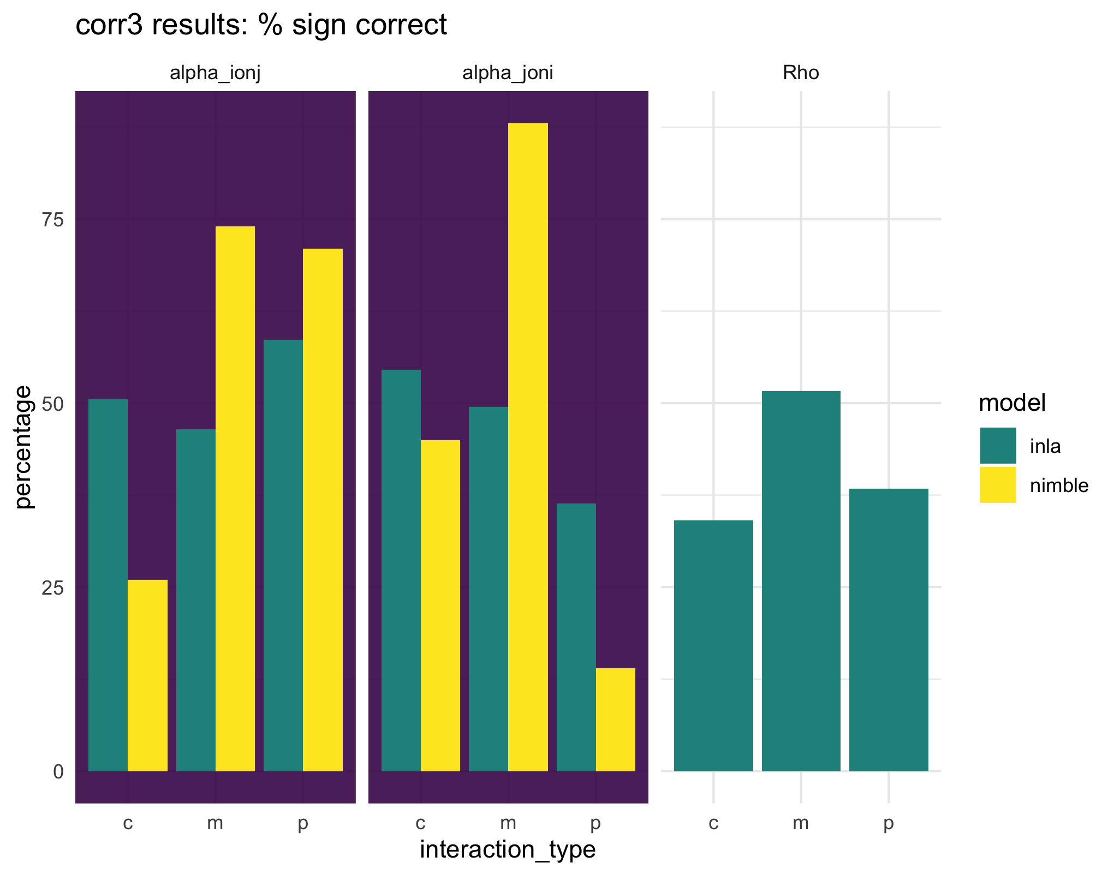
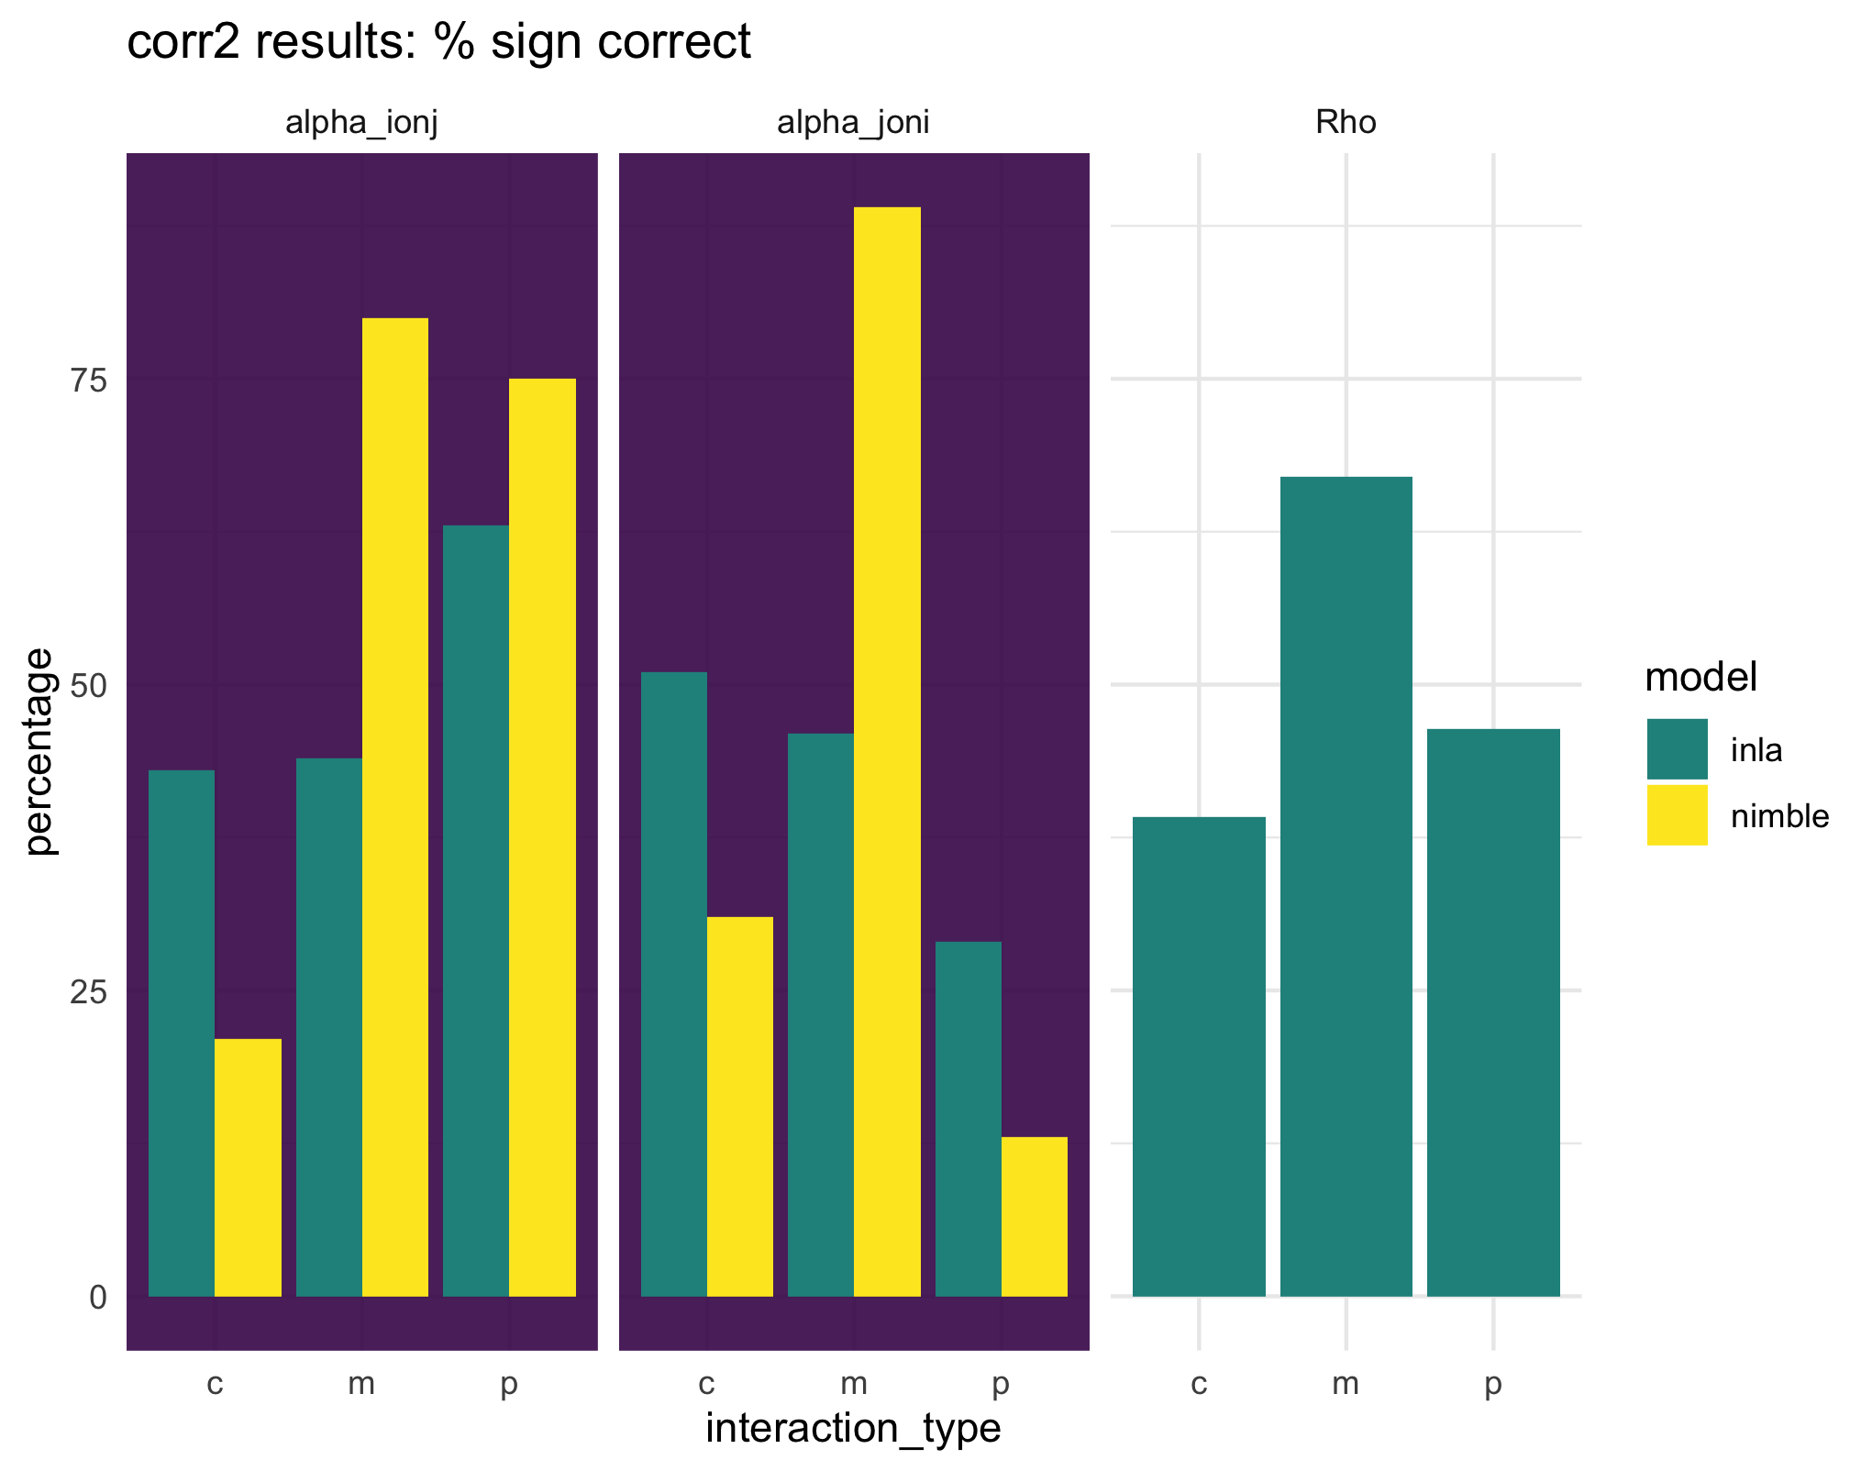
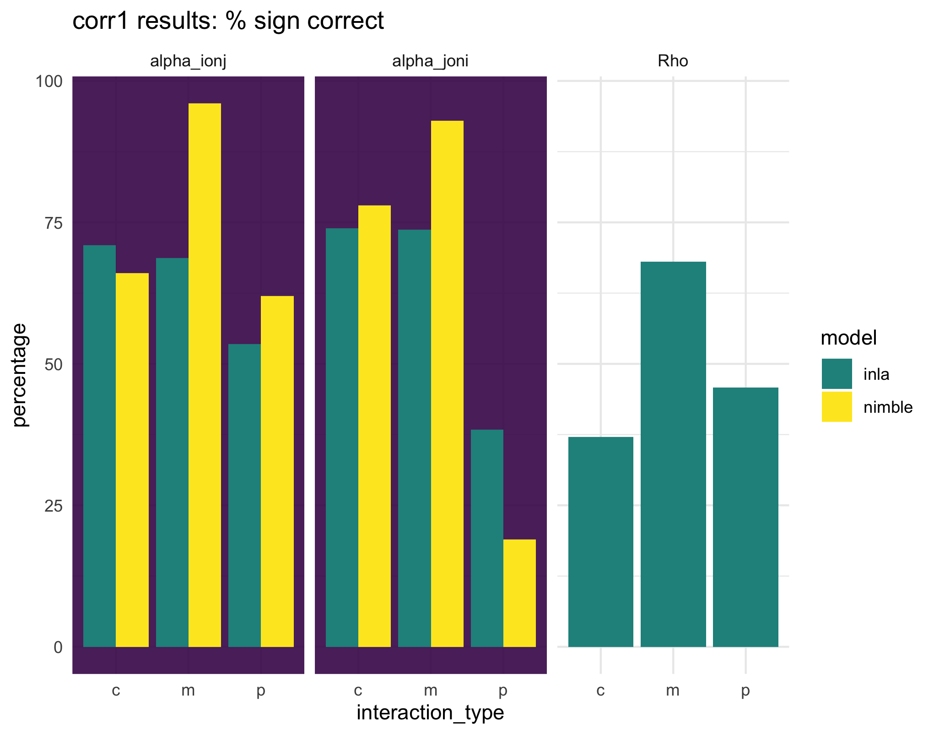
Changes in rho, unequal interaction strength
Rho = 0.5
Rho = 0.3
Key points:
Accuracy of rho is same regardless of strength.
Both perform better for cc IF rho = higher but only when up to 0.9. Not steady.
mm for Nimbler sees slight improvement. pp is largely same maybe bit less accurate for i on j.
INLA improves most for mm.
When rho = 0.9 all over 50% except pp j on i.
Rho = 0.7
Rho = 0.9

