Slide 1
Alignment of the stellar halo of the nIFTy cluster with cosmic web filaments
Emily Hackett
ICRAR-Pawsey Summer Studentship

Slide 2
Background
Hierarchical structure formation:
Cosmological structures (such as large galaxy clusters) are formed by merging processes
In such processes, gas in falls into the gravitational well formed by dark matter haloes
Satellite galaxies are drawn in by a central galaxy in the dark matter halo
As this occurs, stellar matter is tidally stripped during collisions, and we can suppose that this matter will tend to align with the smooth gravitational potential of the large-scale structure

Slide 3
Why is this significant?
Why look at large-scale structure alignment?
Simulations can predict mass distributions and much more, but what we are most capable of observing is galaxies
PROBLEM: When observing at a scale of galaxies, their alignments are so influenced by recent merger events that they cannot point out the large scale structure around them
However perhaps the stellar halo can?
See if the structural properties of the stellar halo aligns with dark matter halo and large-scale filamentary structure

Slide 4

Halo Shape Properties
Reduced moment of inertia tensor
From here, find eigenvalues (square roots correspond to major, intermediate and minor axes lengths – eigenvalues correspond to axes’ direction)
From here, can then get values for sphericity, ellipticity, etc.

Slide 5
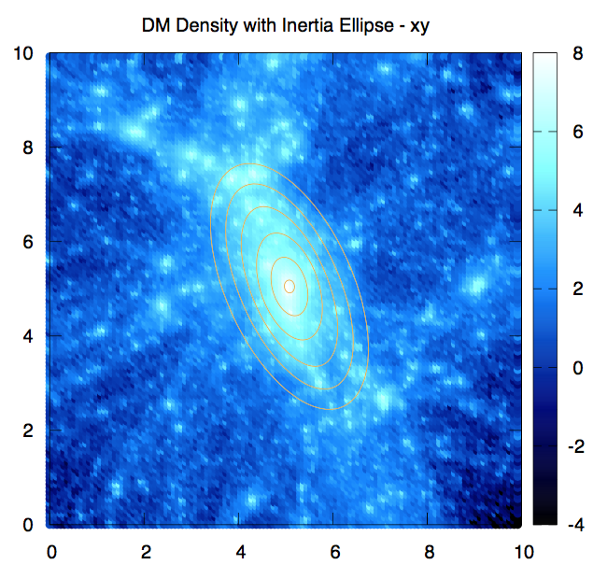
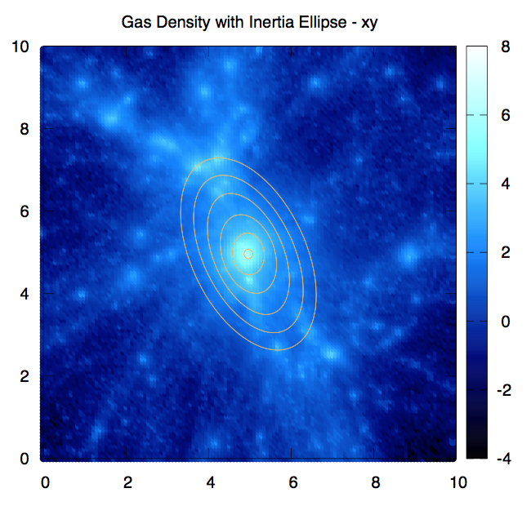
Projection of moment of inertia ellipsoids

Slide 6
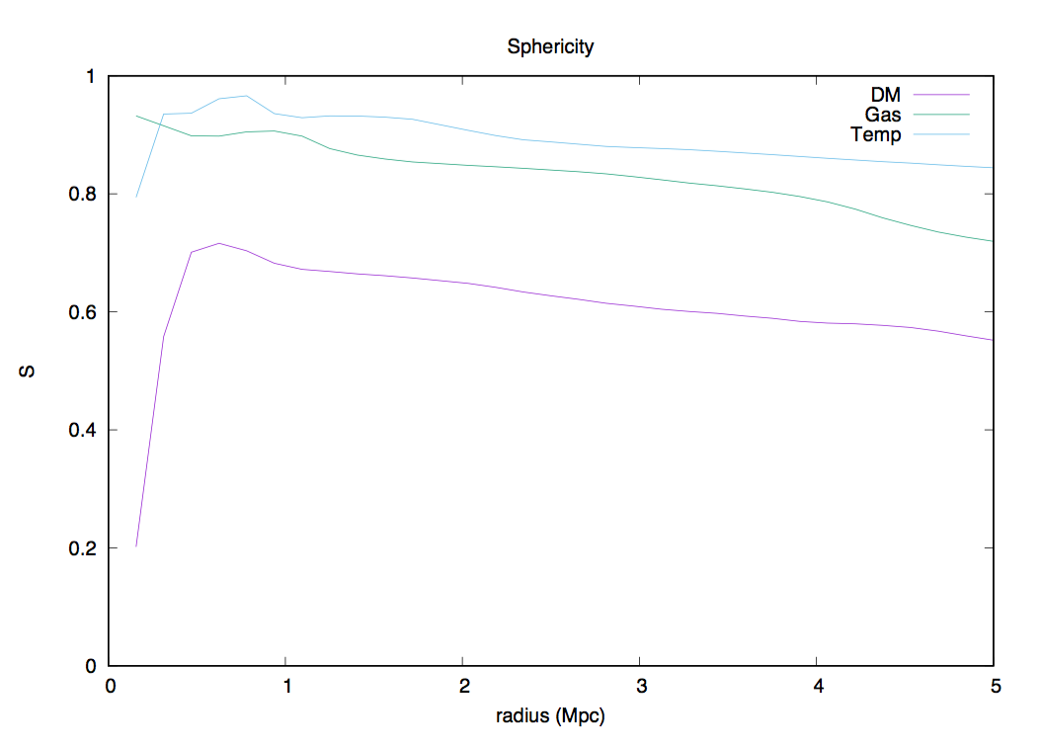
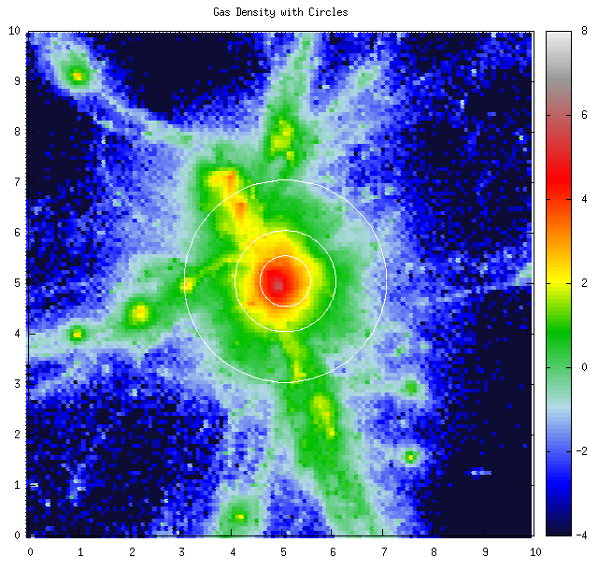
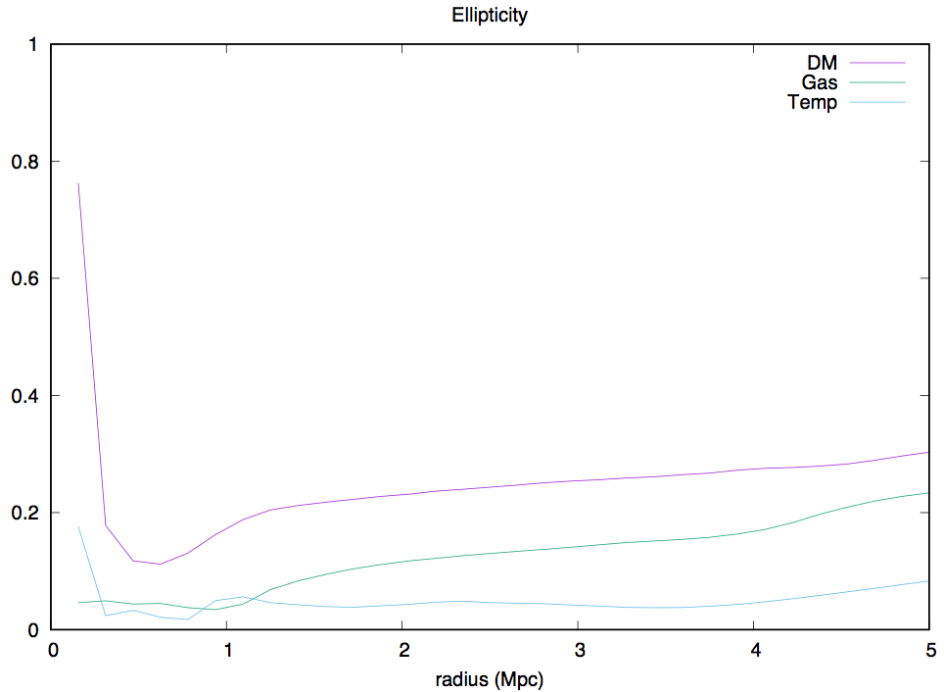
Sphericity and ellipticity
0.1 Mpc thick slice through xy projection for gas density

Slide 7
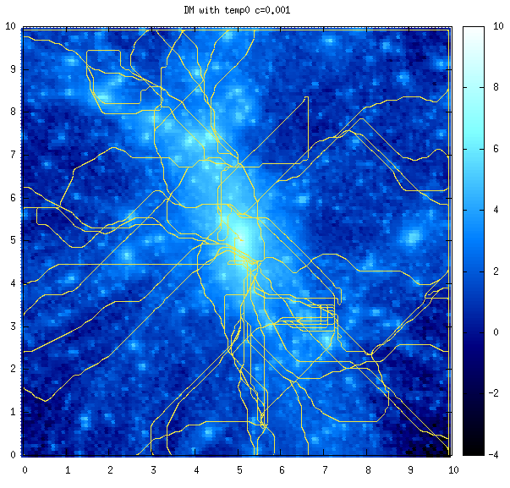
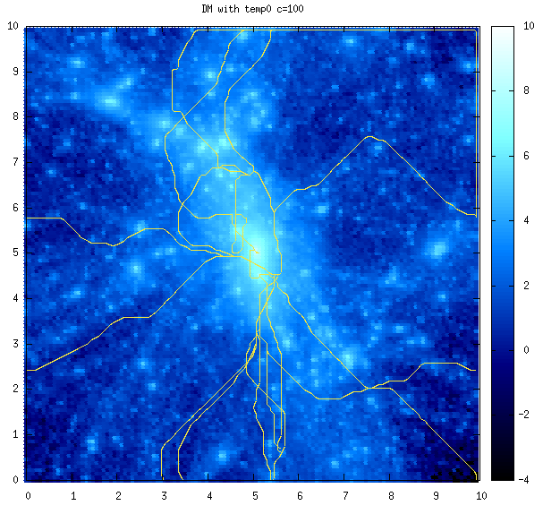
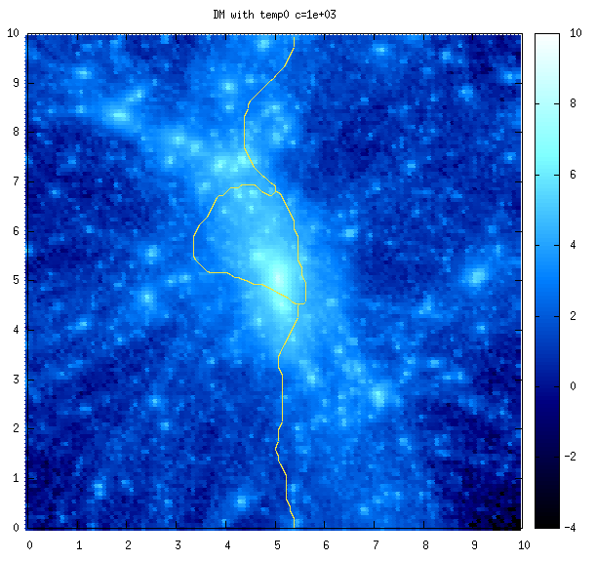
Large-scale structure
Discrete Persistent Source Extractor (DisPerSe)
Extracts filamentary skeleton from grid values through computation of the Morse-Smale complex
Calculated up to a certain persistence level, allowing for removal of noise
Specified for –cut = {0.001,0.01,0.1,1}

Slide 8
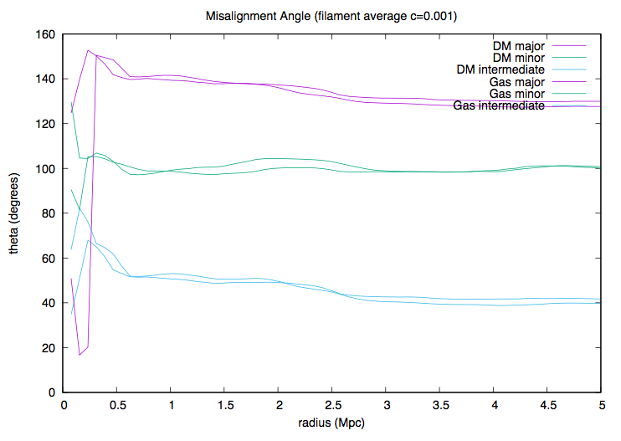
Alignment between halo axes and filament
Looking at DM and gas – intermediate axis shows strongest alignment with filament

Slide 9
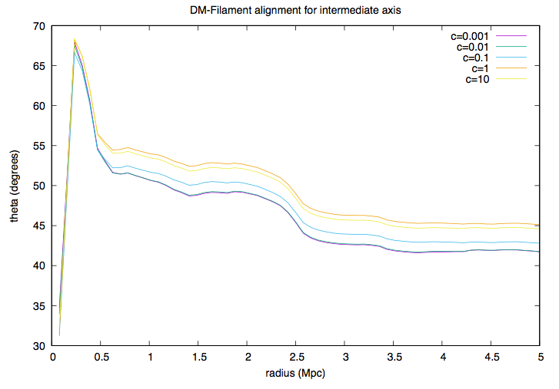
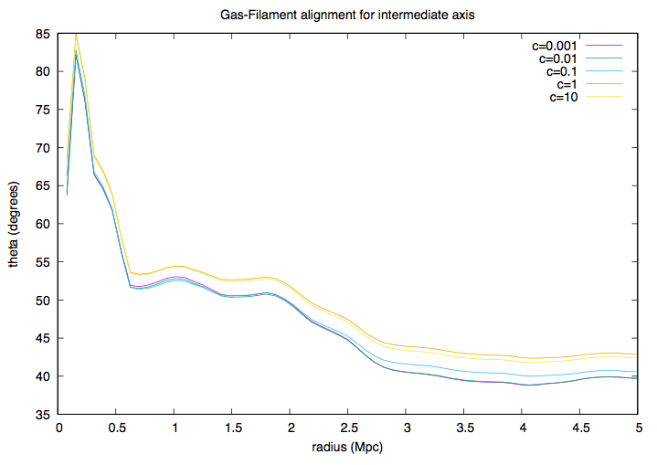
For different skeletons?
DM Alignment
Gas Alignment
See stronger alignment in gas than DM at further distance – as expected, streams along the filament.
Sharp drop at 0.5 corresponds to peak in sphericity for temperature profile – possibly a shock

