Slide 1
Alignment of a massive halo with cosmic web large-scale structure
Emily Hackett
ICRAR-Pawsey Summer Studentship

Slide 2
Background
Hierarchical structure formation:
Cosmological structures (such as large galaxy clusters) are formed by merging processes
In such processes, gas in falls into the gravitational well formed by dark matter haloes
Satellite galaxies are drawn in by a central galaxy in the dark matter halo
As this occurs, stellar matter is tidally stripped during collisions, and we can suppose that this matter will tend to align with the smooth gravitational potential of the large-scale structure

Slide 3
Why is this significant?
Why look at large-scale structure alignment?
Original aim of this project was to analyse stellar halos in the large Horizon-AGN simulation
NEW AIM: Clarify the analysis that will likely be used on the dataset – determine which parameters are significant, what could introduce confounding effects
See if the structural properties of the halo aligns with large-scale filamentary structure

Slide 4
Cluster analysis - nIFTy
Developed using gadget – SPH type simulation
Single galaxy cluster
Idea was to be similar to the Horizon-AGN simulation – hopefully this analysis can extend to larger data set
“What properties of galaxies are driven by the cosmic environment?” (Horizon-AGN website)

Slide 5

Halo Shape Properties
Reduced moment of inertia tensor
From here, find eigenvalues (square roots correspond to major, intermediate and minor axes lengths – eigenvalues correspond to axes’ direction)
From here, can then get values for sphericity, ellipticity, etc.

Slide 6
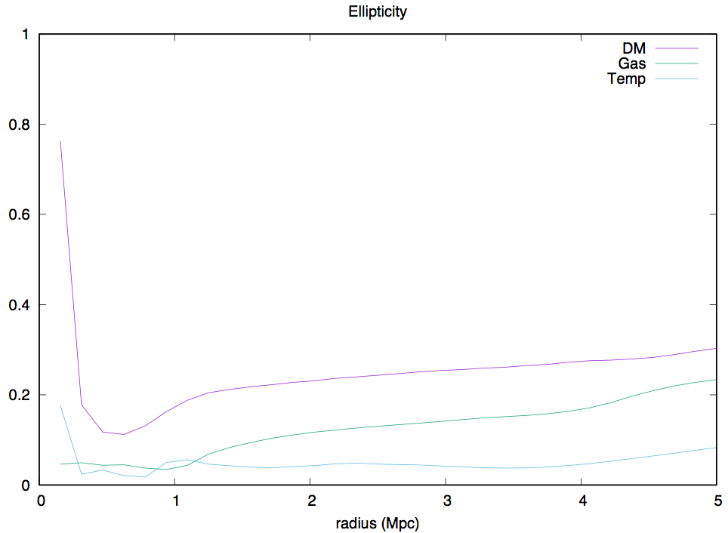
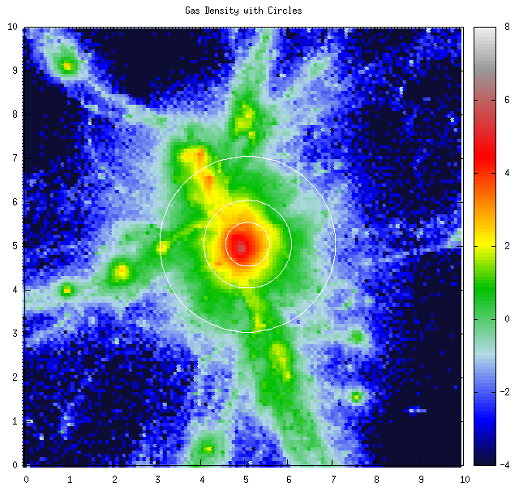

Ellipticity evolution with radius
0.1 Mpc thick slice through xy projection for gas density

Slide 7
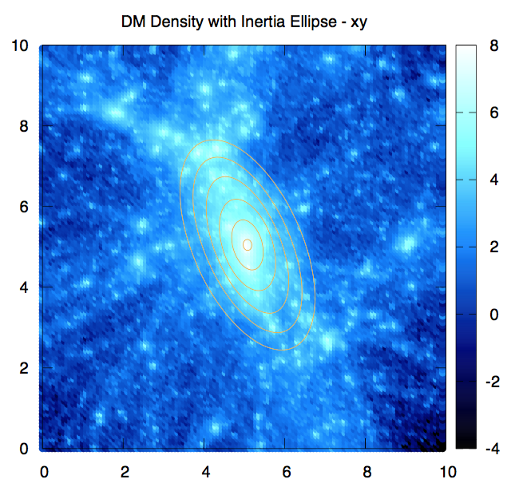
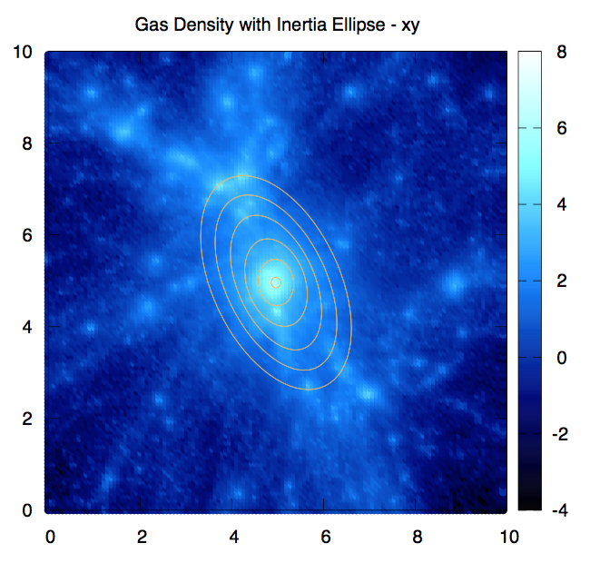
Projection of moment of inertia ellipsoids

Slide 8
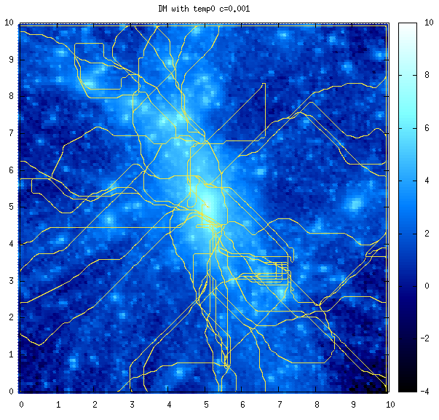
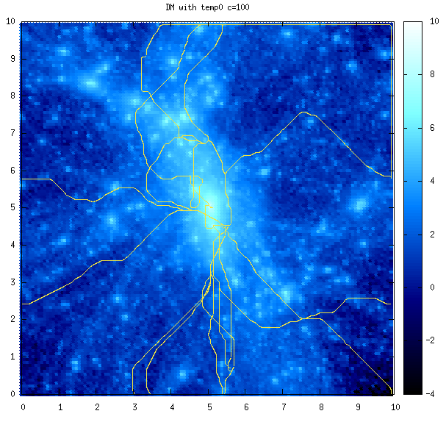
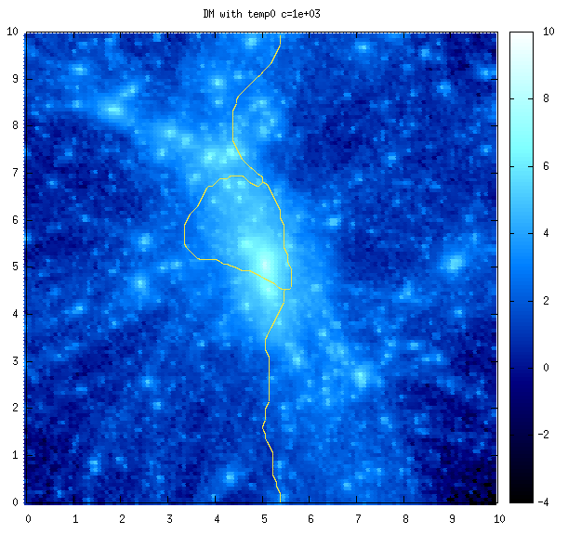
Large-scale structure
Discrete Persistent Source Extractor (DisPerSe)
Extracts filamentary skeleton from grid values through computation of the Morse-Smale complex
Calculated up to a certain persistence level, allowing for removal of noise
Specified for –cut = {0.001,0.01,0.1,1}

Slide 9
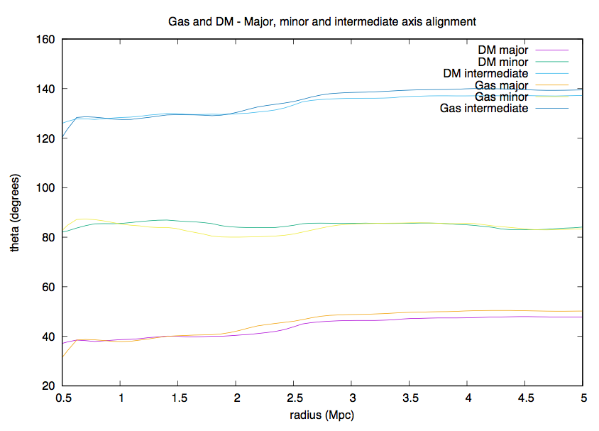
Alignment between halo axes and filament
Looking at DM and gas – major axis shows strongest alignment with filament

Slide 10
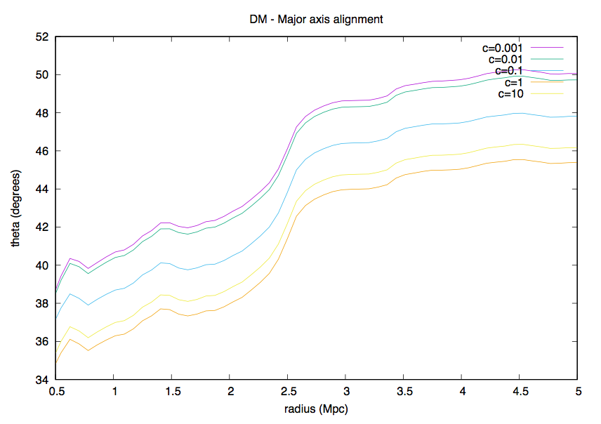
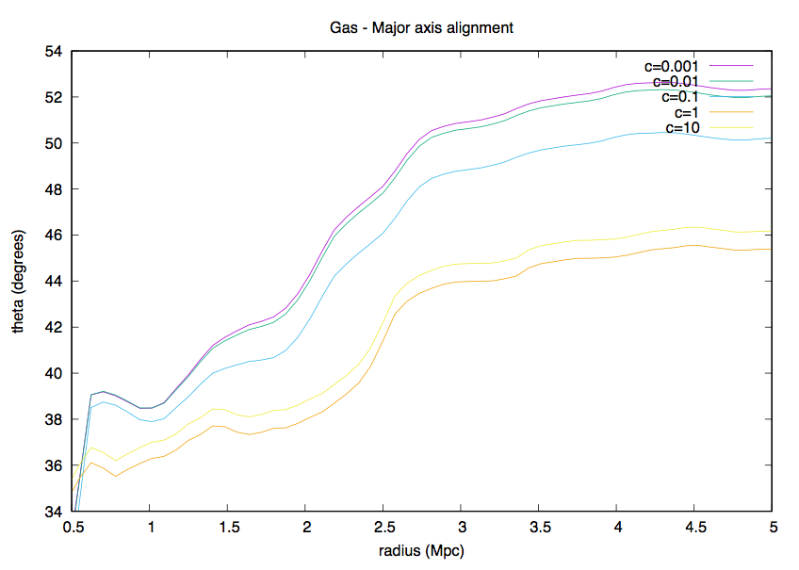
Major axis for different skeletons
DM Alignment
Gas Alignment
Largely consistent for skeletons in DM, not so much Gas
Peak in misalignment at low radius in gas possibly due to shock

Slide 11
Questions?

