Slide 1
Investigating the correlation between structural properties of stellar haloes and the large-scale properties of the cosmic web
Emily Hackett
Supervisors: Dr. Chris Power and Dr. Charlotte Welker

Slide 2
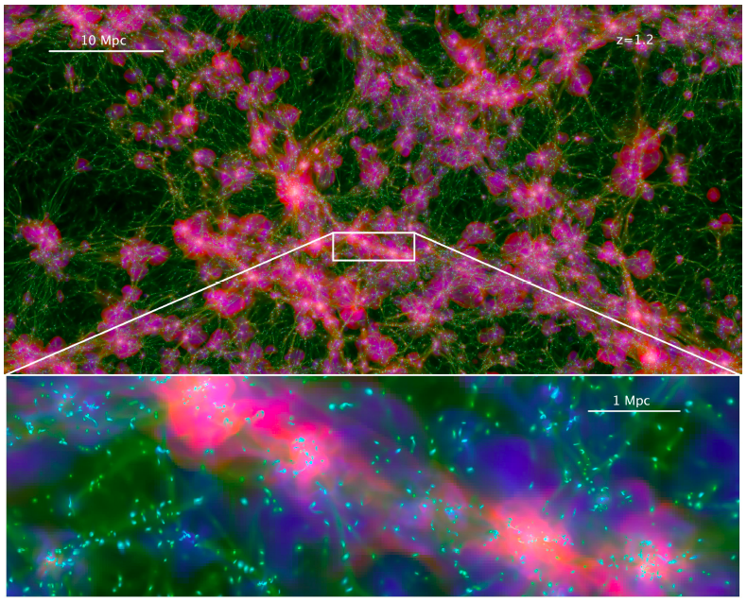
BACKGROUND:
Universe is formed via hierarchical structure formation (under gravitational instabilities)
Angular momentum results from tidal torques between neighboring density fluctuations
WHY?
‘Spin crisis’ in simulations
Semi-analytic models of galaxy formation
Weak gravitational lensing
Projected map of Horizon-AGN simulation, Dubois et al 2014

Slide 3
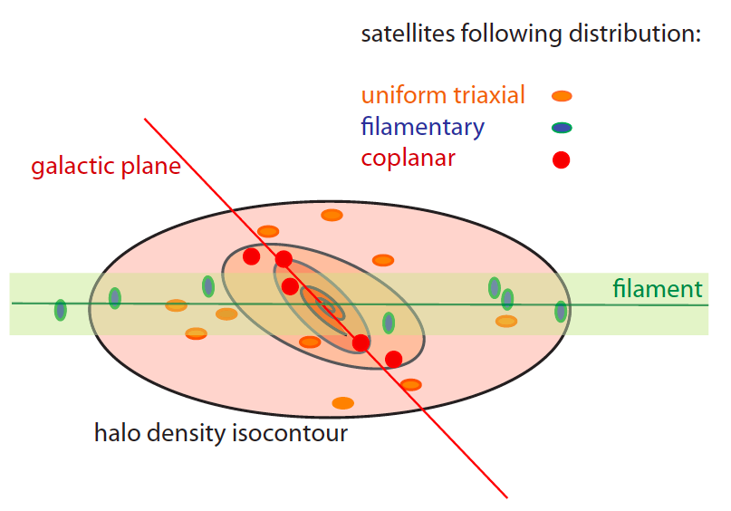
AIM
Previous studies show dark matter halo properties correlate with local environment
Structural properties include orientation, mass and angular momentum profiles
Local environment = voids, walls and filaments
What about galaxies, or more specifically, stellar haloes?
Satellite orientation trends in a dark matter halo, Welker et al 2016
Do the structural properties of stellar haloes correlate with that of the cosmic web in which they reside?

Slide 4
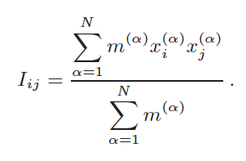
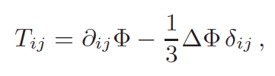
METHOD
Use linear tidal torque theory to calculate the angular momentum of stellar haloes
Reduced moment of inertia tensor, I
Iterative calculation from particle positions
Tidal shear tensor, T
Smoothed kernel calculation from cosmic web
Definitions of moment of inertia tensor I, and tidal shear tensor, T. Chisari et al 2015

Slide 5
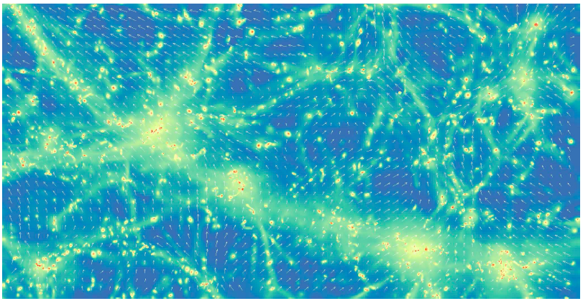
Conclusion
Map of eigenvectors (white arrows) of tidal field, Chisari et al 2015
Thank you for listening

