Slide 1
Investigating the correlation between structural properties of stellar haloes and the large-scale properties of the cosmic web
Emily Hackett
Supervisors: Dr. Chris Power and Dr. Charlotte Welker

Slide 2
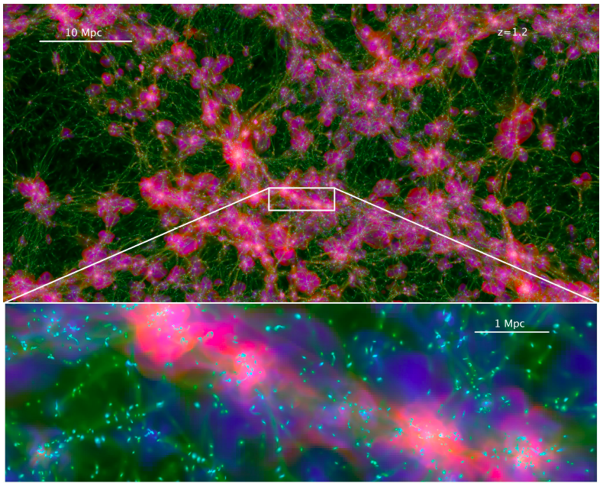
BACKGROUND:
Universe is formed via hierarchical structure formation (under gravitational instabilities)
Angular momentum results from tidal torques between neighboring density fluctuations
WHY?
‘Spin crisis’ in simulations
Semi-analytic models of galaxy formation
Weak gravitational lensing
Radio astronomy
Projected map of Horizon-AGN simulation, Dubois et al 2014

Slide 3
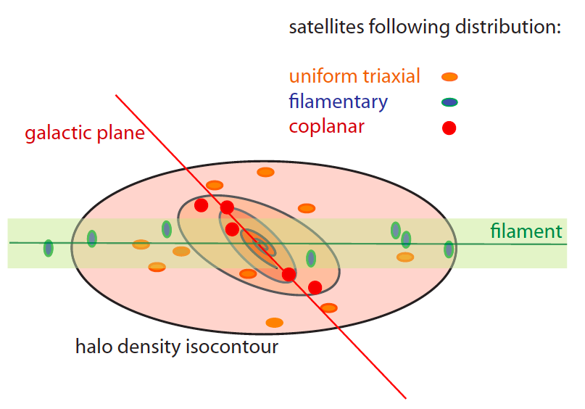
AIM
Previous studies show dark matter halo properties correlate with local environment
Structural properties include orientation, mass and angular momentum profiles
Local environment = voids, walls and filaments
What about galaxies, or more specifically, stellar haloes?
Satellite orientation trends in a dark matter halo, Welker et al 2016
Do the structural properties of stellar haloes correlate with those of the cosmic web in which they reside?

Slide 4
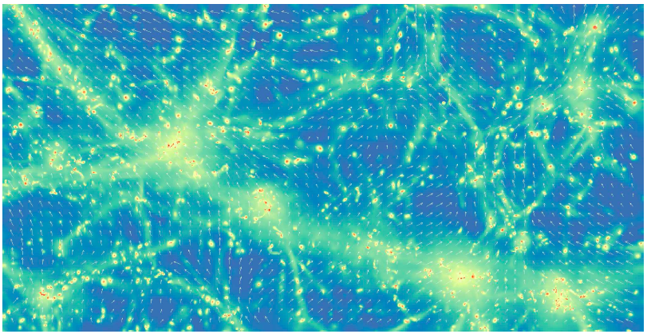
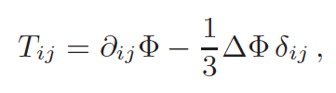
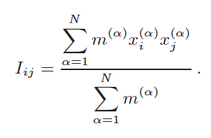
METHOD
Use linear tidal torque theory to calculate the angular momentum of stellar haloes
Reduced moment of inertia tensor, I
Iterative calculation from particle positions
Tidal shear tensor, T
Smoothed kernel calculation from cosmic web
RESOURCES?
Horizon-AGN simulation data located on Magnus at Pawsey
Structural quantities calculated for large data sets
Visualization of cosmic web
Eigenvectors tidal shear tensor, T. Chisari et al 2015
Definitions of moment of inertia tensor I, and tidal shear tensor, T. Chisari et al 2015

Slide 5
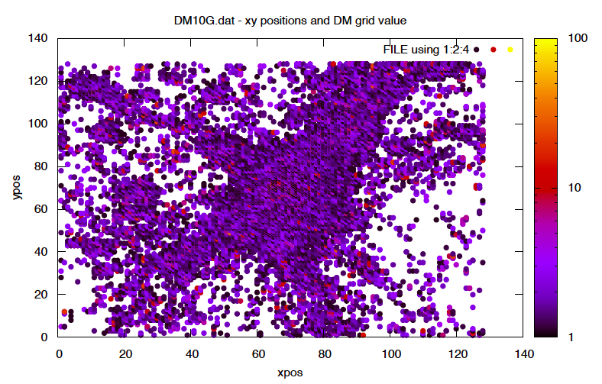
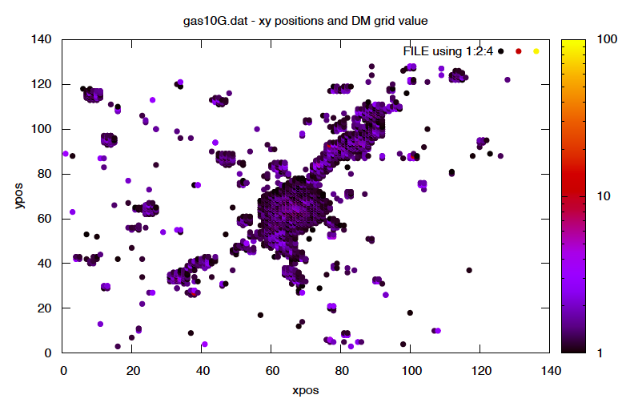
Conclusion
Dark matter particles in a Nifty cluster
Gas particles tracing the dark matter
Thank you for listening

