Slide 1
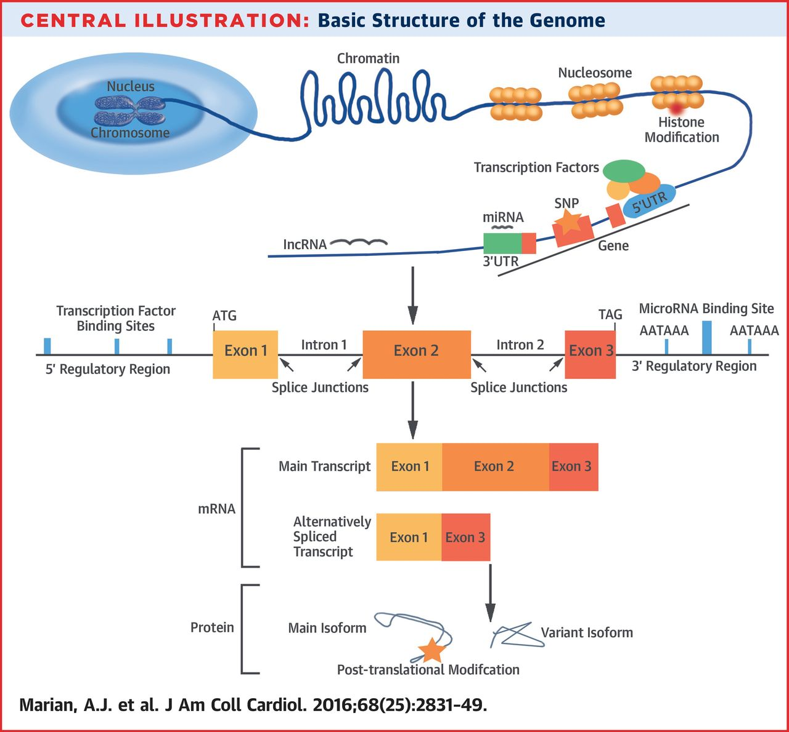

Ali J. Marian et al. JACC 2016;68:2831-2849
American College of Cardiology Foundation
Notes:
Basic Structure of the Genome The nuclear genome is organized into chromosomes and wrapped in histone proteins, condensed into chromatin, and arranged in segments referred to as nucleosomes. Histone modifications affect the chromatin state and gene expression. Each gene contains a 5′ regulatory or untranslated region (UTR) where the transcription factors bind and initiate transcription of the primary transcript. Each gene also contains exons and the intervening regions referred to as introns. Splicing machinery binds to exon-intron boundaries and splices out introns from the coding transcript, referred to as messenger ribonucleic acid (mRNA). The first coding exon contains the signal for initiation of translation, namely ATG, and the last coding exon contains a translation termination codon, such as TAG (UAG in the mRNA). The 3′ regulatory region or 3′ UTR contains 1 or more polyadenylation signals, which signal for adding a poly-A tail to the mRNA. It is also the binding site for microribonucleic acids (miRNAs). miRNAs and long noncoding ribonucleic acids (lncRNAs) are transcribed from introns or intergenic regions. SNP = single-nucleotide polymorphism.

