Slide 1
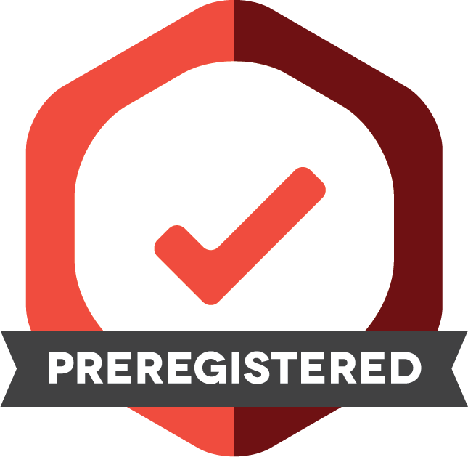
PREREGISTRATION
[Ambassador Name] [Ambassador Title/Affiliation]
Ambassador, Center for Open Science
cos.io/prereg
Notes:
This discussion will focus on Preregistration

Slide 2
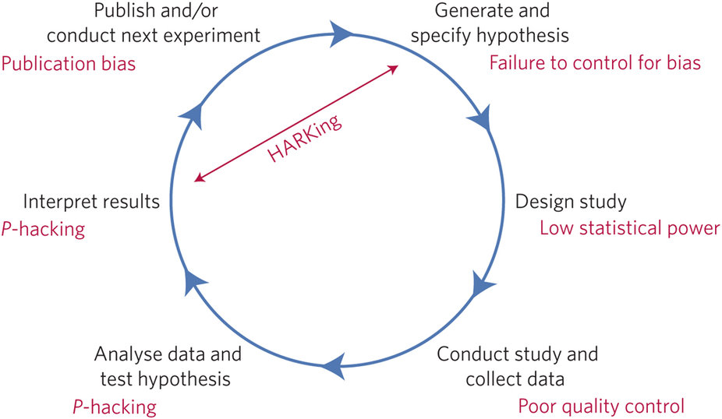

Hypo-Deductive Model of the Scientific Method
Reference: http://www.nature.com/articles/s41562-016-0021#f1
Notes:
Setting the stage:
The hypothetico-deductive scientific model of the scientific method can be short-circuited by a range of questionable research practices -- shown in red. Each step can be broken.
Lack of replication inhibits the elimination of false discoveries. 1 in 1000 papers are direct replications of previous findings.
Low statistical power increases the chances of missing true discoveries, and reduces the likelihood that obtained positive results are real.
P-hacking -- exploiting degrees of freedom -- manifests in two general ways: collecting data only until analyses return statistically significant effects and selectively reporting analyses that reveal desirable outcomes
HARKing, or “Hypothesizing After Results are Known” -- is generating a hypothesis from the data and then presenting it as a priori
Publication bias occurs when journals reject manuscripts on the basis that they report negative or undesirable findings.

Slide 3
The Problem
The combination of a strong bias toward statistically significant findings and flexibility in data analysis results can lead to irreproducible research
Notes:
The Problem: The combination of a strong bias toward statistically significant findings and flexibility in data analysis results can lead to irreproducible research

Slide 4
The Problem
The combination of a strong bias toward statistically significant findings and flexibility in data analysis results can lead to irreproducible research
Notes:
Let’s first talk about bias toward statistically significant findings

Slide 5
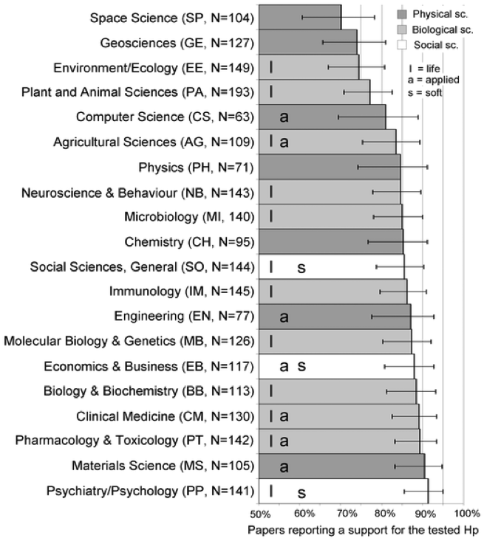
Fanelli D (2010) “Positive” Results Increase Down the Hierarchy of the Sciences. PLoS ONE 5(4): e10068. doi:10.1371/journal.pone.0010068
http://127.0.0.1:8081/plosone/article?id=info:doi/10.1371/journal.pone.0010068
Notes:
An example of ‘Strong bias toward statistically significant results” -- This chart lists various disciplines and the percentage of the articles in each discipline that report positive results.

Slide 6
The Problem
The combination of a strong bias toward statistically significant findings and flexibility in data analysis results can lead to irreproducible research
Notes:
Let’s now talk about Flexibility in data analysis

Slide 7

The Garden of Forking Paths
Statistically significant result
Control for time?
Exclude outliers?
Median or mean?
Start here
Hypothesis: “Does X affect Y?”
Gelman and Loken, 2013
Notes:
This illustration is the Garden of Forking Paths
You ask a seemingly straightforward question like, “Does X affect Y?”
But, all individual decisions you make along the way bifurcate and you end up with 100s of possible analyses…. Which increases the chances that you find some statistically significant result (the STAR illustrated on the slide).

Slide 8
The Problem
The combination of a strong bias toward statistically significant findings and flexibility in data analysis results can lead to irreproducible research
Notes:
Let’s now talk about Flexibility in data analysis

Slide 9
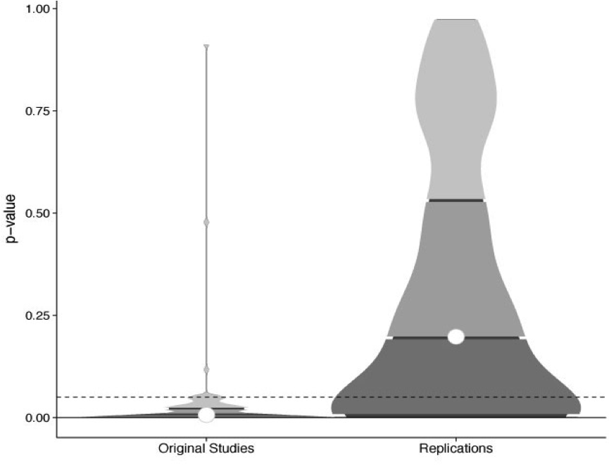
97% significant
37% significant
p-value
Reproducibility Project: Psychology
Original studies Replications
Notes:
This chart illustrates results from the Reproducibility Project: Psychology - a crowdsourced effort of over 270 researchers worldwide to reproduce 100 psychology studies that were published in prominent psychology journals.
You can see from this chart that 97% of the original studies reported significant results, while only 37% of the replications reported a significant result (even with higher effect size being used for the replications)

Slide 10
What is Preregistration?
Notes:
So, how can we as researchers eliminate questionable research practices and prevent publication bias?
Preregistration is one answer.

Slide 11
What is Preregistration?
A time-stamped, read-only version of your research plan created before you begin data collection.
Notes:
What is preregistration: A time-stamped, read-only version of your research plan created before you begin data collection.

Slide 12
What is Preregistration?
A time-stamped, read-only version of your research plan created before you begin data collection.
It contains:
Hypothesis
Data collection procedures
Manipulated and measured variables
Statistical model
Inference criteria
Notes:
A preregistration typically contains: Hypothesis, data collection procedures, manipulated and measured variables, your statistical model, and inference criteria

Slide 13
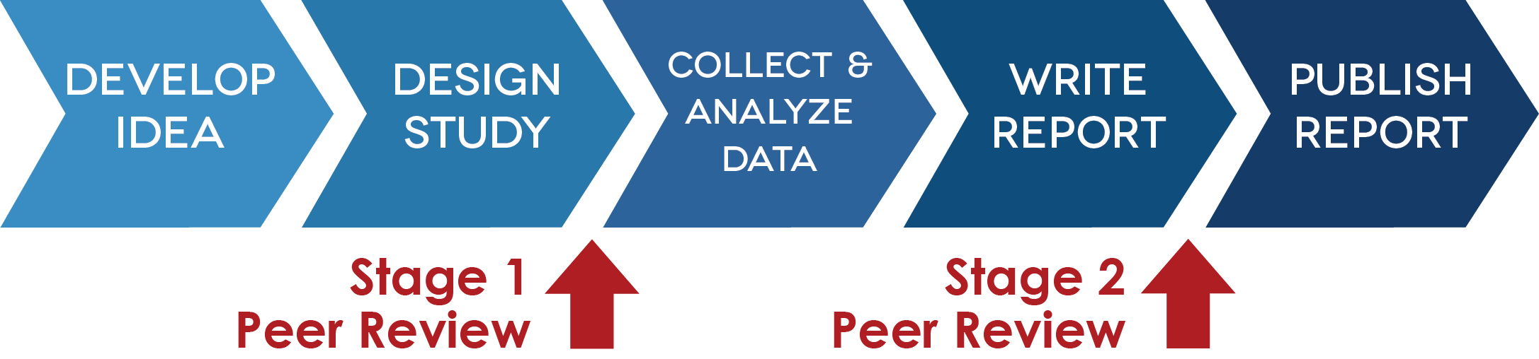
When the research plan undergoes peer review before results are known, the preregistration becomes part of a Registered Report
Notes:
When your research plan undergoes peer review, BEFORE RESULTS ARE KNOWN, the preregistration becomes part of a registered report.
Registered reports another method for combating the previously mentioned problems.
In traditional publishing, peer review occurs after the study is designed, the data collected and analyzed, and the report is written. Well founded hypotheses. Methods detailed? Is the study well powered? (>= 90%) Have the atuhors included sufficient posititive controls to confirm that the study will provide a fair test? -- include a method for “proving” their experimental design was valid, the methods worked, in a way thats independent of the actual result. I.e. Gave the mice the shot in the right place? Give them a shot of fluorescent dye has been administered in the right place. Have to do this before you see the results. Make sure the results are interpretable before the outcome, regardless of outcome.
Registered reports move peer review to after the study design, but before data is collected and analyzed. Thus, the importance of the research question and the quality of the methodology and analysis plan are reviewed -- the outcome of the study.
If a study design is accepted, it is virtually guaranteed publication in the journal, provided authors follow through with the registered methodology.
Second stage: did authors follow protocol> Did the positive controls succeed (did they give the mice the shot in the right place) and are conclusions justified by the data?
49 journals so far

Slide 14
What problems does preregistration fix?
The file drawer effect
2. P-Hacking: Unreported flexibility in data analysis
3. HARKing: Hypothesizing After Results are Known
Dataset
Hypothesis
Notes:
What problems does preregistration fix?
The file drawer effect: which means that selective publication occurs. It is a tendency to publish positive results but not to publish negative or nonconfirmatory results. Thus, the negative results never see the light of day.
P-hacking: mining your data in order to see patterns in this data that are statistically significant, without first specifying a hypothesis.
HARKing: this means Hypothesizing After Results are Known. You create a hypothesis based on or informed by your study’s results. You report it as if it were an a priori hypothesis.

Slide 15
What problems does preregistration fix?
Preregistration makes the distinction between confirmatory (hypothesis testing) and exploratory (hypothesis generating) research more clear.
Notes:
Preregistration makes the distinction between confirmatory (hypothesis testing) and exploratory (hypothesis generating) research more clear.
Both are important. However, the same data cannot be used to generate and test a hypothesis, which often happens unintentionally. With preregistration, confirmatory analyses are planned in advance in order to retain the validity of their statistical inferences, and exploratory analyses are reported as post hoc investigations that might inspire confirmatory tests in future studies.

Slide 16
Confirmatory vs. Exploratory Analysis
Context of confirmation
Traditional hypothesis testing
Results held to the highest standards of rigor
Goal is to minimize false positives
P-values interpretable
Context of discovery
Pushes knowledge into new areas/ data-led discovery
Finds unexpected relationships
Goal is to minimize false negatives
P-values meaningless
Notes:
“In statistics, hypotheses suggested by a given dataset, when tested with the same dataset that suggested them, are likely to be accepted even when they are not true. This is because circular reasoning (double dipping) would be involved: something seems true in the limited data set, therefore we hypothesize that it is true in general, therefore we (wrongly) test it on the same limited data set, which seems to confirm that it is true. Generating hypotheses based on data already observed, in the absence of testing them on new data, is referred to as post hoc theorizing (from Latin post hoc, "after this").
The correct procedure is to test any hypothesis on a data set that was not used to generate the hypothesis.”

Slide 17
Confirmatory vs. Exploratory Analysis
Context of confirmation
Traditional hypothesis testing
Results held to the highest standards of rigor
Goal is to minimize false positives
P-values interpretable
Context of discovery
Pushes knowledge into new areas/ data-led discovery
Finds unexpected relationships
Goal is to minimize false negatives
P-values meaningless
Presenting exploratory results as confirmatory increases the publishability of results at the expense of credibility of results.
Notes:
Presenting exploratory results as confirmatory increases the publishability of results at the expense of credibility of results!

Slide 18
Example workflow
Theory driven, a-priori expectations
Create Preregistration
Collect New Data
Confirmation Phase
Hypothesis testing
Discovery Phase
Exploratory research
Hypothesis generating
Notes:
You create a preregistration before you begin data collection. Remember, a preregistration plan typically contains information about your study design and statistics plan.
After you create your preregistration, you can now begin data collection. This occurs in two phases. First is the confirmation phase, where you are testing your hypothesis that was written in the preregistration plan. Second is the discovery phase - this includes new, unexpected results you may come across (but didn’t necessarily hypothesize in the preregistration). The discovery phase allows you to generate a new hypothesis, and then create a preregistration around this new hypothesis.
Remember: A preregistration separates hypothesis testing from hypothesis generating research.

Slide 19
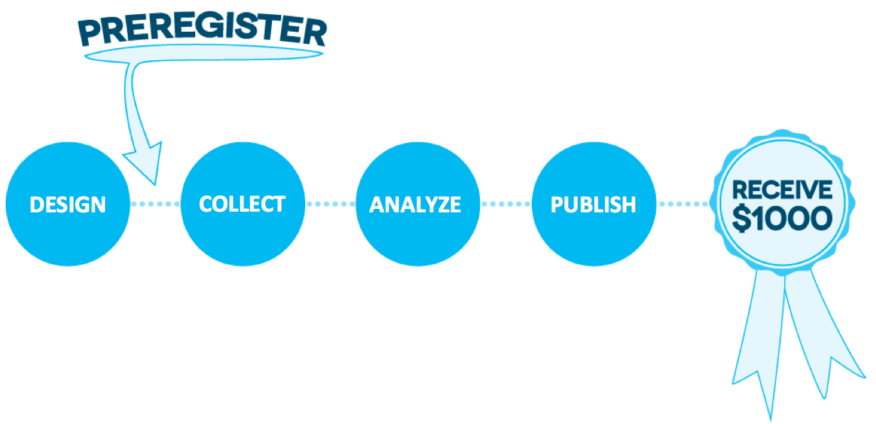
Incentives to Preregister
You have the opportunity to receive $1,000 for preregistering your research study. Visit cos.io/prereg for more info.
Notes:
The Center for Open Science has been running a challenge, The Preregistration Challenge, which began in early January 2016. If you have a project that is entering the data collection phase, COS is giving away $1,000 to 1,000 researchers who preregister their research before they publish it.

Slide 20
Incentives to Preregister
You can receive a Preregistered Badge for preregistering your research before you begin your study. Visit cos.io/badges for more information and to see which journals currently issue badges.
Notes:
Several journals also issue Open Practice Badges. You can receive a ‘Preregistered’ badge for preregistering your research before you begin data collection. This Badge icon will then appear in the journal next to your article title. It will signal to others that you have preregistered your research.

Slide 21
FAQs
Notes:
Let’s move on to some of the more frequently asked questions.

Slide 22
FAQs
Can’t someone “scoop” my ideas?
Notes:
Can’t someone scoop my ideas if I preregister my research?

Slide 23
FAQs
Can’t someone “scoop” my ideas?
Date-stamped preregistrations make your claim verifiable.
By the time you’ve preregistered, you are ahead of any possible scooper.
Embargo your preregistration.
Notes:
Question: Can’t someone scoop my ideas if I preregister my research?
Answer:
Date-stamped preregistrations make your claim verifiable
By the time you’ve preregistered, you are ahead of any possible scooper because are basically ready to begin data collection
Embargo your preregistration meaning you don’t have to make your preregistration public. It can remain private for a certain, specified amount of time.

Slide 24
FAQs
Isn’t it easy to cheat?
Notes:
Question: Isn’t it easy to cheat?

Slide 25
FAQs
Isn’t it easy to cheat?
Making a “preregistration” after conducting the study.
Making multiple preregistrations and only citing the one that “worked.”
Notes:
Question: Isn’t it easy to cheat? You can easily make a preregistration after you conduct your study. Or, you can make multiple preregistrations and only cite the one that worked out.

Slide 26
FAQs
Isn’t it easy to cheat?
Making a “preregistration” after conducting the study.
Making multiple preregistrations and only citing the one that “worked.”
While fairly easy to do, this makes fraud more intentional.
Preregistration helps keep you honest to yourself.
Notes:
It is almost impossible to eliminate all possible ways to game the system. But, these actions make fraud harder to do and more intentional. A preregistration helps keep you honest to yourself.

Slide 27
Tips for writing up preregistered work
Include a link to your preregistration (e.g. https://osf.io/f45xp)
Report the results of ALL preregistered analyses
ANY unregistered analyses must be transparent

Slide 28

THANK YOU!
Learn more: cos.io/prereg

