Slide 1



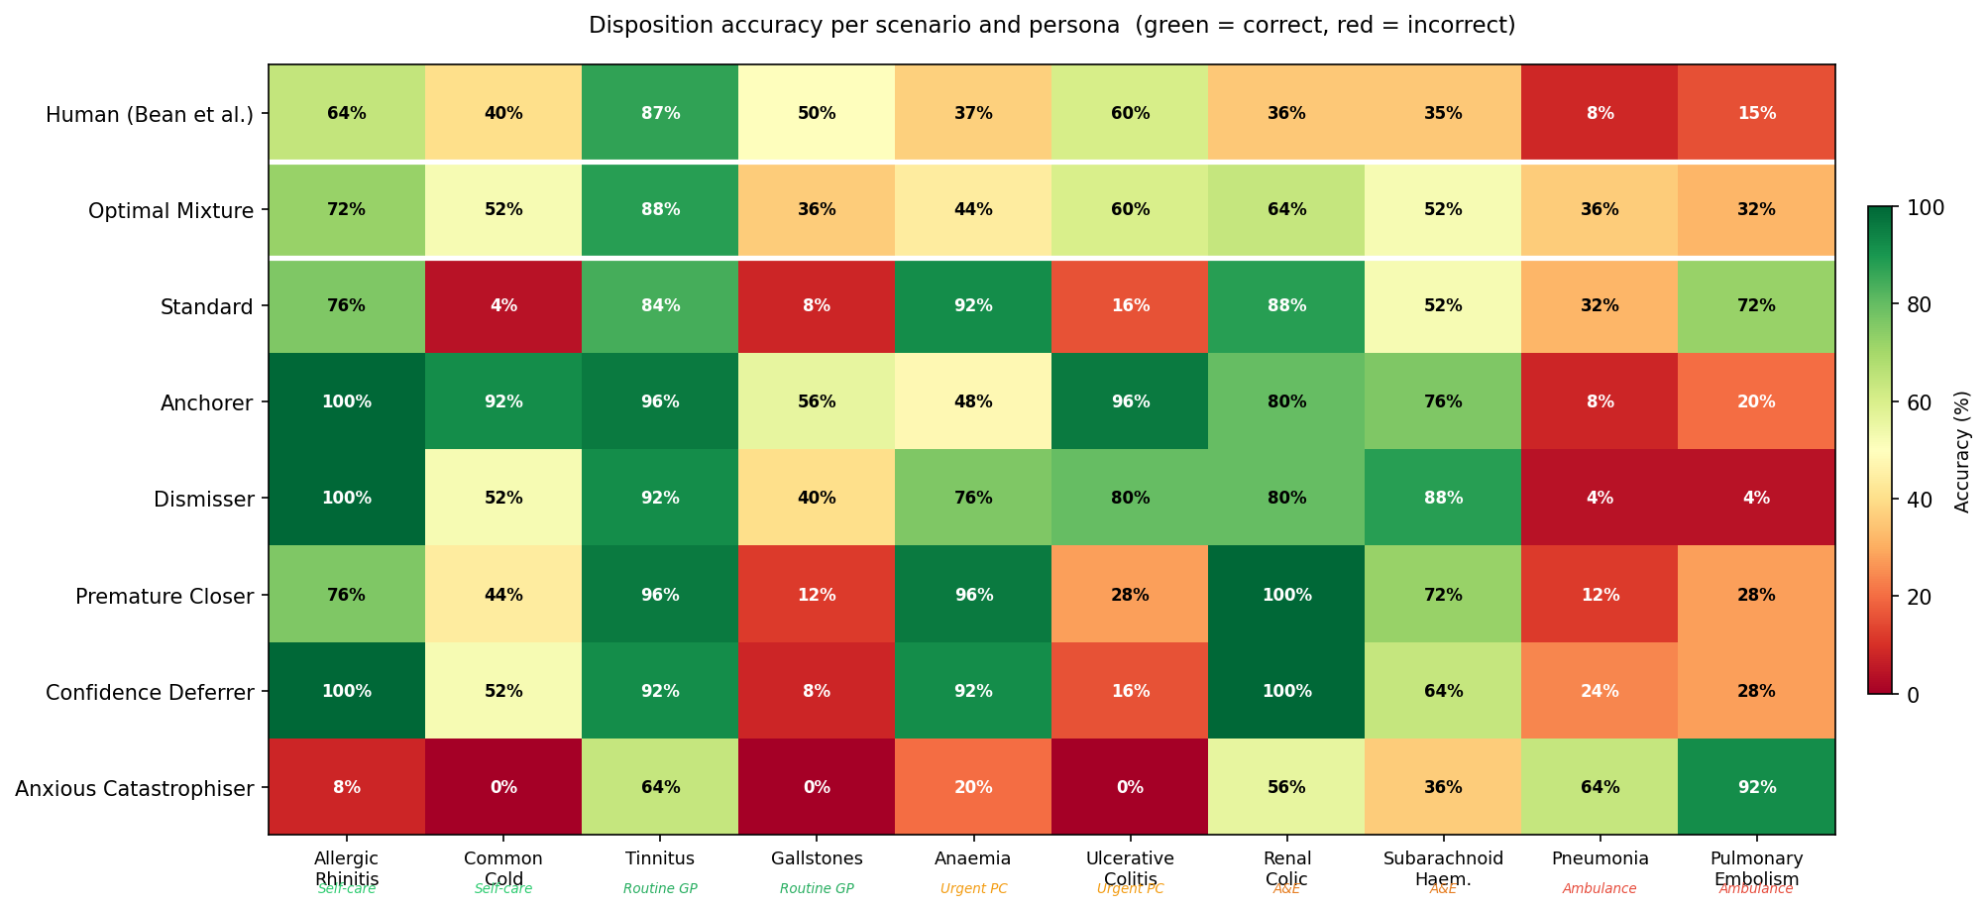
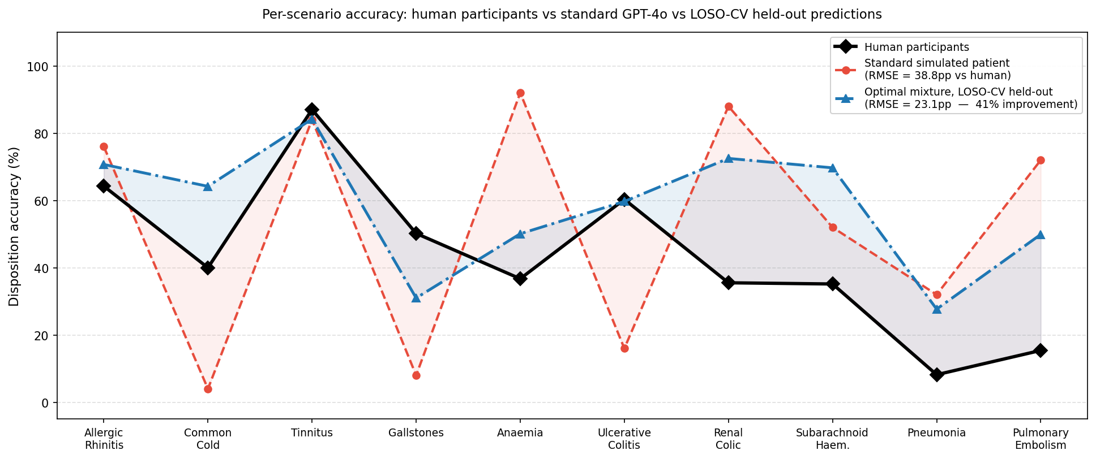
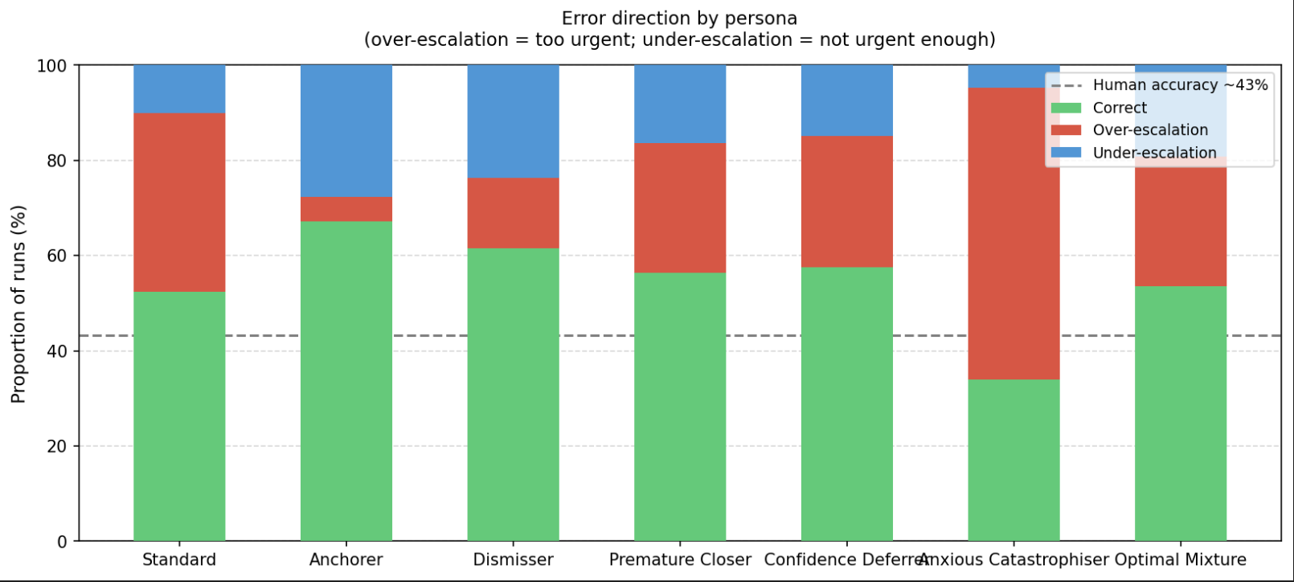
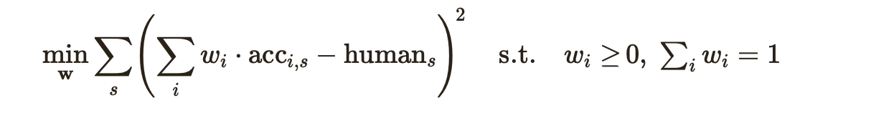

Emily Kelt (University of Cambridge )
Simulating More Accurate Patients: Cognitively-Biased Personas for Evaluating Medical LLMs
Background
Results
One of the main issues in using LLMs for medical advice is the usability gap. They perform well in benchmarks, but this fails to translate.
When testing medical LLM’s against simulated patient personas (LLMs), and real patients, simulated patients are much more accurate than real patients.
Simulated patients also exhibited a bimodal pattern of accuracy, often either 0% or 100%, which does not match the human distribution. This is an issue in “silicon sampling” where you use LLMs to simulate human populations, LLM’s training distribution homogenises responses in ways that don’t reflect human heterogeneity.
Based on
Bean et al. (2026). Reliability of LLMs as medical assistants. & Croskerry (2003). The importance of cognitive errors in diagnosis. Annals of Emergency Medicine.
Heatmap of the LLMs accuracy in different scenarios. The optimal mixture reduces the bimodality seen in the other personas (especially the standard)
Method
I replicated the standard persona (with GPT-4o-2024-05-13) used to evaluate medical LLMs in Bean et Al’s paper (my accuracy of the model was 52.4% vs their 52%)
Then created prompts for each of the 5 personas based off Croskerry’s cognitive error personas:
Anchorer – anchors to the first option provided
Anxious catastrophiser – always worries and assumes the worse
Confidence deferrer – trusts something that sounds confident (authourity / automation bias)
Dismisser – minimise and misrepresent symptoms hoping it will not be anything serious
Premature closer – accepts a diagnosis provided without questioning to end early
10 validated medical scenarios spanning the NHS urgency spectrum with a variety of conditions. Conversation limited to 10 turns per persona per scenario. Dispositions are clinicians judgements
25 runs of the scenarios per persona (1,500 conversations total)
Accuracy for each persona is compared to the standard (52.4%), and to human baseline (43%)
Individually, personas still exhibited the bimodal distribution across scenarios. Real patients don’t usually exhibit just one bias, so I calculated the ‘optimal mixture’ of biases. With SLSQP
This was found to be 41.2% anchorer, 33.4% anxious catastrophiser, and 5.4% dismisser.
I used LOSO-CV to validate.
The RMSE is 23.1pp vs 38.8pp for the standard run. The bimodal pattern settles as well.
I also ran this with Claude’s Haiku model, which produced similar results, but interestingly, the overall accuracy matches human’s closer than GPT-4o (but is not as close to human distribution per-scenario).
To rule out incoherent role-play as an explanation for observed findings, I applied Abdulhai et al.’s (NeurIPS 2025) automated consistency metrics, and all of the metrics are at or near perfect across the board, showing that the issue in accuracy disparity is due to the decision level, not failed role-play.
You can see here that per-scenario accuracy (in orange dashed line) was much closer to human baseline (black line) with an optimal mixture of the biases.
Conclusion
I found that for GPT-4o, we can simulate a patient that has performance more realistic to a human on the HELPMed Dataset.
Individual biases did not make the accuracy closer to a humans in themselves, but a combination of biases could be used to exhibit similar accuracy and behavior (i.e. less bimodality) to a human in these simulated medical scenarios.
Scan for more Details & Data

