Slide 1
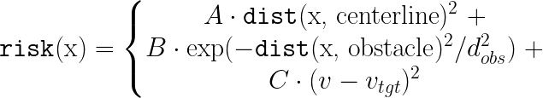


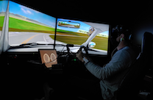

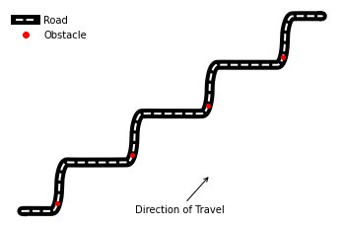
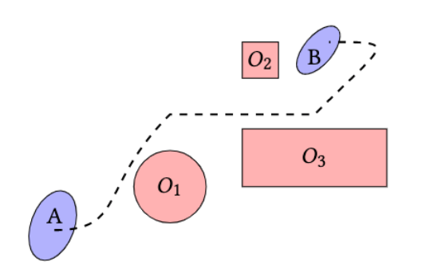
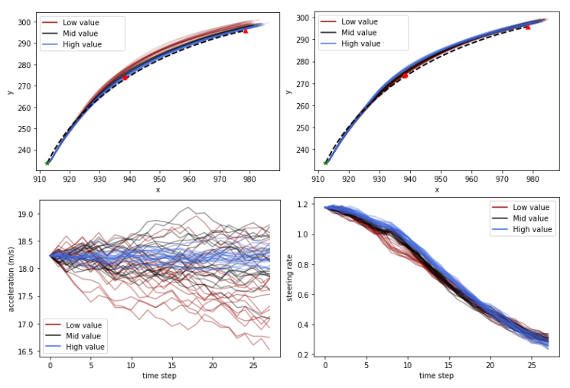
Mathematical Models of Human Operators Using Artificial Risk Fields
Driving Task
Driving Risk Field
Participants: 6 total, 3 male + 3 female
Mean age 21.33 years
Data Collected: 19 total trials on driving course
Trial length is about 4 minutes
Data sampled at 60 Hz
Emily Jensen¹, Maya Luster², Hansol Yoon¹, Brandon Pitts²,
Sriram Sankaranarayanan¹
Objectives: Be safe and stay in lane
Avoid colliding with the 4 obstacles
Maintain speed of 45 mph
Each state is associated with a risk from a variety of factors. We model that drivers will prefer lower risk.
1 University of Colorado Boulder
2 Purdue University
Contact: emily.jensen@colorado.edu
Artificial Risk Fields
Goal: Describe a concise model of a human operating a robot in an uncertain environment. We should be able to learn the model given (state, control) pairs.
Each control input is associated with a cost. We model that drivers will prefer lower cost with a more constant range of inputs.
Problem Formulation: A risk field includes the following:
A set of obstacles to avoid
A set of task specifications (target velocity, time limit)
Start and Goal states
A set of environment states x
A set of possible controls u
A model of human decision making – P( u | x )
We model drivers as Boltzmann rational; they are exponentially more likely to choose a control input if they think it will lead to lower risk and cost.
Fitting the Model
Maximize log-likelihood of decision model using convex optimization tools
Fitting model using parameters A – E
Generated trajectories using 5th and 95th percentile parameter values
Qualitatively different trajectory and control behavior by changing parameters
Trajectories are accurate to reference up to 5 seconds later
Future Work
Predict driver situational awareness
Provide driver interventions based on runtime monitoring
Develop more nuanced method of tracking velocities
Apply models to more complex datasets

