Slide 1
ARE TEACHERS OBSOLETE?
Emily Jensen’s Area Exam
12 November, 2021
Full bibliography at the end
Notes:
Obviously the answer to this question is no (or not yet)
Let’s actually start with the guiding question
We are going to do a whirlwind tour of automated systems, intelligent tutoring systems, and education

Slide 2
How can adaptive systems train humans to perform complex tasks?
Notes:
As I facetiously asked in the title slide, I’m interested in learning (especially mastery of skills), and specifically how we may be able to automate it.
I’ll organize this talk over the key concepts in this question

Slide 3
How can adaptive systems train humans to perform complex tasks?
Notes:
I’ll organize this talk over the key concepts in this question by focusing first on what even are adaptive systems, discussing how we can train humans (mostly through ITS), and then thinking about how this can be generalized to complex problems.

Slide 4
How can adaptive systems train humans to perform complex tasks?
Notes:
I’ll organize this talk over the key concepts in this question by focusing first on what even are adaptive systems, discussing how we can train humans (mostly through ITS), and then thinking about how this can be generalized to complex problems.

Slide 5
How can adaptive systems train humans to perform complex tasks?
Notes:
I’ll organize this talk over the key concepts in this question by focusing first on what even are adaptive systems, discussing how we can train humans (mostly through ITS), and then thinking about how this can be generalized to complex problems.
After that, I’ll discuss some common themes and opportunities for future work.

Slide 6
ADAPTIVE SYSTEMS
A brief overview
Notes:
Let’s discuss what I mean by adaptive systems, since there is some difference in vocabulary depending on who you talk to

Slide 7
Automated Systems
Machine agent performs previously human tasks
Notes:
There is a continuum of how much of the task is done by the machine vs. human
By default these have a fixed allocation, but we may want to dynamically change these over time (for example, human operator becomes fatigued)

Slide 8
Automated Systems
Machine agent performs previously human tasks
Adaptable Automation
Human chooses how to adjust the automation
Adaptive Automation
System adjusts based on current human state
(Parasuraman, 1997; Feigh, 2012)
Notes:
We are going to focus on adaptive automation
Why is this worth studying? Potentially unobtrusive and provides assistance without being asked

Slide 9
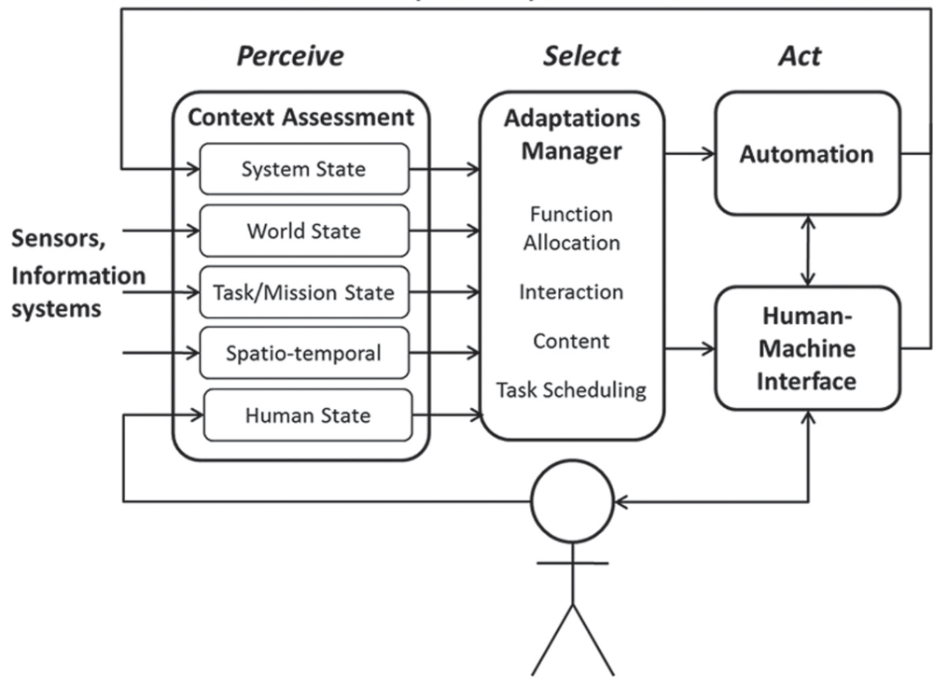
Adaptive Systems
(Fig. from Feigh, 2012; Heard, 2020)
Notes:
Adaptive systems generally function on the Perceive, Select, Act framework (this may be familiar to when we teach basic robotics schemas). This looks like a lot, so I’ll break down the individual parts a bit and use an example from the (Heard 2020) paper.

Slide 10
Adaptive Systems
(Fig. from Feigh, 2012; Heard, 2020)
Notes:
“Perceive” takes in information from the environment and estimates possible factors that need adjustment
There are various types of triggers that may be relevant based on specific context
Some examples include if sensors are out of range, operator fatigue, change in weather

Slide 11
Adaptive Systems
(Fig. from Feigh, 2012; Heard, 2020)
Notes:
“Select” is an internal process where the system chooses what type of change to make based on potential trigger from input data
Common adaptation changes include taking responsibility away from the operator (discussed more later)

Slide 12
Adaptive Systems
(Fig. from Feigh, 2012; Heard, 2020)
Notes:
“Act” provides the external interaction with the user, and starts the cycle over again
Using the same example, we could change the actual interface the user interacts with

Slide 13
TRAINING HUMANS
Efficiently and at scale
Notes:
The main focus of the talk, we will use Intelligent Tutoring Systems as a motivating example, since we are teaching people to “know” something. As we will discuss, there are a few different ways to assess “knowing”, which is a big discussion in the educational community

Slide 14
Learner Modeling
Estimates learner’s internal state
(Pelánek, 2017)
Notes:
Our overall goal in learner modeling is to understand what is going on inside a learner’s head, which we obviously can’t directly observe

Slide 15
Learner Modeling
Estimates learner’s internal state
Domain Model
Task specific representation of skills to learn
Learner Model
System adjusts based on current human state
(Pelánek, 2017)
Notes:
The two main components involve creating a domain and learner model. Most work in Intelligent Tutoring Systems involves designing these types of models
A common approach to domain models is to consult with experts (knowledge components), although some methods exist to automatically learn a skill structure. I’m mainly going to focus on learner modeling

Slide 16
Learner Modeling
Bayesian Knowledge Tracing
(Pelánek, 2017)
Notes:
(briefly) Bayesian knowledge tracing depends on a domain model made of knowledge components, which represent units of information. An example might be “adding fractions with the same denominator”. Bayesian Knowledge Tracing is a method of representing learning as a Hidden Markov Model, where we make a transition for each item attempted

Slide 17
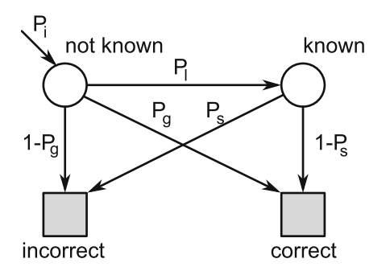
Learner Modeling
Bayesian Knowledge Tracing
P_{i} = initial
P_{l} = learn
P_{g} = guess
P_{s} = slip
(Fig. from Pelánek, 2017; orig. Corbett & Anderson 1995)
Notes:
Learner models are based on four main values. At any time, we have an estimate of the probability that the learner has mastered a concept. Additionally, there are probabilities of learning (unknown → known), slipping (wrong when known), and guessing (right when unknown).
We can update the prob of knowing after they answer each item

Slide 18
Learner Modeling
Bayesian Knowledge Tracing
Learning individual P_{i}
(Pardos, 2010)
Relationship between carelessness + affect
(San Pedro, 2011)
Cf. Deep Knowledge Tracing (Khajah, 2016)
P_{i} = initial
P_{l} = learn
P_{g} = guess
P_{s} = slip
(Fig. from Pelánek, 2017)
Notes:
There’s been a whole line of research extending this original model to better explain the learning process. For example, individualizing the initial knowledge of each student and examining how slips/carelessness relate to affect

Slide 19
Learner Modeling
Inverse Reinforcement Learning
Notes:
Other approaches have taken inspiration from inverse reinforcement learning and planning. Whereas BKT defines learning as getting the right answer, these frameworks usually consider the sequence of actions the learner has taken when solving the problem

Slide 20
Learner Modeling
Inverse Reinforcement Learning
Infer knowledge based on a sequence of actions
Ex: solving algebraic equations
Learner is modeled as an MDP
(Rafferty, 2016)
Notes:
Learner is modeled as a Markov Decision Process where their policy is noisily rational based on their understanding of the concepts. By calculating the posterior distribution, we estimate which concepts may be misunderstood in order to give feedback. The hypothesis space is a continuous space with the number of dimensions = number of concepts.
This assumes people are approximately rational, an assumption which we discuss later

Slide 21
Giving Feedback
Gold standard: human tutors
Curriculum development
Personalization
But, it’s not scalable. Can we automate problem generation? (Gulwani, 2014)
Notes:
Now that we have a few methods of estimating the learner’s knowledge, what can we practically do about it?
Human tutors working 1 on 1 with learners is the most effective form of teaching since they can understand exactly what you need in a given moment

Slide 22
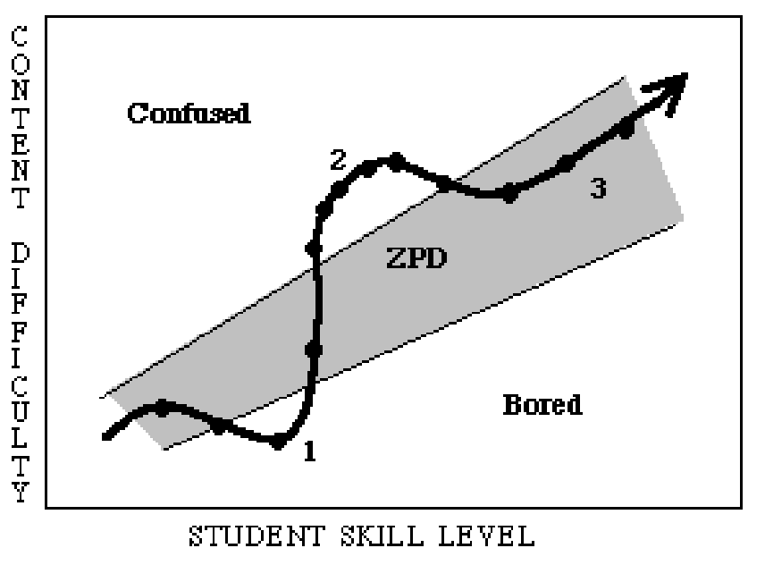
Giving Feedback
Make it challenging, but not too hard
Scaffolding! (Shute, 2008)
Deliberate Practice (Ericsson, 1993)
Zone of Proximal Development (Vygotsky, 1978)
(Fig. from Murray, 2002)
Notes:
Feedback can also be provided in the form of guided instruction and feedback. These are all forms of matching the difficulty level to the learner
Scaffolding = general practice of providing resources when needed, but fading away over time
Deliberate practice = intense, focused practice on areas for improvement, with a long-term outlook
Zone of Proximal Development = what you can do with help. Go over figure and numbers, make a note about how affect is noted here

Slide 23
Giving Feedback
Make it challenging, but not too hard
Scaffolding! (Shute, 2008)
Deliberate Practice (Ericsson, 1993)
Zone of Proximal Development (Vygotsky, 1978)
Some concrete examples
Bayesian Knowledge Tracing based “ready to learn” (Baker, 2020)
Address a misunderstood skill (Rafferty, 2016)
ZPD based on hint use (Murray, 2002)
(Fig. from Murray, 2002)
Notes:
(Baker 2020) - ready to learn means the prerequisite skills have been mastered
(Rafferty 2016) - misunderstood means the posterior distribution estimate is lower for that skill (mean over distribution)
(Murray 2002) - defined ZPD as not confused or bored, which means using just the right amount of hints

Slide 24
COMPLEX TASKS
Current work and opportunities
Notes:
What is currently being done in the field of adaptive systems to teach people complex tasks? Here we start moving away from the strict ITS discussion

Slide 25
Modeling Complex Tasks
How do we measure the internal state of the user?
Driving - Actively force user to display behavior (Sadigh, 2016)
Gaming - Assume actions are rational wrt internal dynamics (Reddy, 2018)
Measure physiological responses (Heard, 2020)
Notes:
To apply the terminology of the last section, we are looking to study the knowledge model of the learner. The heart of this is identifying the internal state of the learner.
(Sadigh 2016) - designed robot reward to probe human if it will distinguish between aggressive or distracted behaviors
(Reddy 2018) - infer user’s transition model which represents their understood dynamics
(Heard 2020) - measure workload based on physiology and used this as a trigger for adaptation

Slide 26
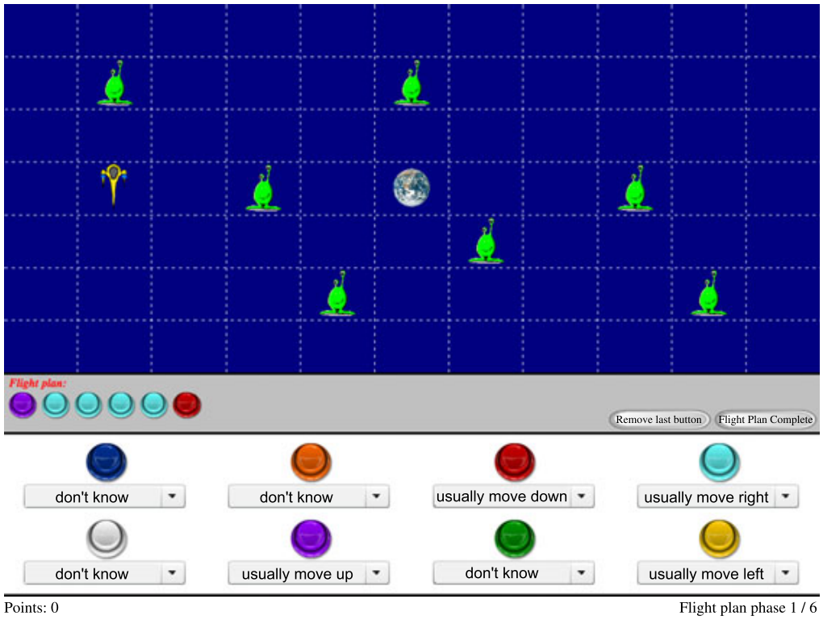
Case Study: Rafferty 2015
Notes:
Give a brief overview of the task to make the theory easier

Slide 27
Case Study: Rafferty 2015
Modeled complex user actions as a Markov Decision Process
Users may have misconceptions about how their actions change the current state
Used inverse planning to reason about knowledge

Slide 28
Review of
Markov Decision Processes
Agent is currently in state s and chooses to take action a
Next state s’ is determined by transition model T = Pr(s’ | s, a)
The result of the action is given a cost/reward r(s, a, s’)

Slide 29
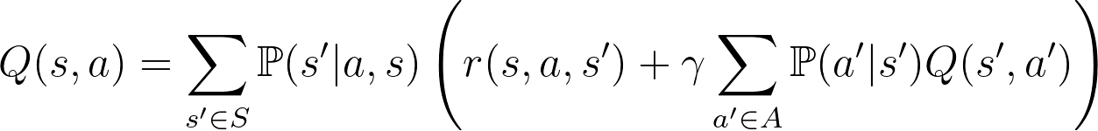
Review of
Markov Decision Processes
Expected long-term value is given by Q(s, a)
Chosen action is determined by policy Pr(a | s)
(optimal policy will maximize Q)
Sum over all possible next states
Prob. of getting to the state
Reward at the state
Discounted result of future actions

Slide 30
Inferring User Beliefs
Assume reward function is given
Goal: infer user’s transition model given action sequence
Posterior: prob of a given transition model
Likelihood: prob of action sequence given model
Prior: distribution over transition models. Can encode misconceptions, set as uniform here

Slide 31
Inferring User Beliefs
Need approximation of policy to calculate likelihood
Use Boltzmann noisily optimal policy
Higher Q represents better choices
Marginalize over various values of β
Determines how close to optimal
Q-value of choosing action in state

Slide 32
Key Results
73% match of Maximum A Posteriori with beliefs
Distinguishes plans with misconceptions
Similar performance to human raters
Notes:
Task = navigate to earth, uncertainty with buttons
Posterior estimate spread out when misconceptions

Slide 33
How can adaptive systems train humans to perform complex tasks?
Notes:
To remind you of where we started, here was our guiding question. We’ve explored some of the work going on in the three key concepts in this question.

Slide 34
Adaptive Automation
Perceive
Select
Act
Notes:
I now want to re-frame and think about the work mentioned above in the sense of the adaptive automation framework, which will hopefully highlight a few areas for future research

Slide 35
Adaptive Automation
Perceive
Great strides in sensing technology (Feigh, 2012)
Theoretical frameworks for assessing knowledge (Pelánek, 2017)
Are humans really rational? (Reddy, 2018; Rafferty, 2015/2016)
How do we represent complex domain models?
Need to address the social-emotional and cultural side of learning
Notes:
Perceive = judging the current state of the system based on sensors and input data
The vast majority of work has been done in this area, which makes sense since you can’t adapt to something you can’t measure
Discuss Herb Simon’s work on bounded rationality and satisficing.

Slide 36
Adaptive Automation
Perceive
Select
Great strides in sensing technology (Feigh, 2012)
Theoretical frameworks for assessing knowledge (Pelánek, 2017)
Are humans really rational? (Reddy, 2018; Rafferty, 2015/2016)
How do we represent complex domain models?
Need to address the social-emotional and cultural side of learning
Triggers and adaptations based on heuristics (Heard, 2020; Murray, 2002; Shute, 2008)
Need to go beyond metrics like performance (Khasawneh, 2019; Heard, 2020)
How do we plan for how humans change over time? (Kress-Gazit, 2021)
Notes:
Select = internal process to choose what type of adaptation to make

Slide 37
Adaptive Automation
Perceive
Select
Act
Great strides in sensing technology (Feigh, 2012)
Theoretical frameworks for assessing knowledge (Pelánek, 2017)
Are humans really rational? (Reddy, 2018; Rafferty, 2015/2016)
How do we represent complex domain models?
Need to address the social-emotional and cultural side of learning
Triggers and adaptations based on heuristics (Heard, 2020; Murray, 2002; Shute, 2008)
Need to go beyond metrics like performance (Khasawneh, 2019; Heard, 2020)
How do we plan for how humans change over time? (Kress-Gazit, 2021)
A whole world of UX/UI and VIZ to explore
What is the role of explainability?
Very little focus on user experience (Khasawneh, 2019; Heard, 2020)
How do we treat humans as an integral part of the system? (Parasuraman, 1997)
Notes:
Act = external interactions between human and system

Slide 38
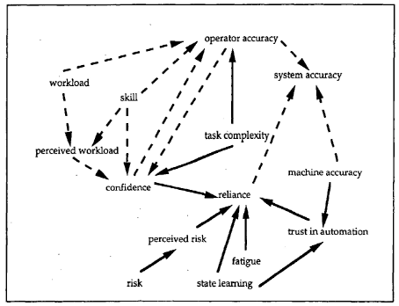
Human-Centered Automation
Theorized
Tested
(Fig. from Parasuraman, 1997; Kress-Gazit, 2021; Khasawneh, 2019)
Notes:
Figure: interactions between factors influencing automation use
There’s clearly a lot of messy factors that go into how humans may choose to interact with automated systems. How do we consider this during the design process? Do we have to start from scratch for every specific application? Can we formalize these interactions in a way that generalize to other people?

Slide 39
How do I fit into this?
Notes:
Very briefly, I wanted to situate my work into this framework and align it with some future directions

Slide 40
How do I fit into this?
Perceive
Sensor-free student affect (EDM 2019; HLA)
Teacher dialog strategies (CHI 2020; LAK 2021b)
Cognitive engagement (LAK 2021a)
Notes:
I’ve primarily focused on the educational sphere, but I’m interested in looking into more complex training tasks that integrate the learner intentionally into the iterative process

Slide 41
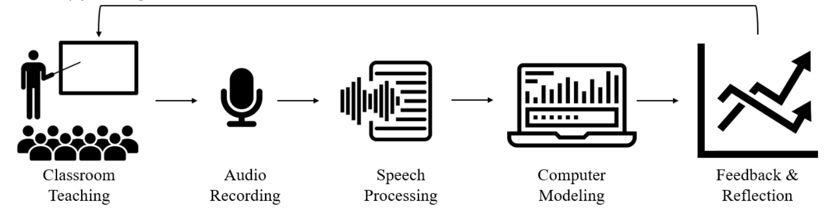
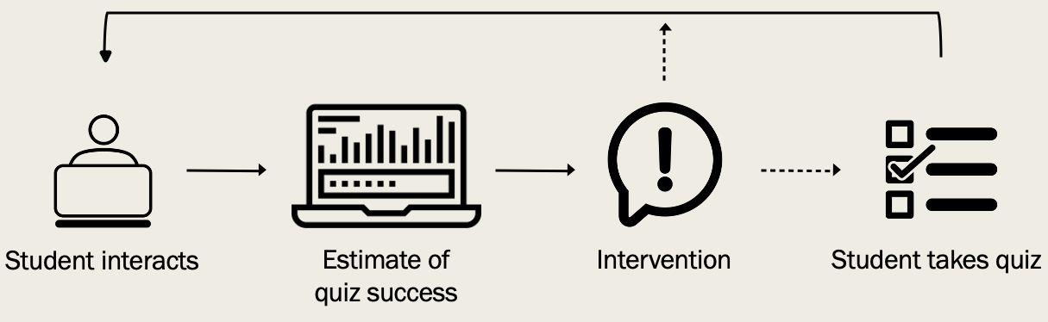
How do I fit into this?
Perceive
Select
Act
Sensor-free student affect (EDM 2019; HLA)
Teacher dialog strategies (CHI 2020; LAK 2021b)
Cognitive engagement (LAK 2021a)
Notes:
I’ve primarily focused on the educational sphere, but I’m interested in looking into more complex training tasks that integrate the learner intentionally into the iterative process

Slide 42
ARE TEACHERS OBSOLETE?
Notes:
To finish on an obvious note, I’ll return to my original question. Clearly there is more work to do before the robots take over, but there is some interesting research in progress!

Slide 43
Thank you!
Questions?

Slide 44
References, pt 1
Baker, R.S.J.d. et al. 2020. The results of zone of proximal development on learning outcomes. Proceedings of The 13th International Conference on Educational Data Mining (EDM 2020) (2020), 749–753.
Corbett, A.T. and Anderson, J.R. 1995. Knowledge-tracing: modeling the acquisition of procedural knowledge. User Modeling and User Adapted Interaction. 4, (1995), 253–278.
Ericsson, K.A. et al. 1993. The role of deliberate practice in the acquisition of expert performance. Psychological Review. 100, 3 (1993), 363–406.
Feigh, K.M. et al. 2012. Toward a characterization of adaptive systems: a framework for researchers and system designers. Human Factors. 54, 6 (2012), 1008–1024.
Gulwani, S. 2014. Example-based learning in computer-aided stem education. Communications of the ACM. 57, 8 (Aug. 2014), 70–80.
Heard, J. et al. 2020. SAHRTA: a supervisory-based adaptive human-robot teaming architecture. 2020 IEEE International Conference on Cognitive and Computational Aspects of Situation Management, CogSIMA 2020 (2020), 37–44.
Khajah, M. et al. 2016. How deep is knowledge tracing? Proceedings of the 9th International Conference on Educational Data Mining, EDM 2016 (2016).
Khasawneh, A. et al. 2019. Human adaptation to latency in teleoperated multi-robot human-agent search and rescue teams. Automation in Construction. 99, January 2018 (2019), 265–277. DOI:https://doi.org/10.1016/j.autcon.2018.12.012.
Kress-Gazit, H. et al. 2021. Formalizing and guaranteeing human-robot interaction. Communications of the ACM. 64, 9 (Sep. 2021), 78–84.

Slide 45
References, pt 2
Murray, T. and Arroyo, I. 2002. Toward measuring and maintaining the zone of proximal development in adaptive instructional systems. International Conference on Intelligent Tutoring Systems (2002), 749–758.
Parasuraman, R. and Riley, V. 1997. Humans and automation: use, misuse, disuse, abuse. Human Factors. 39, 2 (1997), 230–253.
Pardos, Z.A. and Heffernan, N.T. 2010. Modeling individualization in a bayesian networks implementation of knowledge tracing. User Modeling, Adaptation, and Personalization. 255–267.
Pelánek, R. 2017. Bayesian knowledge tracing, logistic models, and beyond: an overview of learner modeling techniques. User Modeling and User-Adapted Interaction. 27, (2017), 313–350.
Rafferty, A.N. et al. 2016. Using inverse planning for personalized feedback. Proceedings of the 9th International Conference on Educational Data Mining, EDM 2016 (2016), 472–477.
Rafferty, A.N. et al. 2015. Inferring learners’ knowledge from their actions. Cognitive Science. 39, 3 (2015), 584–618.
Reddy, S. et al. 2018. Where do you think you’re going?: inferring beliefs about dynamics from behavior. Advances in Neural Information Processing Systems. 2018-Decem, NeurIPS (2018), 1454–1465.
Sadigh, D. et al. 2016. Information gathering actions over human internal state. IEEE International Conference on Intelligent Robots and Systems (2016), 66–73.
San Pedro, M.O.C.Z. et al. 2011. The relationship between carelessness and affect in a cognitive tutor. Affective Computing and Intelligent Interaction (ACII 2011) (2011), 306–315.
Shute, V.J. 2008. Focus on formative feedback. Review of Educational Research. 78, 1 (2008), 153–189.
Vygotsky, L.S. 1978. Mind in society: the development of higher psychological processes. Harvard University Press.

Slide 46
References, pt 3
Jensen, E. et al. 2019. Generalizability of sensor-free affect detection models in a longitudinal dataset of tens of thousands of students. The 12th International Conference on Educational Data Mining (2019), 324–329.
Jensen, E. et al. 2020. Toward automated feedback on teacher discourse to enhance teacher learning. 2020 CHI Conference on Human Factors in Computing Systems Proceedings (CHI 2020) (2020).
Jensen, E. et al. 2021a. What you do predicts how you do: prospectively modeling student quiz performance using activity features in an online learning environment. LAK21: 11th International Learning Analytics and Knowledge Conference (LAK21) (2021).
Jensen, E. et al. 2021b. A deep transfer learning approach to modeling teacher discourse in the classroom. LAK21: 11th International Learning Analytics and Knowledge Conference (LAK21) (2021).
D’Mello, S.K. and Jensen, E. (to appear) Emotional Learning Analytics. Handbook of Learning Analytics.

