Slide 1
What You Do Predicts How You Do: s Prospectively Modeling Student Quiz Performance Using Activity Features in an Online Learning Environment
Emily Jensen Tetsumichi Umada Nicholas C. Hunkins
Stephen Hutt A. Corinne Huggins-Manley Sidney K. D’Mello
Notes:
Introduction

Slide 2


Notes:
Suppose a student is asked to regulate their own learning in a self-paced learning environment (no teacher)

Slide 3

Interactive
Constructive
Active
Passive
Notes:
Ideally, we would want them to spend their time on the interactive side of the ICAP framework

Slide 4
Interactive
Constructive
Active
Passive

Slide 5
Interactive
Constructive
Active
Passive
Notes:
However, it is found that most time is spent on passive activities such as watching videos or re-reading materials

Slide 6
Interactive
Constructive
Active
Passive
Retrieval Practice
Notes:
More specific to assessment, we know that Retrieval practice is an effective form of studying

Slide 7
Interactive
Constructive
Active
Passive
Retrieval Practice
Cram, Memorize
Notes:
Similarly, it is found that students prefer to cram and memorize information, which is not a productive use of time

Slide 8
Proposed Workflow
Notes:
To encourage students to use retrieval practice, we propose the following workflow

Slide 9

Proposed Workflow
Student interacts
Notes:
First, students interact with an online learning environment

Slide 10

Proposed Workflow
Student interacts
Estimate of
quiz success
Notes:
Periodically, the platform will generate an automated estimate of student success on a topic quiz

Slide 11

Proposed Workflow
Student interacts
Estimate of
quiz success
Intervention
Notes:
If the student is estimated as likely to perform well on the quiz, deliver an intervention to encourage them to take the quiz

Slide 12

Proposed Workflow
Student interacts
Estimate of
quiz success
Intervention
Student takes quiz
Notes:
Ideally, student would then take the suggested quiz

Slide 13
Proposed Workflow
Student interacts
Estimate of
quiz success
Intervention
Student takes quiz
Notes:
This is then a cyclic process where learning and interacting continue

Slide 14
Proposed Workflow
Student interacts
Estimate of
quiz success
Intervention
Student takes quiz
Notes:
However, students may choose to not take a quiz

Slide 15
Proposed Workflow
Student interacts
Estimate of
quiz success
Intervention
Student takes quiz
Notes:
In that case, after the intervention we would return to the beginning of the cycle

Slide 16
Proposed Workflow
Student interacts
Estimate of
quiz success
Intervention
Student takes quiz
Notes:
For this paper, we focus on developing an automated method of estimating success on a quiz. In particular, we are going to do this for a high school algebra platform

Slide 17
Prediction Granularity
Notes:
There are many different levels we can predict student success

Slide 18
Prediction Granularity
Fine
Coarse
Notes:
Previous work has looked at everything from very fine to very coarse grained metrics. I’ll flash a few references of prior work here, but you can look at the paper for more details

Slide 19
Prediction Granularity
Item
Fine
Coarse
Programming
Problem
Doan and Sahebi (EDM 2019)
Emerson et al. (EDM 2019)
Pardos et al. (EDM 2013)
Notes:
Here’s some examples of fine-grained metrics of student success

Slide 20
Prediction Granularity
Course
Grade
Item
Fine
Coarse
Programming
Problem
Long
Exam
Drop-out
Doan and Sahebi (EDM 2019)
Emerson et al. (EDM 2019)
Pardos et al. (EDM 2013)
Dalipi et al. (EDUCON 2018)
Koedinger et al. (L@S 2015)
Moreno-Marcos et al. (TLT 2019)
Notes:
Here’s some examples of coarse-grained student success

Slide 21
Prediction Granularity
Course
Grade
Item
Fine
Coarse
Programming
Problem
Long
Exam
Drop-out
Not Informative
Notes:
An issue with the fine-grained feedback is that it is not informative enough to give meaningful feedback to students

Slide 22
Prediction Granularity
Course
Grade
Item
Fine
Coarse
Programming
Problem
Long
Exam
Drop-out
Not Informative
High Stakes
Notes:
An issue with coarse-grained feedback is that these are high-stakes and may be too late to deliver an intervention

Slide 23
Prediction Granularity
Short
Quiz
Course
Grade
Item
Fine
Coarse
Programming
Problem
Long
Exam
Drop-out
Not Informative
High Stakes
Notes:
We propose using a middle ground, which is short formative quizzes that students have the opportunity to take frequently

Slide 24


Notes:
We will be using data from Algebra Nation, an online mathematics learning platform

Slide 25
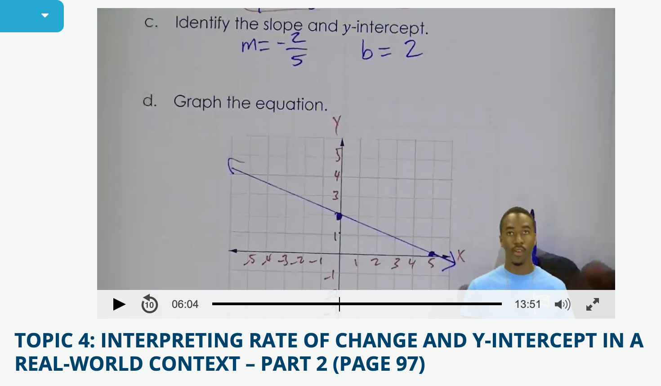
Algebra Nation
Notes:
Students can watch videos from expert tutors

Slide 26
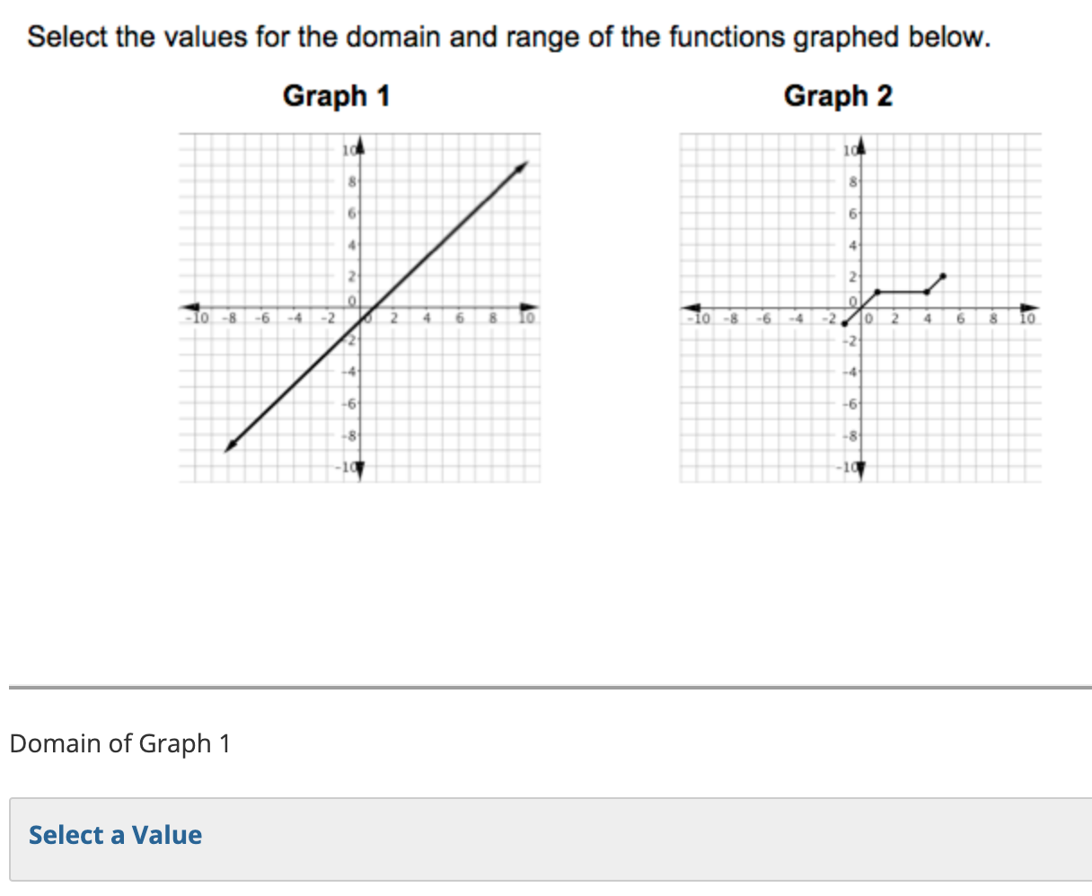
Algebra Nation
Notes:
They can take quizzes that have multiple choice and free response questions to test their knowledge. Some teachers may assign this as a homework assignment

Slide 27
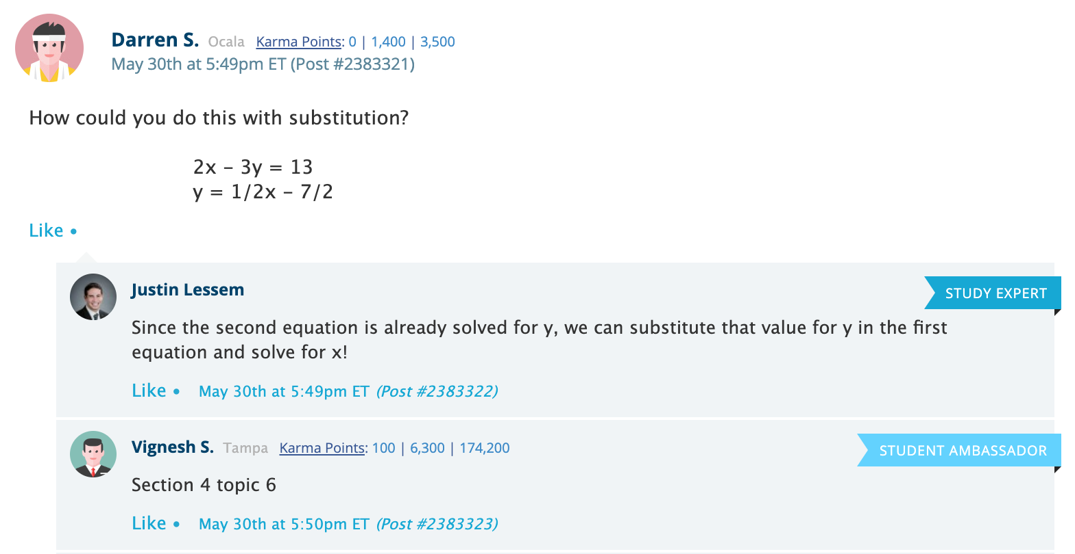
Algebra Nation
Notes:
Students can post questions they are stuck on to get help from other students or the study expert on duty

Slide 28
Data
32,685 students
Notes:
Data is based on 32,685 students using the platform over a year

Slide 29
Data
32,685 students
labels
Quiz Performance
Notes:
Ground truth labels for the models are based on quiz scores

Slide 30
Short
Quiz
Course
Grade
Item
Fine
Coarse
Programming
Problem
Long
Exam
Drop-out
Notes:
As a reminder of what these quizzes are

Slide 31
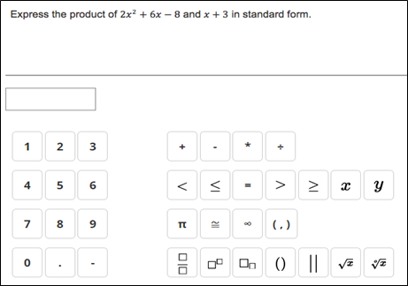
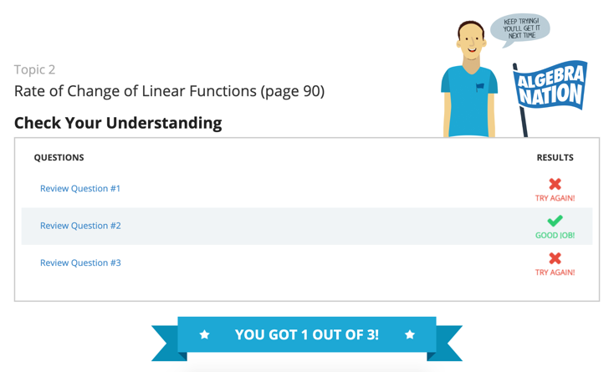
Quizzes
Notes:
These are 3-item quizzes and students can see if their answers were correct

Slide 32
Data
32,685 students
labels
Quiz Performance
(1st attempt only,
N = 210,020)
Notes:
Because they can see correct responses, we only consider first attempts. This gives us 210,020 quizzes

Slide 33

Data
32,685 students
features
labels
Interaction Click Data
Quiz Performance
(1st attempt only)
Notes:
The features we use to train the models are interaction logs with the platform. The reason we chose to use interaction data is that it scales well and doesn’t require expert coded knowledge units

Slide 34
Instance Building
Notes:
Here’s how we generated our training instances

Slide 35
Instance Building
Quiz #1
Notes:
Start when a student takes a quiz

Slide 36
Instance Building
3 minutes
Quiz #1
Notes:
When a student takes a quiz, count the activities in a 3-minute window preceding the quiz.

Slide 37





Instance Building
3 minutes
Quiz #1
Notes:
These can be a variety of different activities

Slide 38
Instance Building
3 minutes
Quiz #1
Quiz ID | Play | Pause | Rewind | Forward | Quiz | Post
1 | 3 | 1 | 1 | 0 | 2 | 1
Notes:
Aggregate the count. We aren’t considering patterns or order of activities. Also note this only considers data leading up to the start of the quiz, not anything that happens after.

Slide 39
Model Building
Random Forest Regression
Predict quiz score (0 – 3)
5-fold student-level cross validation with grid search for parameter tuning
Evaluate results using Pearson correlation between predicted and actual scores
Notes:
Some details on the models we used

Slide 40
How well can we predict quiz performance using immediate learning context?
Notes:
Research Question 1

Slide 41
Interaction Click Data
Notes:
We take interaction click data

Slide 42
Random Forest Regression
Interaction Click Data
Notes:
And feed it into a Random Forest Regression model

Slide 43
Random Forest Regression
Interaction Click Data
Quiz Performance
Notes:
In order to predict performance on a quiz.

Slide 44
Random Forest Regression
Interaction Click Data
Quiz Performance
Pearson r = 0.42
Notes:
We got a Pearson correlation of 0.42 for our initial model. Discuss that correlation goes from -1 to 1 with 0 being no relationship

Slide 45
What is the influence of prior retrieval practice on quiz performance?
Notes:
Research Question 2

Slide 46
Interaction Click Data
Notes:
We take our original interaction click data

Slide 47
Interaction Click Data
Quiz Activity
(9 features)
Non-quiz Activity
(13 features)
Notes:
And split it into quiz activity features and non-quiz activity features. Note that this is for previous quizzes since it is before the quiz of interest.

Slide 48
Random Forest Regression
Quiz-only Activity
Quiz Performance
Notes:
Train a model with just the quiz features

Slide 49
Random Forest Regression
Quiz-only Activity
Quiz Performance
Random Forest Regression
Non-quiz Activity
Quiz Performance
Notes:
And also a model using just the non-quiz features

Slide 50
Random Forest Regression
Quiz-only Activity
Quiz Performance
Pearson r = 0.41
Random Forest Regression
Non-quiz Activity
Quiz Performance
Pearson r = 0.33
Notes:
We found a correlation of 0.41 using the quiz-only features, similar to our original model. This is a plus for supporting retrieval practice, even on potentially unrelated items.
We found a correlation of 0.33 using non-quiz features, which is a slightly weaker signal.

Slide 51
How well can we predict quiz performance using context-independent features?
Notes:
Research Question 3

Slide 52
Context-independent features
Notes:
We introduce some new features here

Slide 53
Context-independent features
IRT 2PL Model
Notes:
Our collaborators have previously developed an IRT 2PL model.

Slide 54
Context-independent features
IRT 2PL Model
Item difficulty
Notes:
One measurement we can get from the model is estimated item (question) difficulty

Slide 55
Context-independent features
IRT 2PL Model
Item difficulty
Average over 3 items
Quiz difficulty
Notes:
If we average this over the items in a quiz, we can get an estimate of quiz difficulty

Slide 56
Context-independent features
IRT 2PL Model
Item difficulty
Estimated section ability
Average over 3 items
Quiz difficulty
Notes:
Similarly, we can get a measure of estimated section ability.

Slide 57
Context-independent features
IRT 2PL Model
Item difficulty
Estimated section ability
Average over 3 items
Average over 10 sections
Quiz difficulty
Student ability
Notes:
We can average this over all 10 sections in the platform to get an estimate of overall student ability. Note that student ability changes over time based on their quiz performance

Slide 58
Quiz Difficulty
+
Student Ability
Random Forest Regression
Quiz Performance
Notes:
We train a model using just these 2 features

Slide 59
Quiz Difficulty
+
Student Ability
Random Forest Regression
Quiz Performance
Pearson r = 0.34
Notes:
And get a correlation of 0.34, which is slightly worse than our original model

Slide 60
Interaction Click Data
+
Random Forest Regression
Quiz Difficulty
+
Student Ability
Quiz Performance
Notes:
If we use the new features along with the original interaction features

Slide 61
Interaction Click Data
+
Random Forest Regression
Quiz Difficulty
+
Student Ability
Quiz Performance
Pearson r = 0.53
Notes:
We get a correlation of 0.53, which explains about 28% of the variance

Slide 62
Interaction Click Data
+
Random Forest Regression
Quiz Difficulty
+
Student Ability
Quiz Performance
Pearson r = 0.53
Best!
Notes:
This is also our best model we achieved

Slide 63
How much context is needed to predict quiz performance?
Notes:
Research Question 4

Slide 64
Instance Building
3 minutes
Quiz #1
Notes:
Reminder of how we built the dataset

Slide 65
Random Forest Regression
3 min data
Quiz Performance
Notes:
We trained models starting with 3 minutes of data before a quiz

Slide 66
Random Forest Regression
3 min data
Quiz Performance
Random Forest Regression
5 min data
Quiz Performance

Slide 67
Random Forest Regression
3 min data
Quiz Performance
Random Forest Regression
5 min data
Quiz Performance
Random Forest Regression
7 min data
Quiz Performance

Slide 68
Random Forest Regression
3 min data
Quiz Performance
Random Forest Regression
5 min data
Quiz Performance
Random Forest Regression
7 min data
Quiz Performance
Random Forest Regression
9 min data
Quiz Performance
Notes:
And incremented up to 9 minutes before the quiz

Slide 69
No significant difference as time window increases
Notes:
There was no benefit to performance by using longer time windows before a quiz

Slide 70
Which features are most influential for predicting quiz performance?
Notes:
Research Question 5

Slide 71
Interaction Click Data
+
Quiz Difficulty
+
Student Ability
Notes:
Using the features from our best model

Slide 72
Random Forest Regression
Interaction Click Data
+
Quiz Difficulty
+
Student Ability
Notes:
We trained a Random Forest Regression model

Slide 73
Random Forest Regression
Interaction Click Data
+
Quiz Difficulty
+
Student Ability
Linear Regression
Notes:
And a linear regression model

Slide 74
Random Forest Regression
Interaction Click Data
+
Quiz Difficulty
+
Student Ability
Linear Regression
Quiz Performance
Notes:
And predicted quiz performance.

Slide 75
Top Features
Random Forest Regression
Linear Regression
0.29 | View Incorrect Item | +0.08
0.22 | Quiz Difficulty | - 0.27
0.22 | Student Ability | +0.22
0.14 | Load Discussion Board | - 0.13
0.05 | Answer Item | - 0.21
Notes:
We took the most important features from these models. Random Forest has positive feature weights that add to 1, while Linear Regression coefficients can be positive/negative to indicate direction of the relationship.

Slide 76
Top Features
Random Forest Regression
Linear Regression
0.29 | View Incorrect Item | +0.08
0.22 | Quiz Difficulty | - 0.27
0.22 | Student Ability | +0.22
0.14 | Load Discussion Board | - 0.13
0.05 | Answer Item | - 0.21
Notes:
Viewing an incorrect question on a previous quiz was the strongest feature and positively associated with quiz performance. This again supports retrieval practice

Slide 77
Top Features
Random Forest Regression
Linear Regression
0.29 | View Incorrect Item | +0.08
0.22 | Quiz Difficulty | - 0.27
0.22 | Student Ability | +0.22
0.14 | Load Discussion Board | - 0.13
0.05 | Answer Item | - 0.21
Notes:
The next feature was quiz difficulty, where harder quizzes intuitively are associated with lower scores

Slide 78
Top Features
Random Forest Regression
Linear Regression
0.29 | View Incorrect Item | +0.08
0.22 | Quiz Difficulty | - 0.27
0.22 | Student Ability | +0.22
0.14 | Load Discussion Board | - 0.13
0.05 | Answer Item | - 0.21
Notes:
Student ability was similarly strong, where “more able” students tend to get higher scores on quizzes. It is a bit concerning that these two external factors are some of the top predictors of success, rather than behaviors students can control in order to improve their learning.

Slide 79
Top Features
Random Forest Regression
Linear Regression
0.29 | View Incorrect Item | +0.08
0.22 | Quiz Difficulty | - 0.27
0.22 | Student Ability | +0.22
0.14 | Load Discussion Board | - 0.13
0.05 | Answer Item | - 0.21
Notes:
Loading discussion board is interestingly associated with lower scores, maybe because of shallow information processing to just get the answers

Slide 80
Top Features
Random Forest Regression
Linear Regression
0.29 | View Incorrect Item | +0.08
0.22 | Quiz Difficulty | - 0.27
0.22 | Student Ability | +0.22
0.14 | Load Discussion Board | - 0.13
0.05 | Answer Item | - 0.21
Notes:
Finally, answering a previous quiz question is associated with lower scores on the current quiz, which needs more investigating. Could be caused by cognitive fatigue.

Slide 81
Applications
Notes:
What can we do with this work?

Slide 82
Applications
Student interacts
Estimate of
quiz success
Intervention
Student takes quiz
Notes:
Reminder of the proposed workflow presented at the beginning

Slide 83
Applications
Student interacts
Estimate of
quiz success
Intervention
Student takes quiz
Notes:
Future work should focus on interventions, especially those that do not harm students if the computer estimates are incorrect.

Slide 84
In Summary
We propose an intervention workflow which provides nudges to students to use retrieval practice as a study strategy.
As a first step, we can use machine learning + interaction patterns to predict how a student will perform on a quiz before the quiz starts.
This doesn’t require a statistical model of learning but is aided by IRT estimates.
Notes:
Here are the main take-aways of the talk

Slide 85








Thank you!
emily.jensen@colorado.edu
Notes:
Thanks, and invite questions

Slide 86
Quiz Details
All Quizzes
First Attempts
724,910 completed attempts
1,065 unique quizzes
Average 15.05 per student
Average score was 1.59/3
416,239 (57%) were first attempt
Complete IRT data yields 210,190 quizzes
Non-empty activity yields 210,020 quizzes
Average 6.42 per student
Average score was 1.15/3

Slide 87
Model Performance Details
Features | Pearson r
Baseline (shuffle across students) | 0.00
Baseline (shuffle within students) | 0.24
Baseline (IRT-generated scores) | 0.16
All Activity Features | 0.42
Non-quiz Activities | 0.33
Only Prior Quiz Activities | 0.41
IRT Features | 0.34
Combined Features | 0.53

