Slide 1
A Deep Transfer Learning Approach To Modeling Teacher Discourse In The Classroom
Emily Jensen Samuel L. Pugh Sidney K. D’Mello
Notes:
Introduction

Slide 2
Teachers as Learners
Notes:
The focus area of this talk is how to support teachers as learners

Slide 3

Teachers as Learners
Notes:
The first main method of teacher professional development is individual observation

Slide 4

Teachers as Learners
Notes:
The other main method of teacher professional development is large conferences

Slide 5
Teachers as Learners
Infrequent
Time cost
Subjective
Ineffective
Money cost
Not personalized
Notes:
Each of these methods has their own issues and aren’t really effective for teacher learning and improvement

Slide 6

Teachers as Learners
Infrequent
Time cost
Subjective
Ineffective
Money cost
Not personalized
Notes:
Is there some other method which is scalable but also personalized to teachers?

Slide 7





Automated Feedback System
Classroom
Teaching
Audio
Recording
Speech Processing
Computer
Modeling
Feedback &
Reflection
Jensen, E. et al. 2020. Toward automated feedback on teacher discourse to enhance teacher learning. (CHI 2020)
Notes:
In previous work we proposed this automated feedback system to serve as professional development

Slide 8
Design Considerations
Notes:
When implementing such as system, there are several design considerations

Slide 9
Design Considerations
Data Collection
Notes:
First, how to collect data? This can include the equipment available and privacy concerns

Slide 10
Design Considerations
Data Collection
Automated Analysis
Notes:
Next, how to model teaching quality. This involves types of models and depends on the type of data available

Slide 11
Design Considerations
Data Collection
Automated Analysis
Presenting Feedback
Notes:
Finally, how do we present feedback to teachers so it is understandable and actionable?

Slide 12
Design Considerations
Data Collection
Automated Analysis
Presenting Feedback
Notes:
In this paper, we focus on the last two questions. The first has been addressed in previous work (see paper for details)

Slide 13
Dataset
16 ELA Teachers
Notes:
Introduce the dataset. ELA = English Language Arts

Slide 14
Dataset
16 ELA Teachers
127 Audio Recordings
Notes:
Got data of teacher speech in the classroom

Slide 15
Dataset
16 ELA Teachers
127 Audio Recordings
16,977 Auto-Transcribed and Coded Utterances
Notes:
Automatically transcribed and coded utterances. See previous work for more details

Slide 16
Machine Learning
Notes:
Here we describe our machine learning process

Slide 17
Machine Learning
features
Transcribed
Utterances
Notes:
We take the transcribed utterances as features

Slide 18

Machine Learning
features
labels
Transcribed
Utterances
Teacher Discourse
Variables
Notes:
And aim to predict the presence of various teacher discourse variables

Slide 19
Teacher Discourse Variables
Notes:
We will discuss teacher discourse variables in more detail

Slide 20
Teacher Discourse Variables
Discourse Variable | Prevalence
Instructional Talk | 81%
Questions | 31%
Goal Specified | 9%
ELA Terms | 9%
Elaborated Evaluation | 6%
Authentic Questions | 5%
High Cognitive Level | 4%
Notes:
Here’s a list along with their prevalence. Examples of each are found in the paper

Slide 21
Model Building
2 types of models
Predict binary discourse variable label
8-fold teacher-level cross validation
Same folds for both models
Evaluation metric depends on type of feedback
Notes:
Some details on the models we built

Slide 22
Model Building
2 types of models
Predict binary discourse variable label
8-fold teacher-level cross validation
Same folds for both models
Under-sample majority classes in training data
Evaluation metric depends on type of feedback
Notes:
We will go into detail about the two different types of models we used

Slide 23
Machine Learning
features
labels
Transcribed
Utterances
Teacher Discourse
Variables
Notes:
Reminder of the general machine learning process

Slide 24
Random Forest Classifier
features
labels
Transcribed
Utterances
Teacher Discourse
Variables
Notes:
Our first model is the random forest classifier. This is a traditional ML approach

Slide 25
Random Forest Classifier
features
labels
N-grams
Teacher Discourse
Variables
Notes:
Specifically, we turned the utterances into n-grams, described next

Slide 26
N-grams
Transcribed Utterance
okay class let’s discuss this poem
Notes:
We make n-grams by starting with a given utterance

Slide 27
N-grams
Transcribed Utterance
okay class let’s discuss this poem
Unigrams
okay
class
let’s
discuss
this
poem
Notes:
And splitting into word chunks. For example, these are 1-word chunks

Slide 28
N-grams
Transcribed Utterance
okay class let’s discuss this poem
Unigrams
okay
class
let’s
discuss
this
poem
Bigrams
okay class
class let’s
let’s discuss
discuss this
this poem
Notes:
Two-word chunks

Slide 29
Deep Transfer Learning
Notes:
We compared the previous approach with a relatively new deep transfer learning approach

Slide 30
Deep Transfer Learning
Other Data
Generic Model
Notes:
Other people have already taken huge data resources to train a generic model, for example one for Natural Language Processing

Slide 31
Deep Transfer Learning
Other Data
Generic Model
Our
Data
Generic Model
Specific Model
Notes:
Spend some time here to get the point across why this is important. Someone has already trained this model to do a general task (like NLP in this case) but we are tweaking it for our own purposes, which allows us to get a specific model without using the huge amount of data usually required to train a neural network this size.

Slide 32
BERT
features
labels
Tokens
Teacher Discourse
Variables
Notes:
We will specifically be using a model called BERT, which turns our transcribed utterances into tokens, described next

Slide 33
Tokens
Transcribed Utterance
the man will be unfriendly
Tokens
the
man
will be
un
friend
ly
Notes:
Here’s an example. Can split words into subparts, learns what parts of a vocabulary occur frequently and are important to represent the training data

Slide 34
Design Considerations
Data Collection
Automated Analysis
Presenting Feedback
Notes:
Now that we have described our two models, we will address some considerations for choosing a method of automated analysis

Slide 35
What is the data-accuracy tradeoff between the two methods?
Notes:
Research Question 1. This is presenting simplified results, if you want to see more sophisticated statistics, please consult the paper

Slide 36
Sample Size Simulations
Notes:
To answer this question we did a series of simulations

Slide 37
Sample Size Simulations
Sample 25% of data
Notes:
We sampled the data at various amounts (starting at 25%)

Slide 38
Sample Size Simulations
Sample 25% of data
Train model on sample
Notes:
And trained a model on the sample

Slide 39
Sample Size Simulations
10x
Sample 25% of data
Train model on sample
Notes:
We repeated this a few times to get a more stable estimate

Slide 40
Sample Size Simulations
10x
Sample X% of data
Train model on sample
Average over 10 iterations
Notes:
And averaged the results over all the iterations. We repeated this for X = 25, 50, 75, 100% of the available data

Slide 41
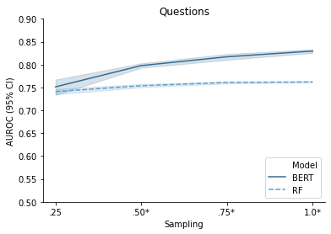
Results
BERT performs better than Random Forest, particularly for larger sample sizes
(BR = 31%)
Notes:
Here’s a representative example of results. AUROC = Area under Receiver Operating Characteristic Curve, which means that 0.5 is chance guessing

Slide 42
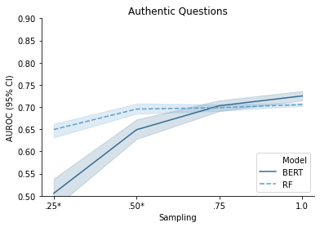
Results
This advantage is not as clear for discourse variables with smaller base rates
(BR = 5%)
Notes:
Here’s another example that is not as clear cut, when predicting a variable with smaller base rates

Slide 43
Design Considerations
Automated Analysis
Notes:
To recap, we focused on automated analysis previously

Slide 44
Design Considerations
Automated Analysis
Consider using simpler models for analysis when…
working with a smaller dataset
predicting outcomes with very small base rates
Notes:
Here are some potential takeaways when designing your own system

Slide 45
Design Considerations
Data Collection
Automated Analysis
Presenting Feedback
Notes:
Now we fill focus on how to present feedback to teachers

Slide 46
How to the two methods compare for different levels of feedback?
Notes:
Research Question 2

Slide 47
Utterance-level Feedback
Notes:
One method of providing feedback is for each individual utterance

Slide 48
Utterance-level Feedback
Predicts whether each utterance is an example of a particular discourse feature
Notes:
Explain what the outcome of interest is

Slide 49
Utterance-level Feedback
Predicts whether each utterance is an example of a particular discourse feature
Model | Mean AUROC
Random Forest
BERT
Notes:
Explain how to interpret AUROC (0.5 is chance-level guessing). For simplicity here we average over all discourse features

Slide 50
Utterance-level Feedback
Predicts whether each utterance is an example of a particular discourse feature
Model | Mean AUROC
Random Forest | 0.783
BERT | 0.841
Notes:
BERT does better on average than Random Forest method. This is what we saw in the previous section

Slide 51
Session-level Proportion Feedback
Notes:
A coarser level of feedback is feedback for the whole class session

Slide 52
Session-level Proportion Feedback
Predicts what proportion of utterances in a session contain a particular discourse feature
Average utterance-level predictions for a session to get a single score
Notes:
Describe what the outcome of interest is and how to calculate it

Slide 53
Session-level Proportion Feedback
Predicts what proportion of utterances in a session contain a particular discourse feature
Average utterance-level predictions for a session to get a single score
Model | Mean Correlation
Random Forest
BERT
Notes:
Here we are measuring using correlation.

Slide 54
Session-level Proportion Feedback
Predicts what proportion of utterances in a session contain a particular discourse feature
Average utterance-level predictions for a session to get a single score
Model | Mean Correlation
Random Forest | 0.354
BERT | 0.557
Notes:
Describe how to interpret correlations (goes from -1 to 1, with – being no relationship). We see again that BERT does better, which makes sense because it directly relies on utterance-predictions

Slide 55
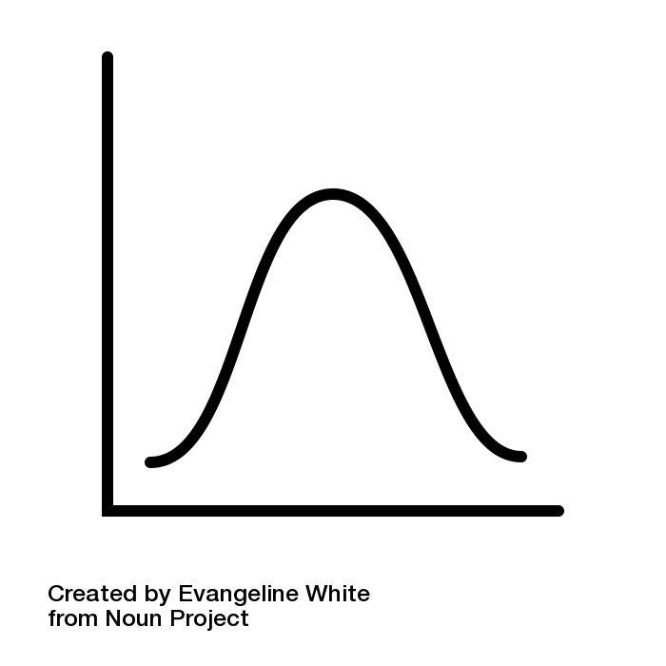
Session-level Ordinal Feedback
Predicts the occurrence of a particular discourse feature relative to other teachers
Compares proportion feedback to distribution of all teachers (predicted/actual)
Proportion
Notes:
Finally, the most coarse feedback is ordinal feedback for a given class session. Consider the distribution of proportions for all teachers

Slide 56
Session-level Ordinal Feedback
Predicts the occurrence of a particular discourse feature relative to other teachers
Compares proportion feedback to distribution of all teachers (predicted/actual)
Low
Medium
High
Proportion
Notes:
We can label one instance as high/medium/low compared to other teachers

Slide 57
Session-level Ordinal Feedback
Predicts the occurrence of a particular discourse feature relative to other teachers
Compares proportion feedback to distribution of all teachers (predicted/actual)
Low
Medium
High
Low
Medium
High
Proportion (true)
Proportion (predicted)
Notes:
This happens separately for computer-predicted and true values

Slide 58

Session-level Ordinal Feedback
Predicts the occurrence of a particular discourse feature relative to other teachers
Compares proportion feedback to distribution of all teachers (predicted/actual)
Low
Medium
High
Low
Medium
High
Proportion (true)
Proportion (predicted)
Notes:
For example, the true proportion might be medium

Slide 59

Session-level Ordinal Feedback
Predicts the occurrence of a particular discourse feature relative to other teachers
Compares proportion feedback to distribution of all teachers (predicted/actual)
Low
Medium
High
Low
Medium
High
Proportion (true)
Proportion (predicted)
Notes:
While the predicted proportion is low. In this case, the prediction doesn’t match the true label

Slide 60
Session-level Ordinal Feedback
Predicts the occurrence of a particular discourse feature relative to other teachers
Compares proportion feedback to distribution of all teachers (predicted/actual)
Model | Mean Agreement
Random Forest
BERT
Notes:
Describe how to interpret agreement (0 - 100%), where these are exact matches between categories

Slide 61
Session-level Ordinal Feedback
Predicts the occurrence of a particular discourse feature relative to other teachers
Compares proportion feedback to distribution of all teachers (predicted/actual)
Model | Mean Agreement
Random Forest | 43.6%
BERT | 52.0%
Notes:
Again, BERT does slightly better than RF for this method of feedback

Slide 62
Design Considerations
Presenting Feedback
Performance advantages are consistent between models
Different forms of feedback may be more or less interpretable to teachers
Notes:
Some key take-aways from this section on how to present feedback

Slide 63
Future Work
What performance is “good enough” to present feedback to teachers?
How do teachers interact with and utilize feedback?
Do automated insights help improve teaching?
Notes:
What to consider doing in the future. We know models will never be 100% perfect. More user studies are needed.

Slide 64
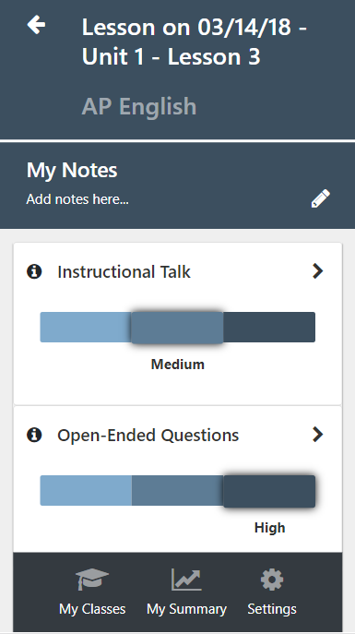
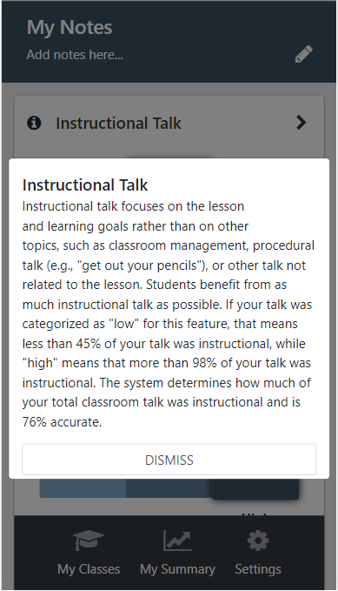
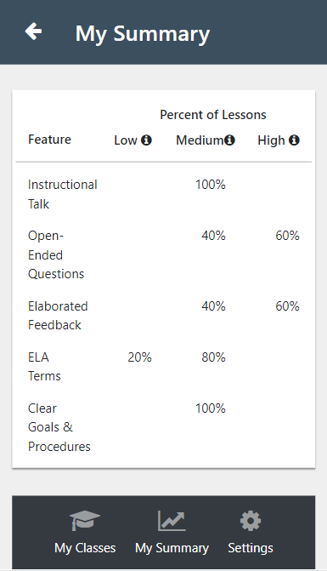
Future Work
Notes:
Here’s the app we are in the process of developing to deliver ordinal feedback to teachers

Slide 65
In Summary
We discuss design considerations when developing an automated teacher discourse feedback system.
We compared deep transfer learning to traditional machine learning methods for detecting teacher discourse.
Deep transfer learning provides better results across different levels of feedback, especially when using larger datasets.
Notes:
Key take-aways from the talk.

Slide 66



Thank You!
emily.jensen@colorado.edu
Notes:
Thank you and questions

Slide 67
Extra Slides

Slide 68
Utterance-level results
AUROC values
Discourse Variable | BERT | Random Forest | # Significant (out of 10)
Instructional Talk | 0.828 [0.827-0.830] | 0.762 [0.761-0.763] | 10
Questions | 0.830 [0.825-0.834] | 0.762 [0.761-0.764] | 10
Goal Specified | 0.878 [0.875-0.881] | 0.826 [0.824-0.828] | 10
ELA Terms | 0.895 [0.891-0.899] | 0.763 [0.762-0.764] | 10
Elaborated Evaluation | 0.861 [0.858-0.863] | 0.814 [0.812-0.816] | 10
Authentic Questions | 0.725 [0.711-0.739] | 0.705 [0.701-0.710] | 6
High Cognitive Level | 0.868 [0.863-0.872] | 0.850 [0.847-0.852] | 9
Mean | 0.841 | 0.783

Slide 69
Session-level Proportion Results
Pearson r values
Discourse Variable | BERT | Random Forest | # Significant (out of 10)
Instructional Talk | 0.545 [0.521-0.569] | 0.262 [0.247-0.276] | 10
Questions | 0.694 [0.666-0.722] | 0.529 [0.520-0.538] | 9
Goal Specified | 0.626 [0.614-0.639] | 0.445 [0.434-0.456] | 10
ELA Terms | 0.695 [0.677-0.714] | 0.292 [0.276-0.307] | 10
Elaborated Evaluation | 0.465 [0.444-0.487] | 0.306 [0.295-0.317] | 9
Authentic Questions | 0.350 [0.249-0.452] | 0.207 [0.170-0.244] | 3
High Cognitive Level | 0.526 [0.507-0.546] | 0.438 [0.429-0.446] | 0
Mean | 0.557 | 0.354

Slide 70
Session-level Ordinal Results
Agreement values
Discourse Variable | BERT | Random Forest
Instructional Talk | 0.511 [0.495-0.527] | 0.394 [0.380-0.408]
Questions | 0.584 [0.559-0.609] | 0.498 [0.484-0.513]
Goal Specified | 0.526 [0.514-0.538] | 0.490 [0.473-0.507]
ELA Terms | 0.654 [0.636-0.673] | 0.387 [0.369-0.405]
Elaborated Evaluation | 0.513 [0.497-0.528] | 0.446 [0.434-0.457]
Authentic Questions | 0.417 [0.373-0.462] | 0.433 [0.403-0.463]
High Cognitive Level | 0.435 [0.427-0.443] | 0.403 [0.390-0.416]
Mean | 0.520 | 0.436

