Slide 1

Lab1

Slide 2
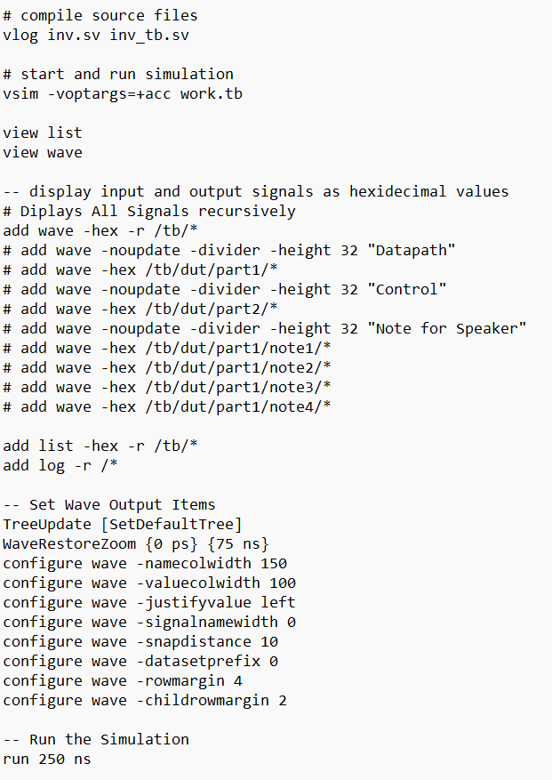
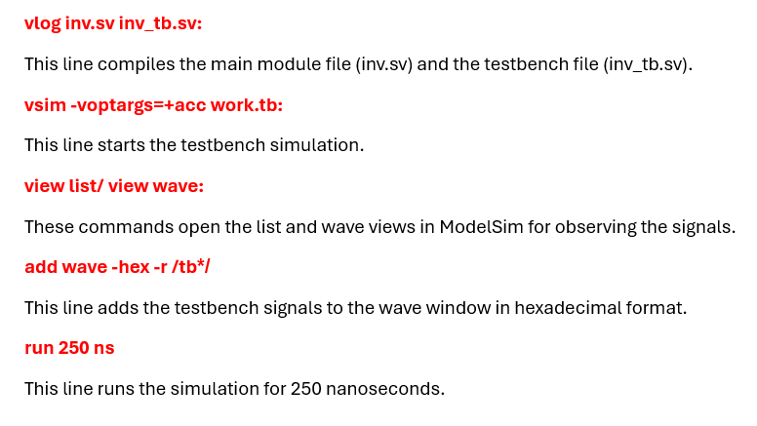
Automation of Simulation with DO File

Slide 3
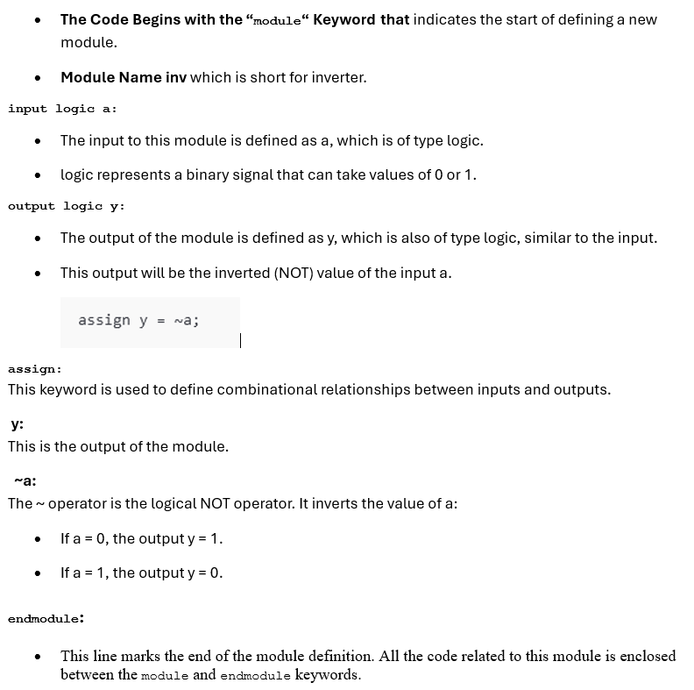
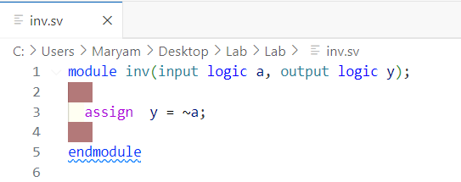
NOT gate

Slide 4
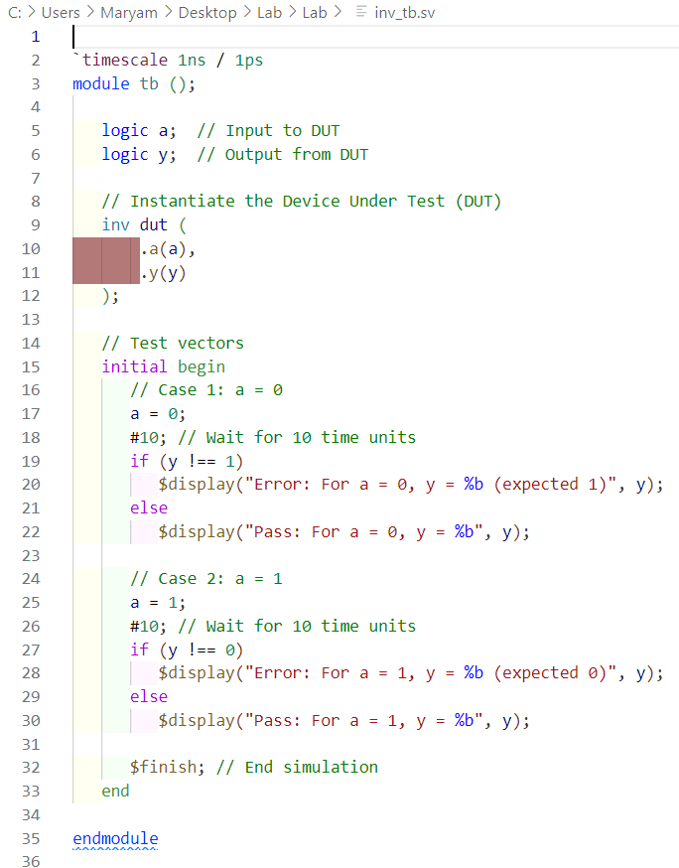
Testbench

Slide 5

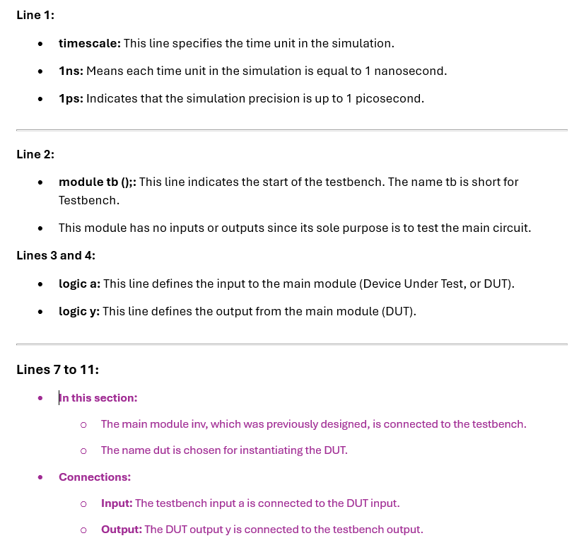

Slide 6
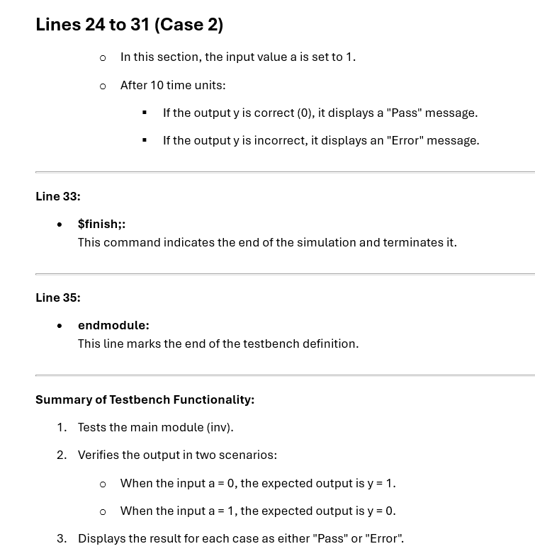

Slide 7
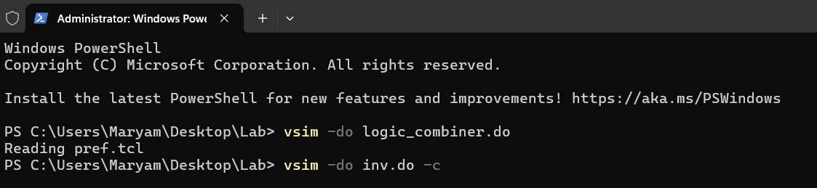
vsim -do inv.do -c
Comparison with and without -c mode:
Without -c: The graphical environment of ModelSim opens, and you can view signals in the Waveform window.
With -c: Only textual outputs (like $display messages) are shown in the terminal.

Slide 8
