Slide 1
8.19.20 Update
Emily Makowski
Patrick Kinnunen

Slide 2
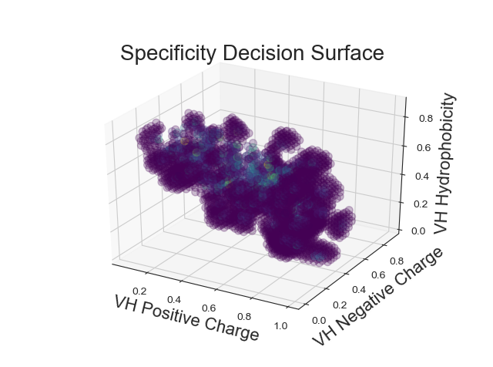
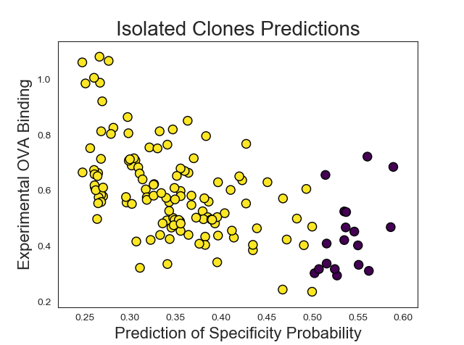
EM11 – mAb pI
Gaussian Process Classifier –
Model with 3 sequence-based features and 86% accuracy on a test set
Decision surface for short kernel length-scale
High spearman correlation with isolated clones for long kernel length-scale
What’s next?
Small Kernel Length
Large Kernel Length
p-value = 1E-12

Slide 3
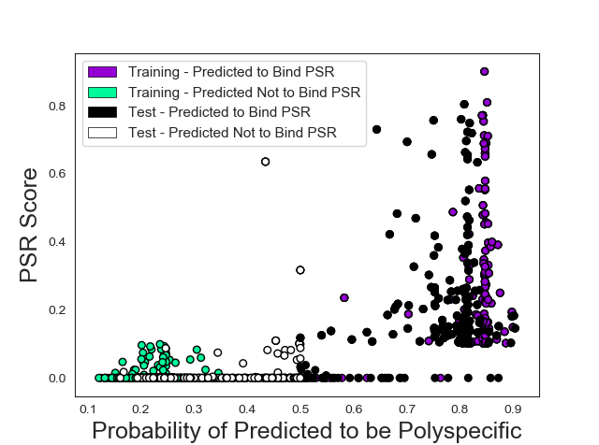
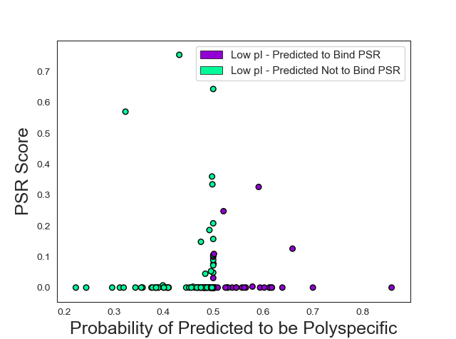
EM11 – Analysis on Low pI mAbs
Fv pI < 6.29
66% accuracy for specificity prediction on low pI mAbs
Specificity is not governed the same way for mAbs with low pI
High pI mAbs
Low pI mAbs

Slide 4
Emi Specificity

Slide 5
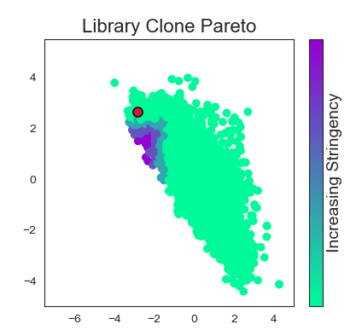
Process flow chart – Pareto optmization
Analog data from isolated clones
Functionalizing LDA
LDA on unirep features
Pareto curve for features
Unirep representations
NGS data from screen/sort

Slide 6
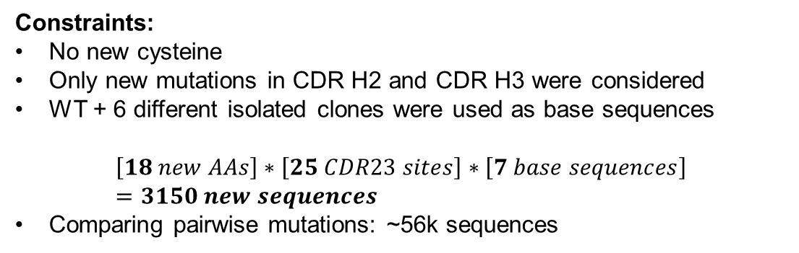
Next steps: Proposing new clones
Simplest way: start from some of the best isolated sequences, and try all possible single mutations
Computationally tractable, fits with Emily’s leave-one-out analysis
LHQWY… Base sequence
AHQWY… Mutation 1 at site 1
BHQWY…
…
LAQWY… Mutation 1 at site 2
LBQWY…
…
LHQWV… Mutation 19 at site N
Constraints:
No new cysteine
Only new mutations in CDR H2 and CDR H3 were considered
WT + 6 different isolated clones were used as base sequences
$$\left[18 new AAs\right]∗\left[25 CDR23 sites\right]∗\left[7 base sequences\right]=3150 new sequences$$
Comparing pairwise mutations: ~56k sequences

Slide 7
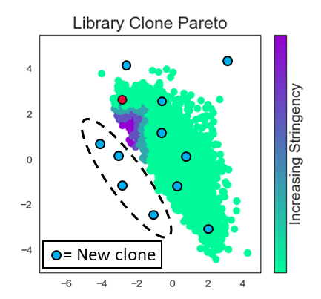
Comparing new and old clones
LHQWY… Base sequence
BHQWY… Mutation 1 at site 1
CHQWY…
…
LAQWY… Mutation 1 at site 2
LBQWY…
…
LBQWV… Mutation 19 at site N
With hypothetical new clones
Good new clones
Get ~3500 unirep representations

Slide 8
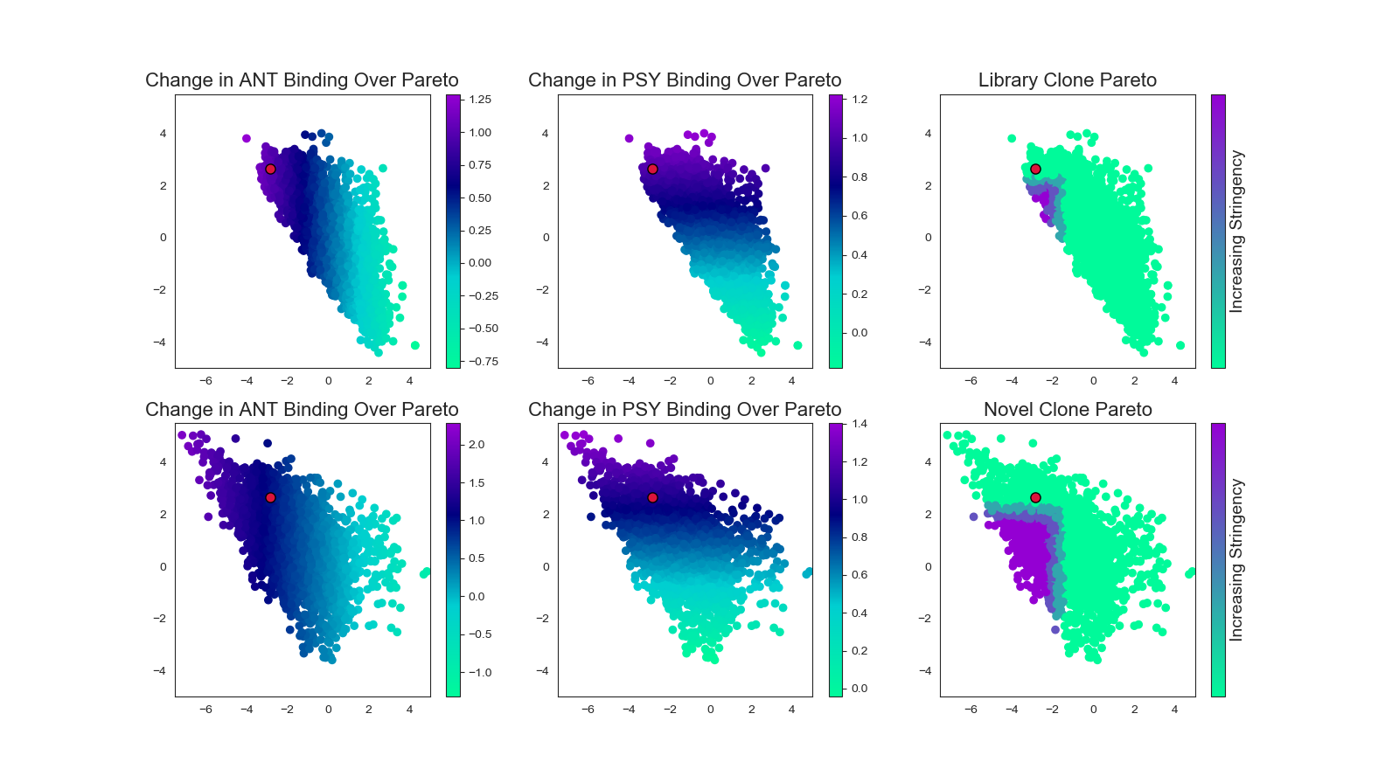
Proposed clones move the pareto front
By picking new mutations, we get many different clones that are past the original pareto front
Old pareto front

Slide 9
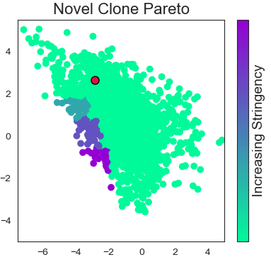
200 Clones on the new pareto front
WT can be made better by adding W to HCDR2
W > F > M > L are the most common residues added
52A(P) > 60(N) > 57(T) > 58(T) are the most common residues mutated away
EM8 > EM45-005 are the most common base sequences found on the pareto frontier
 | 33 | 50 | 54 | 55 | 56 | 93 | 97 | 102
WT | Y | R | R | R | G | A | W | Y
EM45-005 | Y | R | T | A | G | A | L | Y
EM8 | Y | R | A | G | G | A | A | F

Slide 10

44 clones on the pareto front
W > L = N = E = F are the most common residues added
Mostly W
52A(P) is the most common residue mutated away from
EM45-005 > EM8 are the most common base sequences found on the pareto frontier
We could clone these for evaluation
After

Slide 11

41 clones to make and evaluate
2 populations – focused on either antigen binding or specificity
Evaluate the tunability of the analysis
Evaluate the quality of analysis for different properties
Currently we think it’s stronger for antigen binding than polyspecificty binding

Slide 12
Process flow chart – Pareto optimization
Propose new mutations
Unirep Representations
Analog data from isolated clones
Functionalizing LDA
Plot new mutations on pareto curve
Analyze suggested “good” new clones
New suggested mutations/sites
Unirep representations
LDA on unirep features
Pareto curve for features
NGS data from screen/sort
Good new clones
= New clone

Slide 13
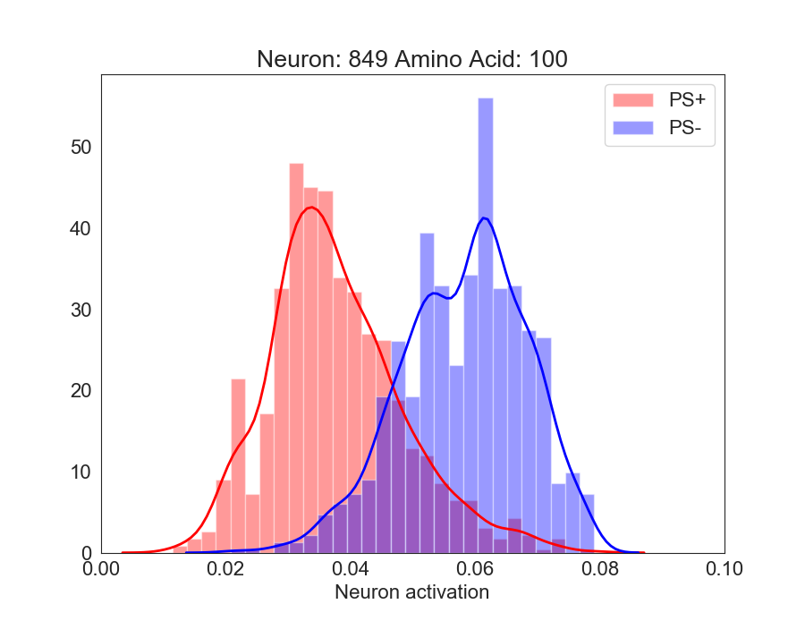
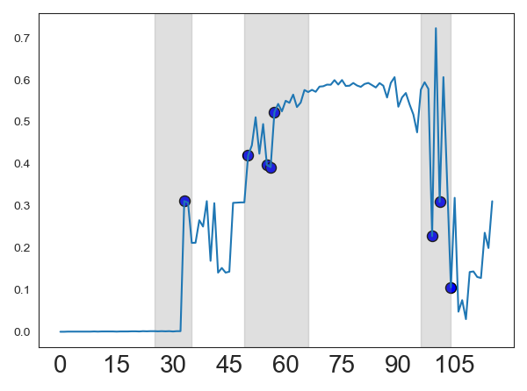
Process flow chart – Feature analysis
Compare distributions for best nodes at each position
Find new amino acids with high differentiation between classes
New suggested mutations/sites
NGS data from screen/sort
Identify best nodes
Unirep full representations

Slide 14
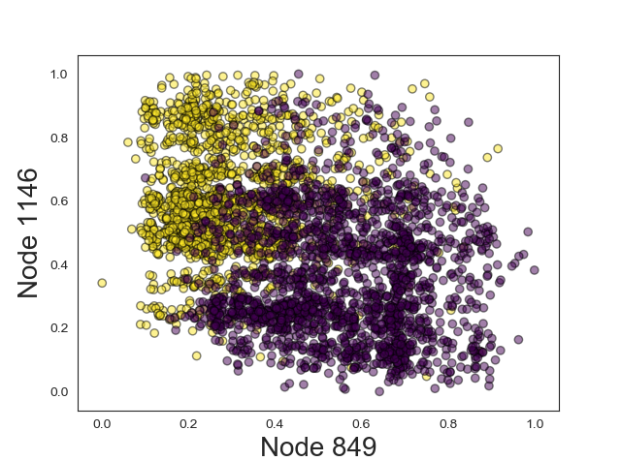
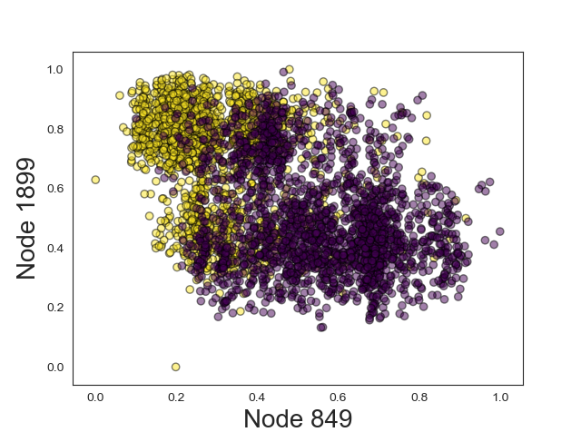
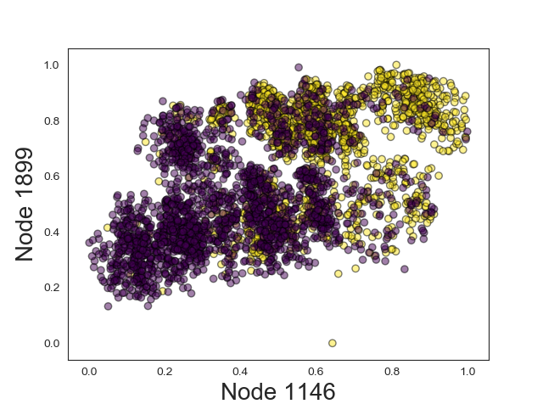
3 nodes that classify best
849, 1146, 1899 – determined by seeing which features(nodes) best classified dataset with SVM with high penalty on feature coefficients
Small coefficients become zero
If only three features are non-zero, then features 849, 1146, and 1899 are the best features

Slide 15
Quantifying difference between specific and nonspecific clone weight values
Jansen Shannon entropy – symmetric divergence between distributions
Quantifies distance between distributions

Slide 16
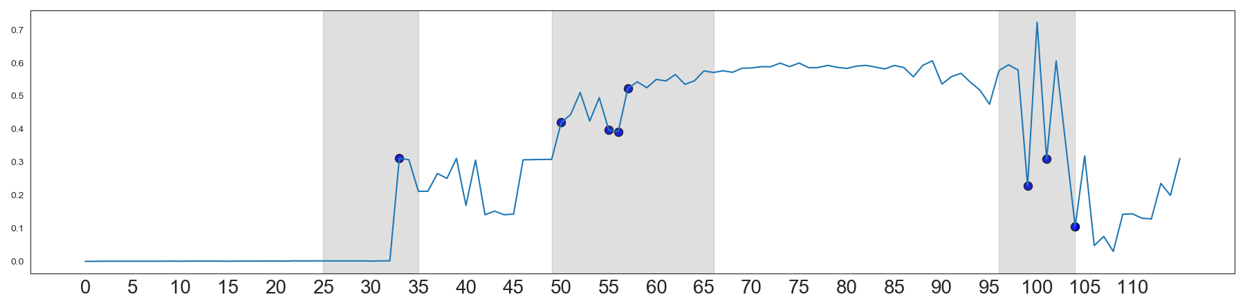
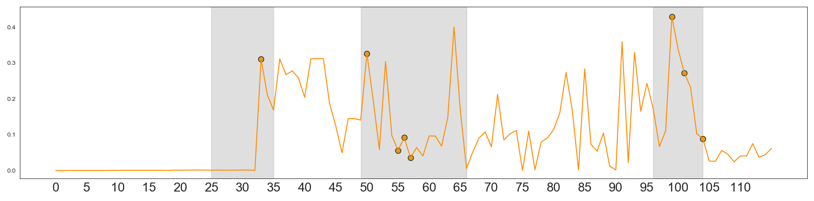
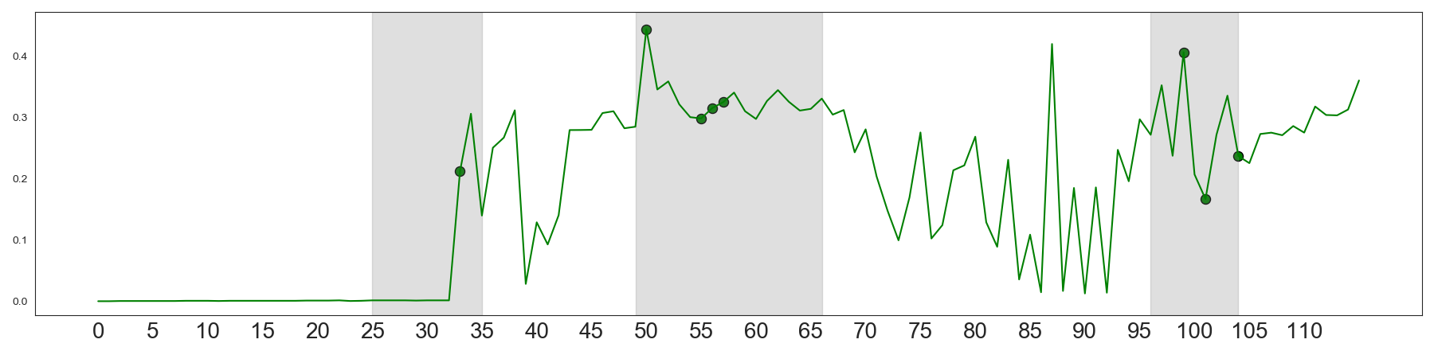
Difference between specific and nonspecific clones
Circles mark mutated residues
849
1146
1899

Slide 17
96 - N
98 - L
63 - F
52 - N

Slide 18
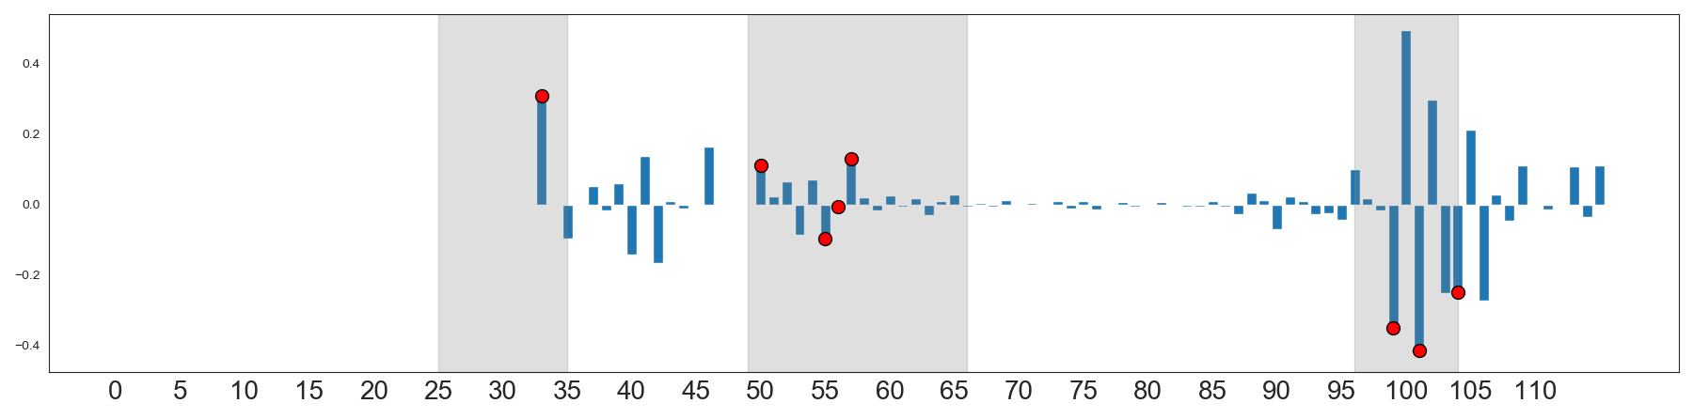
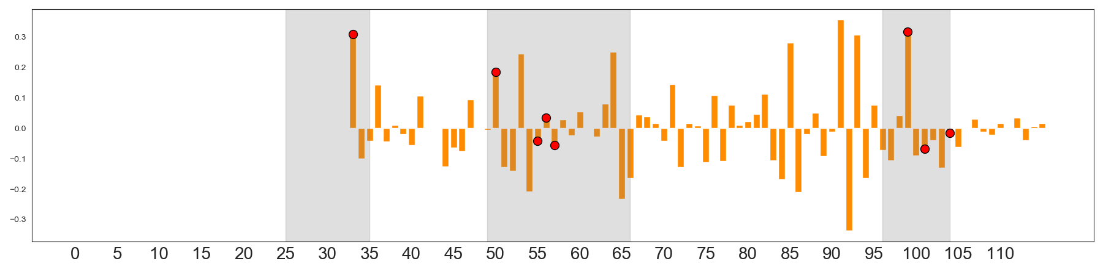
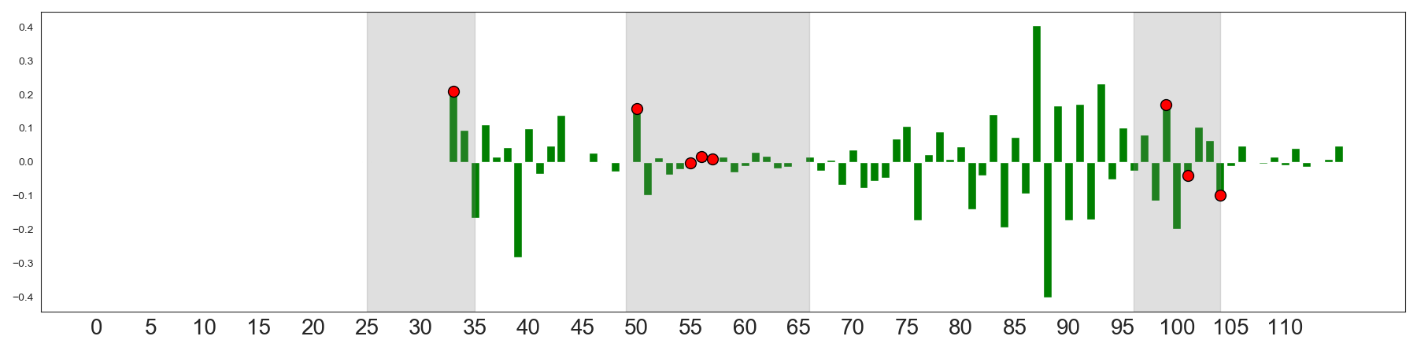
Change in the difference between specific and nonspecific clones
849
1146
1899

Slide 19
96 - N
98 - L
63 - F
52A - P
53 - N
64 - E
96 - N

Slide 20
Residues suggested to be interesting for specificity
Mutations suggested by the mutational scan (200 seqs on pareto frontier – optimized for both psy and ant)
51, 52, 52A, 53, 54, 55, 56, 57, 58, 60, 62, 98
Mutations suggested by the mutational scan (either high divergence between classes or high change in divergence between classes for specificity only)
52, 52A, 53, 63, 64, 96, 98
Most frequently suggested
Commonly suggested

Slide 21
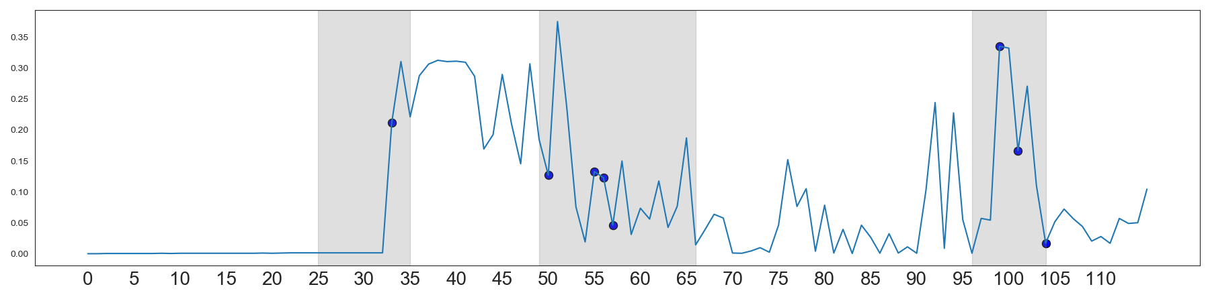
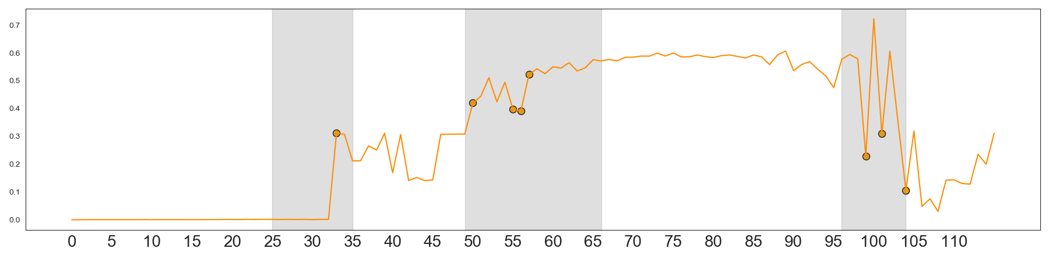
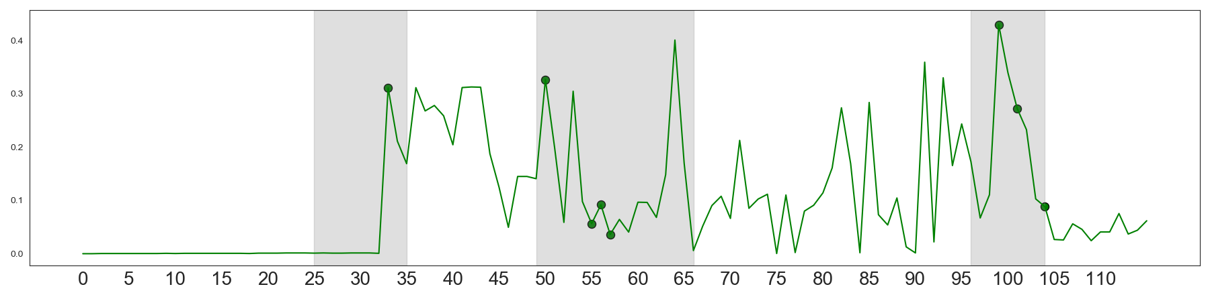
Change in the difference between antigen binding and non-antigen binding clones
1830
849
1146

Slide 22
51 - V
96 - N
98 - L
96 - N
98 - L
63 - F
52A - P

Slide 23
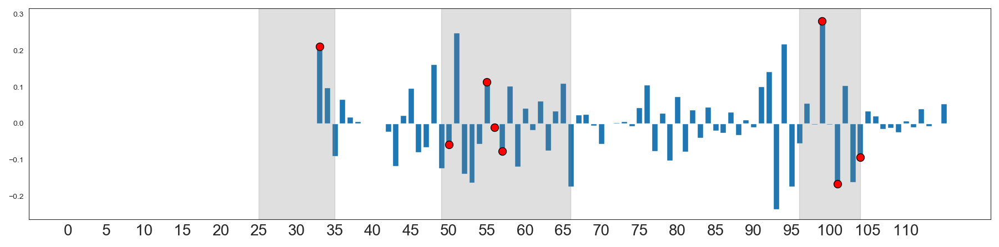
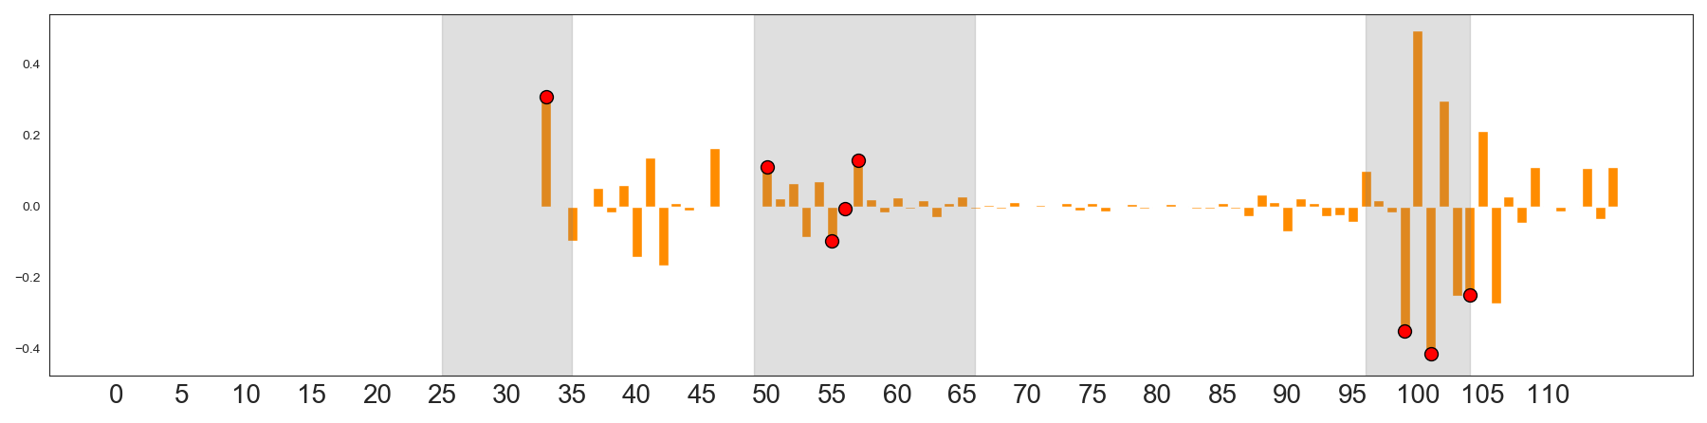
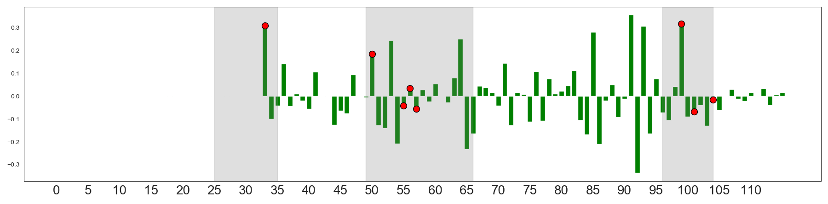
Change in the difference between antigen binding and non-antigen binding clones
1830
849
1146

Slide 24
51 - V
96 - N
98 - L
52A - P
63 - F
64 - E

Slide 25
Residues suggested to be interesting for antigen binding
Mutations suggested by the mutational scan (200 seqs on pareto frontier – optimized for both psy and ant)
51, 52, 52A, 53, 54, 55, 56, 57, 58, 60, 62, 98
Mutations suggested by the mutational scan (either high divergence between classes or high change in divergence between classes for specificity only)
51, 52A, 63, 64, 96, 98
Most frequently suggested
Commonly suggested

Slide 26
How do they work together?
Analog data from isolated clones
New suggested mutations/sites
Pareto Optimization
Do the suggested mutations and sites match for each set of analysis?
NGS data from screen/sort
New suggested mutations/sites
Feature analysis

Slide 27
Overlap of suggested mutations
Overlapping suggested mutations
51, 52, 53, 52A, 98
51-V, 52-N, 53-N, 52A-P, 98-L
Other strong candidates
57, 63, 96
57-T, 63-F, 96-N

Slide 28
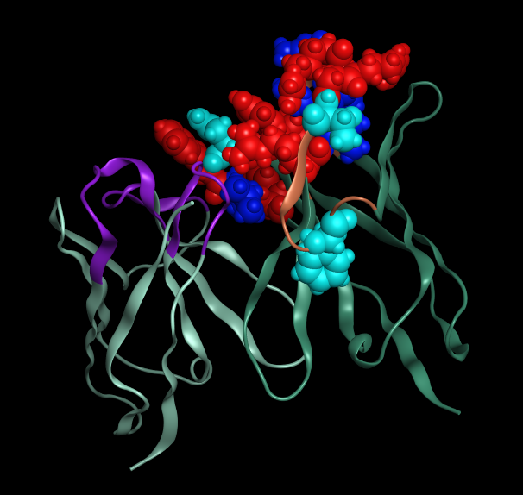
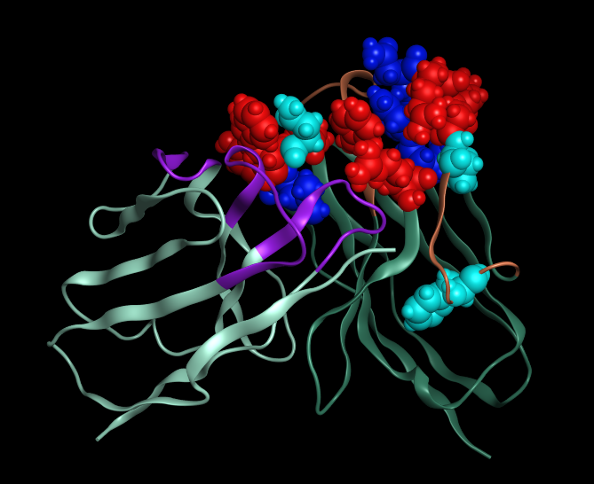
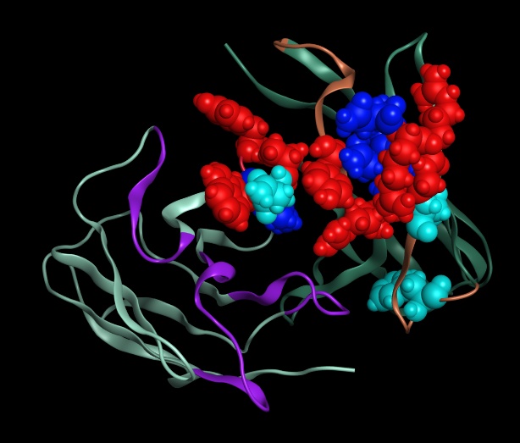
Suggested mutations
Red – mutated in previous library
Royal blue – overlapping mutations suggested by both analyses
Turquoise – mutation strongly suggested by one analysis, not both
CDR1
26 | 27 | 28 | 29 | 30 | 31 | 32 | 33 | 34 | 35
G | Y | T | F | T | D | Y | Y | M | H
CDR2
50 | 51 | 52 | 52A | 53 | 54 | 55 | 56 | 57 | 58 | 59 | 60 | 61 | 62 | 63 | 64 | 65
R | V | N | P | N | R | R | G | T | T | Y | N | Q | K | F | E | G
CDR3
93 | 94 | 95 | 96 | 97 | 98 | 99 | 100 | 101 | 102
A | R | A | N | W | L | - | - | D | Y
96
57
63

Slide 29
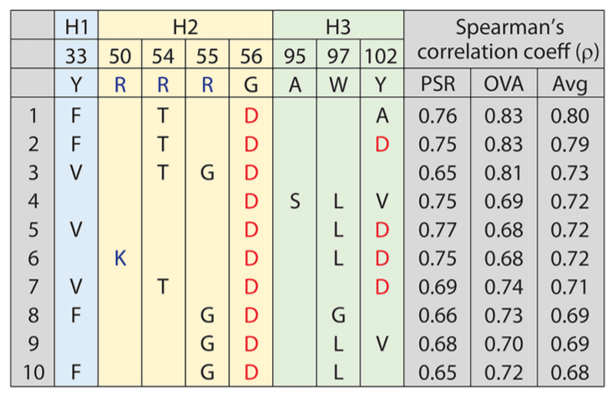
New Library Design
Yulei’s paper – residues important for specificity
95 97
Base Sequences
 | 33 | 50 | 54 | 55 | 56 | 93 | 97 | 102
WT | Y | R | R | R | G | A | W | Y
 | Y | R | R | G | D | A | G | D
 | Y | R | R | G | D | A | A | V
 | Y | R | T | A | G | A | L | Y
 | Y | R | A | G | G | A | L | D
 | Y | R | T | G | A | A | L | A
 | Y | R | A | G | G | A | A | F
Never mutated - Important for antigen binding
Mutated in Yulei’s findings for specificity by not here when considering antigen binding
Never mutated – important for specificity and antigen binding
Not mutated in Yulei’s findings or here
Both could be removed from new library design

Slide 30
New Library Design
From old library
New suggestions
 | 54 | 55 | 56 | 97 | 102
WT | R | R | G | W | Y
 | 51 | 52 | 52A | 53 | 57 | 63 | 96 | 98
WT | V | N | P | N | T | F | N | L
Freq | 82% I |  | (27% P) |  | 56% T | 50% V
Additional considerations
Natural diversity
Too many mutations too close
Yulei’s past analysis to make the old library
Properties of residues being mutated
Properties of residues sampled
…etc

Slide 31
Next Steps
Finalize decision of new clones to produce and evaluate
Order gene blocks and clone
Library design
Work with Yulei and Matt
Heuristic decisions about what to include

Slide 32
Bonus info!

Slide 33
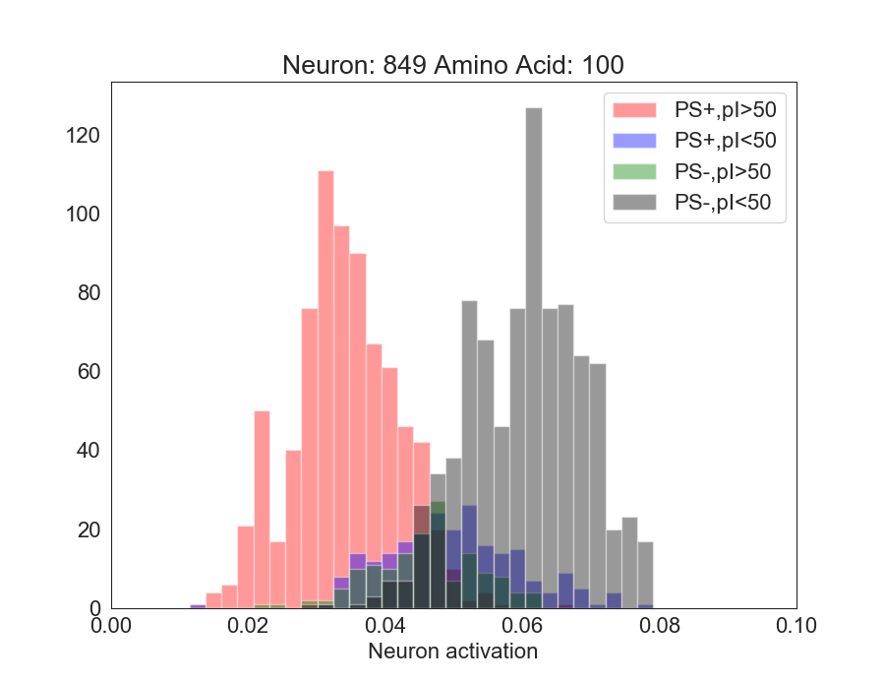
Segregating features by biophysical property
Distribution of sequences that emerges from unirep features analysis. Each sequence also has a set of biophysical descriptors
If we know both the neuron activation for a new sequence, and the sequence pI, we can be even more confident in our prediction of PS+ vs PS-.

Slide 34
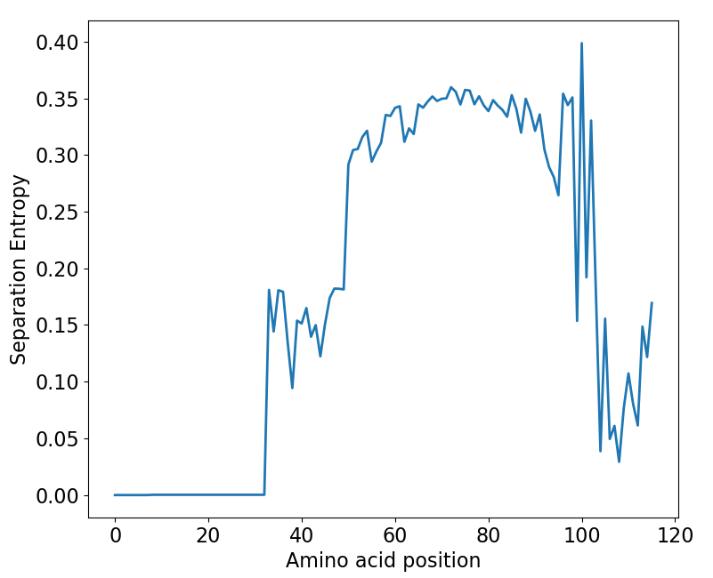
Process flow chart – Feature analysis
Segregate distributions by Biophysical properties
Compare distributions for best nodes at each position
New suggested mutations/sites
NGS data from screen/sort
Identify best nodes
Unirep full representations
Find new amino acids with high differentiation between classes

