Slide 1
Rails Project Web Server Programming
-------Manyu Xu
-------20069545

Slide 2
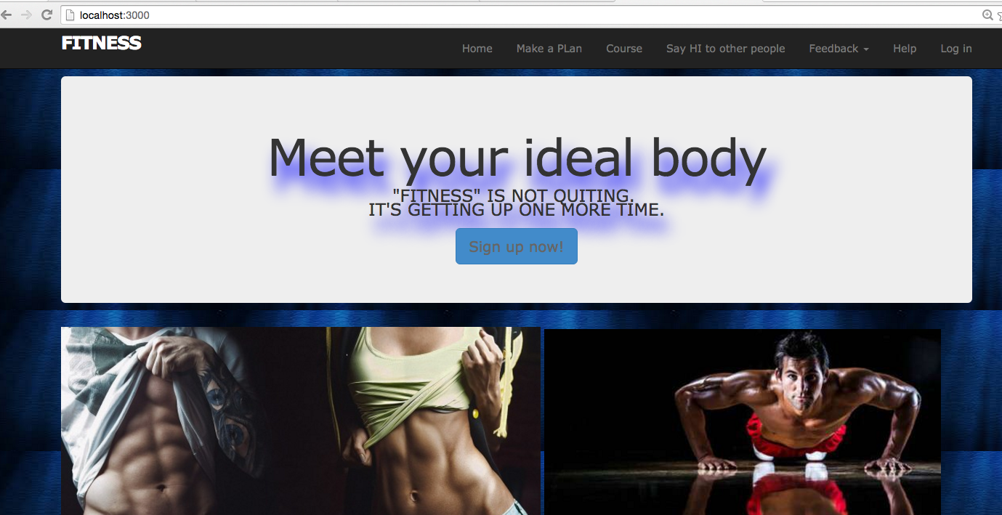

Slide 3
Brief statement of application's objective
The application being developed is a Fitness website.
You can save Videos about fitness from the internet that you like and want to save them so that you can watch them later easily.
You can post microposts and check the history of microposts.
You can make a plan that record your exercise the time, distance and progress,and you can check the history of your plan,you can edit and destroy as well.
You can send requests to others that say HI to other people and can see the list of requests.
You can give a feedback that you can comment on us about the website,and can choose the amount of stars that standing for your support degree.

Slide 4
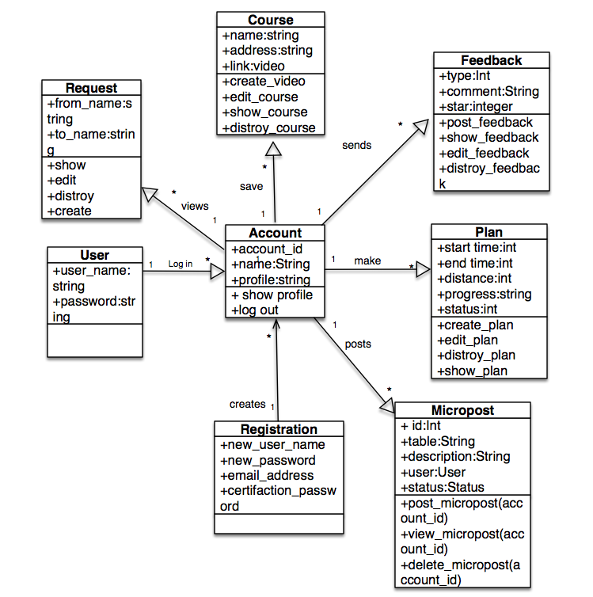
Data model diagram

Slide 5
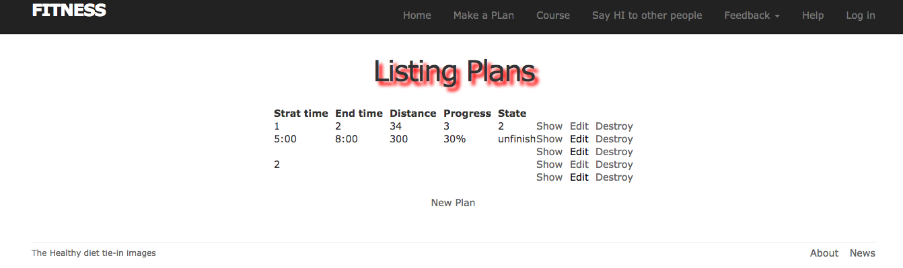

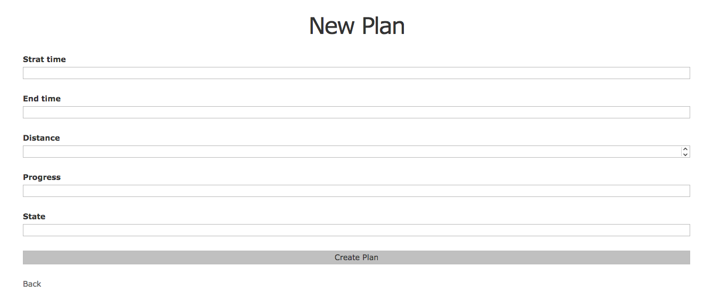

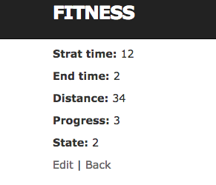
The plan can record your start and end time, distance and progress.
You can create a new plan and edit ,desroy it. You can view your list of plans

Slide 6
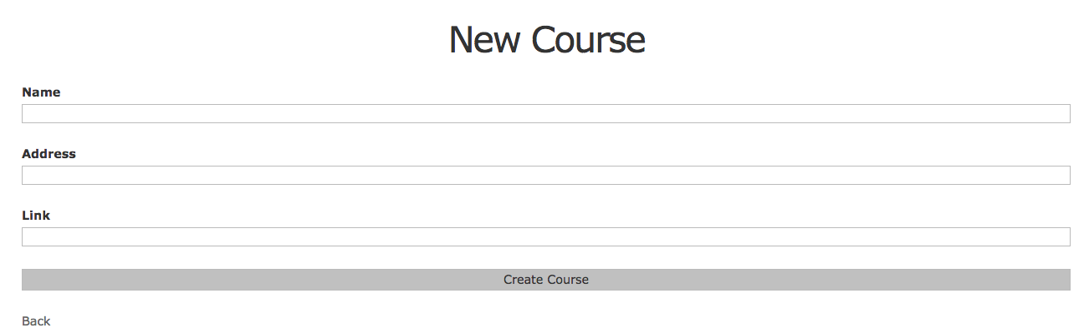

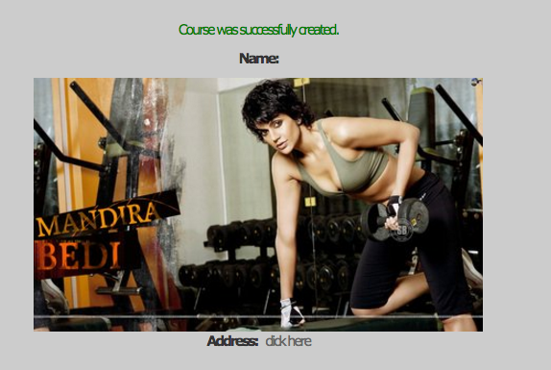
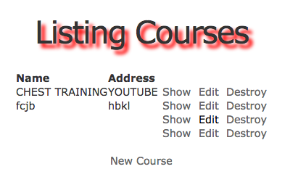
You can create your courses that videos you like ,
You just fill in link, you can watch it in the show page.

Slide 7
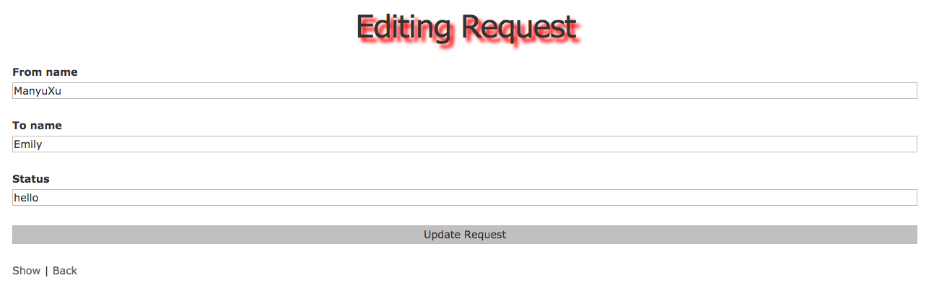

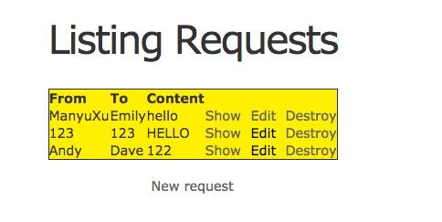
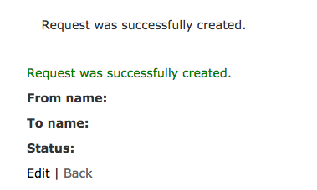

You can send requests to other people and edit ,desroy it. You can view your list of requests

Slide 8

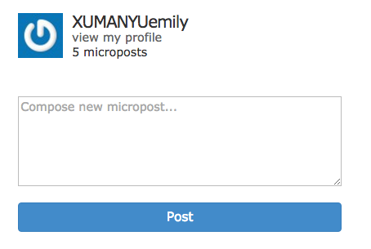
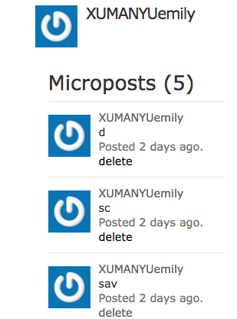
You can post microposts,you delete and view yor profile

Slide 9
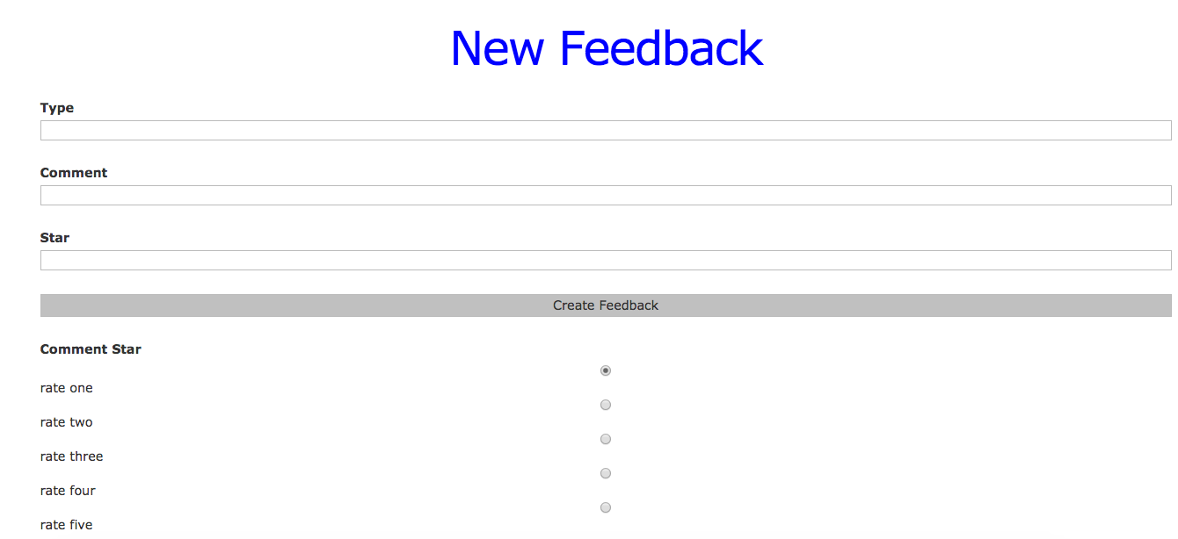
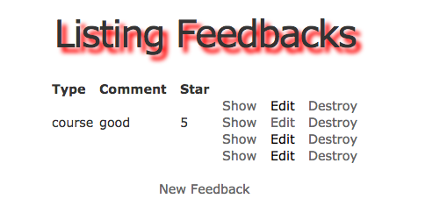
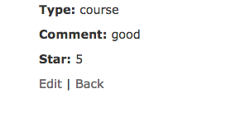
You can create a new Feedback and edit ,desroy it. You can view your listing Feedbacks
You can comment and choose the star.

Slide 10
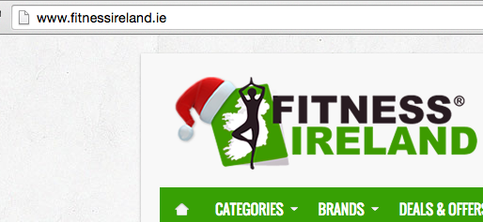
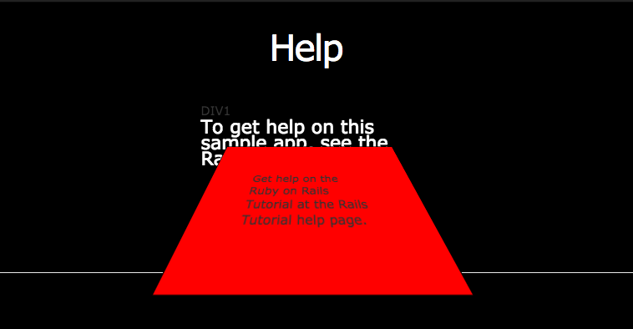
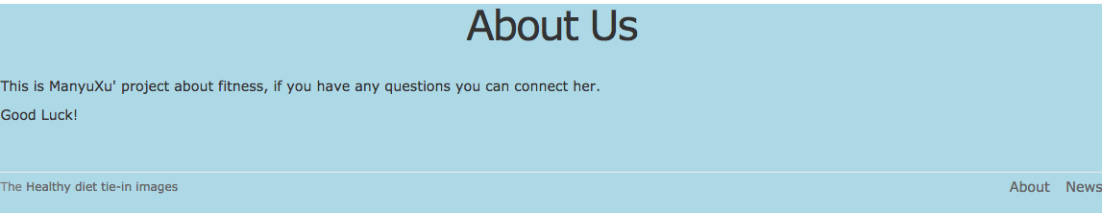

Slide 11
