Slide 1
ENGI 301 Musical Tuner Proposal
October 5, 2021
Emily McAmis

Slide 2
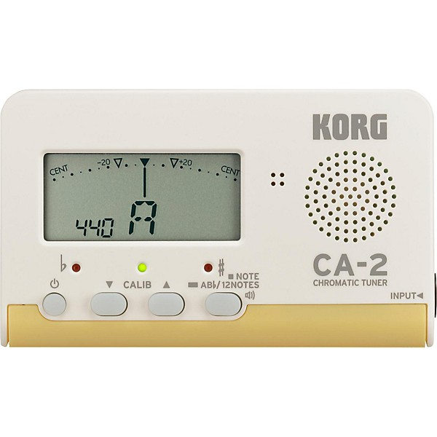
Background Information
I propose creating a tuner that can take an audio input and display the note, and whether it is sharp or flat
Program will distinguish between different frequencies
Will utilize LEDs to display both note and sharpness/flatness
One set of LEDs for each category
Could not find PocketBeagle tuner projects, but found some Arduino projects
https://www.instructables.com/Guitar-Tuner-With-an-Arduino/
https://circuitdigest.com/microcontroller-projects/arduino-uno-guitar-tuner
Frequency detection project on Arduino
https://www.instructables.com/Arduino-Frequency-Detection/
May also consult previous ENGI301 project involving audio recording
https://www.hackster.io/bw21/engi-301-project-01-2577c1
Plan on improving existing projects by having improving display (LEDs rather than mini-LCD screen) and researching improved audio processing (software)
Example of standard musical tuner

Slide 3
System Block Diagram
Audio input (note)
Microphone
PCB Board
Resistors (in-tune)
Green LED (x1) (in-tune)
Push button (on/off)
LEDs display values based on frequency calculations
Pocket Beagle
Resistors (#/♭)
Red LEDs (x4) (#/♭)
Resistors (A-G)
Blue LEDs (A-G)
Power source

Slide 4
Questions I still have
Do I need an op-amp to increase the signal from the microphone?
Do I need any sort of noise filtering?

Slide 5
Power Block Diagram
Ground
Microphone
PCB Board
Resistors (in-tune)
Green LED (x1) (in-tune)
Push button (on/off)
LEDs display values based on frequency calculations
Resistor
Pocket Beagle
Resistors (#/♭)
Red LEDs (x4) (#/♭)
9 mA (assuming 1k Ohm resistor). “Resistive load” is 1-50 mA for button
Ground
P1.01
Resistors (A-G)
Blue LEDs (A-G)
27.27 mA (assume 330 ohm resistors)
9V Power input

Slide 6
Power Block Diagram Questions
Honestly, I wasn’t really sure how to properly represent power and currents on the power block diagram
How do you know if you need to change the resistances?
Does there only need to be one power source?

Slide 7
Components to Buy (some may be at OEDK but not sure)
Component | Need to Buy | Cost
7 Blue LEDs (display note value) | Maybe | $0.49*7=$3.43
1 Green LED (to denote correct pitch) | Maybe | $0.49
4 Red LEDs (sharp/flat) | Maybe | $0.49*4=$1.96
Microphone | Yes | $12.83
On/off switch | Maybe | $0.29
USB Audio adapter | Yes | $9.95
PCB for LEDs (easy integration into wood housing) | Yes | $5.99
9V Battery | Maybe | $6.95
Batter snap connector | Maybe | $2.99
Total cost: $44.88
Note: Hyperlinks for example parts are provided

Slide 8
Provided Components (by OEDK or ENGI301 kit)
Component
Solderless breadboard
PocketBeagle
Jumper wires (generic)
Resistors
USB-A to mini-USB cable
Wood (to build display case for LEDs)
Need all components to be purchased by instructor listed; additional components may be purchased by student

