Slide 1
ENGI 301 Musical Tuner Proposal
October 5, 2021
Emily McAmis

Slide 2
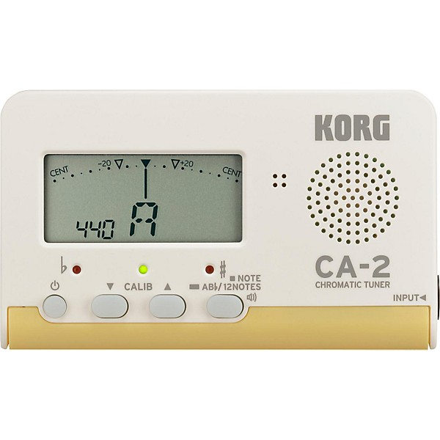
Background Information
I propose creating a tuner that can take an audio input and display the note, and whether it is sharp or flat
Program will distinguish between different frequencies
Will utilize LEDs to display both note and sharpness/flatness
One set of LEDs for each category
Could not find PocketBeagle tuner projects, but found some Arduino projects
https://www.instructables.com/Guitar-Tuner-With-an-Arduino/
https://circuitdigest.com/microcontroller-projects/arduino-uno-guitar-tuner
Frequency detection project on Arduino
https://www.instructables.com/Arduino-Frequency-Detection/
May also consult previous ENGI301 project involving audio recording
https://www.hackster.io/bw21/engi-301-project-01-2577c1
Plan on improving existing projects by having improving display (LEDs rather than mini-LCD screen)
Example of standard musical tuner

Slide 3
Sample user display
On-off switch
Hex display with frequency value
Wake up button
Sound input
♭
#
A
B
C
D
E
F
G

Slide 4
System Block Diagram
Hex display with frequency value
Audio input (note)
Microphone
PCB Board
Resistors (in-tune)
Green LED (x1) (in-tune)
On/off switch
LEDs display values based on frequency calculations
Pocket Beagle
Resistors (#/♭)
Red LEDs (x4) (#/♭)
Low power mode button (“wake up”)
Resistors (A-G)
Blue LEDs (A-G)
Power source

Slide 5
Power Block Diagram
Ground
Microphone
Hex display
PCB Board
Resistors (in-tune)
Green LED (x1) (in-tune)
On/off
switch
1-50 mA
LEDs display values based on frequency calculations
Pocket Beagle
Resistor
Resistors (#/♭)
Red LEDs (x4) (#/♭)
Ground
P1.01
Resistors (A-G)
Blue LEDs (A-G)
Wake up button
27.27 mA (assume 330 ohm resistors)
Resistor
5V Power input
1-50 mA

Slide 6
Components to Buy (some may be at OEDK but not sure)
Component | Need to Buy | Cost
USB Microphone | Instructor | $19.95
Total cost: $19.95
Note: Hyperlinks for example parts are provided

Slide 7
Provided Components (by OEDK or ENGI301 kit)
Component
Solderless breadboard
PocketBeagle
Jumper wires (generic)
Resistors
USB-A to mini-USB cable
Wood (to build display case for LEDs)
On/off switch + low power mode button
5V Battery or AA battery pack + snap connector
LEDs
PCB for LEDs
Hex display for frequency values
Need all components to be purchased by instructor listed; additional components may be purchased by student

