Slide 1
Does the Economy Affect Movie Preference?
Emily McDaniel, Maria Gabriela Ordaz, Matthew Stadler, Phil Schechter

Slide 2
Project Overview
To wordsmith / get team input
Include evolution of project goal & prelim. considerations
Project Goal
[wordsmith: To determine whether the economy influences people’s preferences in movie genre]
Considerations
[availability of data]
[economic indicators]
[capability of ML models]

Slide 3
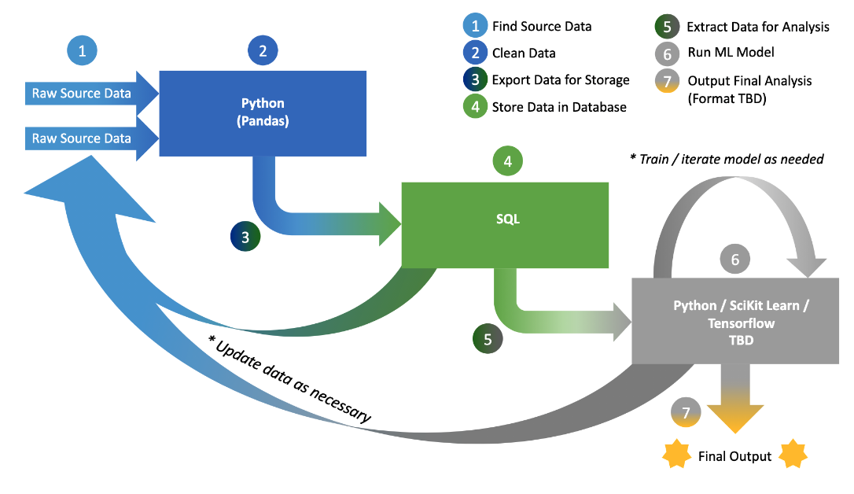
Project Roadmap

Slide 4
Methods
To wordsmith / get team input
Data Collection & Cleaning
Machine Learning Model
[xxx]
[xxx]
[xxx]
[xxx]
[xxx]
[xxx]
[xxx]
[xxx]

Slide 5
Results
Add charts w/ actual data. This might end up being 2 slides
[insert main result chart → cluster / trendline / etc. anything that clearly shows the primary takeaway]
Impact of Economic Indicator on Genre Preference

Slide 6
Interpretation of Results
Need to see data before working this

Slide 7
Importance of Findings and Next Steps
Need to see data before working this…but this will answer: 1) why does this matter & 2) what were limitations of our project / what additional analyses could be done

