Slide 1
Does the Economy Affect Movie Preference?
Emily McDaniel, Maria Gabriela Ordaz, Phil Schechter, Matthew Stadler

Slide 2
Project Overview
Project Goal
As economic change occurs, what genres of media do we choose? When you're financially stressed, do you maintain the same habits in your media selections? Or do you lean on self-help, finance, or comedy media?
Hypothesis
We hypothesize that: Economic change DOES impact the genre of medias consumed

Slide 3
Project Design
Preliminary Questions
How can "economic change" be defined? Are some indicators better than others?
What types of media should be considered? Can different types of media be viewed in aggregate, or should they be individually weighted?
What data sources will be useful?
How can this question be computationally answered?
Topic Relevance
This question evaluates consumer preferences against the state of the economy. This type of exercise is valuable for marketing strategies for any industry, and is a worthwhile analysis to time product releases.
We selected this topic because it intersects several areas of interest among our group members, including e-commerce, finance, and reading.

Slide 4
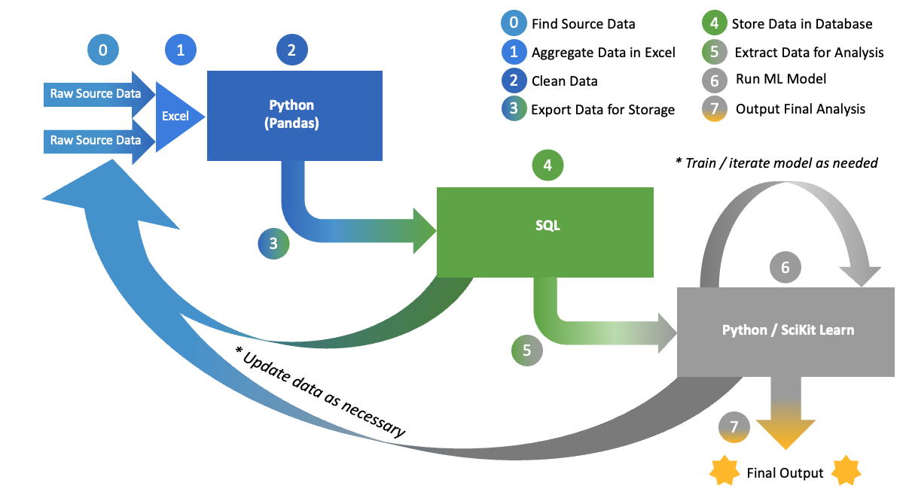
Project Roadmap

Slide 5
Database
Economic & Genre Datasets
Data Issues & Resolutions
Economic Indicators: CPI, Dow Jones, S&P 500, unemployment rates, Home Buyer Index, Consumer Sentiment¹
Movie Genres: Adventure, Comedy, Action & Drama, and Horror²
Some data quarterly, some monthly. Dates were standardized to end-of-month formats, shown as YYYYMM.
History goes back for different time periods in different datasets. Data start date = Jan2006; end date = Dec2020.
Some data was retrieved in 2-dimensional excel charts, others as csv lists. An Excel pivot-table was used to show sum of gross by genre by issue month to conform 2-dimensional excel charts to csv lists.
Total gross for genres is given in the month of issue, and is not reflected per month. This will need to be converted to align in with other data reporting timeframes. A moving average of the data over a rolling 12 month period for movie data was calculated, then currency was converted into percent of monthly total by genre. Figures within each datatype were also be normalized (ranges and volumes vary). Genre data was combined with the economic data dataframe before applying machine learning.
Available data was in different units. Must be converted prior to machine learning application.
¹ Data from University of Michigan, Bureau of Labor Statistics, Yahoo! Finance, Federal Housing Finance Agency, and the Federal Reserve Economic Data, respectively
² Data from https://www.the-numbers.com/

Slide 6
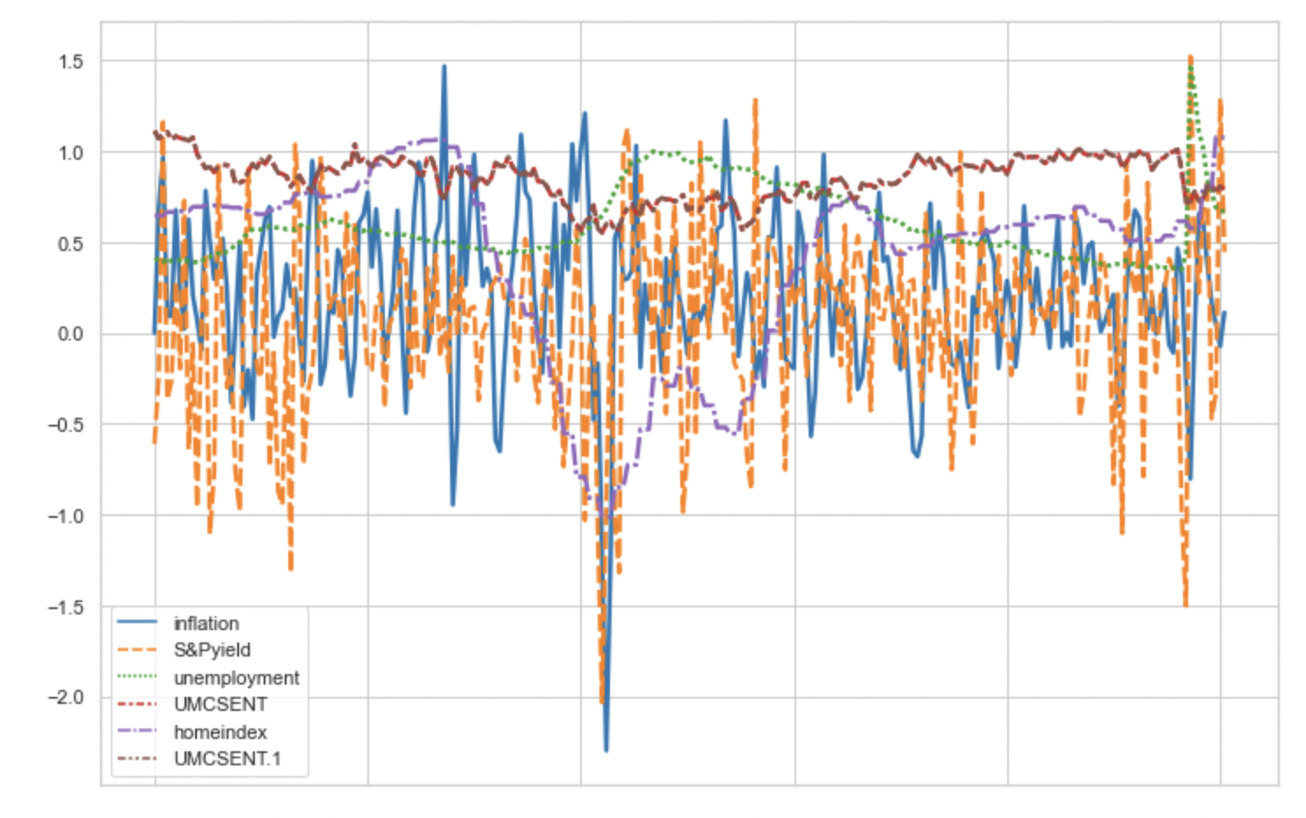
Economic Volatility
2006
2020
time

Slide 7
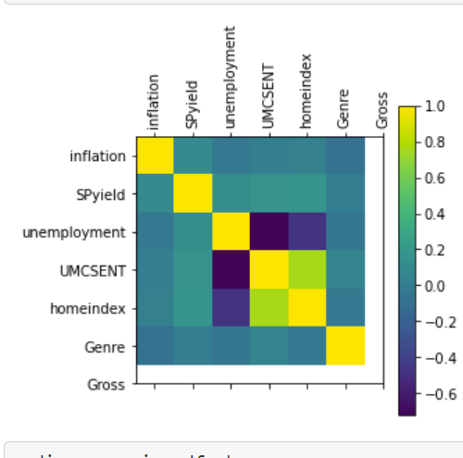
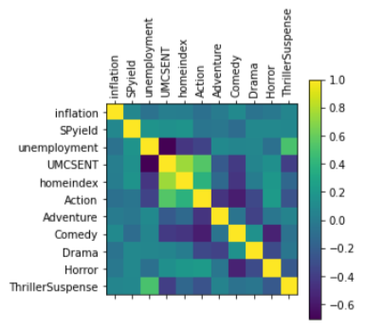
Correlation Analysis Among Inputs

Slide 8
Machine Learning Model
The independent variables "X" for each model were the economic data. We then applied the model by looping through each genre; the monthly market share by genre was our "y" (dependent variable).
Since we are using an input (economic features) to predict an output (market share by genre) we want to balance ease of interpretation with accuracy. In order of transparency to best fit:
Linear regression (least squares) model is easy to explain when it works, and shows which factors are important. We did not get a good fit with this model
Decision tree models attempt: We used Scikit-learn to create training and test sets, then graphed the predicted and actual y test values. Graphs showed some relationship, but not strong for must genres
Random Forest Regressor: used the same approach as for the decision tree model, gave a tighter fit

Slide 9
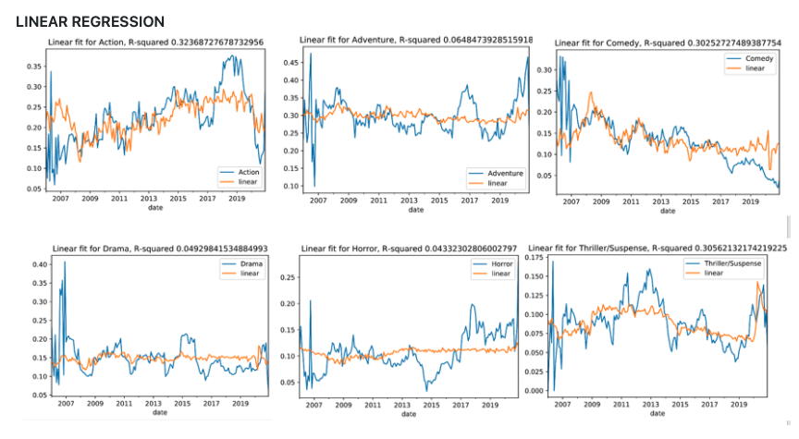
Linear Regression Outputs
market share
market share

Slide 10
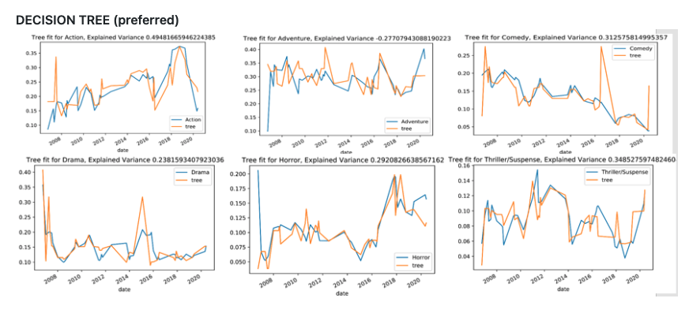
Decision Tree Outputs
market share
market share

Slide 11
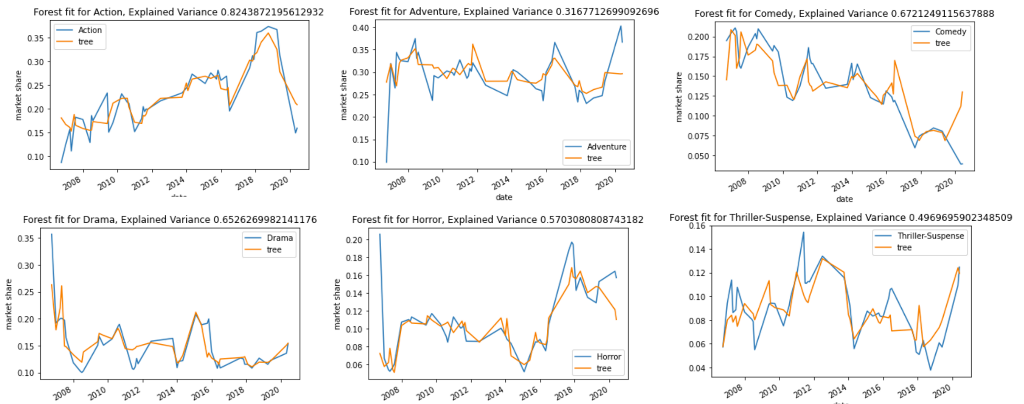
Deep Forest Outputs

Slide 12
Importance of Findings and Next Steps
Interpretation of Results
There appeared to be at least some correlation between economic indicators and genre preference
Among the genres analyzed, Action appeared most strongly correlated with economic indicators
Potential Next Steps
More analysis can be done to determine if certain economic indicators are better suited for the model
Separate polling experiments can be conducted to investigate whether the relationship between the economy and genre preference is a correlation or causation

