Slide 1
Breast Cancer Diagnosis Rates and Socio-Demographic Factors
Group 1
Team Members: Charles Quinn, Emily Boulware, Shelby Reyes-Widrick, Jackeline Larios
Notes:
Jackie will do introduction

Slide 2
Project Description
Examine the occurrence of breast cancer diagnoses and mortality rates over a 5-year period while focusing on various socio-demographic factors (ethnicity, median household income, and unemployment) and how these factors differ between the U.S. and Texas.
Research Questions to Answer:
At the national level, what are the breast cancer incidences by race, income, and unemployment rate?
At the national level, what are the cases of mortality by race, income, and unemployment rate?
At the state level, what is the breast cancer incidence by race, income, and unemployment rate?
At the state level, what are the cases of mortality by race, income, and by unemployment rate?

Slide 3
Breast Cancer Incidences in the U.S.
2015 - 2019
Notes:
Charles will cover US

Slide 4
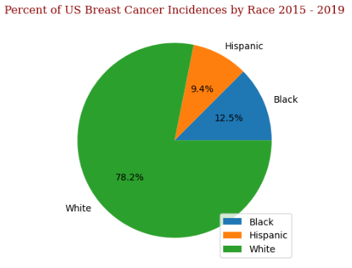
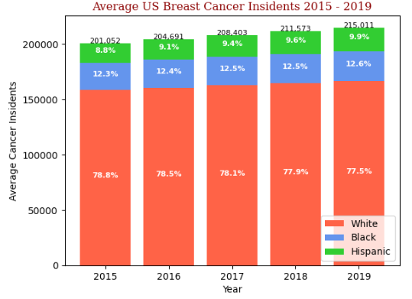
Incidences based on Ethnicity

Slide 5
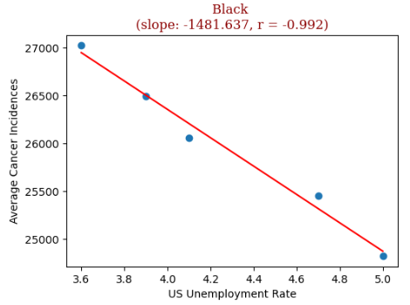
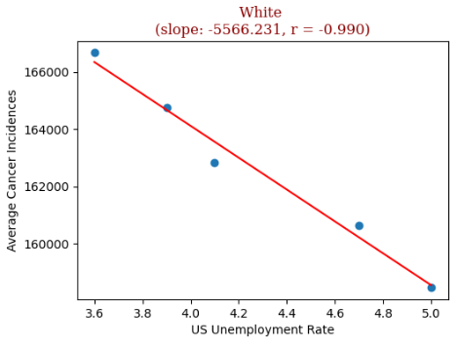
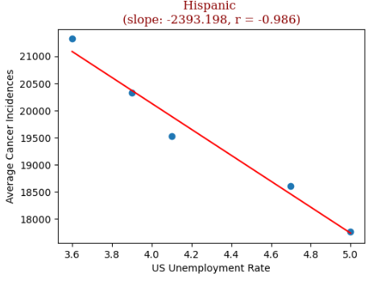
Incidences by Unemployment Rate and Race

Slide 6
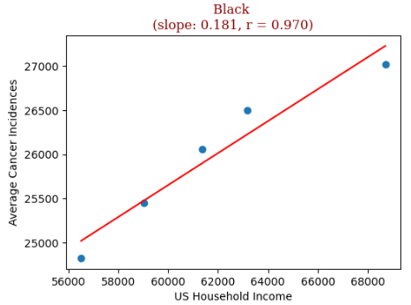
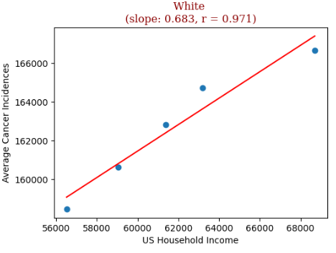
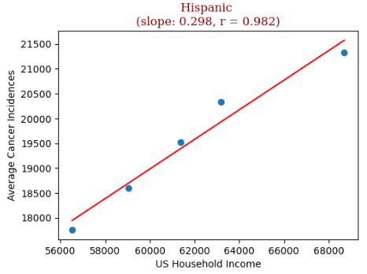
Incidences based on Income and Race

Slide 7
Breast Cancer Mortalities in the U.S.
2015 - 2019
Notes:
Charles will cover US

Slide 8
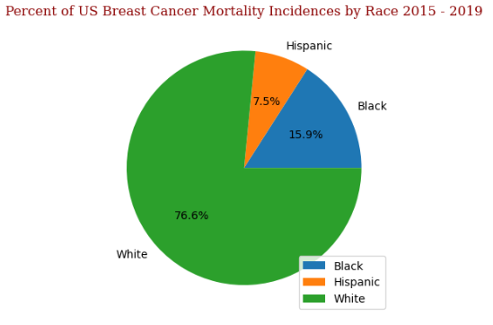
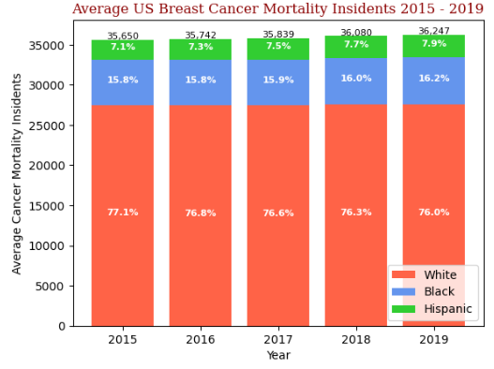
Mortalities by Unemployed Population and Race

Slide 9
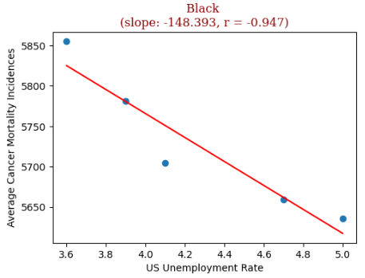
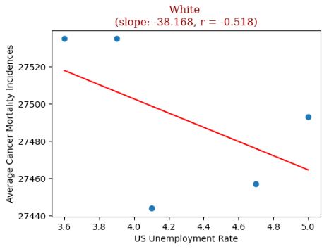
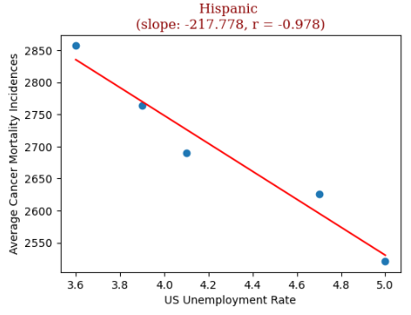
Mortalities by Unemployment Rate and Race

Slide 10
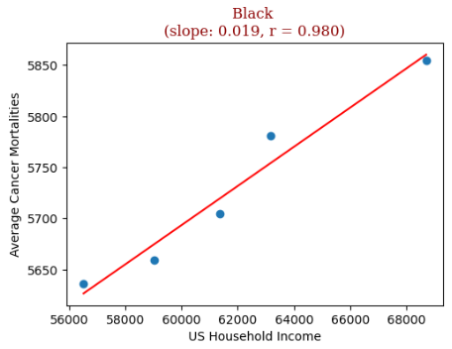
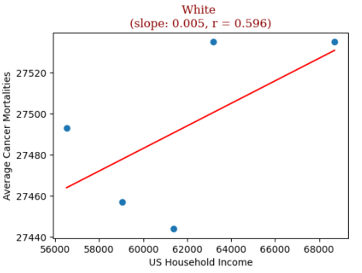
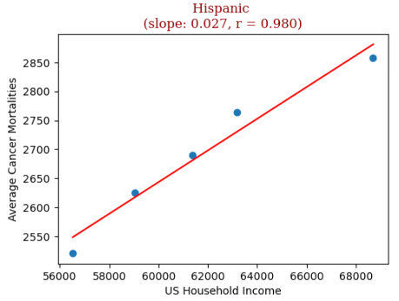
Mortalities based on Income and Race

Slide 11
Texas Breast Cancer Incidences
2015 - 2019

Slide 12
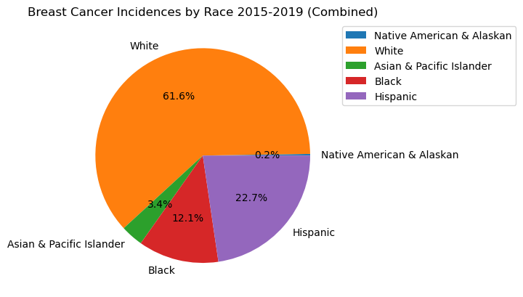
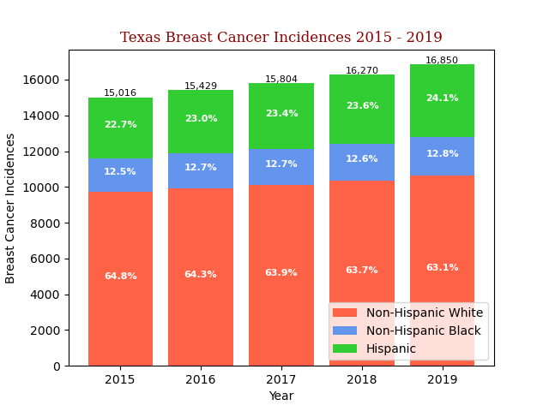
Incidences based on Ethnicity
Notes:
Here we have broken down the incidences of breast cancer by ethnicity. The white population makes up the largest percentage of breast cancer incidences in Texas following with hispanic, black, asian & pacific islander, and native americans. Minorities do experience a very slight increase in incidences each year, while the incidences in white population go down very slightly over the years.

Slide 13
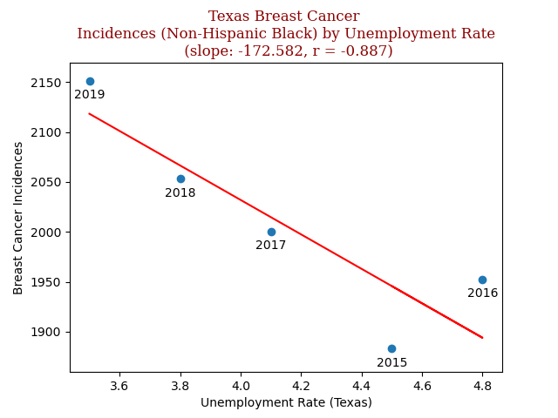
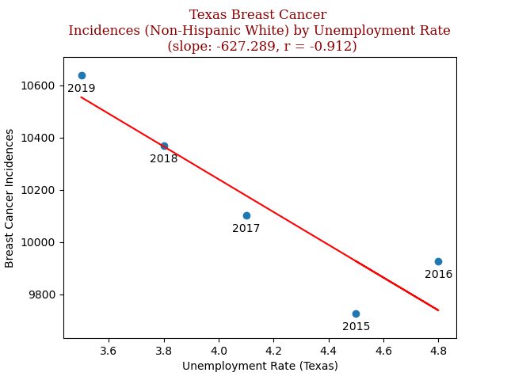
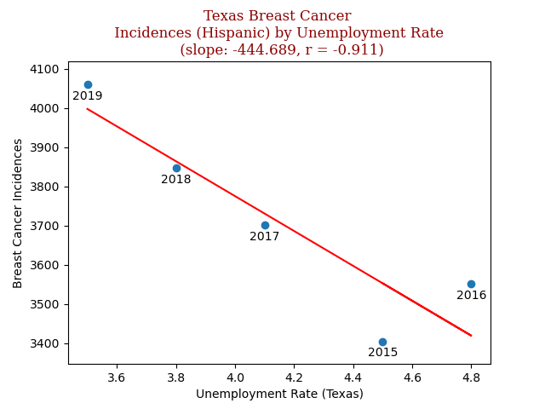
Incidences by Unemployment Rate and Race
Notes:
We found there to be a negative correlation between cancer incidences and unemployment rate. We found this interesting and think that this likely could be explained by the health care system in the United States being frequently tied to employment. Therefore, whenever a person is unemployed, they are less likely to seek medical attention or put going to the doctor on the backburner.

Slide 14
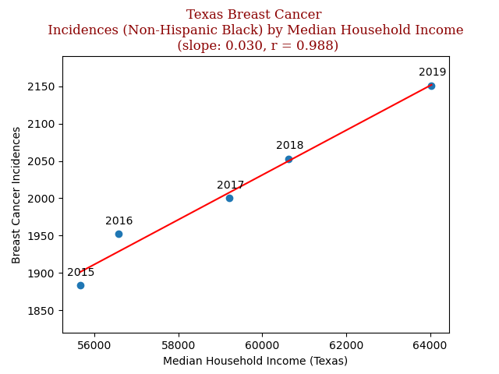
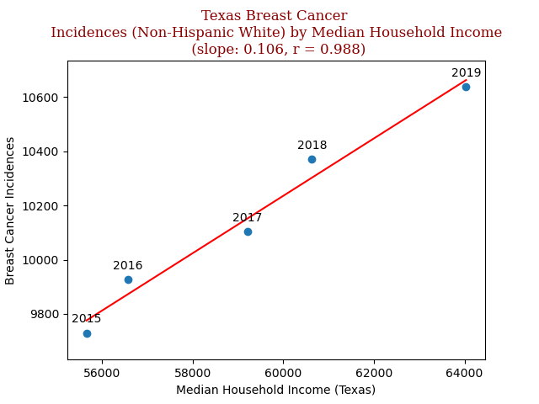
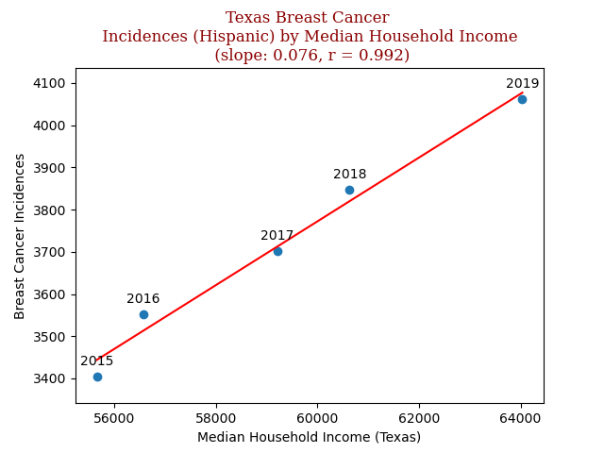
Incidences based on Income and Race
Notes:
We found there to be a positive correlation between cancer incidences and income. We theorize that this may be because the more income a person has, they have easier access to doctors.

Slide 15
Texas Breast Cancer Mortalities
2015 - 2019

Slide 16
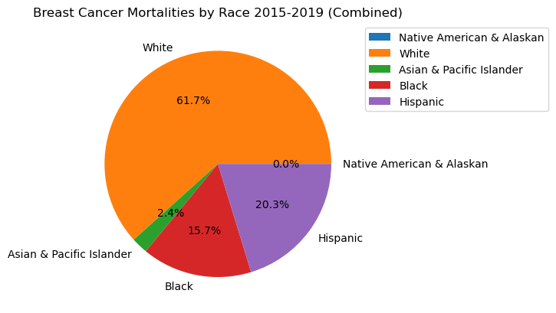
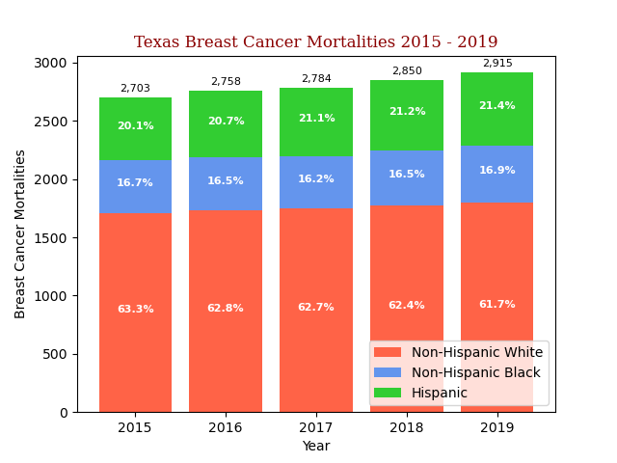
Mortalities based on Ethnicity
Notes:
Here we are looking at the number of breast cancer mortalities each year from 2015 to 2019 including each ethnicities’ percentage of the total mortalities each year. Overall, the total number of breast cancer mortalities have increased each year, and NH White and Hispanic populations number of mortalities increased each year as well, but we found that the number of NH Black breast cancer mortalities decreased slightly from 2015-2017 and then increased in 2018 and 2019. Also, even though NH White mortalities increased each year the NH White percentage actually decreased from 2015-2019 suggesting that the suggesting that the number of mortalities for other ethnicities was increasing at a faster rate.

Slide 17
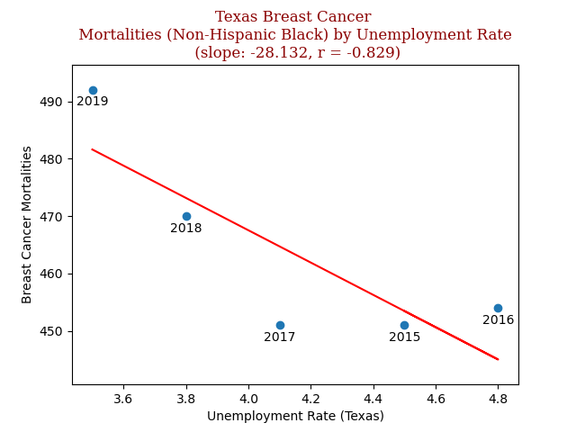
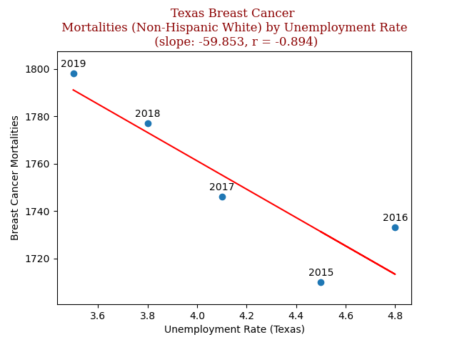
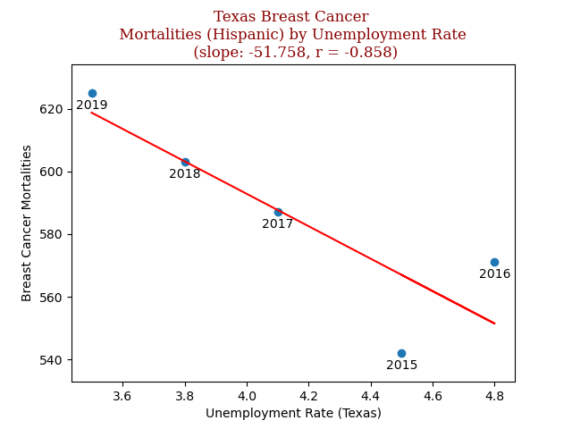
Mortalities by Unemployment Rate and Race
Notes:
When comparing the Texas unemployment rate and mortalities due to breast cancer from 2015 to 2019, we found that there was a strong negative association for all ethnicities. Even though there was a slightly stronger negative correlation for the white population in comparison to other ethnicities, there doesn’t seem to be any significant changes based on race.

Slide 18
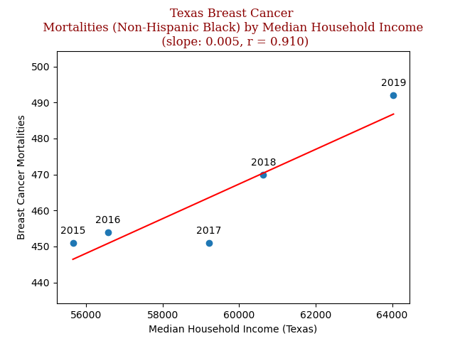
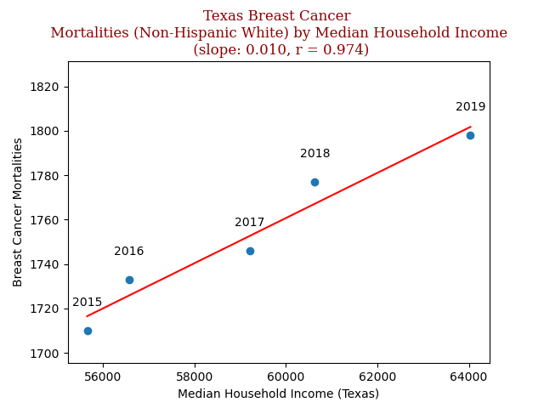
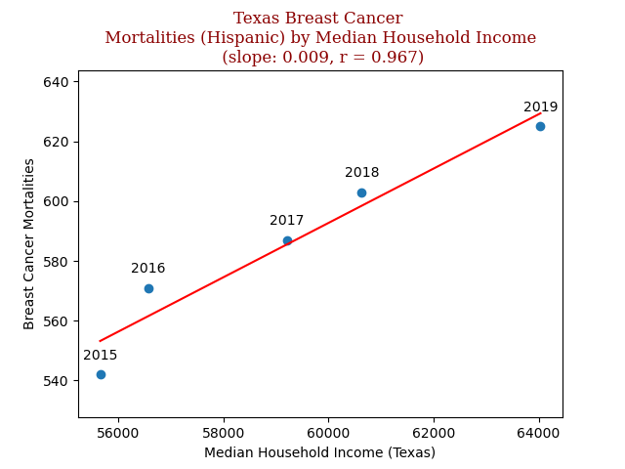
Mortalities based on Income and Race
Notes:
This is now comparing the median household income for each ethnicity with the breast cancer mortalities each year from 2015-2019. Here we can see there is a very strong positive relation between median household income and breast cancer mortalities across the board for each ethnicity. We can only speculate that a higher income may mean you are more likely to have insurance coverage leading to easier access to medical care so because of this individuals are more likely to undergo breast cancer screenings which may lead to a diagnosis, and in the very unfortunate cases, may mean an increase in the number of mortalities as a result of breast cancer. Without future research and study this is only speculation, but based on the datasets we compared we can see there is no significant change in mortalities based on ethnicity.

Slide 19
Conclusion
Race
White had a higher incidence & mortality rate compared to black & hispanic both nationally and in Texas
Income
A strong positive relation between median household income and breast cancer mortalities & incidences across the board for each ethnicity both nationally and in Texas
Unemployment
There is a negative correlation between unemployment rate and breast cancer mortalities & incidences both nationally and in Texas

Slide 20
Data Sources Used
Centers for Disease Control and Prevention (CDC): Chronic Conditions (Cancer)
Bureau of Economic Analysis (BEA): Median Household Income
Bureau of Labor Statistics (BLS): Unemployment Rates (1976 – Present)
S&P 500 PE Ratio: US Median Income by Year

Slide 21
Q&A

