Slide 1
NYC Housing Data 2017
Linda Farley, Emily Nassi, Zach Quasney

Slide 2
Motivation and Summary
Just how expensive is it to live in different parts of NYC?
This project explores NYC Housing data from the last year (2017), and uncover trends based on borough, neighborhood, price, crime and school data.

Slide 3
Questions and Data
Questions include:
Which borough are people moving to?
What is the most expensive borough to live in?
Does the age of a building make a difference in its price?
What months are the most popular for sales?
Does crime have an impact on sales prices or where people are moving to?
What about quality of schools?
Data includes:
NYC Department of Housing Sales Data
NYC OpenData (for crime data) API
SchoolDigger API

Slide 4
Data Cleanup and Exploration
Sort out residential purchases (remove commercial and rentals)
Drop rows missing a significant amount of data
Group by borough
Collect school ratings from SchoolDigger API
Explore crime data based on classification and area

Slide 5
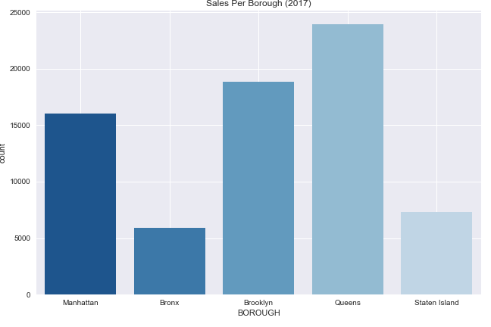
Sales Per Borough
Queens had the most amount of sales in 2017
The Bronx and Staten Island had the least

Slide 6
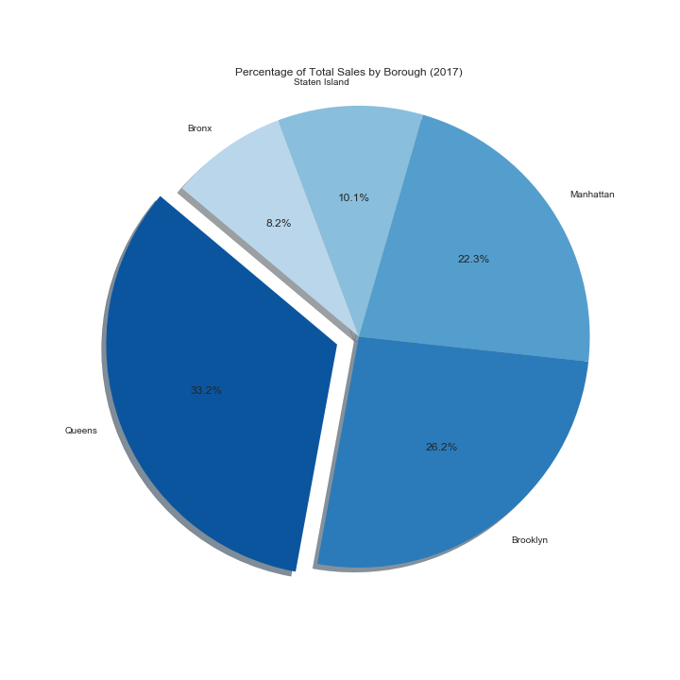
Percentage of Sales by Borough
Queens had the highest percentage at 33.2%
Brooklyn and Manhattan each held a similar share

Slide 7
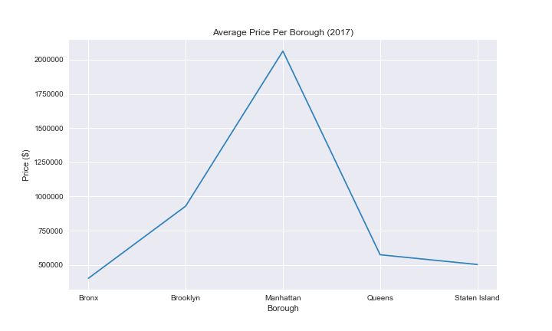
Average Price Per Borough
Mahattan was the only borough where the average sales price was in the millions
This was impacted by the existence of high price sales, the highest of which was @$65,661,800.

Slide 8
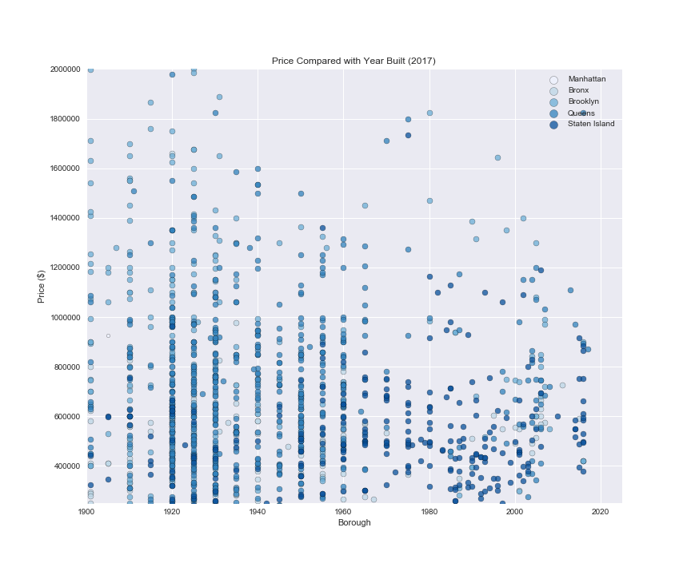
Price compared to year built
*Sample of 1500 rows taken for readability
No real discernable trends based on the year a residence was built, compared to price.

Slide 9
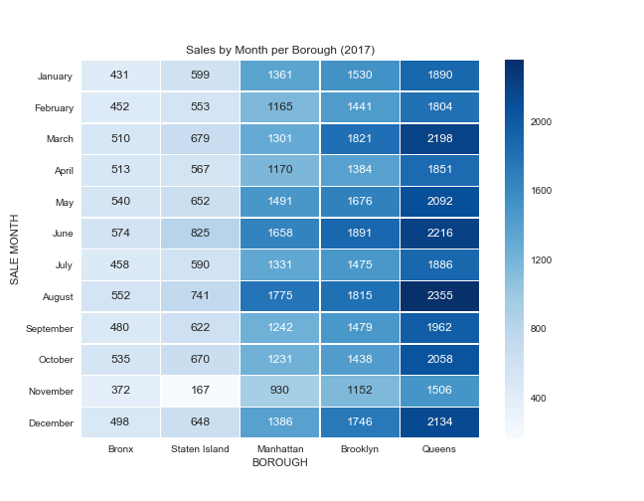
Sales by Month
More sales tend to happen when the weather gets warmer, however, in October, the market improved again for Staten Island, the Bronx and Queens.

Slide 10
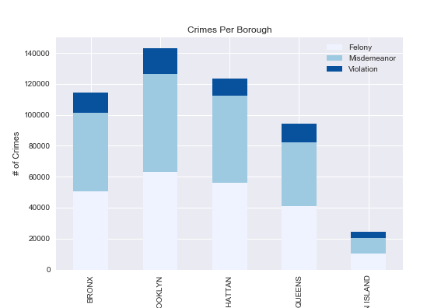
Crime per borough
Crime split by Degree of Crime, Felony, Misdemeanor & Violations. Over the last Year.
Brooklyn at the top with the most crimes, followed by Manhattan, Bronx, Queens and finally Staten Island.
Tying this back to housing sales, Queens has the most sales, and one of the lower crime rates.

Slide 11
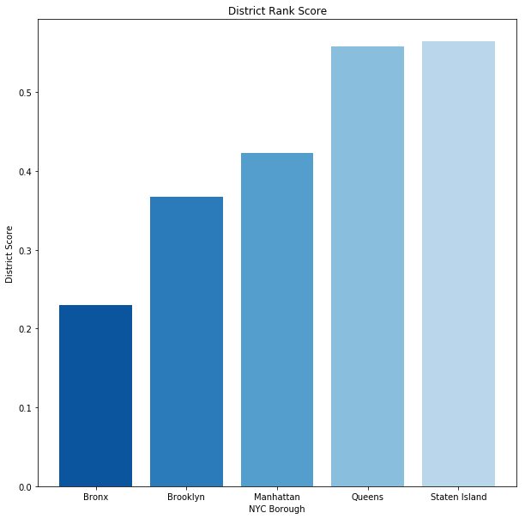
District Rank Score
Mean ‘rank score’ of public school districts in each NYC borough, according to School Digger API.
Staten Island and Queens have highest scores, followed by Manhattan and Brooklyn; lowest score in the Bronx.

Slide 12
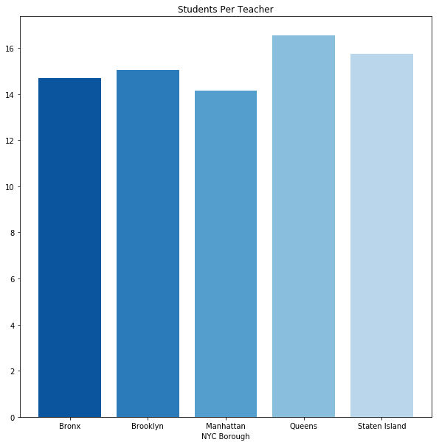
Students per teacher
Mean number of Students per teacher in public school districts in each NYC borough
Even spread across boroughs

Slide 13
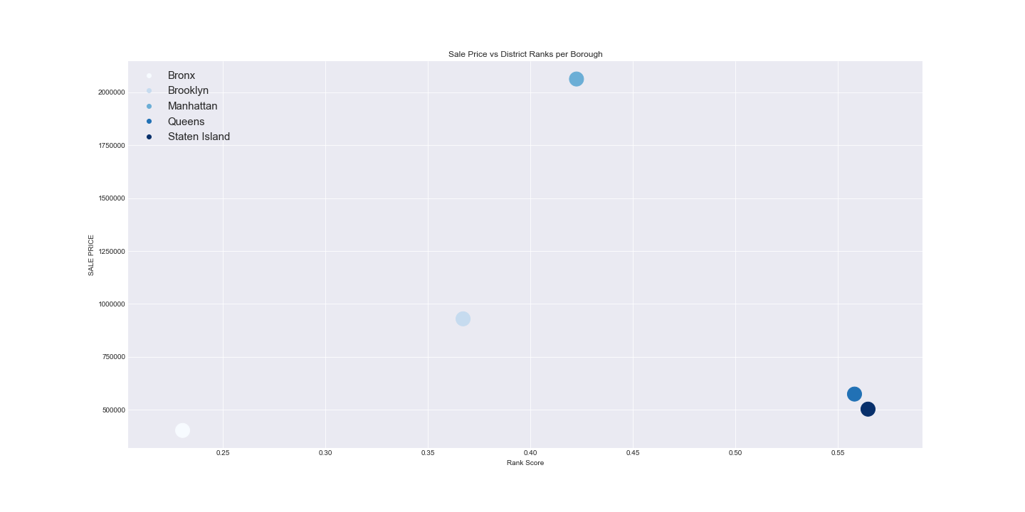
Sales prce vs ranks
Comparison of housing sale prices in each borough versus mean public school district rank score.
No direct correlation found.

Slide 14
trends
Queens had the highest sales percentage at 33.2% of the total sales, second lowest crime rate, and the best school rating.
Bronx had the lowest sales at 8.2%, a higher crime rate, and the lowest school rating.

