Slide 1


Whilst we’re waiting to begin, please say hi in the chat and what experience(if any!) you have using R.

Slide 2
Intro to R
Emily Nordmann
@emilynordmann
Rebecca Lai
@_R_Lai

Slide 3
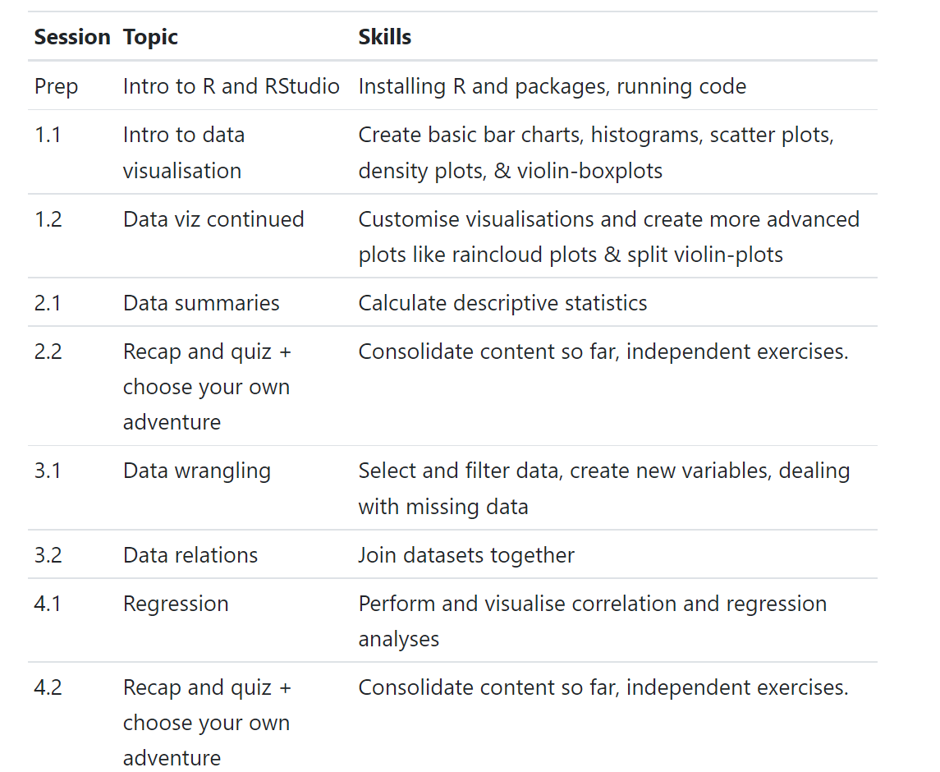
Schedule
You will all learn at different paces
The schedule tries to account for this
Use the “speed up” and “slow down” Zoom reactions to let us know how you’re getting on

Slide 4
Format
Camera-on, mic-off
Help each other!
Please ask questions in the chat or raise hand to speak
If you get an error you can’t solve, screen share & we’ll problem solve together
Breaks: little and often
Catch-up
Help each other
Read ahead

Slide 5
Before we begin
You will make errors
Learning to code is mostly learning to problem solve
Look for typos – remember that R is case sensitive
Read the error messages
Make sure you’ve run the code, don’t just write it
Always look at your output
You are not expected to memorise code
The aim is to build up a collection of recipes
Learning to read the help documentation is a skill in itself
It’s not just you, it’s mostly terrible

Slide 6
Error log
Error | Code that produced the error | Plain language explanation of problem | Code that fixed the error
Error in read_csv("my_file.csv") : could not find function "read_csv" | dat <- read_csv(“my_file.csv”) | The function read_csv is in the tidyverse package readr and I had not loaded the tidyverse before trying to run read_csv | library(tidyverse dat <- read_csv(“my_file.csv”)
Error: ‘my_file' does not exist in current working directory | dat <- read_csv(“my_file.csv”) | I forgot to add on the .csv file extension to the name of the file. | dat <- read_csv(“my_file.csv”)
Error: ‘my_file' does not exist in current working directory | dat <- read_csv(“My_file.csv”) | The file I was trying to load is named “my_file” not “My_file” – R is case sensitive. | dat <- read_csv(“my_file.csv”)
This will slow you down in the short-term, but it will help you to learn and fix recurring errors

Slide 7
Above all else…
If you want to learn R, you have to use R

