Slide 1
Yonsei bamboo fb-page
analysis using Python
Kakyung Kim, Myeongjin Ko, Chaewon Park, Hyungjun Ha

Slide 2
Contents
Explanation of the overall project
Data Crawling
Re-organizing the data
Visualization
Fun facts
Conclusion

Slide 3
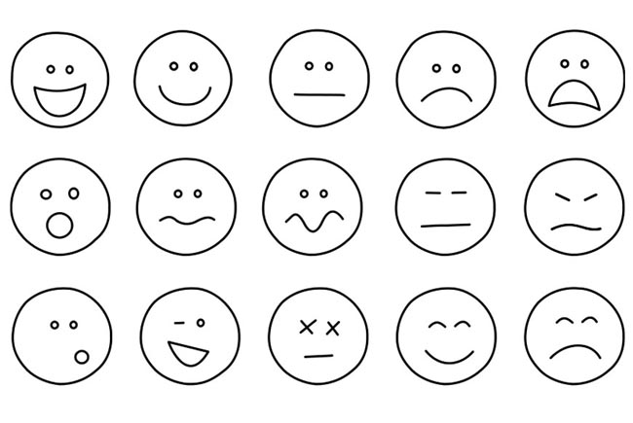
Q. How does Yonsei Students’ Emotion change over time?
When are they happy?
And When are they easy to get angry?
Overall Project (2) Data Crawling (3) Re-organizing
(4) Visualization (5) Fun facts (6) Conclusion

Slide 4
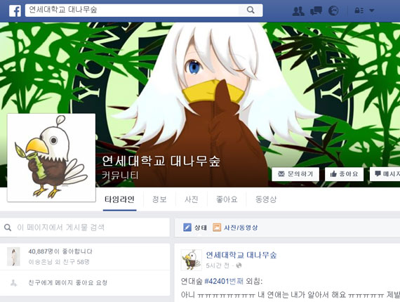
Yonsei Bamboo Facebook page
Students send
their writings
to the page
anonymously
Then,
Facebook page
Administrator
picks some
and post them
in 72 hours
Overall Project (2) Data Crawling (3) Re-organizing
(4) Visualization (5) Fun facts (6) Conclusion

Slide 5
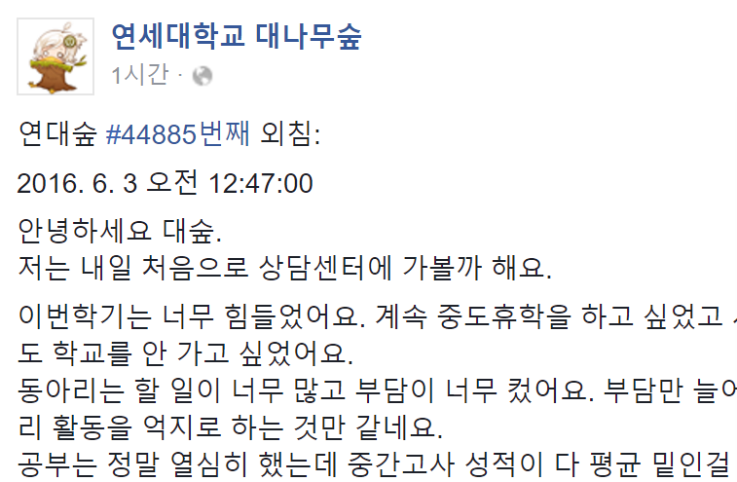
Yonsei Bamboo Facebook page
Administrators post
students’ writings within
their written time
This post was written around at 12:47:00!!
Overall Project (2) Data Crawling (3) Re-organizing
(4) Visualization (5) Fun facts (6) Conclusion

Slide 6
How to get the Data on Facebook
< Graph API ? >
- A Basic way to approach the data on Facebook
Python provides ‘facebook’ library to use this API
For more information ( instructions )
https://developers.facebook.com
Overall Project (2) Data Crawling (3) Re-organizing
(4) Visualization (5) Fun facts (6) Conclusion

Slide 7
Crawled Data type
{Dictionary}
‘data’ key (list type)
1st post
3rd post
‘paging’ key
N-th post
…
2nd post
‘created_time’ key
‘message’ key
Date, time data
(string type)
Post contents data
(string type)
Overall Project (2) Data Crawling (3) Re-organizing
(4) Visualization (5) Fun facts (6) Conclusion

Slide 8
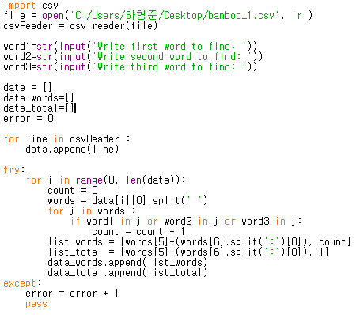
Re-organizing the Data
Get contents of Yonsei Bamboo facebook Page as string files
Use the ‘split’ function so that we can identify a word which makes us recognize the reported time(Not created time)
Make a list which has
[reported time, counting number] format
[[reported time1, counting number1], [reported time2, counting number2],
[…] ,[…], […], …]
Overall Project (2) Data Crawling (3) Re-organizing
(4) Visualization (5) Fun facts (6) Conclusion

Slide 9
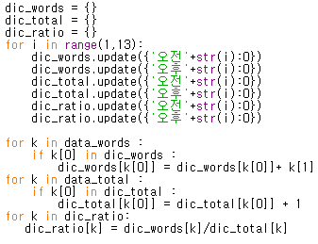
Re-organizing the Data
Dic={‘hour’: number}
Key: every hour, value: frequency
Overall Project (2) Data Crawling (3) Re-organizing
(4) Visualization (5) Fun facts (6) Conclusion

Slide 10
Re-organizing the Data
data_words/ data-total
[reported time =k[0], counting number =k[1]]
dic_ratio[k]=
Total frequency of word/ Total number of post
Overall Project (2) Data Crawling (3) Re-organizing
(4) Visualization (5) Fun facts (6) Conclusion

Slide 11
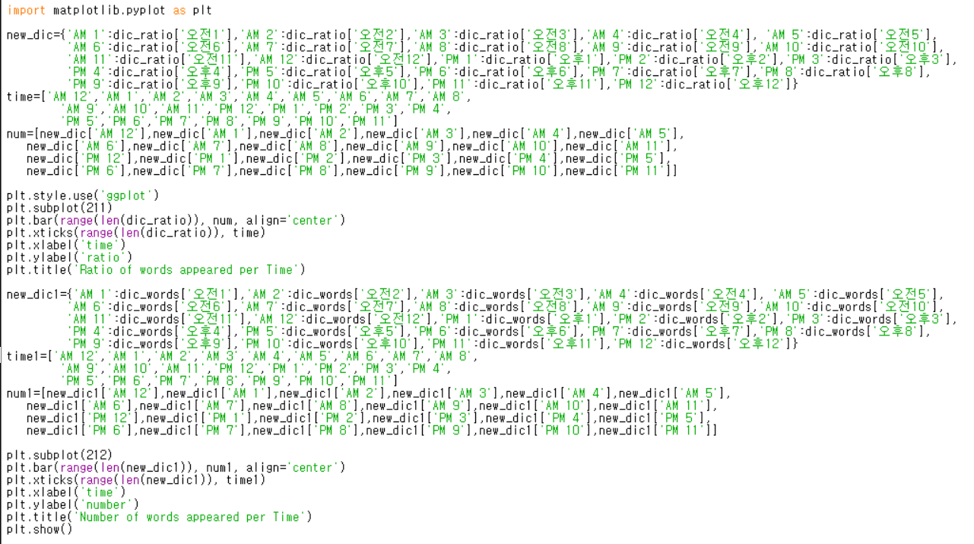
Visualization
Each codes in box represents repeated code for ratio and word count respectively
Overall Project (2) Data Crawling (3) Re-organizing
(4) Visualization (5) Fun facts (6) Conclusion

Slide 12
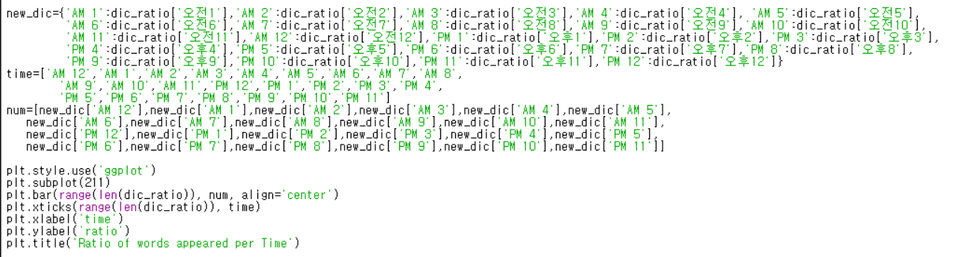
Visualization
Since key values in dictionary are immutable, we got to set new dictionary to switch key values
Overall Project (2) Data Crawling (3) Re-organizing
(4) Visualization (5) Fun facts (6) Conclusion

Slide 13
Visualization
To set data of x axis, we set new list time and then put data in num list
Overall Project (2) Data Crawling (3) Re-organizing
(4) Visualization (5) Fun facts (6) Conclusion

Slide 14
Visualization
Style.use function to decorate graph
Subplot function to arrange graphs
Bar function to create par
Xlabel function to set x label
Ylabel function to set Y label
Title function to set title
Overall Project (2) Data Crawling (3) Re-organizing
(4) Visualization (5) Fun facts (6) Conclusion

Slide 15
Visualization
Each codes in box represents repeated code for ratio and word count respectively
Overall Project (2) Data Crawling (3) Re-organizing
(4) Visualization (5) Fun facts (6) Conclusion

Slide 16
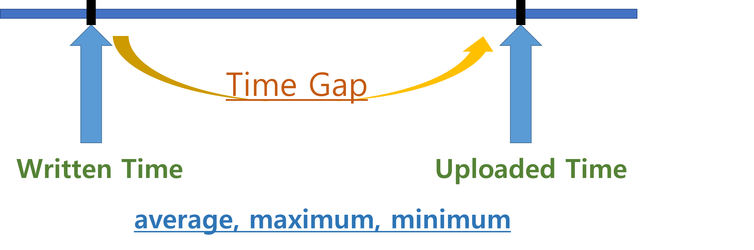
Fun Facts: Is the Yonsei Bamboo FB page doing its job?
Overall Project (2) Data Crawling (3) Re-organizing
(4) Visualization (5) Fun facts (6) Conclusion

Slide 17
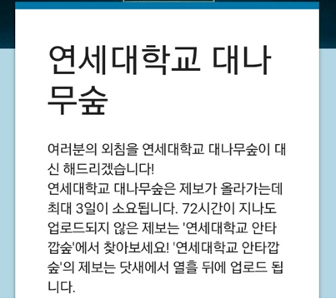
Fun Facts: Is the Yonsei Bamboo FB page doing its job?
Within 72 hours?
Overall Project (2) Data Crawling (3) Re-organizing
(4) Visualization (5) Fun facts (6) Conclusion

Slide 18
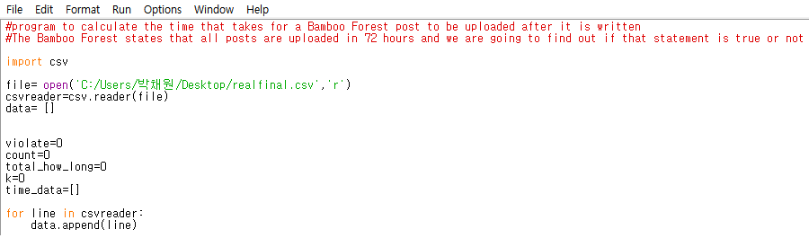
Fun Facts: Is the Yonsei Bamboo FB page doing its job?
Overall Project (2) Data Crawling (3) Re-organizing
(4) Visualization (5) Fun facts (6) Conclusion

Slide 19
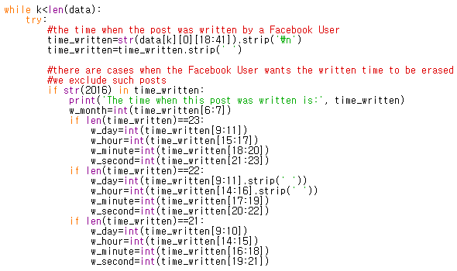
Fun Facts: Is the Yonsei Bamboo FB page doing its job?
Overall Project (2) Data Crawling (3) Re-organizing
(4) Visualization (5) Fun facts (6) Conclusion

Slide 20
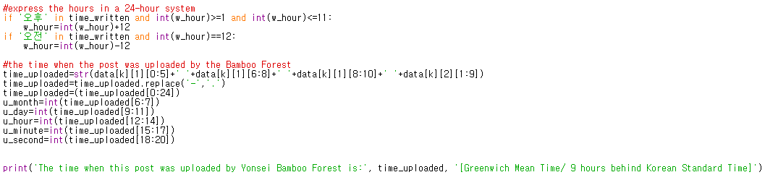
Fun Facts: Is the Yonsei Bamboo FB page doing its job?
Overall Project (2) Data Crawling (3) Re-organizing
(4) Visualization (5) Fun facts (6) Conclusion

Slide 21
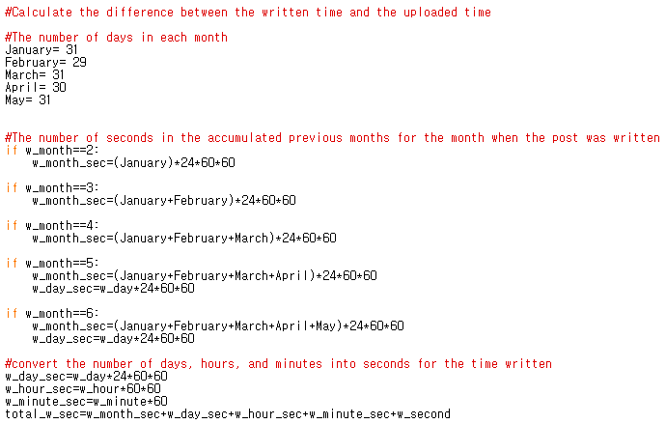
Fun Facts: Is the Yonsei Bamboo FB page doing its job?
Overall Project (2) Data Crawling (3) Re-organizing
(4) Visualization (5) Fun facts (6) Conclusion

Slide 22
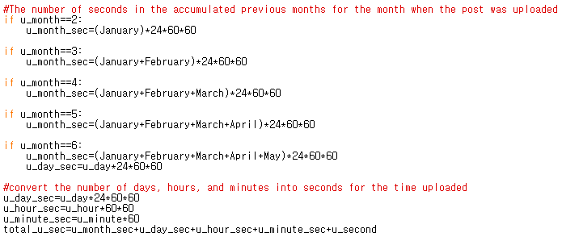
Fun Facts: Is the Yonsei Bamboo FB page doing its job?
Overall Project (2) Data Crawling (3) Re-organizing
(4) Visualization (5) Fun facts (6) Conclusion

Slide 23
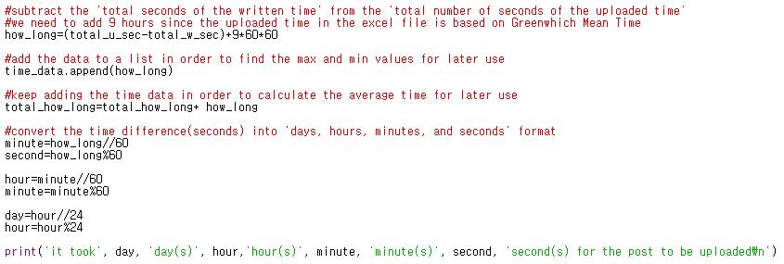
Fun Facts: Is the Yonsei Bamboo FB page doing its job?
Overall Project (2) Data Crawling (3) Re-organizing
(4) Visualization (5) Fun facts (6) Conclusion

Slide 24
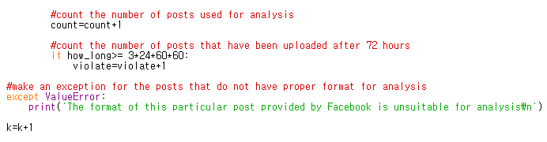
Fun Facts: Is the Yonsei Bamboo FB page doing its job?
Overall Project (2) Data Crawling (3) Re-organizing
(4) Visualization (5) Fun facts (6) Conclusion

Slide 25
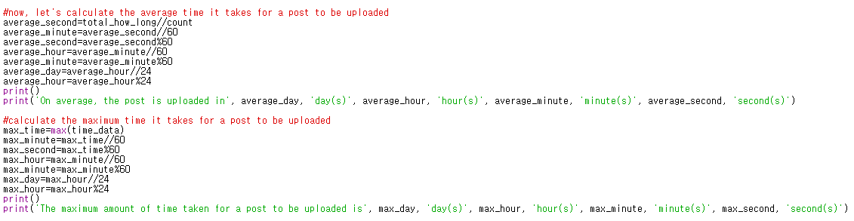
Fun Facts: Is the Yonsei Bamboo FB page doing its job?
Overall Project (2) Data Crawling (3) Re-organizing
(4) Visualization (5) Fun facts (6) Conclusion

Slide 26
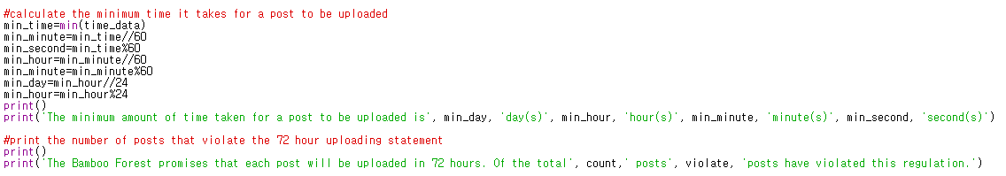
Fun Facts: Is the Yonsei Bamboo FB page doing its job?
Overall Project (2) Data Crawling (3) Re-organizing
(4) Visualization (5) Fun facts (6) Conclusion

Slide 27
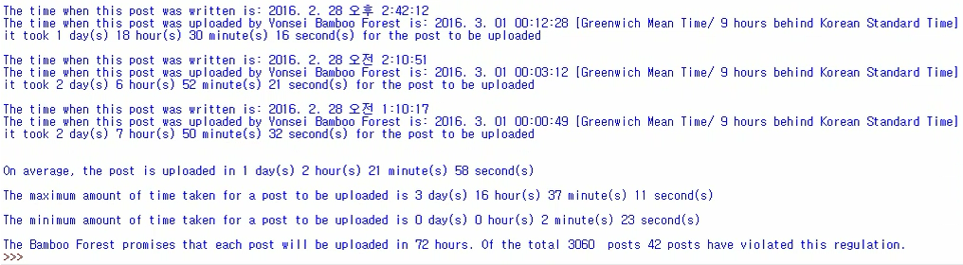
Fun Facts: Is the Yonsei Bamboo FB page doing its job?
Overall Project (2) Data Crawling (3) Re-organizing
(4) Visualization (5) Fun facts (6) Conclusion

Slide 28
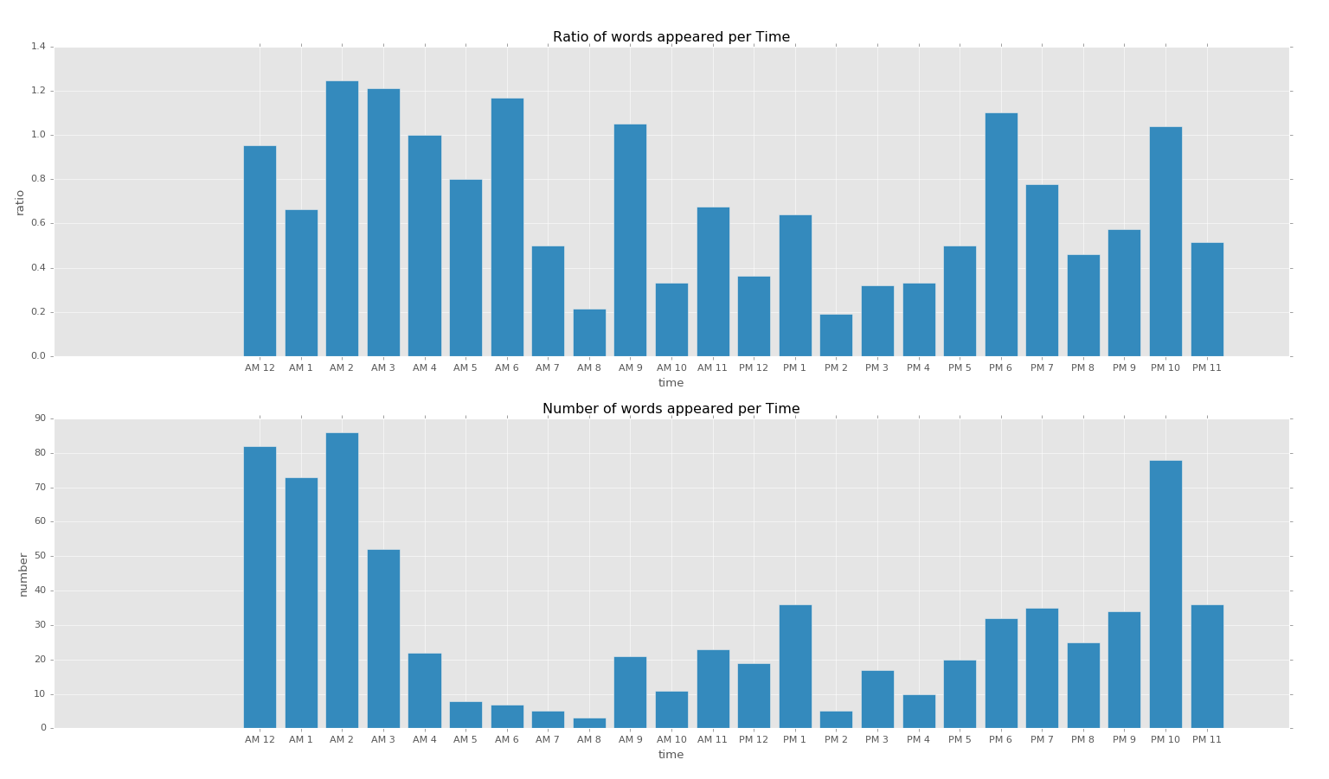
Conclusion
Result when the input word is ‘사랑’, ‘썸’, ‘연애’
1.25 at 2AM
1.21 at 3AM
Overall Project (2) Data Crawling (3) Re-organizing
(4) Visualization (5) Fun facts (6) Conclusion

Slide 29
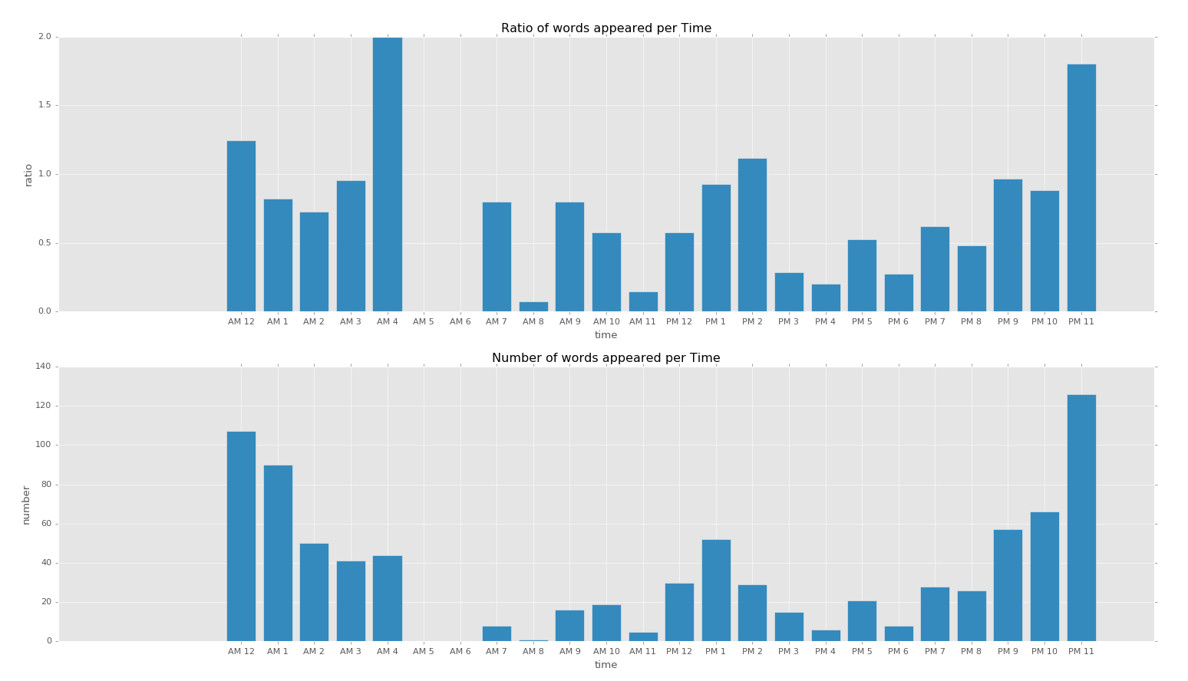
Conclusion
Result when the input word is ‘아빠’, ‘엄마’, ‘집’
2.0 at 4AM
Generally high after the sun sets
People become emotional at night and dawn time
Overall Project (2) Data Crawling (3) Re-organizing
(4) Visualization (5) Fun facts (6) Conclusion

Slide 30
Conclusion
Result when the input word is ‘짜증’, ‘빡’, ‘어이없’
0.15 at 9PM
0.14 at 8AM
We thought that this time is the time when students usually do homework.
Overall Project (2) Data Crawling (3) Re-organizing
(4) Visualization (5) Fun facts (6) Conclusion

