Slide 1
Expanding the Child and Dependent Care Credit (CDCC)
A Critical Investment in Our Future
By Emily Picinich
Notes:
Good [morning/afternoon], everyone. Thank you for being here. I’m Emily Picinich, and today I’m going to make the case for expanding the Child and Dependent Care Credit—why it’s not only a lifeline for working families, but a strategic investment in our economy and our children’s future. Over the next few minutes, I’ll show you where we are today, what the data tell us about unmet need, and how targeted changes to this credit can deliver real benefits—for parents, for businesses, and for society at large.

Slide 2
Childcare Demand
12 – the age a child can be left alone
46.6 million children under 12 in the US
Notes:
This is where the need for childcare really comes into focus: experts advise that a child under age 12 or 13 shouldn’t be left home alone, which means every one of those 46.6 million U.S. kids under 12 needs some form of supervised care. That’s nearly one in seven Americans who rely on daycare centers, family caregivers, or other arrangements every day—and it helps explain why any tweak to the Child and Dependent Care Credit can have such a broad impact on families’ lives and the economy.

Slide 3
The Problem
Skyrocketing expenses
Regional disparities
Workforce Impact
Quality trade-offs
Budget squeeze
Economic drag and safety-net reliance
Deepening inequalities
Notes:
Skyrocketing expenses: Across the U.S., the rising cost of childcare has become a major financial burden for families. Childcare costs in the U.S. have risen sharply, often matching or exceeding rent or mortgage expenses.

Slide 4
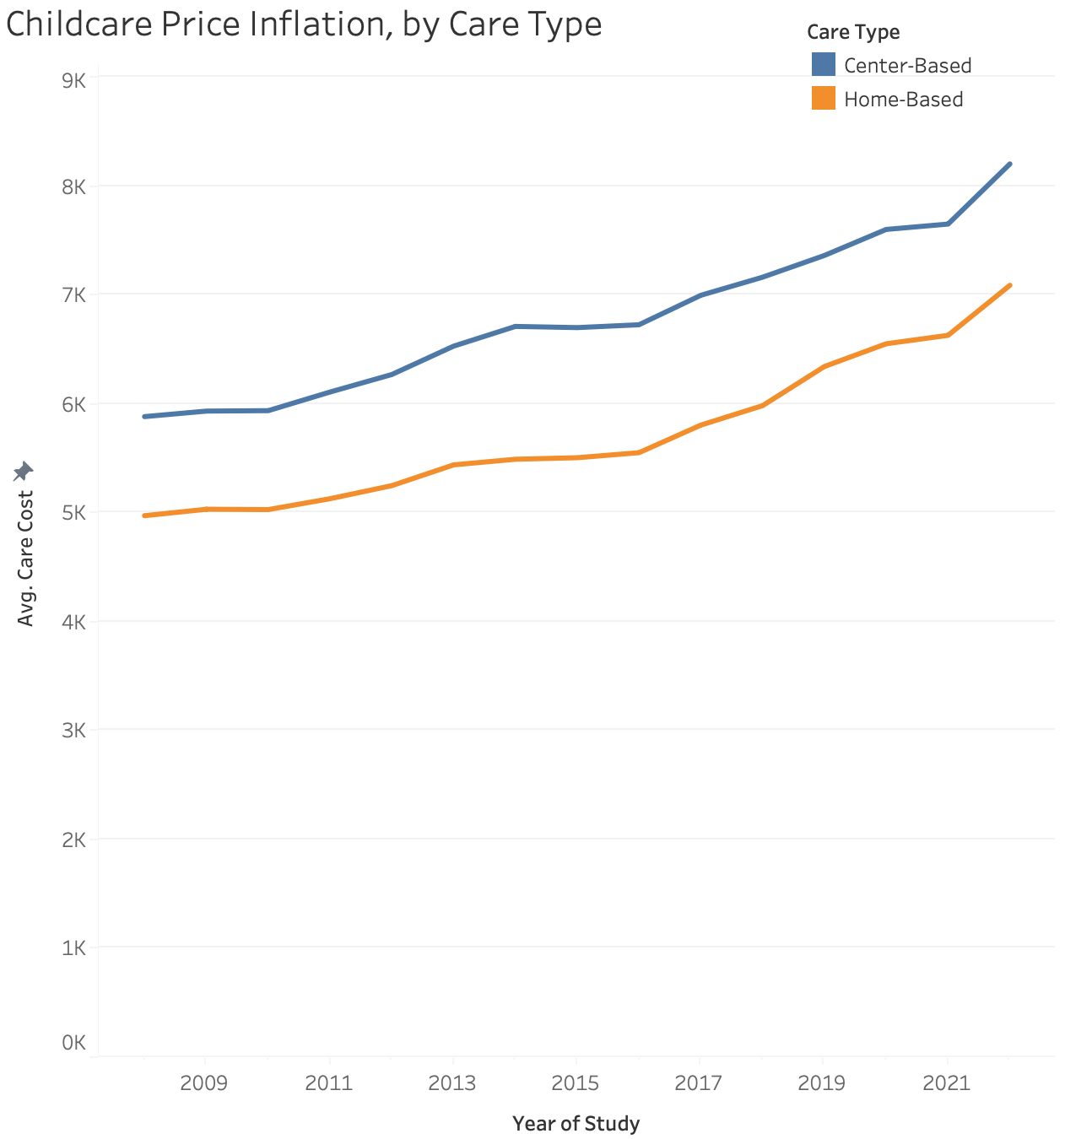
Notes:
This chart shows how the average annual cost of center‑based (blue) and home‑based (orange) care have climbed from 2008 through 2022. Both lines slope steadily upward—but look at the steepening rise after 2016, and then the pronounced jump around 2021–22. Center‑based care went from about $5.9 K in ’08 to over $8.2 K in ’22—a nearly 40 percent increase—while home‑based care rose from $5 K to $7.1 K (over 40 percent).
That acceleration reflects tightening labor markets, wage pressures on providers, and broader inflation. In practical terms, families are facing faster‑growing childcare bills just when many incomes are under stress. It’s precisely this kind of runaway cost growth that argues for a credit that can adjust to evolving financial pressures, not just a static subsidy.

Slide 5
The Problem
Skyrocketing expenses
Regional disparities
Workforce Impact
Quality trade-offs
Budget squeeze
Economic drag and safety-net reliance
Deepening inequalities
Notes:
Regional disparities: Annual care fees range from roughly $5,000 to $25,000 and vary widely by state and county and whether care is center-based or home-based.

Slide 6
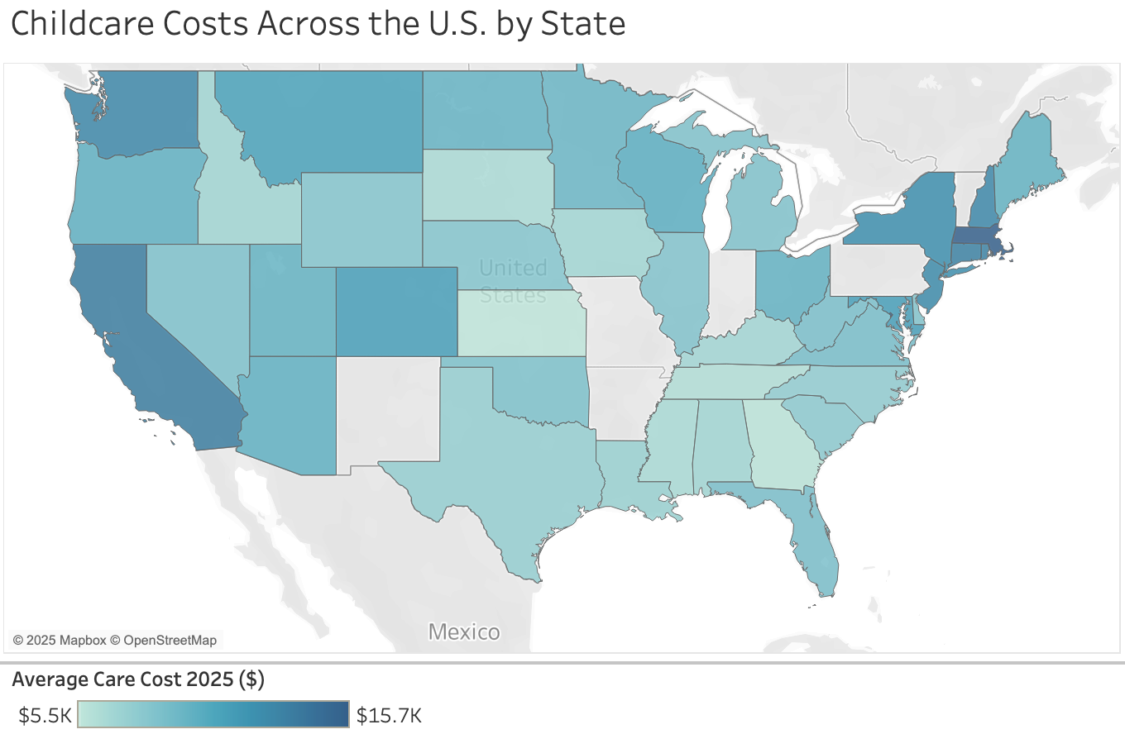
Notes:
On this map, each state’s shade shows its average annual childcare cost, from about $5.5K in the lightest‐colored states up to nearly $16K in the darkest.
Notice the hot spots: California, New York, Massachusetts, and other high‐cost metros in the Northeast and on the West Coast—all above $13K. In contrast, many states in the South and Midwest—think Mississippi, Arkansas, Oklahoma—hover down around $6–7K.
This geographic spread reflects differences in local wages, real estate prices, and provider availability. It also highlights why a one‑size‑fits‑all credit falls short: families in high‑cost states face a much bigger burden. By indexing or tiering the child‑care credit to local cost levels, we can better target relief where it’s needed most.

Slide 7
The Problem
Skyrocketing expenses
Regional disparities
Workforce Impact
Quality trade-offs
Budget squeeze
Economic drag and safety-net reliance
Deepening inequalities
Notes:
Workforce impact: High costs force many parents, especially mothers, to reduce work hours, postpone returning to work, or exit the workforce entirely.

Slide 8
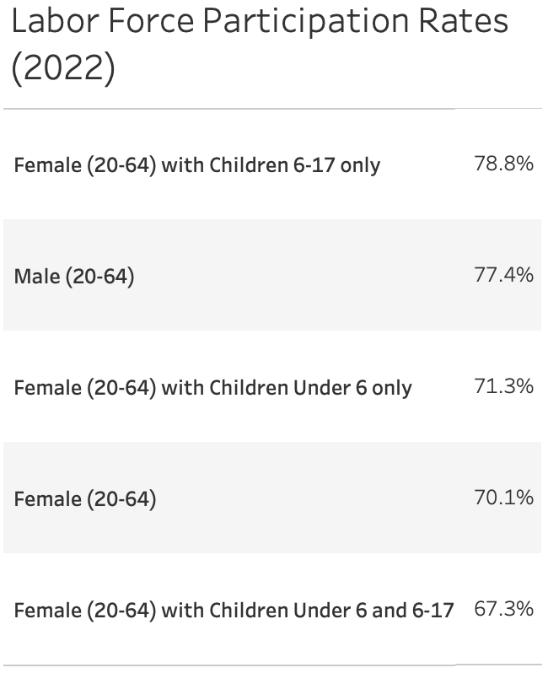
Notes:
Here we see how caregiving responsibilities map onto workforce attachment.
Women with only school‑age kids actually participate at 78.8 percent—slightly above the overall male rate of 77.4 percent—showing that when kids are older, mothers remain fully in the labor force.
But the moment you look at mothers of young children, participation falls to 71.3 percent, and it dips further to 67.3 percent for women juggling both preschoolers and school‑agers.
That gap—a 10‑point swing compared with moms of older kids and more than a 6‑point shortfall versus men—captures the “care penalty” in action and underlines why strengthening the Child and Dependent Care Credit is so vital to keeping parents, especially mothers, in paid work.

Slide 9
The Problem
Skyrocketing expenses
Regional disparities
Workforce Impact
Quality trade-offs
Budget squeeze
Economic drag and safety-net reliance
Deepening inequalities
Notes:
Quality trade‑offs: To save money, families may opt for lower‑quality care or less-regulated care arrangements, which research links to poorer development outcomes for children.

Slide 10
The Problem
Skyrocketing expenses
Regional disparities
Workforce Impact
Quality trade-offs
Budget squeeze
Economic drag and safety-net reliance
Deepening inequalities
Notes:
Budget squeeze: Soaring childcare bills strain household budgets and limit consumer spending.

Slide 11
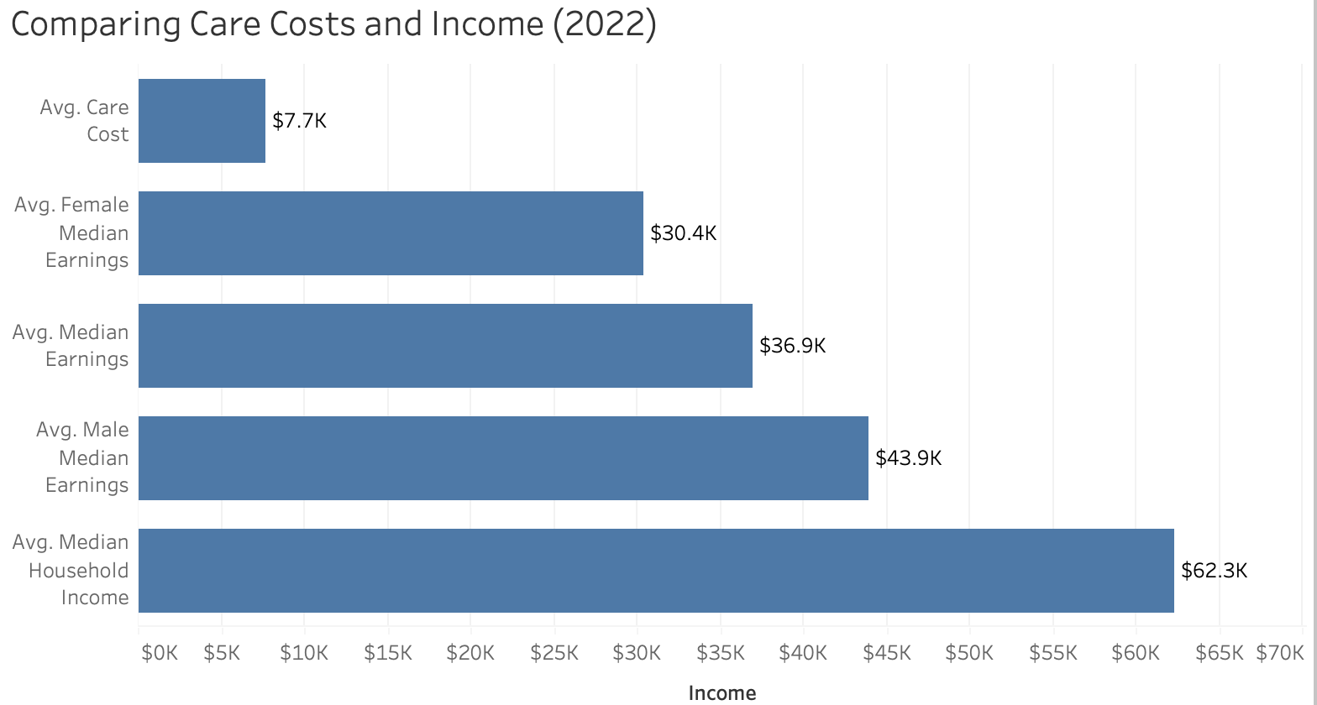
Notes:
On this slide I’ve lined up the average annual cost of childcare against different income benchmarks for 2022. At the top you see families are paying about $7.7K per child each year. That $7.7K isn’t just a small line item – it eats up roughly 12 percent of the typical household’s $62.3K income, and fully a quarter of what the average mother earns ($30.4K). Even for two‑earner households or dads ($43.9K on average), and the overall median earner ($36.9K), childcare is a significant budget slice. These gaps underscore why expanding the Child and Dependent Care Credit is so critical: it directly offsets a cost that represents a much larger share of many parents’ paychecks than of household income as a whole.

Slide 12
The Problem
Skyrocketing expenses
Regional disparities
Workforce Impact
Quality trade-offs
Budget squeeze
Economic drag and safety-net reliance
Deepening inequalities
Notes:
Economic drag & safety‑net reliance: Expensive care contributes to slower economic growth and higher reliance on social safety‑net programs.

Slide 13
The Problem
Skyrocketing expenses
Regional disparities
Workforce Impact
Quality trade-offs
Budget squeeze
Economic drag and safety-net reliance
Deepening inequalities
Notes:
Deepening inequalities: These pressures exacerbate gender and income inequalities, disproportionately affecting lower‑ and middle‑income families.

Slide 14
Economic Costs of Inaction
Lower labor force participation
Widening income inequality
Higher public expenditures elsewhere
Reduced consumer spending
Increased employer-side costs
Notes:
Lower labor force participation: Without expanded credits, many parents—particularly mothers—face prohibitive care costs that force them to reduce hours or leave the workforce altogether, dragging down household earnings and GDP growth.
Widening income inequality: High‑earners can more easily absorb care expenses, while lower‑ and middle‑income families fall further behind, exacerbating wealth gaps.
Higher public expenditures elsewhere: Families unable to afford care often turn to Medicaid, TANF, or other safety‑net programs, shifting costs to taxpayers.
Reduced consumer spending: Stretched household budgets mean less discretionary spending, weakening demand for goods and services in local economies.
Increased employer‑side costs: Employers bear the burden of higher turnover, absenteeism, and productivity losses when employees struggle to find reliable, affordable care.

Slide 15
Social and Long-Term Impacts
Stunted child development
Entrenched gender disparities
Higher poverty rates
Caregiver burnout and stress
Weaker social cohesion
Notes:
Stunted child development: Families cut back on quality early‑care options, which can impair children’s cognitive, social, and emotional development—risks that compound over a lifetime.
Entrenched gender disparities: The “care penalty” disproportionately falls on women, limiting their career progression, lifetime earnings, and retirement security.
Higher poverty rates: Without refundable support, families with very low incomes receive little to no benefit, trapping more households below the poverty line.
Caregiver burnout and stress: Financial strain and juggling unpredictable schedules contribute to poorer mental and physical health for parents and other family caregivers.
Weaker social cohesion: When families can’t access dependable care, community engagement suffers—parents have less time for volunteerism, civic participation, and local networks that strengthen social fabric.

Slide 16

The Proposed Expansion
Increase eligible expenses and credit rates
Broden eligibility
Simplify access
Index and stabilize for the future
Notes:
Increase eligible expenses and credit rates:
Raise the cap on qualifying expenses to $12,000 for one child (and $24,000 for two or more), reflecting today’s average care costs in high‑price regions.
Boost the credit percentage to up to 70% of those expenses for lower‑ and middle‑income households, phasing down gradually only for those above 200% of the federal poverty level.
Broaden eligibility
Extend eligibility to cover a wider array of caregivers (e.g., grandparents, extended family, registered neighborhood cooperatives) and dependent care situations (elder care, care for disabled adults).
Simplify access
Eliminate complex phase‑outs by adopting a single sliding‑scale formula tied to a taxpayer’s adjusted gross income, with full refundability for all filers.
Index and stabilize for the future
Index expense caps to the Consumer Price Index each year to protect against inflation.
Make the expansion permanent, removing sunset clauses, so families and employers can plan around a stable credit each tax season.
By raising both the dollar limits and credit rates, simplifying the claim process, and indexing for inflation, this expanded CDCC would deliver stronger, more equitable support for today’s diverse caregiving needs – and help ensure that no family is priced out of the workforce by the high cost of care.

Slide 17
Economic Benefits
Higher labor force participation
Increased earnings and tax revenue
Reduced employer costs
Stimulated consumer spending
Poverty reduction
Notes:
Higher labor force participation: By lowering out‑of‑pocket care costs, more parents—especially mothers—can stay in or rejoin the workforce, boosting overall employment and GDP.
Increased earnings & tax revenue: As caregivers earn and spend more, federal and state tax receipts grow, helping offset the credit’s cost.
Reduced employer costs: Employers benefit from lower turnover and absenteeism when workers can reliably secure affordable care.
Stimulated consumer spending: Extra household income freed by the credit flows back into local economies, supporting small businesses and service industries.
Poverty reduction: Larger, refundable credits lift more families above poverty thresholds, reducing reliance on other social safety‑net programs.

Slide 18
Social Benefits
Better child development
Gender equity
Improved caregiver well-being
Expanded support networks
Stronger communities
Notes:
Better child development: Access to quality care and early education improves cognitive, social, and emotional outcomes for children, setting them up for long‑term success.
Gender equity: Easing the “care penalty” helps close gender gaps in employment, wages, and retirement savings by valuing caregiving as work.
Improved caregiver well‑being: Reduced financial stress leads to better mental and physical health for parents and other family caregivers.
Expanded support networks: Broadening eligibility to include elders and disabled dependents recognizes diverse family structures and care needs.
Stronger communities: When families aren’t forced to choose between work and care, communities enjoy more stability, engagement, and social cohesion.

Slide 19

Act Today
Contact your members of Congress
202-225-3121, House of Representatives
202-224-3121, Senate
Notes:
That brings us to how you can help turn these insights into impact. If you believe—like I do—that affordable, reliable care is the backbone of a strong economy and healthy families, please pick up the phone this week. Call your member of the House at 202‑225‑3121 or your Senators at 202‑224‑3121, and urge them to support an expanded, indexed Child and Dependent Care Credit. Every call makes a difference, and together we can give working parents the support they deserve.

