Slide 1
Food Price Analysis and Market Segmentation Across Pakistani Cities
Emily Picinich
Notes:
Hello everyone, and thank you for joining me today. My name is Emily Picinich, and this presentation summarizes my data science project analyzing food prices across Pakistan. I’ll walk through the business problem, the methods, insights, and the clustering techniques used to uncover patterns in city-level price behavior.

Slide 2
Business Problem
Rising food prices affect affordability and food security
No unified view of how prices vary across cities and categories
Need to identify price patterns, high-cost items, and market segmentation
Goal: Build analytical models and cluster cities based on price behavior
Notes:
The main issue we’re addressing is the lack of consolidated insight into how food prices differ across cities in Pakistan. Price volatility impacts affordability, planning, and policy decisions. By analyzing item-, category-, and city-level price data, my goal was to uncover meaningful patterns, identify the costliest products, and segment cities based on their price profiles. This helps forecast trends, pinpoint problem areas, and support decision-making.

Slide 3
Background and History
Food prices across Pakistan show variability due to supply chain differences
Urban centers tend to experience higher price pressures
Some categories, like meat, oil, and beverages, consistently drive household costs
Notes:
Food prices in Pakistan are shaped by transportation distance, local production, and market competition. Larger cities often face higher markups, while rural-proximate markets may benefit from lower distribution costs. Historically, meat, oil, and beverages have been the biggest cost drivers. This context is important because it influenced how I structured the analysis and interpreted the results.

Slide 4
Dataset Overview
1,100 observations
10 major cities
9 food categories, 35 distinct items
Variables include:
  City
  Category
  Item
  Month
  Source
  Price_per_Kg
Notes:
The dataset includes 1,100 observations from ten cities. It captures over thirty food items across nine major categories, as well as monthly variations and source information. The target variable for modeling and clustering is the price per kilogram.

Slide 5
Data Preparation
Validated values
Encoded categorical variables
Scales features for machine learning
Created aggregated datasets for analysis
Notes:
I began by cleaning and validating the data. I encoded categorical variables for modeling and checked for outliers. For some analyses, such as clustering and predictive modeling, I also scaled the features to ensure comparability.

Slide 6
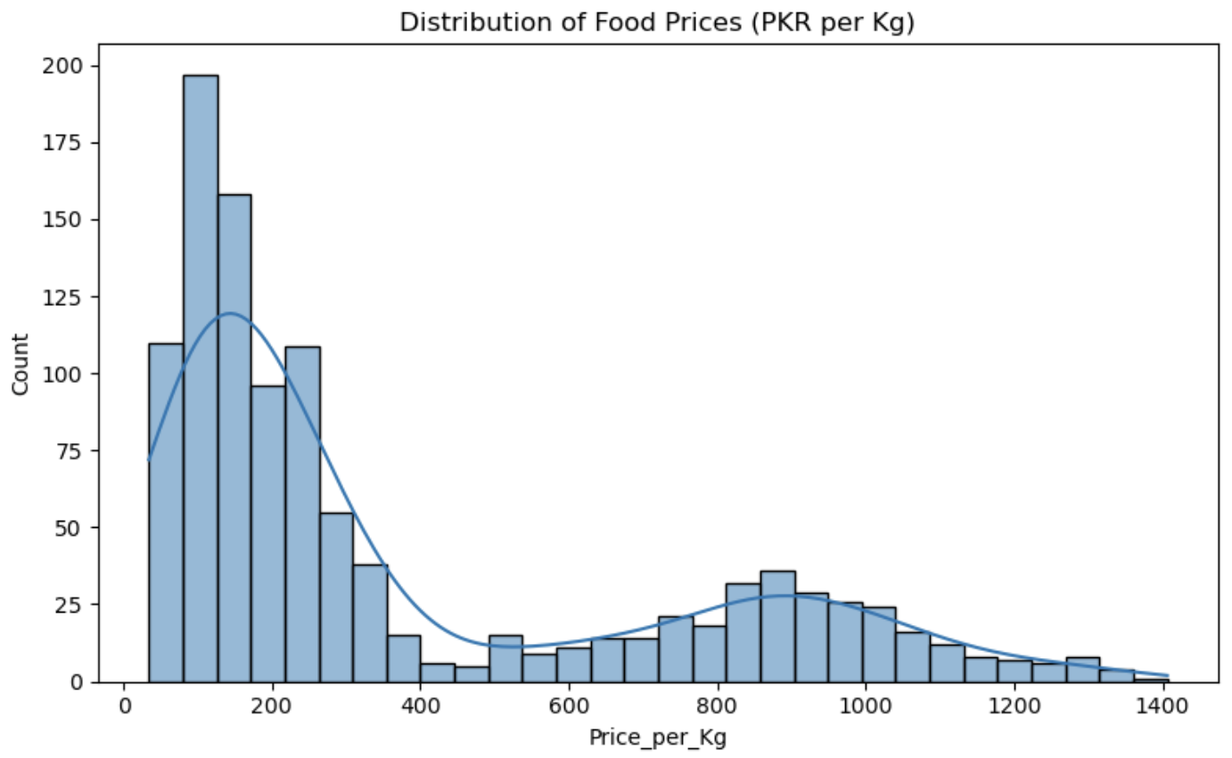
Distribution of Food Prices
Notes:
This histogram shows a bimodal distribution of prices. Most items fall between 50 and 300 PKR per kilogram, which includes grains, fruits, vegetables, and pulses. A second cluster of prices, between about 700 and 1,300, represents premium items such as mutton, ghee, tea, and high-quality fish. This separation is what later informs clustering.

Slide 7
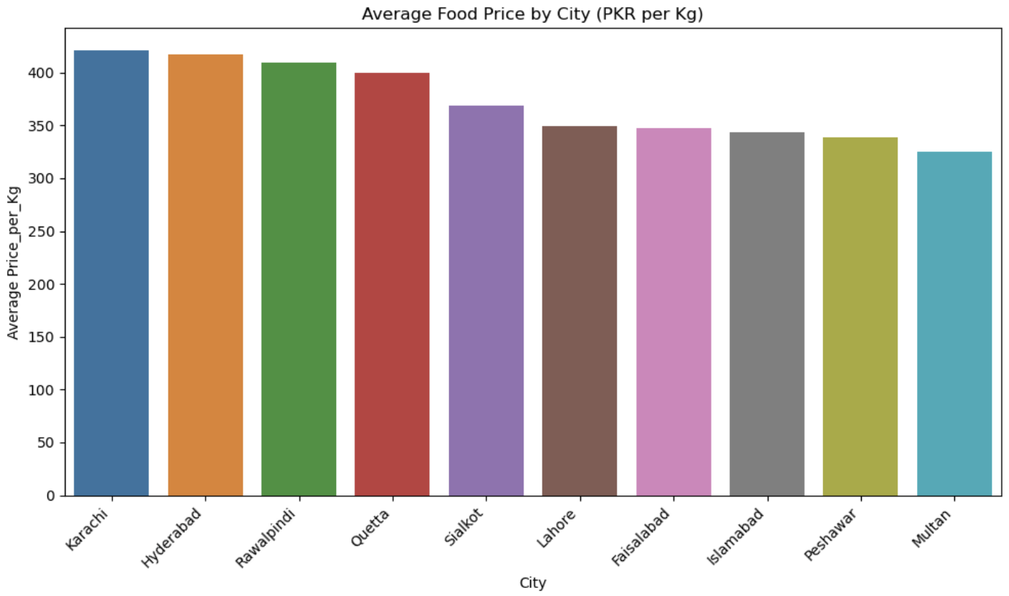
Average Price by City
Notes:
Here we see that Karachi and Hyderabad have the highest average food prices, followed by Rawalpindi and Quetta. Cities like Peshawar and Multan remain more affordable. These inter-city differences suggest unique market dynamics and justify clustering cities based on price patterns.

Slide 8
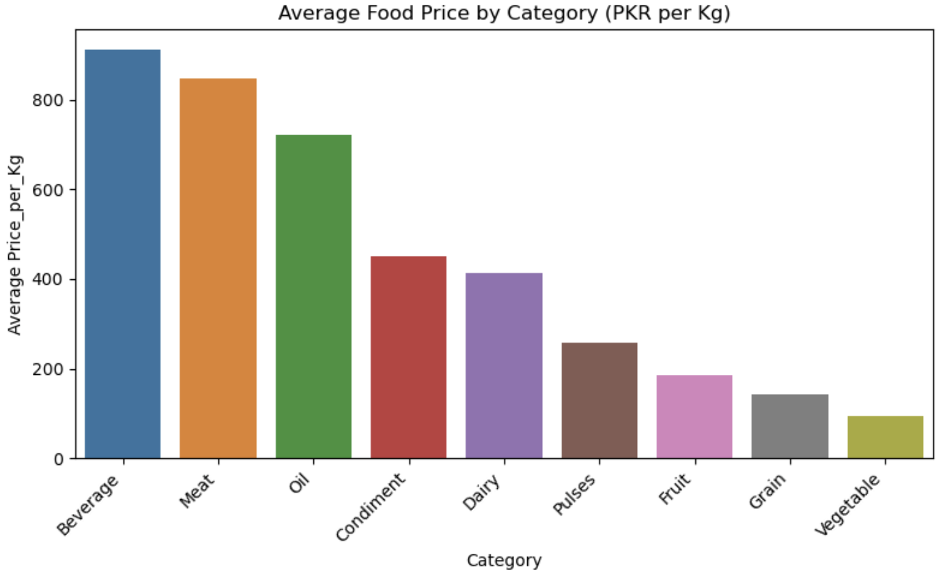
Average Price by Category
Notes:
Category-wise, beverages, meat, and oil are by far the most expensive categories overall. On the opposite end, vegetables, grains, and fruit consistently remain affordable. This highlights the unequal burden placed on households depending on dietary needs.

Slide 9
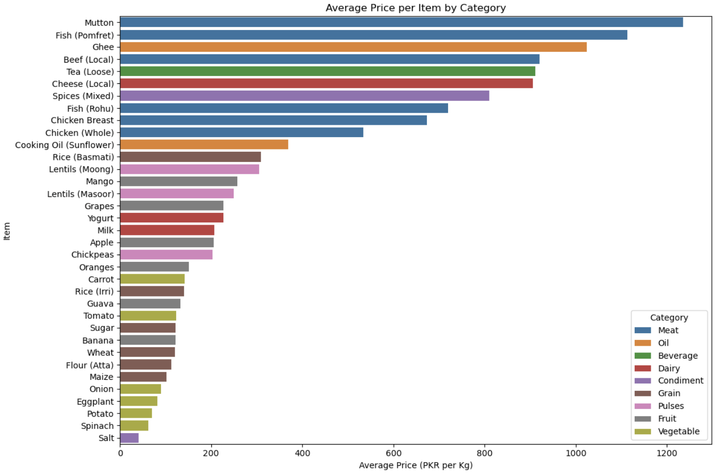
Top and Bottom Priced Items
Notes:
When examining individual items, mutton, pomfret fish, ghee, and tea appear as the highest-cost foods. Meanwhile, staples like salt, potatoes, onions, and spinach are at the low end. These findings align with expectations around perishability, protein content, and import dependencies.

Slide 10
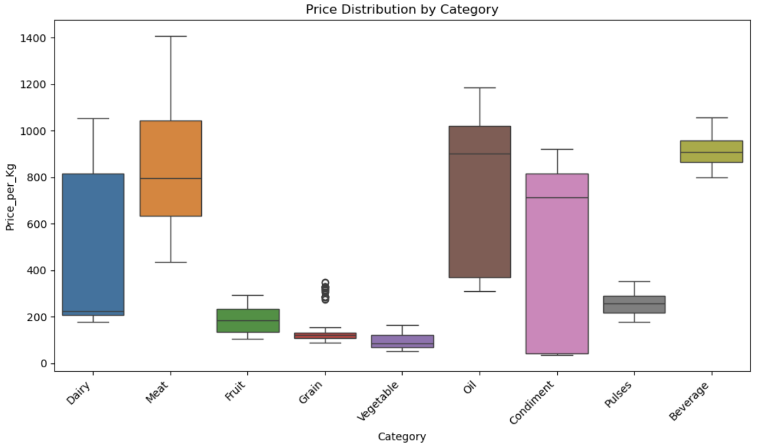
Price Variation by Category
Notes:
The boxplot highlights variability within each category. Meat and oil show the widest price range and contain the highest outliers, indicating greater market instability. In contrast, grains and vegetables are stable with tight price distributions.

Slide 11
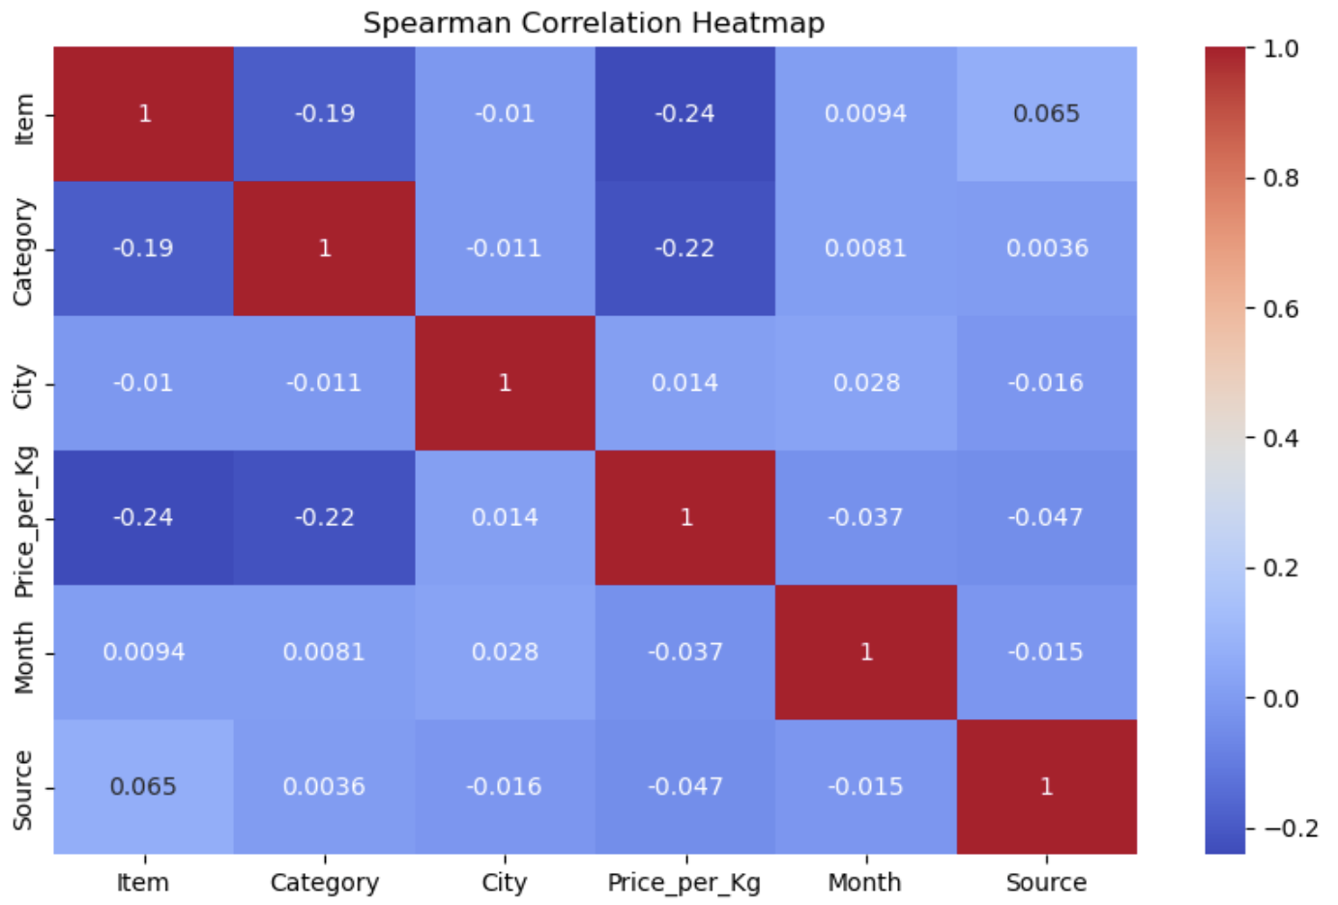
Correlation Findings
Weak correlations among categorical fields
Item and category encode price level more than city or month
Price is primarily item-dependent
Notes:
I used Spearman correlation for categorical encodings. Most fields showed extremely weak relationships with price except for category and item, which confirms that price differences are strongly product-driven rather than heavily influenced by city or time of year.

Slide 12
Predictive Modeling
²
²
Linear Regression
  RMSE = 37
  R^2 = 0.989
Random Forest
  RMSE = 16
  R^2 = 0.998
Feature importance dominated by meat, ghee, cheese, spices, tea
Notes:
I tested two models to predict price using encoded features. Linear regression performed well, but the random forest model improved accuracy with an RMSE of 16 and an R² of 0.998. Feature importance reveals that items in the meat, dairy, and condiment categories are the strongest predictors of price level.

Slide 13
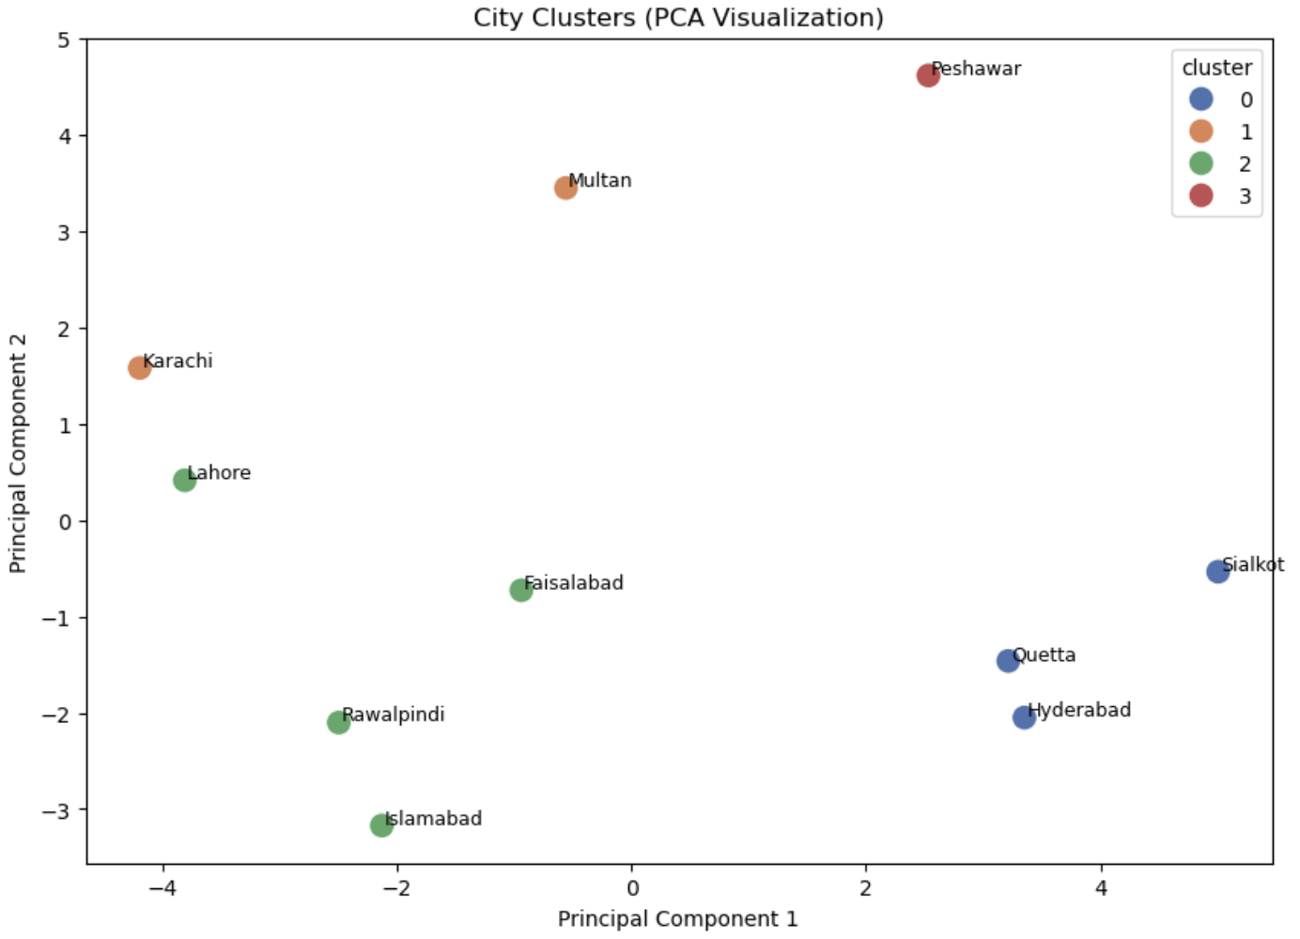
City Clustering (K-Means + PCA)
Cluster 0: Lowest-cost cities
Cluster 1: Moderate-to-high price cities
Cluster 2: Mixed-price urban centers
Cluster 3: High-cost outlier (Peshawar)
Notes:
Using K-means clustering and PCA visualization, I found four distinct city groups. Cluster 0 includes Quetta, Hyderabad, and Sialkot—these cities have the lowest prices. Cluster 1 includes Karachi and Multan with moderately high prices. Cluster 2 includes cities like Lahore and Islamabad with mixed cost profiles. Cluster 3 contains only Peshawar, which stands alone due to unusually high prices for multiple items.

Slide 14
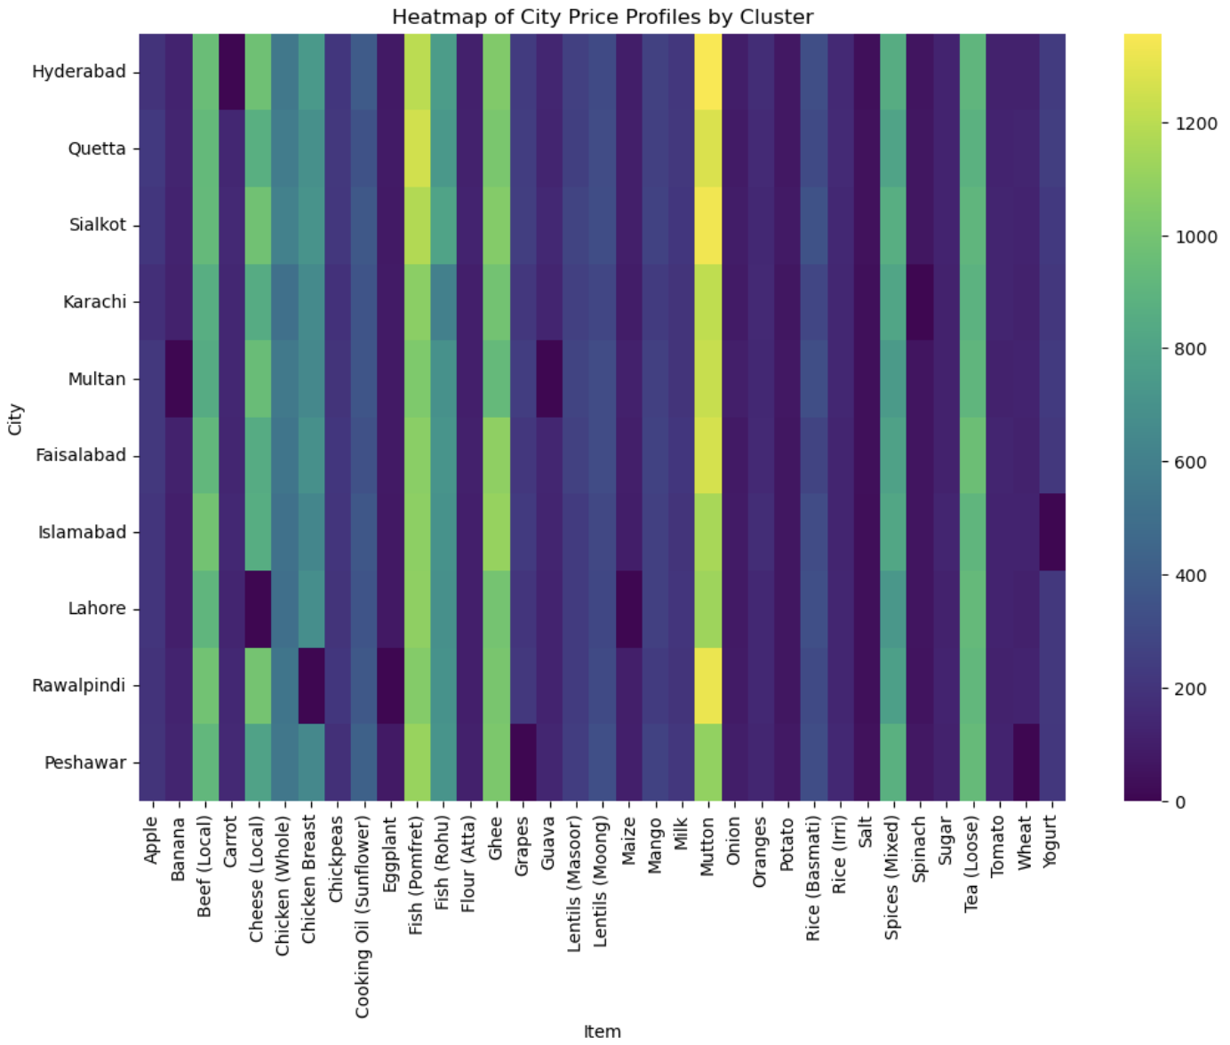
City Heatmap
Notes:
This heatmap visualizes price profiles across all cities and items. You can clearly see patterns that drove the clustering. Some cities consistently have darker bands, indicating higher prices across several categories.

Slide 15
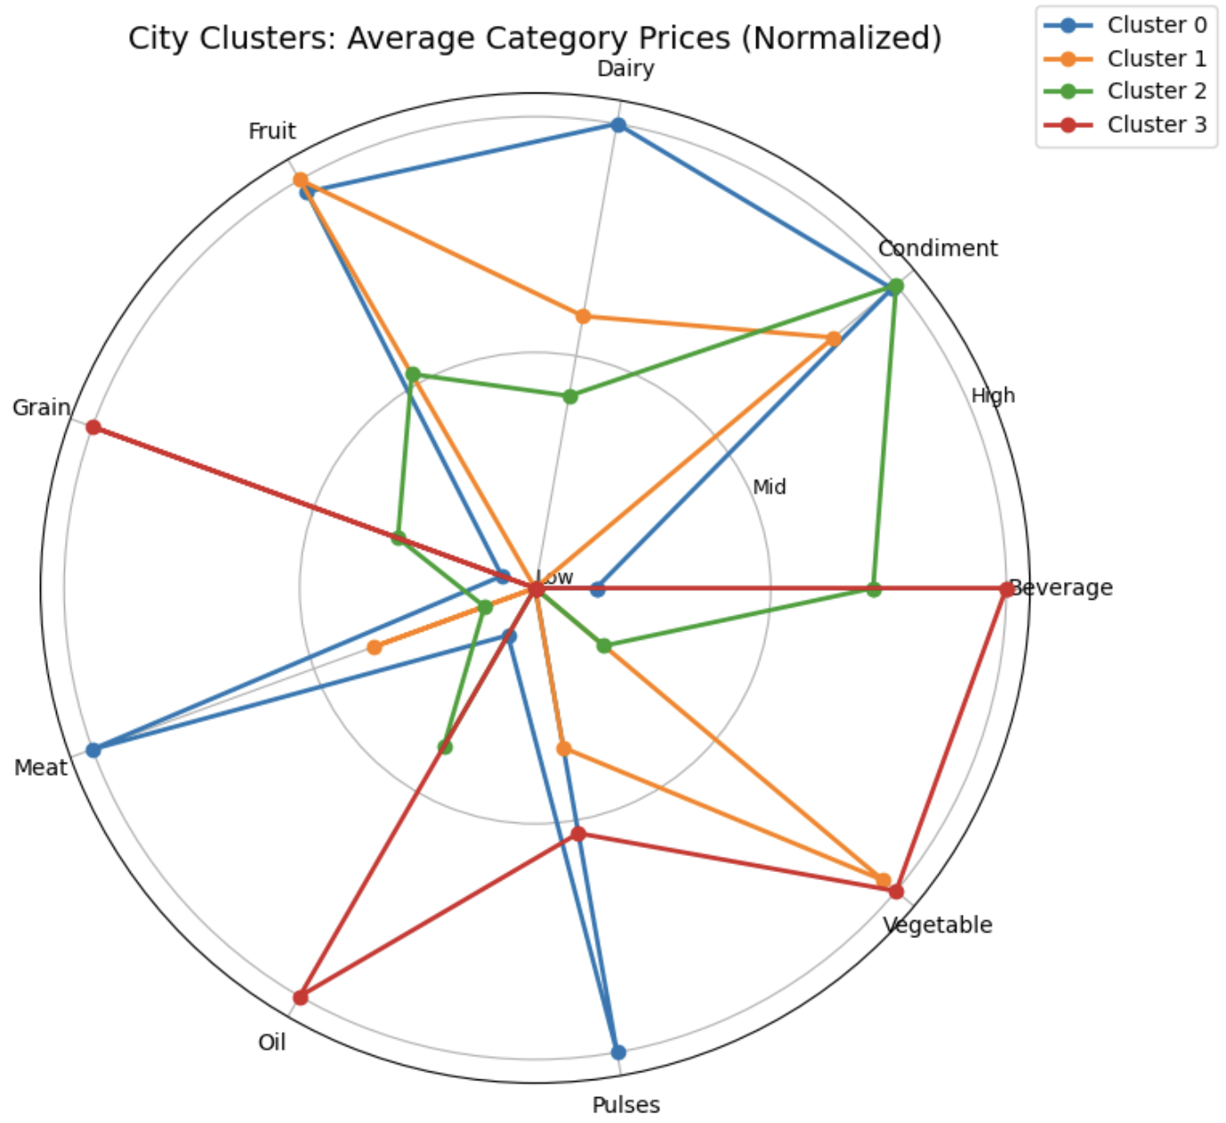
Radar Chart: Cluster Profiles
Notes:
This radar chart shows how each cluster compares across categories. For example, Cluster 3 spikes sharply on beverages, oil, and vegetables. Cluster 0 tends to have the lowest normalized prices across categories. These profiles help explain the segmentation.

Slide 16
Conclusion
Prices vary widely by category and item
Cities differ significantly, enabling meaningful segmentation
Predictive modeling shows item type is the strongest driver of price
Clustering reveals four distinct market groups
Notes:
In summary, food prices vary widely across both categories and cities. Modeling confirmed that item type is the strongest predictor of price, while clustering revealed four clear market groups that could support targeted interventions, supply chain planning, and market regulation.

Slide 17
Recommendations
Use clusters for targeted policy-making
Monitor high-cost categories (meat, oil, beverages)
Improve price transparency in higher-cost cities
Expand dataset to include wholesale vs retail comparisons
Notes:
I recommend using the city clusters to guide targeted market interventions. High-cost categories should be monitored closely for shortages or price manipulation. Increasing transparency could help reduce price inequality, and expanding the dataset could strengthen future models.

Slide 18
Future Applications
Forecasting future price trends
Expanding data to more cities and years
Integrated dashboards for policymakers
Notes:
There are many opportunities to build on this work, including forecasting models, more robust clustering using multi-year data, and developing interactive dashboards to help support economic policy and food security initiatives.

Slide 19
Ethical Assessment
Avoid misuse of clustering for discriminatory practices
Ensure transparency in modeling
Use data to support vulnerable populations
Notes:
Ethically, it’s important that this analysis is used to improve equity rather than reinforce disparities. Clusters should guide supportive policies, not punitive measures. Transparency in every step of the modeling process is essential.

Slide 20
Questions
Notes:
Thank you for listening. That concludes my presentation. I’d be happy to answer any questions.

