Slide 1
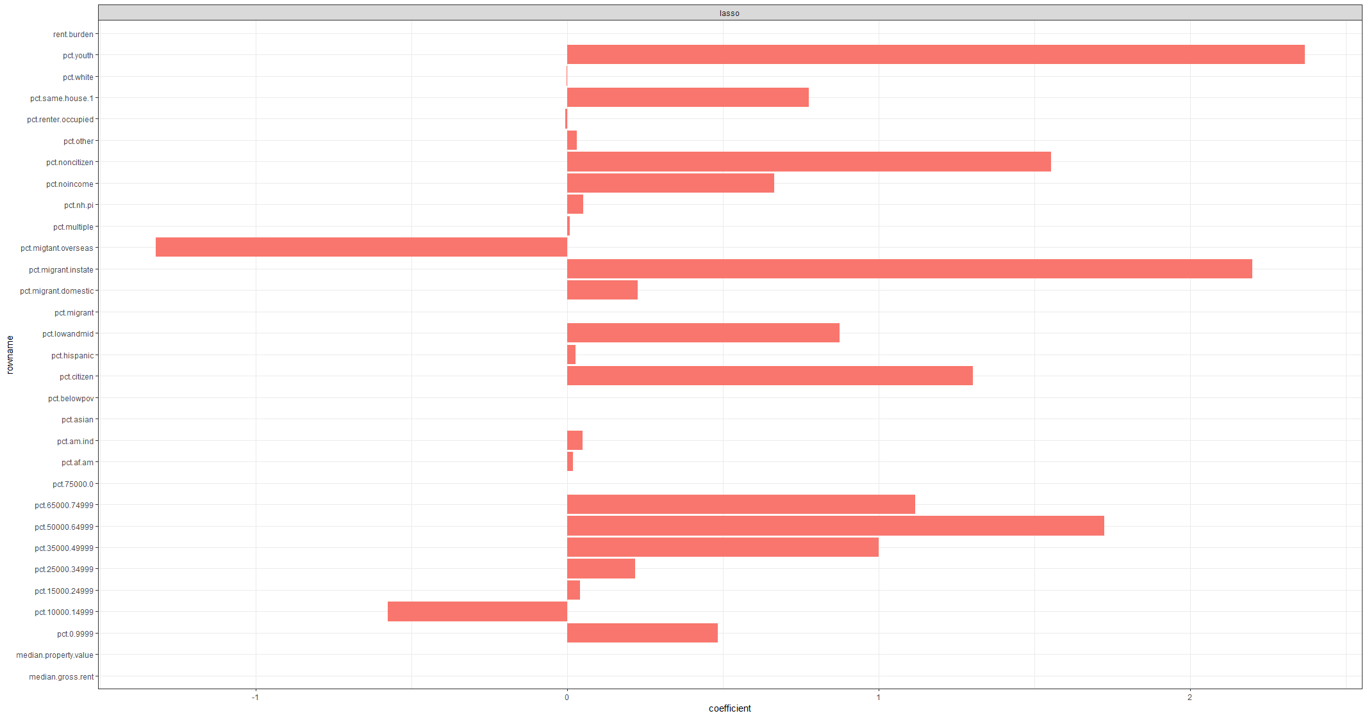

Slide 2
DIC : 3825.34 , pd=48.16
DIC : 3816.09,pd=44.59
DIC : 3816.16, pd=45.45

Slide 3
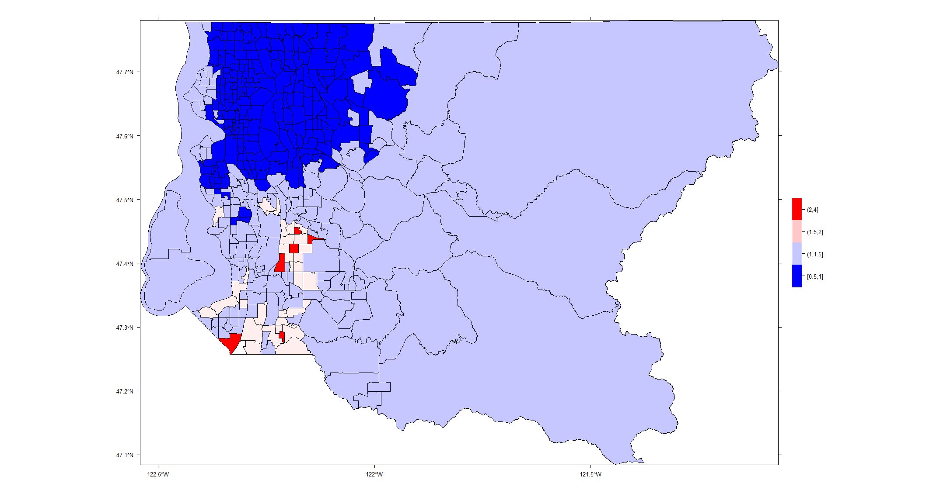

Slide 4
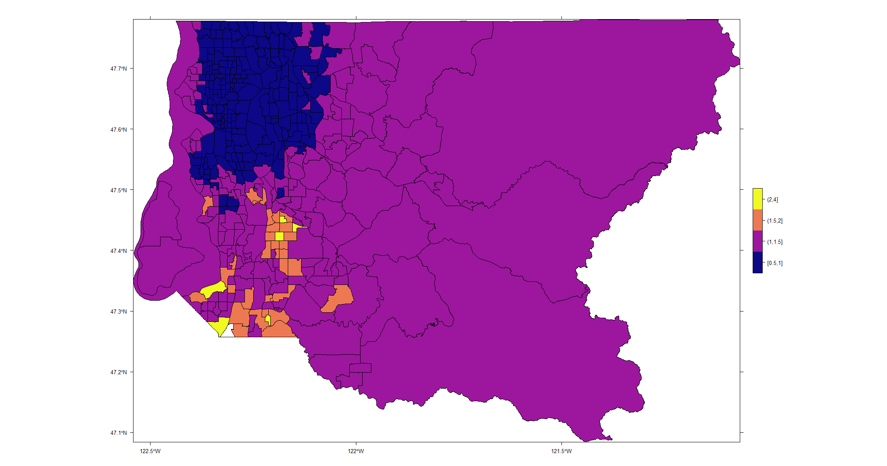

Slide 5
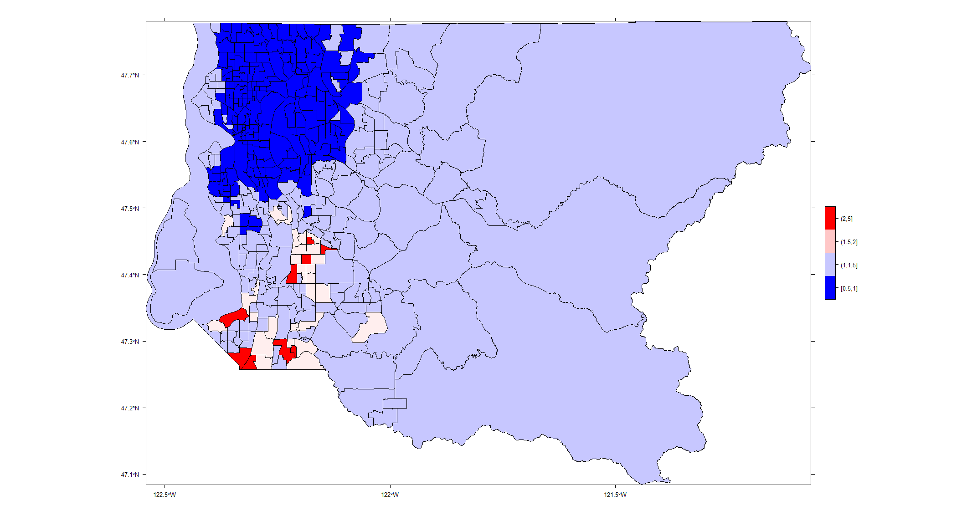

Slide 6


Slide 7
 | RR (sd) | Cr. I
pct.af.am | 1.01(1.01) | 0.986-1.026
pct.hispanic | 1.01(1.007) | 0.998-1.027
pct.nh.pi | 0.99(1.027) | 0.942-1.046
pct.youth | 9.36(3.748) | 0.697-124.963
median.property.value | 1.00(1.00) | 0.999-1.001
pct.75000.0 | 0.18(6.22) | 0.005-6.503

